Slide 1
Wireshark
Installation and
Use.
Carlos Gerez
January 2024

Slide 2
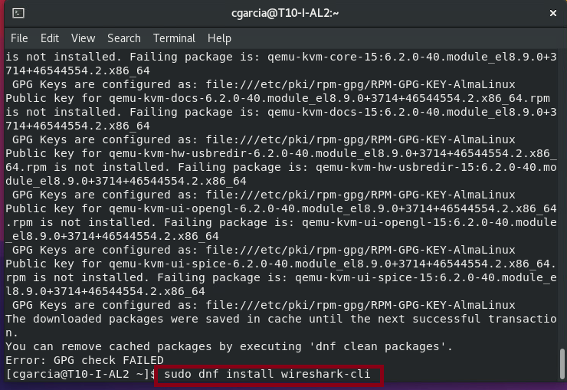
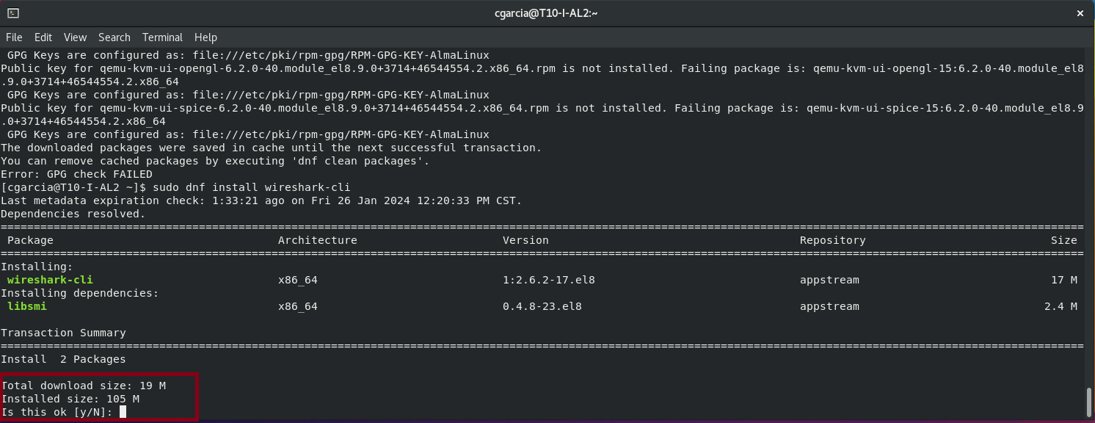
Wireshark installation from command line in Linux Alma:
sudo dnf install wireshark
sudo dnf install wireshark-cli
sudo wireshark &

Slide 3
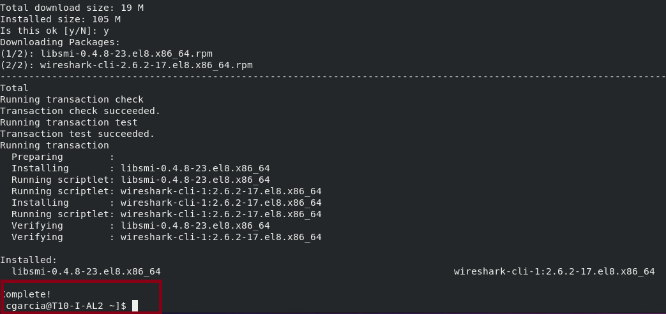
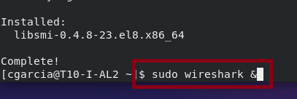
Wireshark installation from command line in Linux Alma:

Slide 4
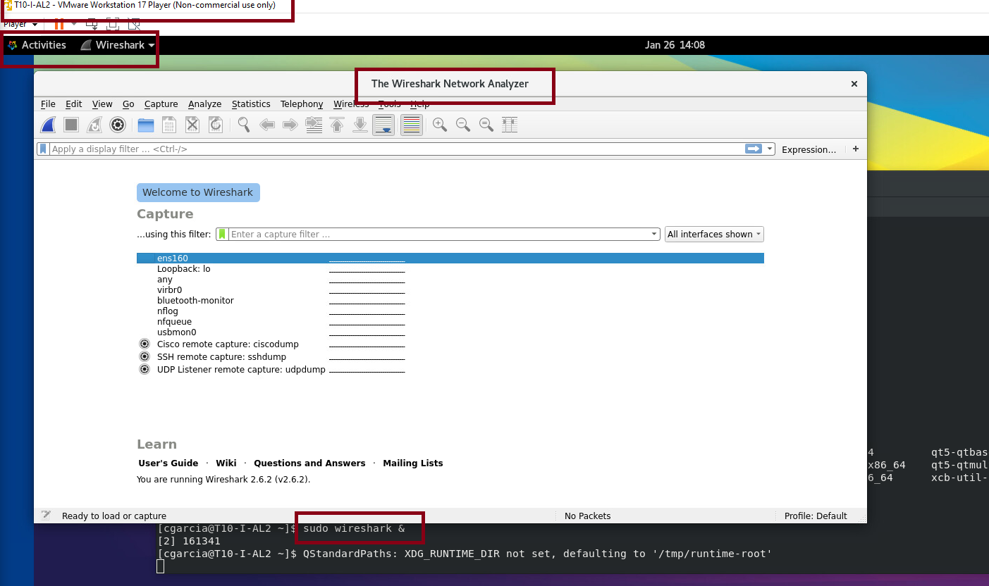
Wireshark can be open from the command line or from the gui

Slide 5
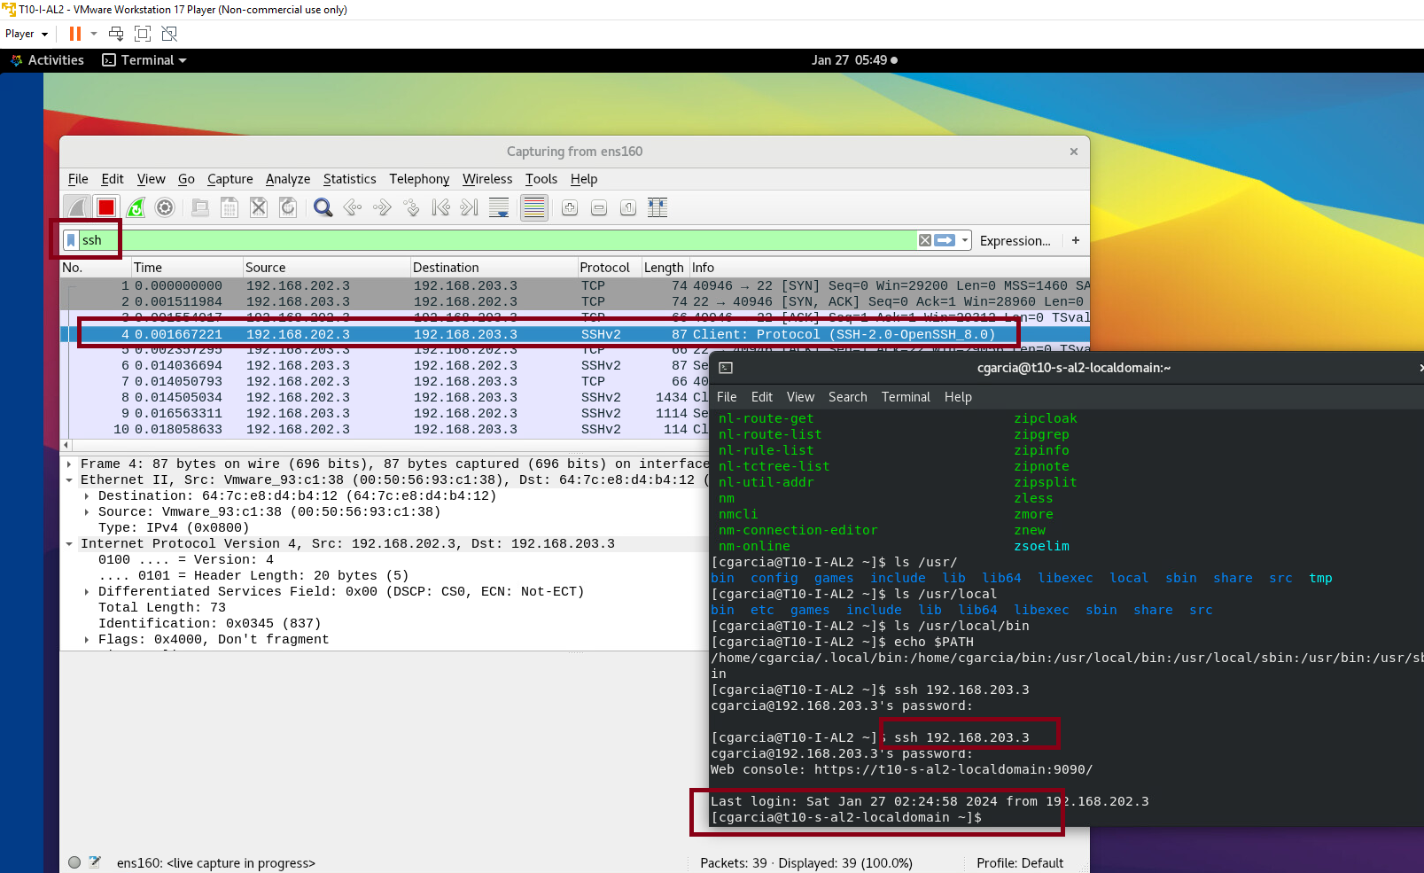
We had connectivities problems in our network and want to know if we lack connectivity to another computer while connecting with ssh or it was a problem in the settings of the machine. We can capture traffic filtering what is of interest to isolate problems in this case.
We tried ssh from 192.168.203.3 towards our machine 192.168.202.3

Slide 6
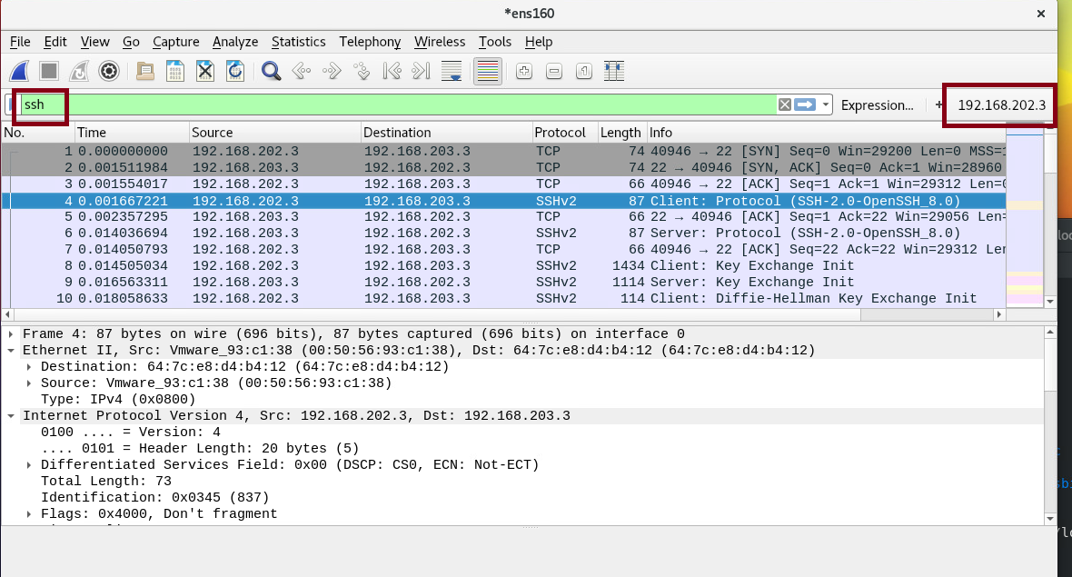
To isolate the problem we used Wireshark filtering the ssh connections from and to our machine to see if firewalls allow connections. Here we apply 2 filters, one to ssh connections and the other to the address 192.168.202.3 of our machine. We see that connections are working well, then the problem was located later in the $PATH variable of our Linux.

