Slide 1


Slide 2
Devops
Development + Operations
By Carlos Agudelo

Slide 3
Order.
What DevOps means and history.
Concepts.
Why use DevOps?
Challenges adopting DevOps.
Conclusions.
Bibliography.
Practice DevOps
Introduction to Unit Test with node
Making pipelines using Github and ( AWS || Azure )

Slide 4
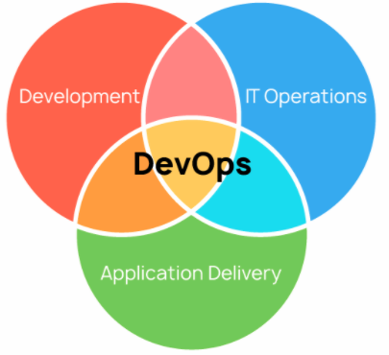
DevOps
It’s a set of practices, tools, and cultural philosophy that automate and integrate the processes between developers and IT team.

Slide 5
Concepts.
Continuous integration - Is the practice of automating code changes to the software project.
Continuous delivery - Automating code changes to software and the productive and testing environment.
Situational awareness - Automating process that alerts about bug, issues, no integration sotware process and flows that don’t work correctly.
Automation - The main process. That also team work most quickly because make process of test, deploy and solved some problem without a person on that.
Infrastructure as Code - You can write scripts that can configure server, instances and multiples environments.
Microservices - architectual technique for build applications as a collections of smaller services can be deployed, operate and work independently from each others.
Monitoring - Allow to team are always informed about the future things that they do, that thy did and make metrics and statistics of work.

Slide 6
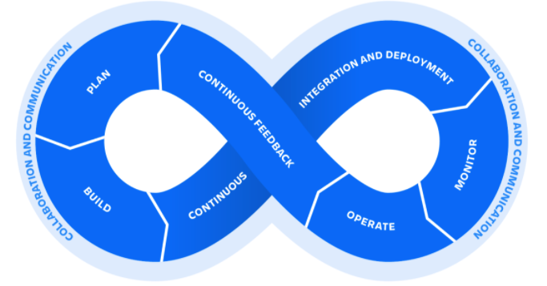
DevOps Lifecycle

Slide 7
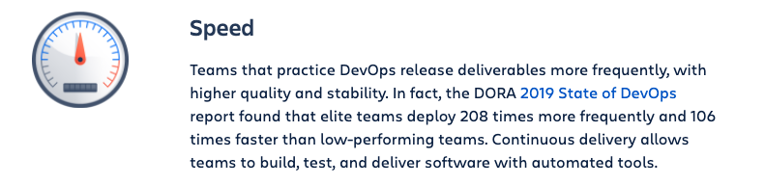
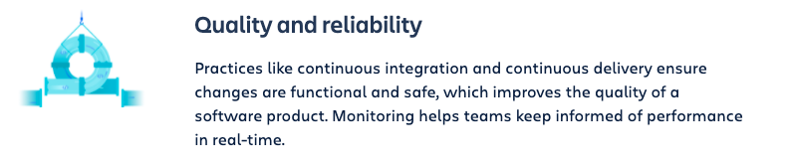
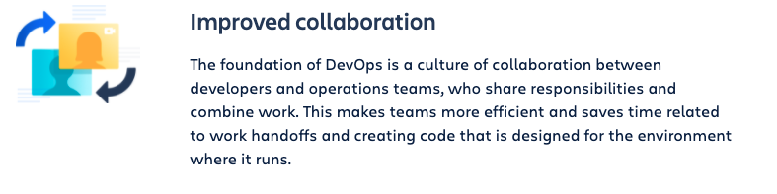
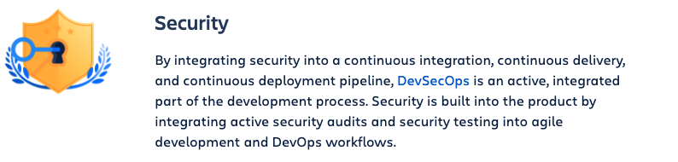
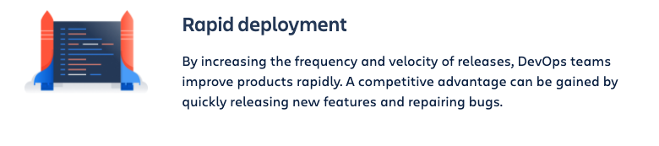
Why use DevOps.

Slide 8
Challenges.
DevOps Culture - Introducing a new ways to work, great collaboration and communication.
Continues learning - Each implementations is different and has many changes. The experimentation and risk are on the day.
Agile - Implement agile framework work on a tradicional process is hard. Set new strategies and work flows to teams that can take high time.
Legacy infrastructure vs microservices - Change infrastructure od services cab be problematic and start problem that before don’t exist.

Slide 9
Conclusions.
DevOps is a cultural philosophy supported on different tools, work frameworks and Infrastructure as a services.
DevOps isn’t any single persons job. It’s a everyone’s job.
It’s hard to start on great companies that hace defined process but no imposible.
Born like a traditional not optimized work flow to developers and IT infrastructure solution.
It’s highly used on startups and companies that change their software implementation quickly because It’s agile and flexible.

Slide 10
Documentation.
https://www.atlassian.com/devops
https://platzi.com/blog/que-es-devops/
https://searchitoperations.techtarget.com/definition/DevOps
https://newrelic.com/devops/what-is-devops

Slide 11
Practice ….

