Slide 1


Slide 2
Microservices
Made a distributed system information
By Carlos Agudelo

Slide 3
Order.
What’s microservices.
Characteristics.
Benefits.
Challenges.
Uses case.
Conclusions .
Bibliography.

Slide 4
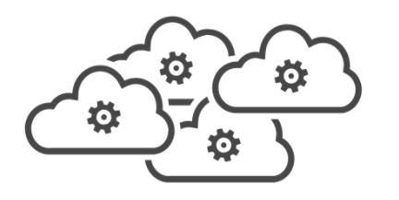
Microservices
It’s a architectural patron to design and build applications where divide a application on a individual functions and resposabilities.

Slide 5
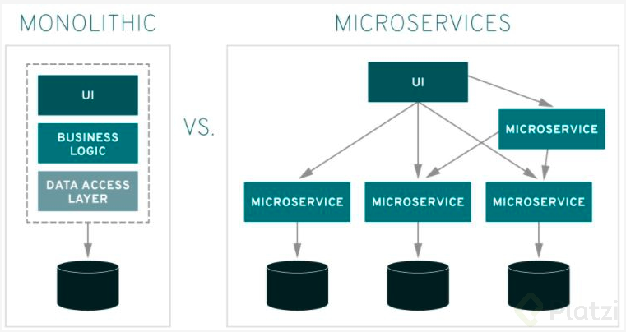

Slide 6

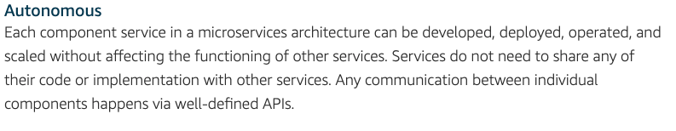

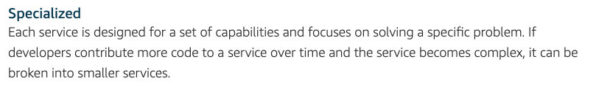
Characteristics.

Slide 7
Benefits
Agile- Foster on all size organizations that teams works more quickly, independents and getting results in short time.
Flexible scaling - Each microservices scaling by demand on specific function or service.
Easy deploy - Enable CI/CD accelerating the time to solving some problem on making new products.
Technological freedom - It can build with different technologies using the best option to solve something.
Reusable code - You can use a write method or a service on multiples stage that times you the project need it.
Resilience - As a independent services, the failure on a services don’t mens the complete app don’t work again.

Slide 8
Challenges.
Design - Take care tho choose the way to connect differences microservices and data sources.
Testing - It’s necessary write test to testing the correct functionality of the services and integrations with others services, it can be hard.
Implementation - At the start can have a lot of problems of configurations and automate process.
Centralization - It should have a center to register all process or service involved on operations necessary to future growth.
Monitoring - It should have too a center to have a general view of all status of process.
Depuration - It’s a process that you’ll need in multiple cases. But this process don’t have a standard.
Connectivity - Define the way to connect all services it’a another great challenge on implement this architecture.

Slide 9




Uses cases.

Slide 10
Conclusions.
Microservices is a architectural patron designed to implement great applications.
Monolithic architecture isn’t bad. So it’s recommend to implement a small applications.
The success to implement this patron is on defined the best form to manage multiple apps, solve issues and CI/CD.
In the future maybe can born new tool to work better with microservices, in this moment, it has some difficulties.
There are many services (AWS, AZURE, GOOGLE CLOUD) that allow’s this kind of implement exist.

Slide 11
Documentation.
https://www.tibco.com/solutions/microservices
https://aws.amazon.com/microservices/
https://www.ibm.com/cloud/learn/microservices
https://platzi.com/tutoriales/1247-arquitectura-software/9250-que-es-un-microservicio/
https://www.redhat.com/es/topics/microservices
https://smartbear.com/solutions/microservices/
https://apiumhub.com/es/tech-blog-barcelona/los-microservicios/

