Slide 1


Slide 2
GraphQL
A query language API’s
By Carlos Agudelo

Slide 3
Order.
RestAPI review
What’s GraphQL?
Important concept's
Comparative RestAPI vs GraphQL
Industry usages.
Real time code / Start class project

Slide 4

Restful
Architectural style for an application program interface to communicate with another machines.

Slide 5
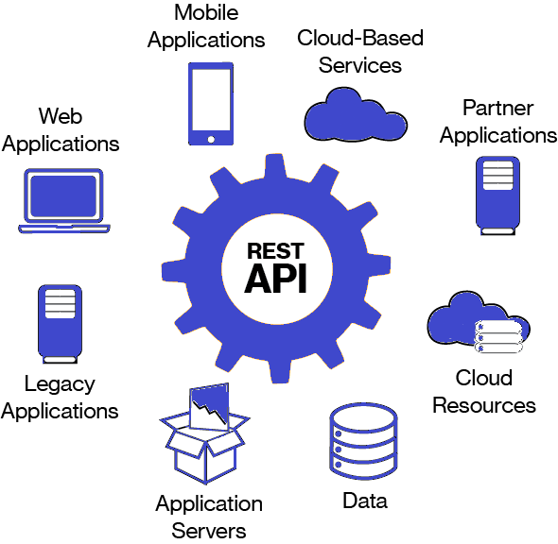

Slide 6
Features.
Standard connect. Use HTTP methods and responses uniq identification response and custom response
High scalability Easy to extend, versioning and add new features.
Using multiples format Allow work with JSON, XML, HTML and TXT
Easy understanding Allow to make Wonderfull queries with code less
Simple Language understanble by humans and machine to ease maintenance.
Security Integrate with multiples tools to provide most security lawyers on information.
Cachable Is easily cacheable providing a faster information transportation.
Highly usage Is usage from 15 years ago on several implementations.

Slide 7
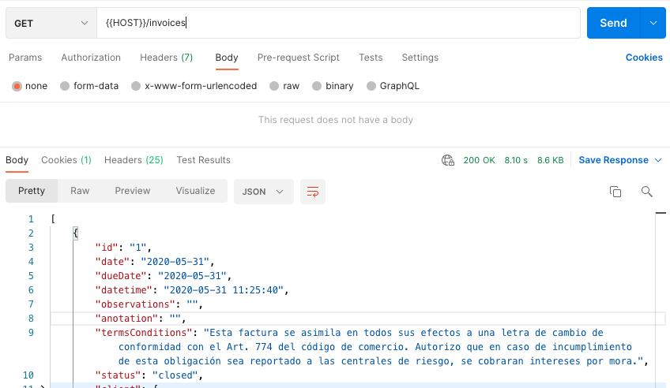
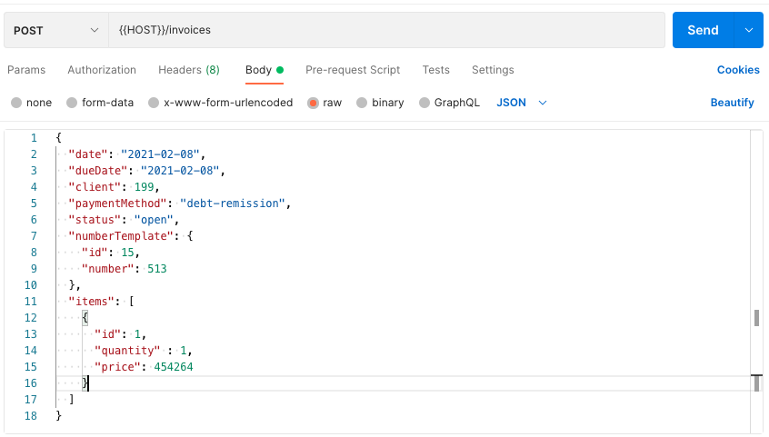
Examples
GET request
POST request

Slide 8


Slide 9
Query language for your API’s and server side runtimes and mobile applications
Dynamic data Respond the data that you specific need it and the format that you want.
Uniq URL Use a specific url and uniq HTTPS method to operate the data.
Multi language. You can use this implementation on all several exist languages.
Usability Easy to develop, test, deploy versioning and maintenance.
High performance Saving no necessary data, get data and response a fastest.
Security Provides custom lawyers and tools to manage a great security system.

Slide 10
Concept’s
Query Is the information that we sent to API and the only data that we need to show on the response.
Mutation At difference with query, this operation allow to operate data (create, update, delete.)
Subscription Is a real time implementation to know what changes happens on the databases. Like a newsletter subscription.
Schema Define the objects and atributes that you can access on de data set or database.

Slide 11
Advantages
God for colme system and microservices.
Fetching data with a single API call.
Fetching data with specific information.
Detailed error messages
Autogenerating API documentation
Code-sharing
Rapid application prototyping

Slide 12
Disadvantages
Performance issues with complex queries.
File uploading.
Web caching complexity.
No recommend on small applications.
Takes a while to understand.

Slide 13
GraphQL vs Rest API
GraphQL | Rest
Offering efficiency and flexibility for solving common problems when interring API’s | An architecture style largely viewed as a conventional standard for design API’s
Lacks automatic caching mechanism | Using caching automatically
Deploy over HTTP using a single endpoint that provides full capabilities of expose services | Deploy over set a URL’s where each of then exposes a single resource
No API versioning | Support multiple versioning
JSON representation only | Sopport multiple languages
Complicate to handling HTTP methods an identify errors | Uses HTTP and easy to identify errors

Slide 14
Real uses and experiences
Shopify - https://shopify.engineering/using-graphql-for-high-performing-mobile-applications
Sainsbury’s - https://medium.com/sainsburys-engineering/our-graphql-experience-a8bf511341a2
Facebook - https://m.facebook.com/story.php?story_fbid=1268985559916551&id=19292868552&_rdr-

Slide 15
Conclusions.
GraphQL is a great option for build a services but not is the best options, it depends of System Information need.
GraphQL is not mature technology that means that can be change in the future and make features that solves security and performance problemas that it have.
It solved a specific problems that have with a traditional rest implementation have.
Mixed implementation of both technologies is possible and isn’t a bad practice to implement System Information.
It isn’t popular technology that meas don’t have a great community that uses and improve the product.

Slide 16
Documentation.
https://www.json.org/json-en.html
https://www.redhat.com/es/topics/api/what-is-a-rest-api
https://platzi.com/blog/introduccion-a-graphql/
https://graphql.org/learn/
https://blog.api.rakuten.net/graphql-vs-rest/
https://maark.com/insights/graphql
https://blog.postman.com/the-future-of-graphql/

