Slide 1


Slide 2
Docker
Packages Software into Containers
By Carlos Agudelo

Slide 3
Order.
What’s docker?
How Docker works?
Concepts.
Why use Docker?
When to use Docker?
Practice - exploring commands.
Conclusions.
Bibliography.

Slide 4
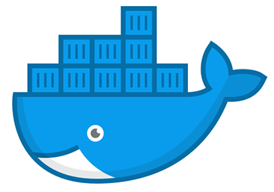
Docker
Is a software platform (PaaS) that allow you build, test, and deploy applications quickly.

Slide 5
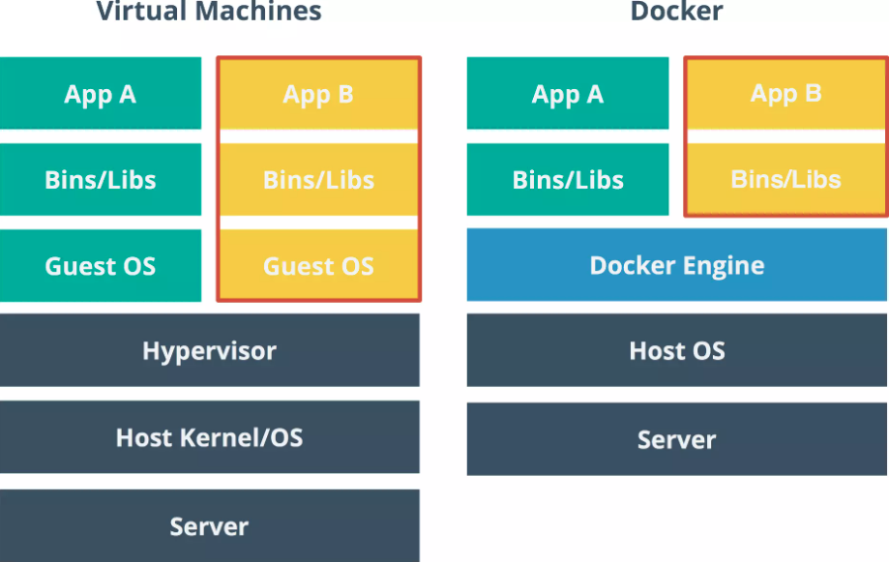
How it works

Slide 6
“The impact to work with containers is immediately. Containers don’t share physical resources, use the SO kernel and works like a independent application and. Ex, start a container don’t have a impact on pc to difference with a Virtual Machine that decrease’s a software performace.”.

Slide 7
Concepts.
DockerFile It’s a file (.dockerfile) that contains all instructions for how Docker should build the image.
Image Contain executable application source code, tools, libraries and dependencies that application code needs to run as a container.
Container It’s a live runnig instance of docker image.
DockerHub It’s the public repository of docker images, there are millions of images the you can use and download to improve.
Compose It’s a tool to define and running multi-containers or docker application using a simple .yaml file.
Kubernets It’s a container orchestrator easy to use and make sure applications.

Slide 8
Why use Docker.
Improve and seamless portability - Can make easy and quickly deploys.
Lighter weight and more granular updates - Can create a system distributed software.
Automated container creation - You can create a new docker with simple instructions.
Container versioning - Docker can track changes on containers and images.
Container reuse - You can use builded images to make another.
Share container libraries - You can access to open source registry from million’s containers
Estandarizad operations - Create a software process to maintenance and work in group.
Save money - It can run more code on each server.

Slide 9
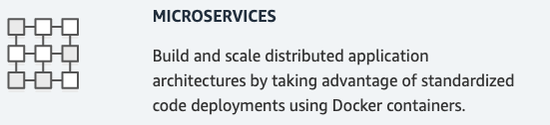
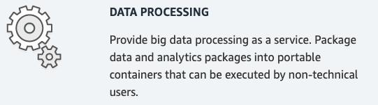
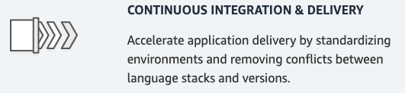
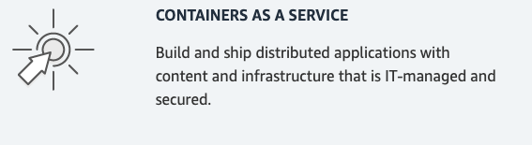
When use Docker.

Slide 10
Conclusions.
Docker is a great tool to easy configure development environments that can pass to productive stage without complications.
Like a Git allow track all changes and modifications. Thats is important becase can show this information and make rollback to recovery point.
It’s a technology that it’s improving constantly that means it’s not fixed yet.
It’s open source we can show and change the main code if is necessary.
It’s powerfull with Kunernets.
We can use VM yet but depends that we need to build.

Slide 11
Documentation.
https://docs.docker.com/
https://aws.amazon.com/docker/
https://www.ibm.com/cloud/learn/docker
https://docker-curriculum.com/

Slide 12
Practice ….

