Slide 1
US Budget Analysis Model Issues

Slide 2
Model Diagnostics
A Few Symptoms:
Model produces unexpected behavior: GDP collapses in 46% of cases in the baseline model.
Model produces exponential GDP growth, which may be unreasonable over the 75 year time-horizon we are looking at.
Model also produces tooth saw behavior we think is unrealistic. Expenditure rebounds immediately after a period of adjustment.

Slide 3
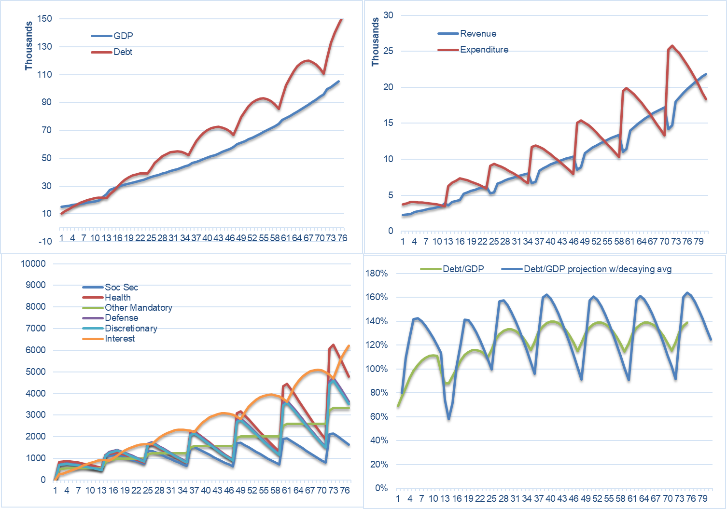
GDP Growth Behavior
This behavior is consistent across strategies, even in the absence of economic shocks.
This behavior may or may not be acceptable for our purposes.

Slide 4
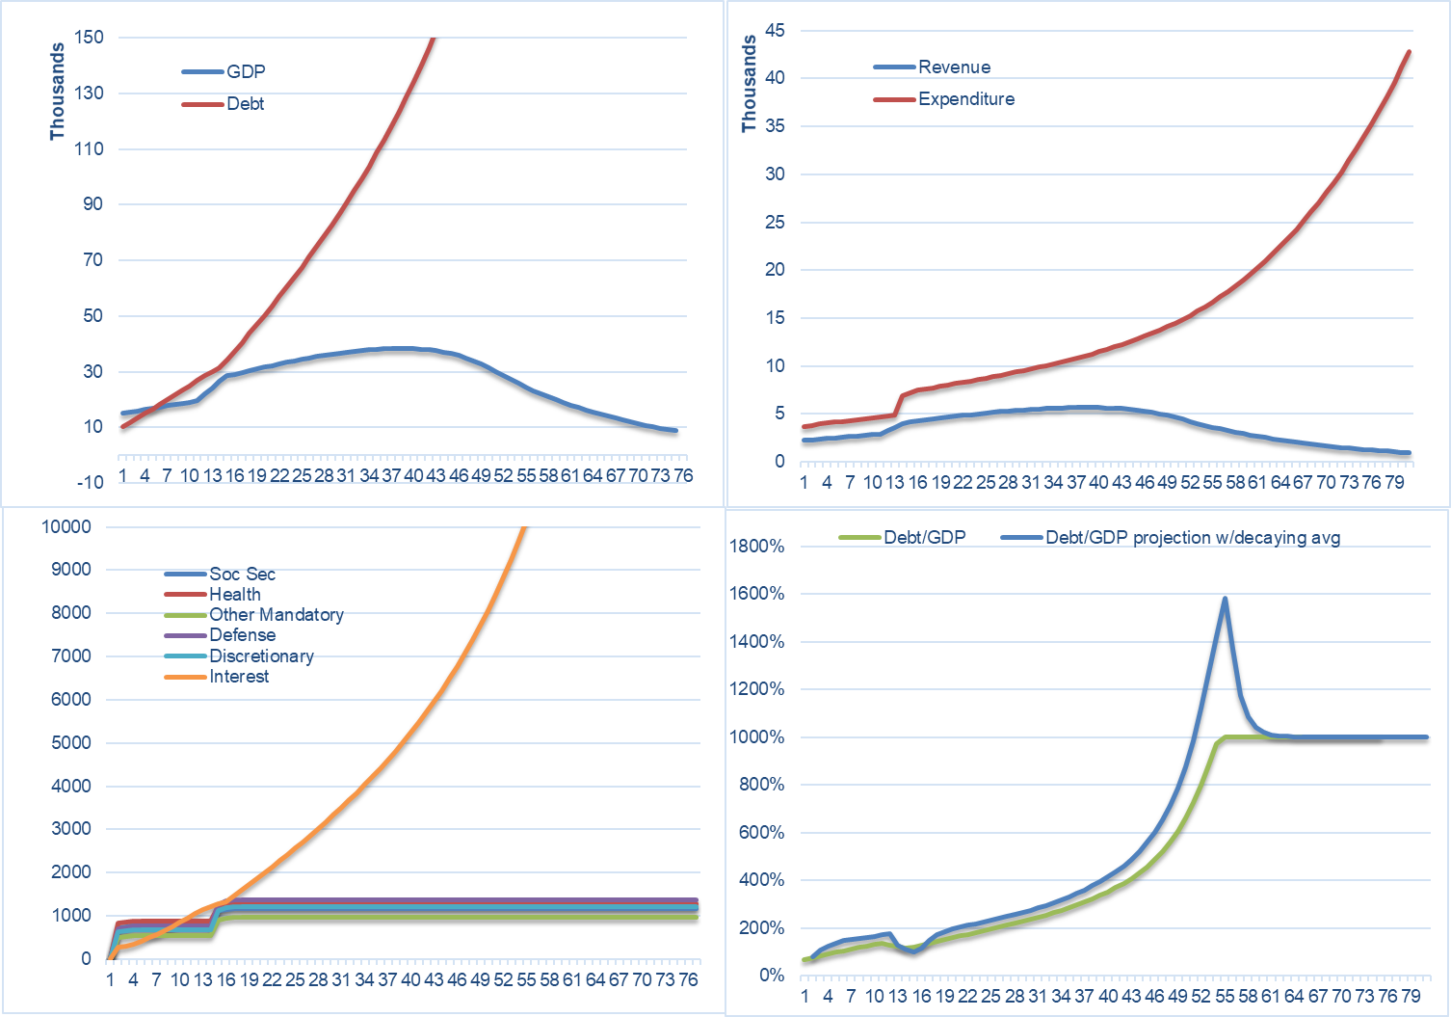
GDP Collapse Behavior – under the Baseline Strategy
Under the baseline strategy, the economy collapses fairly often.

Slide 5
GDP Collapse Behavior – under the Baseline Strategy
Under

Slide 6
GDP Collapse Behavior – Strategy 1

Slide 7
A conceptual problem – Can we claim we are using a Solow-Swan Model?
The Solow-Swan Model includes a feedback loop on the capital stock through depreciation, and a feedback loop relating GDP and Capital;
In our model, Capital Grows through an exogenous variable, and is completely detached from GDP;
Can we claim our model is a “Solow Swan” model without having Capital defined endogenously in the model?
I’ve looked at System Dynamics Implementations of the Solow Swan model (because that’s how I think I would implement this model), and they are not complicated.
Also, next figure suggests that the model is breaking when capital stock growth is “too low”.

Slide 8
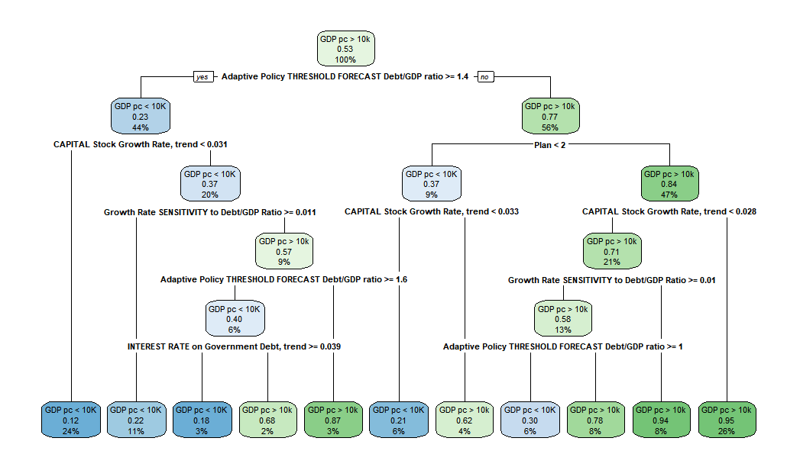
Having Capital Growth Rate as an exogenous variable seems to break our model
Should this be exogenous??
Should this be exogenous??
In the Swan Solow model, dK is determined endogenously, which closes the loop between Capital and GDP

Slide 9
Model Issues / Questions
The dGDP is capped at -5%. Was this an intentional fix?
Economic shocks are active., pre-scheduled and with fixed magnitude. This seem arbitrary and hard to justify in a DMDU analysis. Is this intentional? How do we want to deal with this?
There is a RAND() formula in the G1 cell. It does not affect most of the cells, but it does change results when GDP collapses.
Need Lags Alert: F39 -> F44 – What does that mean?

Slide 10
Testing an Alternative Adaptive Function
Instead of IF/Else, use

Slide 11
Weird Bugs
Weird Bug found at AQ:10 – AZ:10
Weird formula found at I2 and I12. Could not make sense of what was the idea behind these formulas.

Slide 12
Looking for problems in Clunky Statements (If/else, and MAX/MIN)
In general, I don’t like having MIN/MAX or IF/ELSE statements in models like these, as these stataments usually introduce noisy behavior and bugs.
I1 through I11 cells contain IF statements I don’t understand. Can we get rid of them?
Shocks to the Economy are activated. Should we keep them?

Slide 13
Options for Discussion
The Solow Swan Model has
Excel Models are hard to diagnose and debug. Reimplementing the model in R would help me better understand what is going on and debug the model sequentially. Is it worth it if it takes a full day of effort?

