Slide 1
Bank Telemarketing
CIND119 - Group 2
Carman Fan, carman.fan@torontomu.ca Carlos Elizondo, celizondo@torontomu.ca Thanos Paschalis, thanasios.paschalis@torontomu.ca

Slide 2
Introduction
Aim of the Project:
A Portuguese bank seeks to improve its telemarketing strategy to identify customers likely to subscribe to a long-term deposit account
Why Machine Learning?
Phone-based campaigns require predicting subscription likelihood in advance to reduce cost and improve conversion rates
Goal: apply data analytics and machine learning classification to support data-driven targeting decisions
Notes:
This project addresses a real-world business problem faced by a Portuguese bank conducting phone-based marketing campaigns for long-term deposit accounts.
Multiple contacts per customer were often required, making the campaigns resource-intensive.
By applying machine learning classification, the goal is to predict which customers are likely to subscribe — enabling the bank to prioritize its outreach more effectively and reduce wasted contact attempts.

Slide 3
Methodology
Tools:
Python (pandas, scikit-learn, matplotlib, seaborn)
Machine Learning Methods:
Decision Tree (DT) Classification
Naïve Bayes (NB) Classification
Strategy for Dataset Split:
Train-Test Split (80/20, stratified sampling)
Evaluation Metrics:
Confusion Matrix (True Positive Rate, and False Positive Rate)
Accuracy, Recall, Precision, F1-Score
Classification Report
Notes:
The analysis is conducted in Python using pandas for data preparation, matplotlib and seaborn for visualizations, and scikit-learn for machine learning.
Data Preparation Tasks:
Data Inspection
Detection of Null, Unknown, and Outlier values
Handling “unknowns” for “job” and “education” attributes
Basic Statistics for Numerical Variables
Frequencies for Categorical Variables
Visualizations
Outlier Removal
Bining, Ordinal & Binary Mapping, Log Transformation, One-Hot Encoding
Correlation Heat-map
Predictive Modeling:
The two classification algorithms are applied: Decision Tree (DT) and Naïve Bayes (NB).
Each algorithm is trained across three strategies — baseline (all 29 features), selected (13 features from DT importance), and optimized (13 Voting Consensus features) — producing six models in total, enabling a comprehensive performance comparison across all feature selection approaches.
Performance is evaluated using Classification Reports (which encompasses Accuracy, Recall, Precision, F1-Score), and Confusion matrices (which help visualize True Positive Rate (TPR), and False Positive Rate (FPR)).

Slide 4
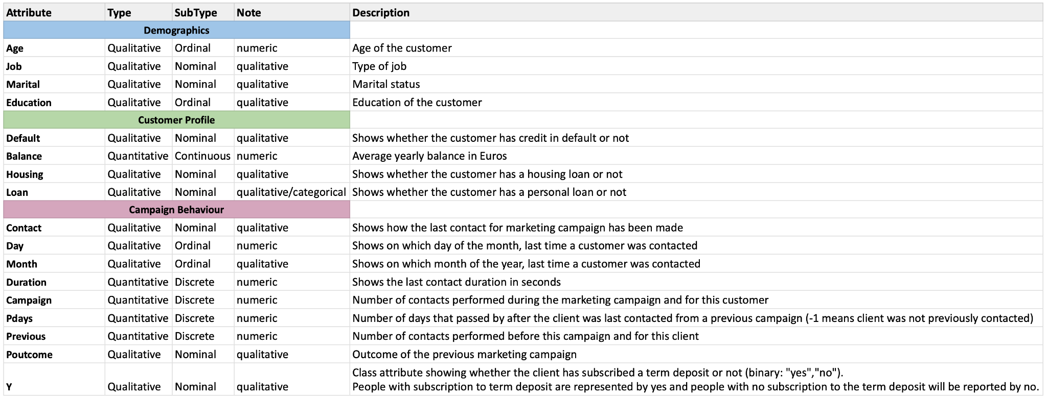
Dataset Summary
Bank Marketing Dataset
4,521 records (rows)
17 attributes (columns)
Target variable: y — whether the customer subscribed to a term deposit (yes/no)
Notes:
The Bank Marketing dataset consists of 4,521 customer records across 17 attributes. There are 10 categorical attributes and 7 numerical attributes.
These attributes include information on customer demographics (such as age, martial status, job, education), financial profile (such as yearly balance, default credit, housing, and loans), and campaign contact data (such as method of contact, number of contacts, duration of calls, days & months after last contact, and previous campaign outcomes).
Our target variable is y, also known as subscriptions to the long-term account, which is binary attribute - yes (client subscribed) or no (client did not subscribe).
The dataset had no duplicate records and no null values.

Slide 5
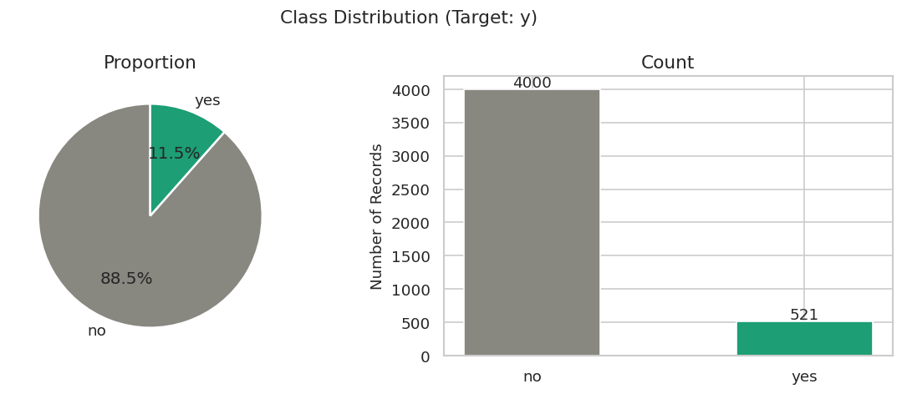
Data Preparation: Attributes & Class Imbalance
Notes:
Step 1 — Class Imbalance Analysis
Analyzed the distribution of the target variable y across the full dataset.
Finding: The dataset is heavily imbalanced — 4,000 records (88.5%) are "no" and only 521 (11.5%) are "yes."
This means a naive model that always predicts "no" would achieve 88.5% accuracy without learning anything. This directly affects how we interpret accuracy in the modeling section and makes True Positive Rate a critical metric.
Implication for modeling: Both models must be evaluated on TPR and FPR, not accuracy alone. This finding will be explicitly referenced in the modeling section.
Recall is an important metric in this case as well, since the bank would want to maximize opportunities in identifying potential client subscribers - a high recall would mean that the classification model is able to capture a higher percentage of clients who would want to subscribe.
Figure 1: bar chart of class distribution

Slide 6
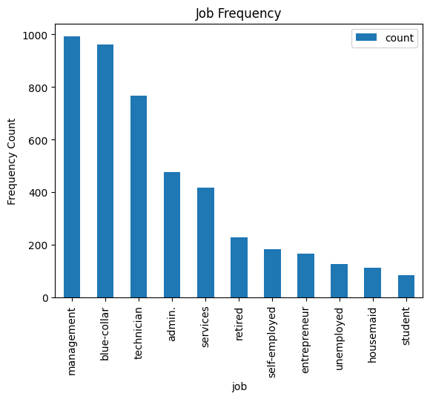
Data Preparation: Unknowns
Columns with “unknown” values:
Job: 38 unknowns
Education: 187 Unknowns
Contact: 1324 Unknowns
Poutcome: 3705 Unknowns
Notes:
Step 2.1: Addressing Unknowns
We found that columns job, education, contact (the method used to contact the client during the last campaign) and Poutcome (Outcome of the previous marketing campaign) had these respectively unknown values.
For Job and Education, we handled the unknown values by substituting them with the mode.
If both job and education were unknown for 1 record, they were replaced with the mode of each respective category
If job was unknown and education was known, job would be replaced with the mode of that job with that education level. For example, if, for that record, the education was secondary, then the unknown job value would be replaced with the most frequent job with a secondary education. And vice versa.
Figure 1: This graph shows the frequency of each job after replacing the unknowns.

Slide 7
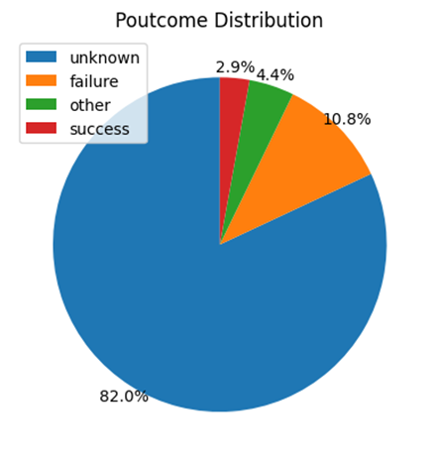
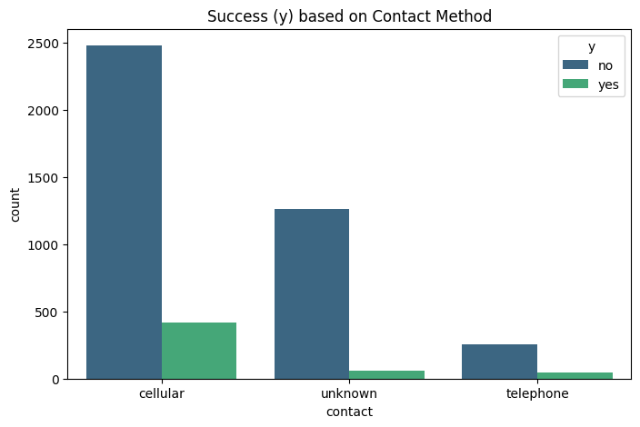
Data Preparation: Unknowns (cont.)
Columns with “unknown” values:
Job: 38 unknowns
Education: 187 Unknowns
Contact: 1324 Unknowns
Poutcome: 3705 Unknowns
Notes:
Step 2.2: Addressing Unknowns
For contact and Poutcome, we decided to leave them as is due to the vast number of unknowns.
In the graph on Contact Method, the unknown value has a significantly lower success rate than cellphone and telephone, which could mean that unknown is a strong predictor.
Poutcome’s unknown values represent at least 82% of the data in its respective category.
We also observed that all poutcome with unknown values also had:
pday (representing the number of days that passed after the client was last contacted) as -1 (which means that client was never contacted) and
previous (Number of contacts performed before this campaign) as 0 (which means the client had no contact from the bank in the last campaign).
Therefore, despite the number of unknowns in Poutcome, we believe that there is a chance that these clients could also be potential subscribers.
Figure 1: This graph shows that for the (method of) contact attribute, the “unknowns” have significantly a lower success rate than cellphone and telephone, meaning that the contact attribute is a strong predictor of success.
Figure 2: This graph helps visualize the number of unknowns in Poutcome

Slide 8
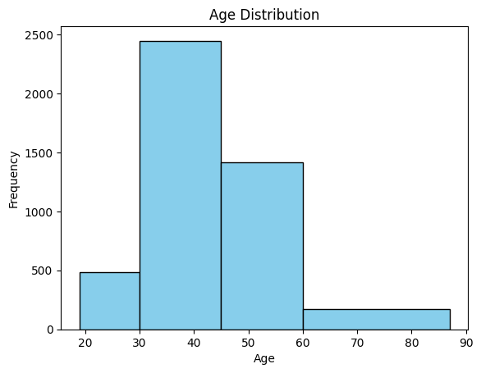
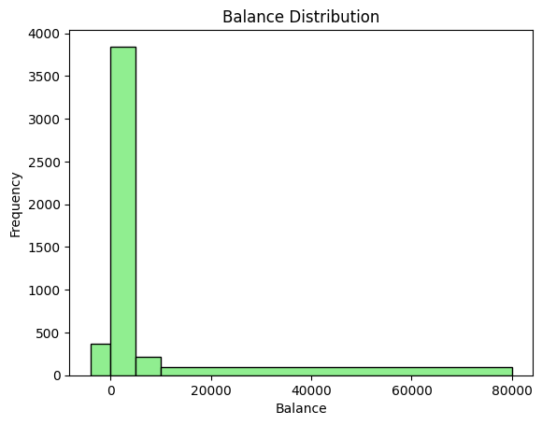
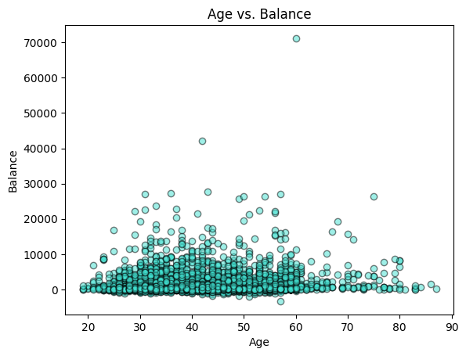
Data Preparation: Attributes Inspection
Notes:
Step 3 — Data Inspection: Attribute inspections by using visualizations of basic statistics e.g, distributions.
Another attribute we explored is the age and yearly balance. As the values in both these columns vary, we decided that putting them into defined groups would assist in our model training to yield a better performance.
Our age groups are:
Young (less than 30 years old)
Early Mid (ages 30 to 45)
Late Mid (ages 46 to 60)
Seniors (ages 61 or older)
Our balance groups are:
Negative (yearly balance of less than 0)
Low (yearly balance is between 0 to 5000)
Medium (yearly balance is between 5001 to 10000)
High (yearly balance is 10001 or more)
Figure 1: Age Distribution in defined bins of Age Groups: young, early mid, late mid, and seniors
Figure 2: Balance Distribution in defined bins of Balance Groups: negative, low, medium, and high
Figure 3: Age vs. Yearly Balance

Slide 9
Data Preparation: Measures of Central Tendency
4521 Entries | Age | Balance (€) | Day | Duration | Campaign | pdays | previous
Mean | 41.17 | 1422.66 | 15.92 | 263.96 | 2.79 | 39.77 | 0.54
STD | 10.58 | 3009.64 | 8.25 | 259.86 | 3.11 | 100.12 | 1.69
MIN | 19 | -3313.00 | 1 | 4 | 1 | -1 | 0
25% | 33 | 69.00 | 9 | 104 | 1 | -1 | 0
Median | 39 | 444.00 | 16 | 185 | 2 | -1 | 0
75% | 49 | 1480 | 21 | 329 | 3 | -1 | 0
MAX | 87 | 71188.00 | 31 | 3025 | 50 | 871 | 25
Notes:
Step 4.1 — Measures of Central Tendency of Numerical Values
We looked at the measures of central tendency of the numerical features in our dataset, which we visualized using box plots in the next slide

Slide 10
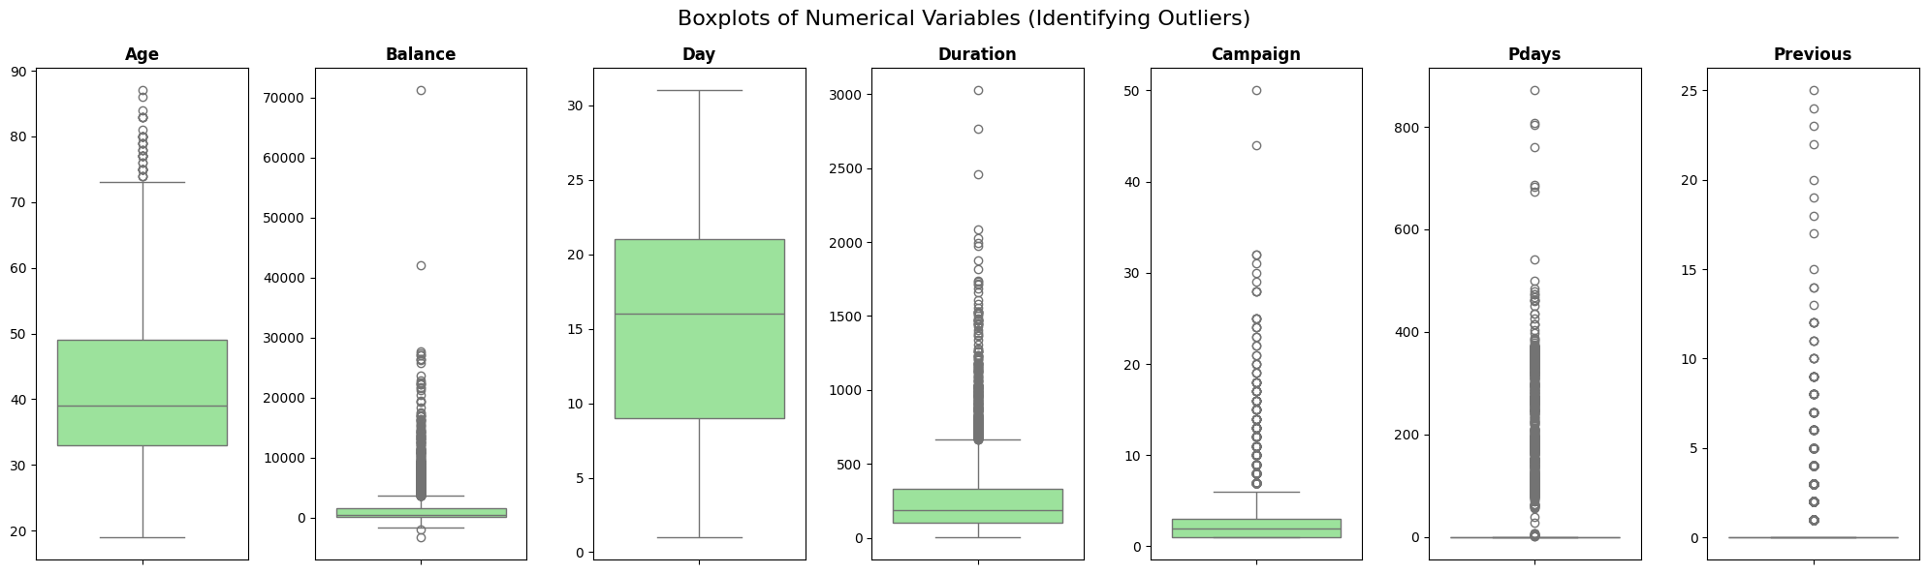
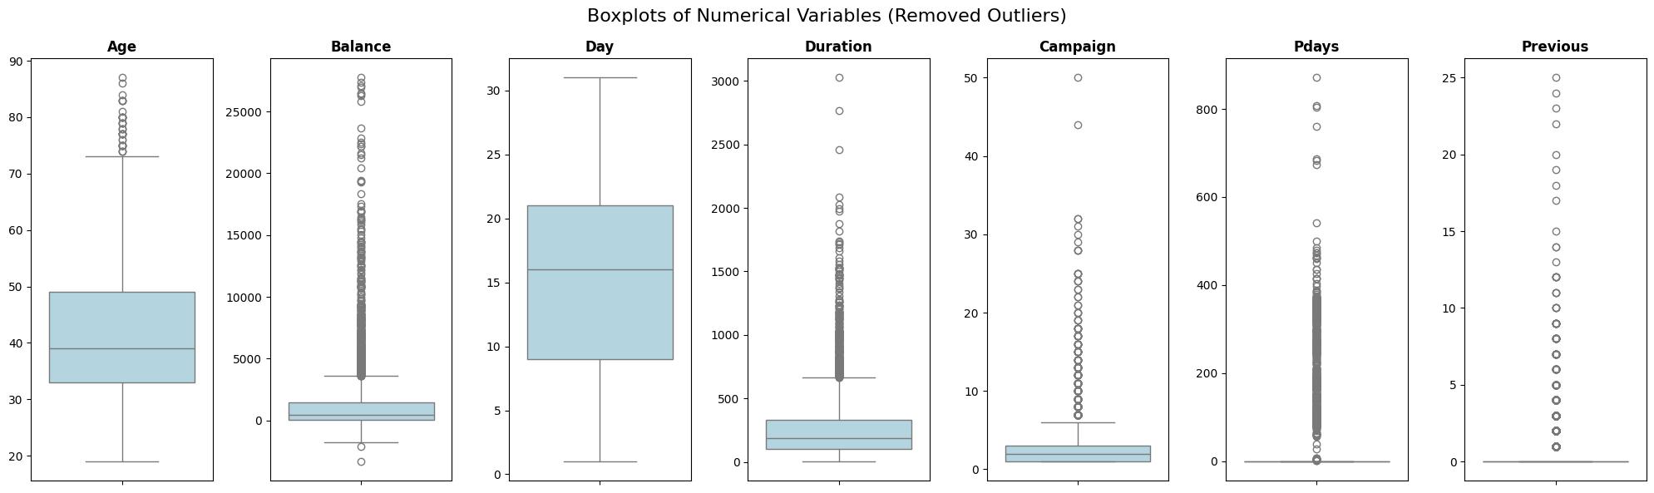
Data Preparation: Outlier Handling
Notes:
Step 4.2 — Outlier Detection
We created box plots for all six numeric attributes and visualized results to examine outliers; to decide whether to keep them or remove them.
Findings by attribute:
age: 38 outliers — mostly older customers (above ~65); not severe, we decided to keep these because we believe that the outliers would help us train our model to recognize different age groups.
balance: 506 outliers — range −€3,313 to €71,188; highly right-skewed distribution with extreme high-yearly balance customers
pdays: 816 outliers — most customers were never previously contacted (value = −1); those who were contacted show a wide spread
previous: 816 outliers — most clients had zero prior contacts; a small group had up to 25 number of contacts.
(as mentioned previously, these two features are quite connected to Poutcome’s unknown value)
duration: 330 outliers — most calls are short, but some extend to over 3,000 seconds (50 min)
campaign: 318 outliers — most needed 1–3 contacts; a few required up to 50 (Campaign represents the number of contacts performed during the marketing campaign)
Ultimately, we decided to remove the 2 extreme outliers in the balance distribution, which helped us improve our model performance as this distribution was heavily skewed (as you will see in the next slide).
Figure 4: seven box plots, one per numeric attribute, with outlier counts annotated
Figure 5: seven box plots, one per numeric attribute, with outliers removed

Slide 11
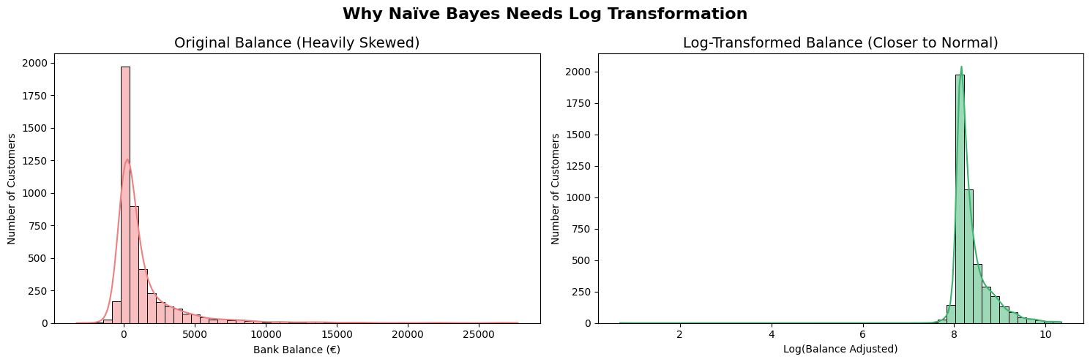
Data Preparation: Log Transformation
Notes:
Step 5 — Log Transformation: Balance
Unlike the Decision Tree, the Naïve Bayes model relies on Gaussian probability (the Bell Curve). When we explored our data, we found that financial attributes like balance were heavily right-skewed. If we fed the raw balance data to the Naïve Bayes model, it would struggle. So, we applied the Log Transformation to the balance distribution to normalize the skewed data as it pulls the extreme outliers in and creates a much more "normal" bell curve shape. Therefore, this would meet the normality assumption for the Gaussian Naïve Bayes Model.
We also applied log transformation to Duration.
Figure 6: “balance” attribute before and after Log Transformation for the Naïve Bayes Model.

Slide 12
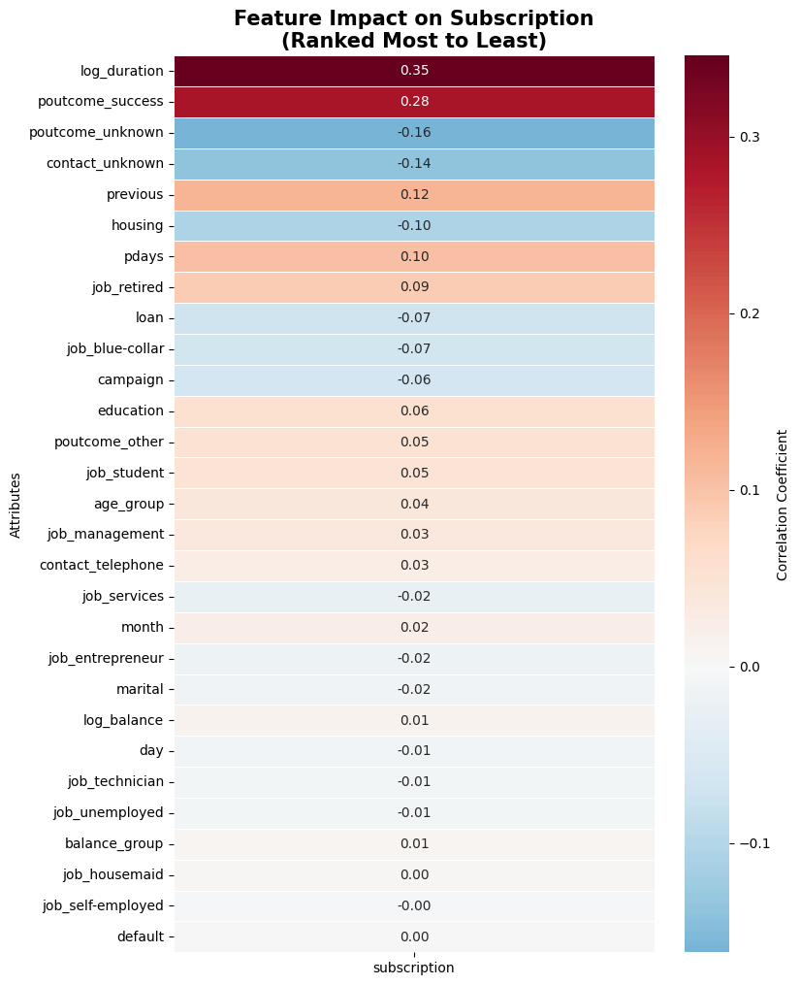
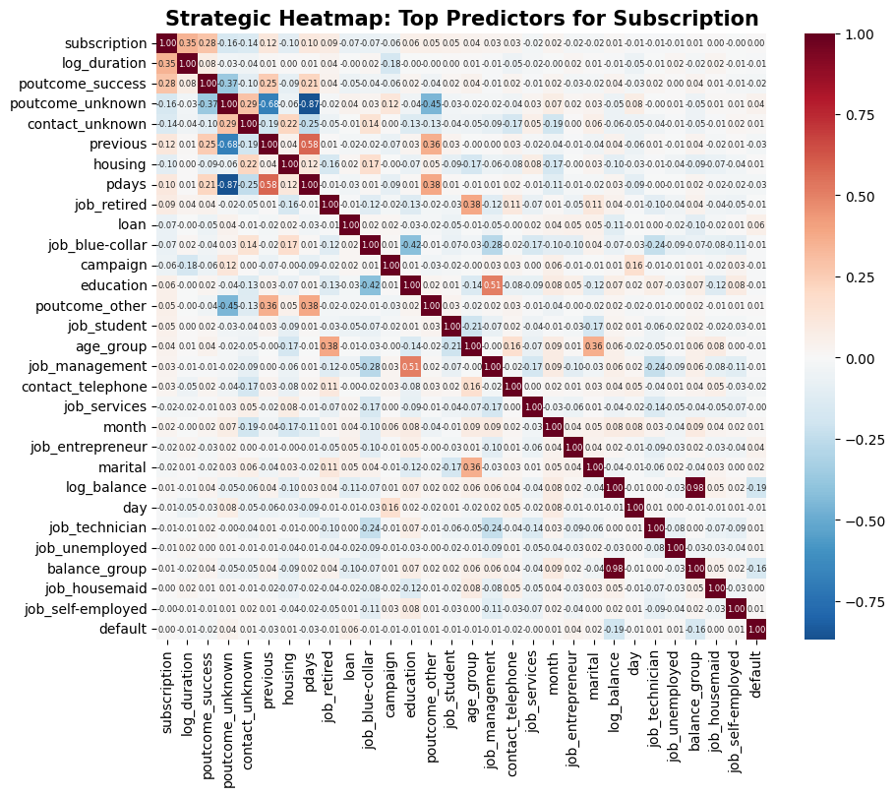
Data Preparation: Correlation Analysis
Notes:
Step 6a — Feature Relevance Analysis (Correlation review)
The correlation heatmap is computed on the fully prepared and cleaned dataframe (df_model in our python file), which contains a total of 29 features after one-hot encoding of nominal variables (job, contact, poutcome), ordinal mapping (education, month, marital, age_group, balance_group), binary mapping (default, housing, loan, subscription), and log transformation of balance and duration. These were necessary steps as machine learning models required numerical inputs. Age, balance, and duration are dropped from the model to prevent double-counting with their encoded/transformed counterparts.
Our Findings:
Notable inter-feature correlations from the heatmap:
pdays and previous are strongly correlated with each other (r ≈ 0.45) — both captured prior campaign contact history and are partially redundant
As mentioned before, this could be due to the vast number of unknowns in poutcome. We observed that for all 3,705 entries of poutcome that are unknown, pday = -1 (not contacted) and previous is 0 (no contact).
contact and month show moderate correlation — campaign timing and contact method are linked
No severe multicollinearity issues among the remaining features
The correlation findings contribute directly into the 4-method Voting Consensus feature selection (covered in the Bonus slides), where correlation rankings will be combined with features that were determined to be important by the Decision Tree Gini Importance, Naïve Bayes Permutation Importance, and Chi-Square scores to produce the final 13-feature set for our machine learning model.
Figure 7: a. full heatmap (includes columns created from one-hot encoding of categorical features) b. target correlation bar chart

Slide 13
Predictive Modeling
Strategy
80/20 stratified train-test split (random state = 42)
Training set: 3,615 records
Test set: 904 records
Stratified to preserve the 88.5% / 11.5% class ratio in both splits
Why train-test split over cross-validation:
Given the class imbalance, stratified splitting ensures the minority class (subscribed = yes) is proportionally represented in both sets, giving reliable and consistent metric evaluation across all six models.
Notes:
- We chose an 80/20 train-test split over a 70/30 because we needed to maximize our training data while still holding out a robust 900+ record test set. - More importantly, we used stratified sampling. Given our severe 88.5% to 11.5% class imbalance, a random split could easily result in a test set with barely any actual subscribers. Stratifying guaranteed that our 11.5% minority class was perfectly preserved across both sets so our evaluations reflect reality

Slide 14
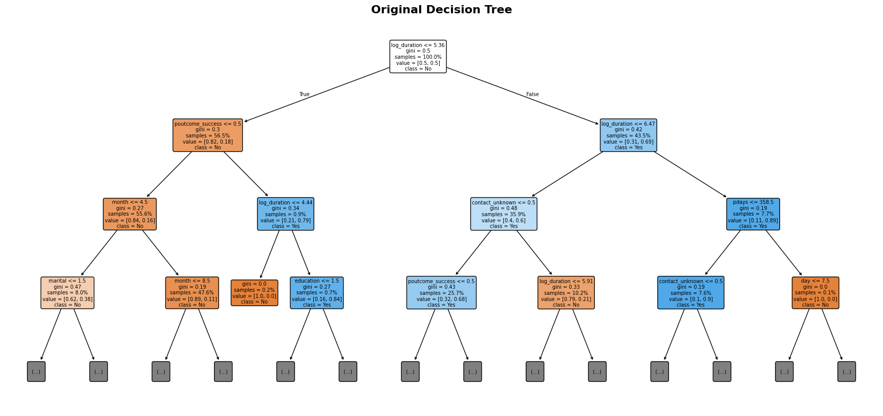
Predictive Modeling: Baseline Decision Tree
Notes:
We trained our baseline Decision Tree using all 29 prepared features, balanced class weights, and a max depth of 5 to prevent overfitting. The tree immediately showed us what matters: log_duration is the top feature accounting for 63% of the total information gain.
Secondary splits branch off contact type and prior campaign success. Just as importantly, the tree ignored features like housing, loans, and age groups entirely—proving they add zero discriminating power once you know how long the call lasted.
Model: DecisionTreeClassifier, max_depth = 5, class_weight = 'balanced', random_state = 42.
Trained on the full prepared feature set of 29 attributes after one-hot encoding, binning, ordinal mapping, and log transformation.
How the tree makes decisions — key rules (baseline model):
The root split is on log_duration — the log-transformed call duration is by far the dominant split criterion, accounting for 62.8% of total feature importance. The second-level splits use contact_unknown (10.9%) and poutcome_success (9.4%) — customers contacted by an unknown method or with a prior successful campaign outcome follow different decision paths. Deeper nodes use month (6.0%), day (3.7%), marital (2.4%), and job_blue-collar (2.0%) as secondary discriminators.
Features with zero importance in the baseline tree include: default, balance_group, age_group, campaign, loan, housing, and several job dummies — confirming these add no discriminating power once log_duration and contact type are known.

Slide 15
Predictive Modeling: Baseline Naive Bayes
Feature | Permutation Importance | Interpretation
poutcome_success | 0.0279 | Strongest signal — prior campaign success dramatically increases subscription probability
log_duration | 0.0152 | Longer calls strongly associated with subscription
job_retired | 0.0038 | Retired customers more likely to subscribe
housing | 0.0034 | Having a housing loan is negatively associated with subscription
loan | 0.0031 | Having a personal loan is negatively associated with subscription
job_student | 0.0019 | Student customers show above-average subscription rates
Notes:
For our Naïve Bayes baseline, we had to address its reliance on Gaussian probability. Naïve Bayes assumes independent, normally distributed features."
The Key Insight: "This is exactly why the log transformations on balance and call duration was necessary. The original right-skewed data would have completely broken the model. After transformation, our permutation importance confirmed the Decision Tree's findings: past campaign success and call duration are our strongest signals The Naïve Bayes model uses Gaussian probability — it models each feature's distribution separately for the "yes" and "no" classes, then combines them using Bayes' theorem. Because the model assumes feature independence, it is sensitive to the shape of each feature's distribution.
That is why log transformation of balance and duration was critical: the original distributions were heavily right-skewed, which would cause the Gaussian assumption to fail. After log transformation, the distributions are closer to normal, allowing the NB model to compute meaningful conditional probabilities.
Class priors learned from training data:
P(y = no) = 0.8847
P(y = yes) = 0.1153
The permutation importance table above shows which features, when shuffled randomly, cause the largest drop in model accuracy — confirming that poutcome_success and log_duration are the two most critical features for the Naive Bayes model, consistent with the Decision Tree findings. Features with negative permutation importance (contact_unknown, poutcome_unknown, month) actually hurt the Naive Bayes model and are candidates for removal.

Slide 16
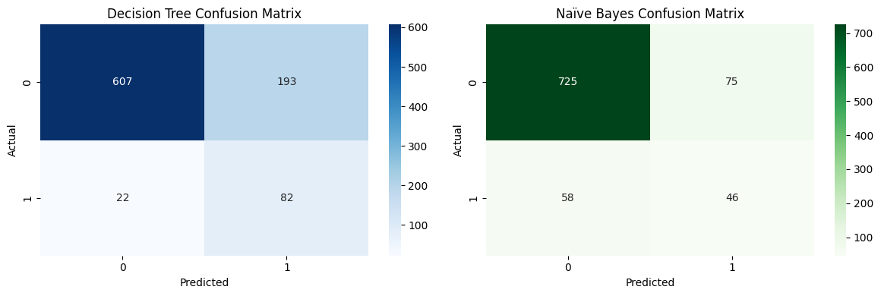
Predictive Modeling: Baseline Models Evaluation - Preliminary Results
 | Accuracy | Precision | Recall | FPR | F-1 Score
Decision Tree Baseline | 0.7622 | 0.2982 | 0.7885 | 0.2412 | 0.4327
Naive Bayes Baseline | 0.8529 | 0.3802 | 0.4423 | 0.0938 | 0.4089
Notes:
Best model depends on priority:
Highest accuracy: NB Selected — 87.17%
Highest TPR — best at catching subscribers: DT Selected — 84.62%, correctly identifies the most actual "yes" customers
Best FPR — fewest wasted calls: NB Selected — 6.38%
Best F1 balance: DT Optimized (Consensus) — 0.4518
Critical note on accuracy: Given the 88.5% class imbalance, a model that always predicts "no" would achieve 88.5% accuracy without learning anything. Accuracy alone is therefore misleading. TPR and FPR are the decisive metrics — the bank's goal is to identify as many subscribers as possible (high TPR) while minimising wasted calls to non-subscribers (low FPR). The team produced six trained models in total — two baselines, two on the 13 features from DT importance, and two on the 13 Voting Consensus features — enabling a comprehensive comparison across all strategies.
What to say: "Before we compare models, we need to talk about metrics. In a dataset where 88.5% of people say 'no', an accuracy score is a trap. A model that blindly predicts 'no' every time is technically 88.5% accurate, but utterly useless to the bank."
The Metric Breakdown: * "Recall (or True Positive Rate): This is our revenue driver. Out of all actual subscribers, how many did we catch?"
"False Positive Rate (FPR): This is our operational cost. How many non-subscribers are we wasting agent time calling?"
"F1-Score: This is our primary balance metric, finding the harmonic mean between precision and recall."

Slide 17
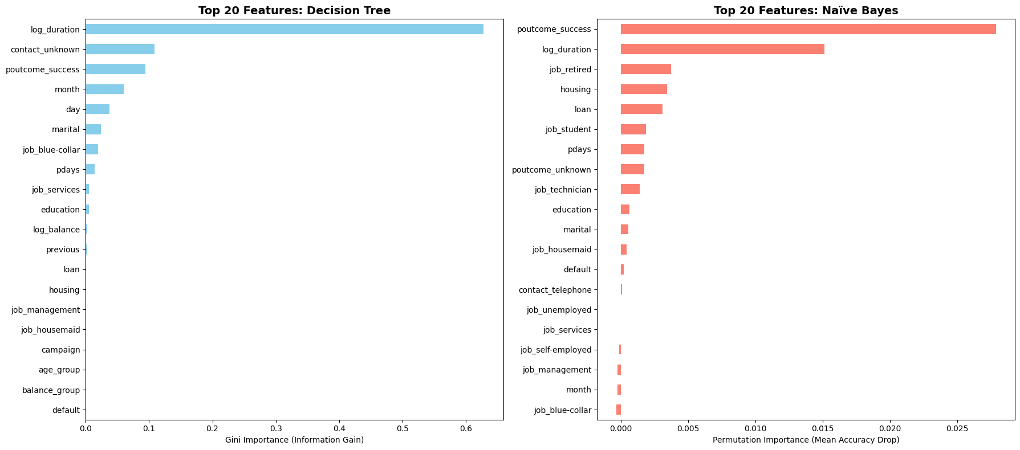
Predictive Modeling: Feature Importance based on Baseline Models
Notes:
"Looking at the top 20 features across both baselines, you can see the consensus forming. We decided to trim the fat and run models using only the top 13 features identified by the Decision Tree.”
Feature importances — DT Baseline (Gini / Information Gain):
log_duration: 62.8% — dominates the tree by a wide margin; the log-transformed call duration is the single most powerful predictor
contact_unknown: 10.9% — whether the contact method is unknown is a strong negative signal
poutcome_success: 9.4% — prior successful campaign outcome is the strongest categorical predictor
month: 6.0% — campaign timing carries meaningful information
day: 3.7% — day of the month contributes secondary signal
marital: 2.4%
job_blue-collar: 2.0%
pdays: 1.4%
All remaining features (default, balance_group, age_group, campaign, loan, housing, and most job dummies): 0% — contribute no information gain to the baseline tree
Feature importances — DT Optimized (Consensus 13 features, Gini):
log_duration: 69.2% — rises further in importance once weak features are removed
contact_unknown: 11.8%
poutcome_success: 10.2%
job_blue-collar: 2.1%
campaign: 2.1%
housing: 1.8%
pdays: 1.7%
Feature importances — NB Baseline (Permutation Importance):
poutcome_success: 0.0279 — highest permutation importance; shuffling this feature causes the largest accuracy drop
log_duration: 0.0152
job_retired: 0.0038
housing: 0.0034
loan: 0.0031
job_student: 0.0019

Slide 18
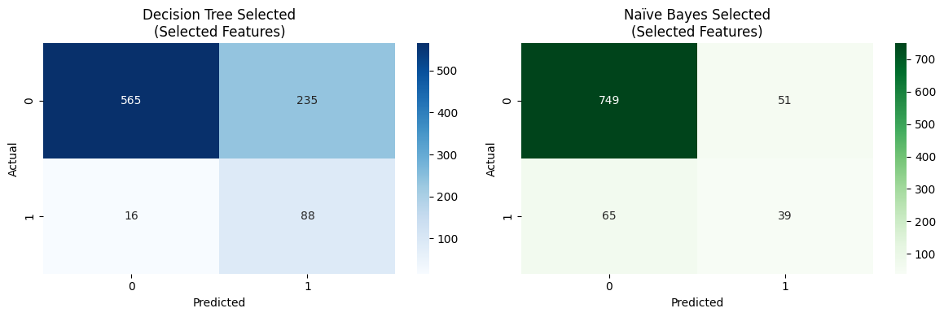
Predictive Modeling: Selected Features Models Evaluation - Preliminary Results
 | Accuracy | Precision | Recall | FPR | F-1 Score
Decision Tree Selected Features | 0.7223 | 0.2724 | 0.8462 | 0.2938 | 0.4122
Naive Bayes Selected Features | 0.8717 | 0.4333 | 0.3750 | 0.0638 | 0.4021
Notes:
We re-ran the Decision Tree and Naive Bayes models with only the 13 features indicated as important by the baseline Decision Tree model.
This figure shows the Confusion Matrix of the two new models
Stripping the data down to 13 features made a massive difference. Our 'Selected' Decision Tree achieved an incredible 84.62% True Positive Rate—it became hyper-aggressive at catching subscribers. However, it cost us in False Positives. We needed a smarter way to select features

Slide 19
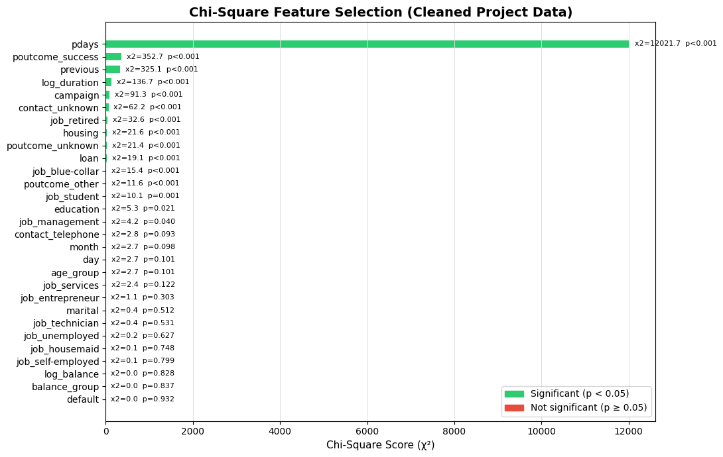
Bonus: Chi-Square Analysis
Notes:
BONUS — Chi-Square Feature Selection (Notebook Implementation)
In the notebook, the chi-square (χ²) test is applied to the fully prepared df_model — the same 29-feature encoded dataset used for model training. Because chi-square requires non-negative values, all features are shifted by subtracting their minimum value before the test is run. The chi-square results are not used in isolation — they form one of four inputs to the Voting Consensus (see next slide). Features that score highly on chi-square receive a vote in the consensus, alongside rankings from Pearson Correlation, Decision Tree Gini Importance, and Naïve Bayes Permutation Importance. The top 13 features from chi-square are passed to the consensus scoreboard.
Key findings from the chi-square on the prepared dataset:
log_duration and poutcome_success score highest, consistent with all other selection methods.
contact_unknown, pdays, and previous also rank strongly.
Features like default and balance_group score near zero, confirming they carry no statistical association with the subscription outcome.

Slide 20
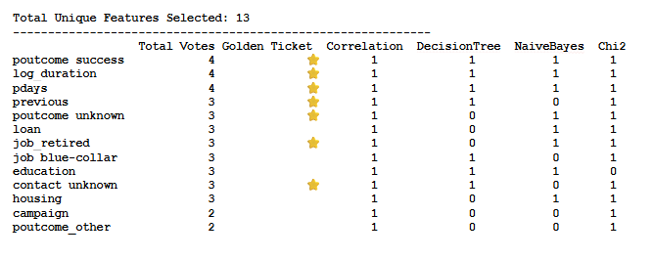
Bonus: Feature Selection via Consensus
Combining Baseline Models with Correlation, Chi-Square
Notes:
We compared all top 20 feature lists from the Pearson Correlation, DecisionTree, Naive Bayes and Chi-Square analyses, and we combined them to select the features for the filtered model.
We ensured the top 3 features of each individual method were always included in the final selection, regardless of their total vote count across all methods. This "Golden Ticket" rule prevents strong single-method signals from being lost in the consensus averaging.

Slide 21
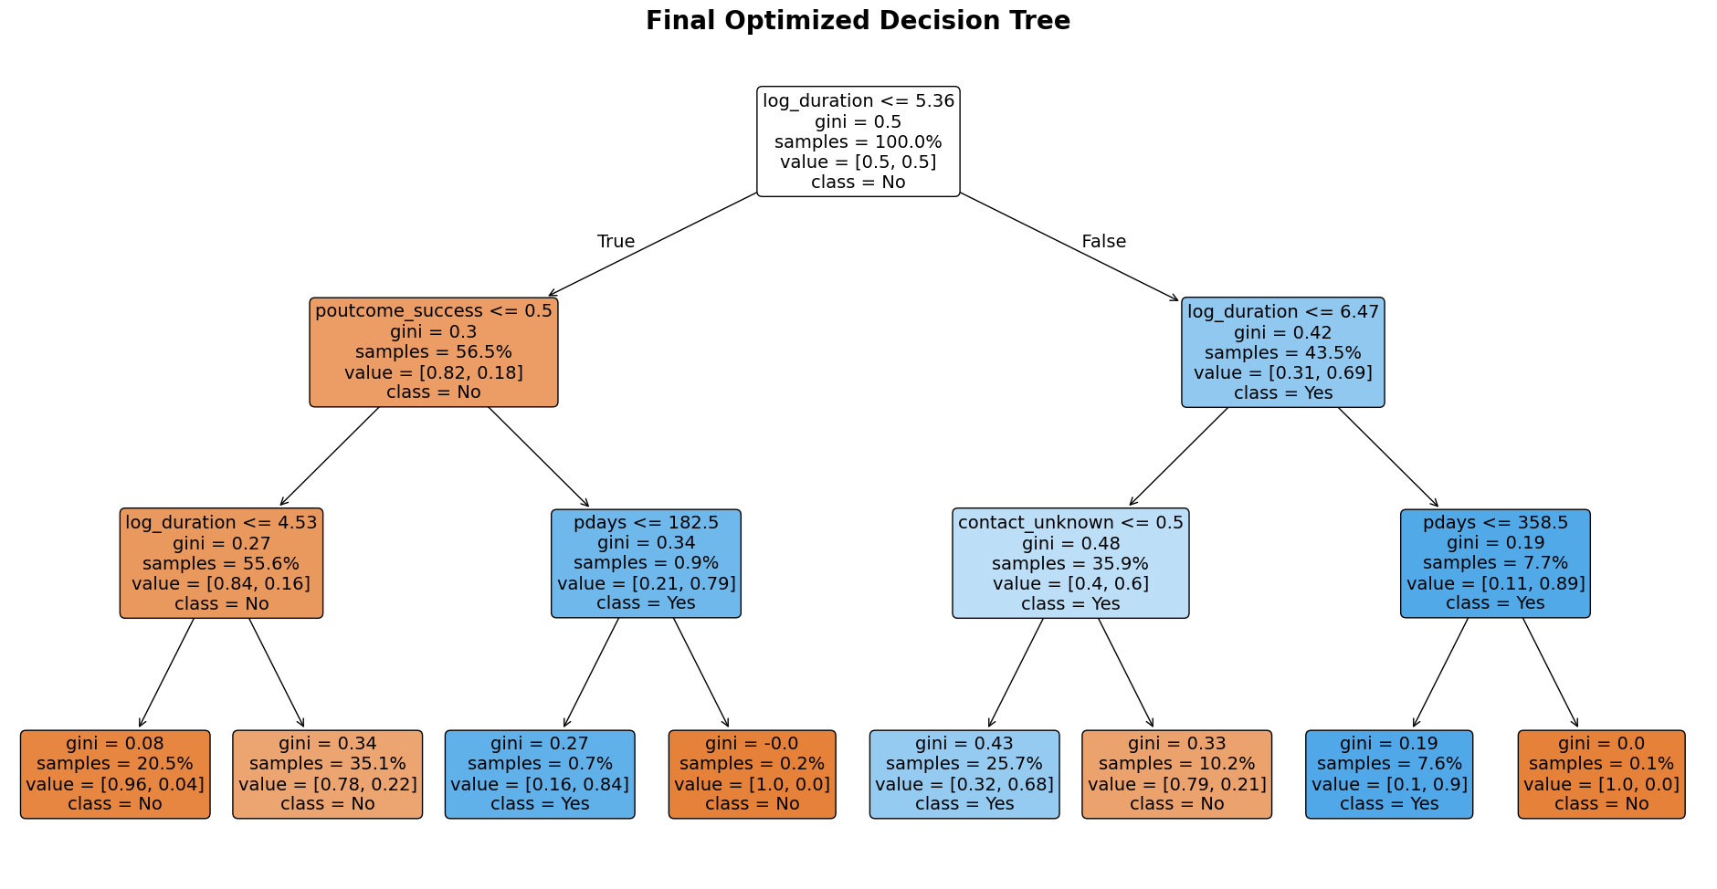
Bonus: Decision Tree w/ Consensus Features
Notes:
This diagram shows the Final Optimized Decision Tree trained on the 13 Voting Consensus features (dt_model_v2), visualised at max_depth = 3 for readability.
The root split confirms log_duration as the primary decision criterion.
Second-level splits use contact_unknown and poutcome_success — customers with a prior successful outcome and longer calls are routed toward the "yes" class early in the tree.
The balanced class_weight parameter ensures the tree does not simply default to predicting "no" due to the 88.5%/11.5% class imbalance.

Slide 22
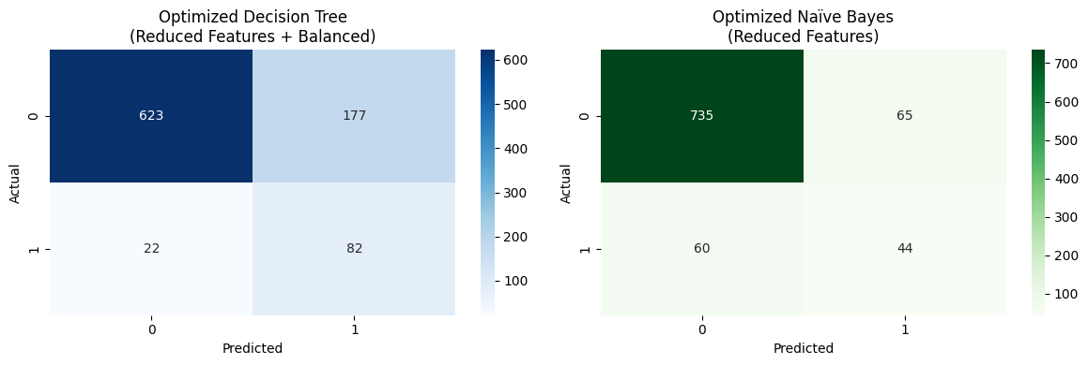
Bonus: Optimized Model Performance w/ Consensus Features
 | Accuracy | Precision | Recall | FPR | F-1 Score
Decision Tree Consensus Features | 0.7799 | 0.3166 | 0.7885 | 0.2213 | 0.4518
Naive Bayes Consensus Features | 0.8617 | 0.4037 | 0.4231 | 0.0813 | 0.4131
Notes:
This table presents the performance of both models trained on the 13 Voting Consensus features (dt_model_v2 and nb_model_v2).
Compared to their respective baselines: DT Optimized improves on accuracy (+1.77%), maintains the same TPR, and reduces FPR by 1.99% — a strictly better result than the baseline with no trade-offs.
NB Optimized improves accuracy (+0.88%) and FPR (−1.25%) at the cost of a slight TPR reduction (−1.92%).
The Voting Consensus feature set produces reliable, consistent improvements for both model types.
And the metrics prove the strategy worked. Our Consensus Decision Tree hit the highest F1-score of the entire project at 0.4518. It maintained a near 79% True Positive Rate while dropping the False Positive Rate down to 22%

Slide 23
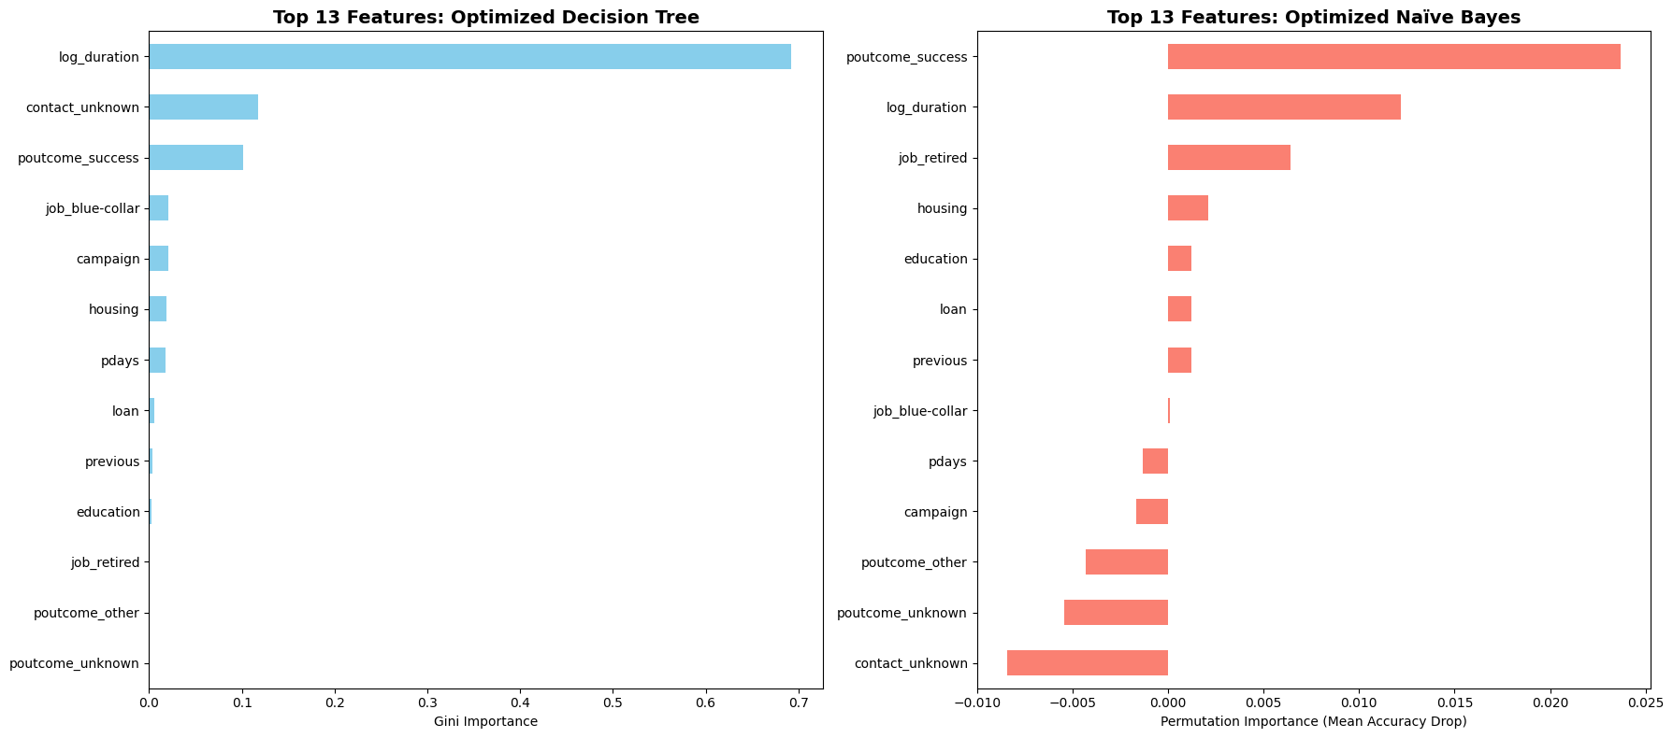
Decision Tree: Selected Features
Notes:
Here is the final feature ranking for those optimized models, proving a much more balanced reliance on our core signals.
This diagram shows the Decision Tree trained exclusively on the 13 features selected by the DT baseline's own importance scores (dt_model_v3), visualised at max_depth = 3.
Compared to the Consensus DT (Slide 20), the structure is similar at the top — log_duration remains the dominant root split — but deeper nodes differ as some features present in the consensus set (e.g., pdays, previous) are absent here. This model achieves the highest TPR of all six models (84.62%) but at the cost of a higher FPR (29.38%), making it the best choice when maximising subscriber capture is the priority over operational efficiency.

Slide 24
Baseline vs. Selected vs. Consensus Comparison
Comparison | Accuracy | Recall | FPR | F1-Score
DT Original (all 29 features) | 76.22% | 78.85% | 24.12% | 0.4327
DT Selected (13 from DT) | 72.23% | 84.62% | 29.38% | 0.4122
DT Optimized (13 Consensus) | 77.99% | 78.85% | 22.13% | 0.4518
NB Original (all 29 features) | 85.29% | 44.23% | 9.38% | 0.4089
NB Selected (13 from DT) | 87.17% | 37.50% | 6.38% | 0.4021
NB Optimized (13 Consensus) | 86.17% | 42.31% | 8.13% | 0.4131
Notes:
The team trained six models in total, enabling three distinct comparisons:
Baseline → DT Selected (13 features from DT importance): Accuracy drops (76.22% → 72.23%, −3.99%) but TPR increases significantly (78.85% → 84.62%, +5.77%), at the cost of a higher FPR (24.12% → 29.38%, +5.26%). The tree trades overall accuracy for better subscriber detection.
Baseline → DT Optimized (13 Voting Consensus features): Accuracy improves slightly (76.22% → 77.99%, +1.77%), TPR is unchanged (78.85%), and FPR improves (24.12% → 22.13%, −1.99%). The consensus feature set produces a cleaner, more efficient tree with no trade-off.
Baseline → NB Optimized (13 Voting Consensus features): Accuracy improves (85.29% → 86.17%, +0.88%), TPR decreases slightly (44.23% → 42.31%, −1.92%), FPR improves (9.38% → 8.13%, −1.25%).
Baseline → NB Selected (13 from DT importance): Accuracy improves (85.29% → 87.17%, +1.88%), TPR decreases (44.23% → 37.50%, −6.73%), but FPR drops significantly (9.38% → 6.38%, −3.00%). NB gains precision at the cost of some recall.
Feature selection method: 4-method Voting Consensus — Pearson Correlation, Decision Tree Gini Importance, Naïve Bayes Permutation Importance, and Chi-Square — each nominating their top 13 features. A Golden Ticket rule protects the top 3 of each method. 13 features were selected unanimously or by majority.
Accuracy: If the model correctly classifies 877 out of 1,000 customers, accuracy is 87.7%. Since 88.5% of customers did not subscribe, a model that always predicts "no" would score 88.5% accuracy without learning anything useful.
Precision: "Of all the customers the model predicted would subscribe, how many actually did?"
Recall: "Of all the customers who actually subscribed, how many did the model correctly identify?"
The Decision Tree responds differently to feature reduction depending on the method:
Removing features based on the DT's own importance scores (DT Selected) increases recall dramatically (+5.77%) — the tree becomes more aggressive in flagging subscribers — but at the cost of more false positives (FPR +5.26%) and lower overall accuracy (−3.99%).
Using the Voting Consensus features (DT Optimized) produces a strictly better result: higher accuracy, same TPR, and lower FPR — confirming that consensus-based selection is more robust than single-method selection.
For Naïve Bayes, feature selection consistently improves performance across the board. Both NB Selected and NB Optimized outperform the baseline on accuracy and FPR. The trade-off is a reduction in TPR, as NB becomes more conservative in its "yes" predictions.
For a telemarketing use case where agent time is the primary cost, the FPR reduction is the most operationally valuable improvement.
The 4-method Voting Consensus proved to be the most reliable selection strategy — features endorsed by multiple independent methods are more likely to represent genuine signal rather than noise.

Slide 25
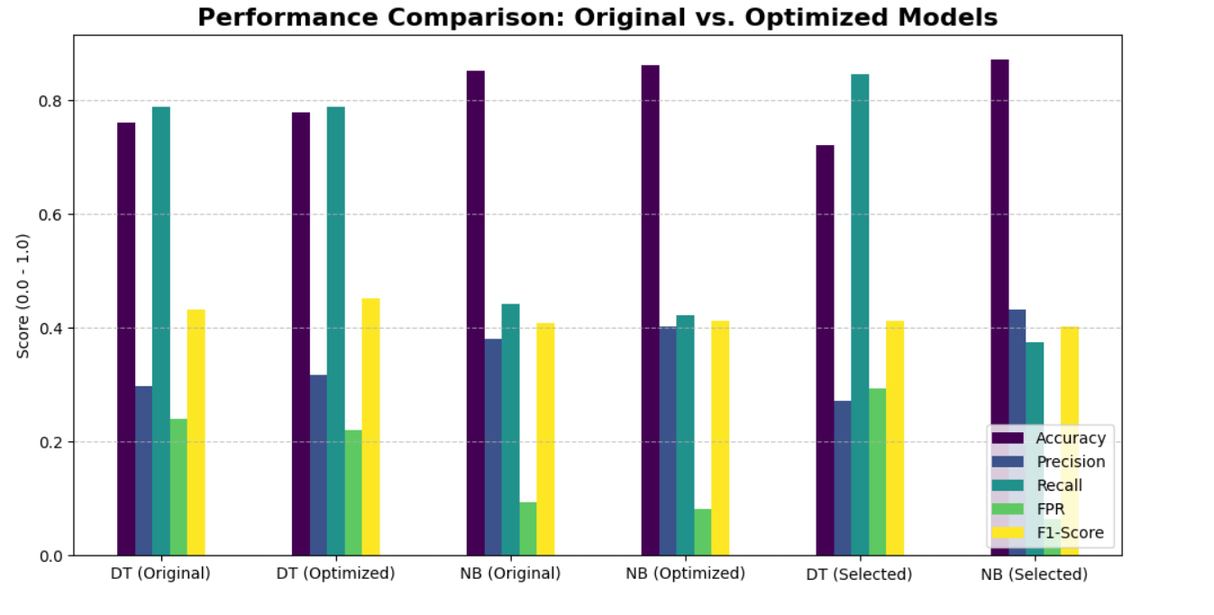
Baseline vs. Selected vs. Consensus Comparison
Notes:
The team trained six models in total, enabling three distinct comparisons:
Baseline → DT Selected (13 features from DT importance): Accuracy drops (76.22% → 72.23%, −3.99%) but TPR increases significantly (78.85% → 84.62%, +5.77%), at the cost of a higher FPR (24.12% → 29.38%, +5.26%). The tree trades overall accuracy for better subscriber detection.
Baseline → DT Optimized (13 Voting Consensus features): Accuracy improves slightly (76.22% → 77.99%, +1.77%), TPR is unchanged (78.85%), and FPR improves (24.12% → 22.13%, −1.99%). The consensus feature set produces a cleaner, more efficient tree with no trade-off.
Baseline → NB Optimized (13 Voting Consensus features): Accuracy improves (85.29% → 86.17%, +0.88%), TPR decreases slightly (44.23% → 42.31%, −1.92%), FPR improves (9.38% → 8.13%, −1.25%).
Baseline → NB Selected (13 from DT importance): Accuracy improves (85.29% → 87.17%, +1.88%), TPR decreases (44.23% → 37.50%, −6.73%), but FPR drops significantly (9.38% → 6.38%, −3.00%). NB gains precision at the cost of some recall.
Feature selection method: 4-method Voting Consensus — Pearson Correlation, Decision Tree Gini Importance, Naïve Bayes Permutation Importance, and Chi-Square — each nominating their top 13 features. A Golden Ticket rule protects the top 3 of each method. 13 features were selected unanimously or by majority.
Accuracy: If the model correctly classifies 877 out of 1,000 customers, accuracy is 87.7%. Since 88.5% of customers did not subscribe, a model that always predicts "no" would score 88.5% accuracy without learning anything useful.
Precision: "Of all the customers the model predicted would subscribe, how many actually did?"
Recall: "Of all the customers who actually subscribed, how many did the model correctly identify?"
The Decision Tree responds differently to feature reduction depending on the method:
Removing features based on the DT's own importance scores (DT Selected) increases recall dramatically (+5.77%) — the tree becomes more aggressive in flagging subscribers — but at the cost of more false positives (FPR +5.26%) and lower overall accuracy (−3.99%).
Using the Voting Consensus features (DT Optimized) produces a strictly better result: higher accuracy, same TPR, and lower FPR — confirming that consensus-based selection is more robust than single-method selection.
For Naïve Bayes, feature selection consistently improves performance across the board. Both NB Selected and NB Optimized outperform the baseline on accuracy and FPR. The trade-off is a reduction in TPR, as NB becomes more conservative in its "yes" predictions.
For a telemarketing use case where agent time is the primary cost, the FPR reduction is the most operationally valuable improvement.
The 4-method Voting Consensus proved to be the most reliable selection strategy — features endorsed by multiple independent methods are more likely to represent genuine signal rather than noise.

Slide 26
Major Findings: Data Preparation
The dataset is significantly imbalanced — 88.5% of customers did not subscribe, only 11.5% did. This makes accuracy a misleading metric and elevates TPR and FPR as the decisive evaluation criteria throughout the project.
Outlier analysis revealed that balance, pdays, previous, duration, and campaign all contain substantial outliers — these reflect real customer behaviour (e.g., high-balance clients, heavily contacted customers) and were deliberately retained as meaningful signals rather than noise.
Chi-square analysis was applied to all 29 prepared features (including log_duration, one-hot encoded job, contact, and poutcome dummies) and combined with three other selection methods into a 4-method Voting Consensus. The top features confirmed by chi-square include log_duration, poutcome_success, pdays, and contact_unknown — consistent with all other selection methods.
log_duration (log-transformed call duration) was the single strongest predictor across every analysis method — Chi-Square (highest χ² score), Pearson correlation (r = 0.40 on raw duration), and Decision Tree Gini importance (62.8% of total information gain in the baseline model). Call duration is the most reliable signal in the dataset.
Notes:
Summary of Major Findings: Data Preparation:
Dataset was significantly imbalanced: 88.5% of customers did not subscribe, only 11.5% did. This makes accuracy a misleading metric and elevates TPR and FPR as the decisive evaluation criteria throughout the project.
Outlier Analysis: balance, pdays, previous, duration, and campaign all contain substantial outliers — these reflect real customer behaviour (e.g., high-balance clients, heavily contacted customers) and were deliberately retained as meaningful signals rather than noise.
For Chi-Square: The Chi-square analysis was applied to the fully prepared df_model (29 features after encoding, binning, and log transformation), not the original raw attributes. Its results were combined with three other selection methods — Pearson Correlation, Decision Tree Gini Importance, and Naïve Bayes Permutation Importance — into a 4-method Voting Consensus. Features endorsed by multiple methods were retained; 13 features were selected for the optimized models. A Golden Ticket rule ensured the top 3 features from each individual method were always protected. The top features confirmed by chi-square include log_duration, poutcome_success, pdays, and contact_unknown — consistent with all other selection methods.
Log_duration: was our strongest predictor across every analysis method and was our most reliable signal in the dataset.

Slide 27
Major Findings: Predictive Modeling
Six models were trained and evaluated across three strategies: baseline (all 29 features), selected (13 features from DT importance), and optimized (13 Voting Consensus features).
The Decision Tree Baseline achieved a TPR of 78.85% — correctly identifying nearly 4 in 5 actual subscribers — but at the cost of a high FPR of 24.12%, meaning a large number of non-subscribers would also be called. Accuracy was 76.22%.
The Naïve Bayes Baseline achieved the best accuracy at 85.29% with a significantly lower FPR of 9.38%, but a lower TPR of 44.23% — identifying fewer subscribers overall.
The DT Optimized (Consensus 13 features) delivered the best F1-Score (0.4518), with TPR of 78.85%, FPR of 22.13%, and accuracy of 77.99% — an improvement over the DT Baseline across all three rubric metrics.
The NB Selected (13 features from DT) achieved the highest accuracy overall (87.17%) and the lowest FPR (6.38%), making it the most precise model for avoiding wasted calls, though TPR drops to 37.50%.
The DT Selected (13 from DT) achieved the highest TPR of all six models (84.62%) — the strongest subscriber detection — though this comes with the highest FPR (29.38%).
Notes:
Major Findings: Predictive Modeling
The six-model comparison reveals a fundamental trade-off in this dataset: models that catch more subscribers (high TPR) tend to also generate more false positives (high FPR), and vice versa.
The optimal choice depends on the bank's operational priority:
If the goal is to maximise subscriber detection (capture every potential "yes"): DT Selected is best — TPR 84.62%, but FPR 29.38%
If the goal is to minimise wasted agent calls (operational efficiency): NB Selected is best — FPR 6.38%, but TPR 37.50%
If the goal is a balanced performance across all metrics: DT Optimized (Consensus) is best — F1 0.4518, TPR 78.85%, FPR 22.13%
Feature selection consistently improved Naïve Bayes across accuracy and FPR. For the Decision Tree, the Voting Consensus features (DT Optimized) produced better results than the DT's own importance-based selection (DT Selected), confirming that multi-method consensus is a more robust selection strategy than single-model self-selection.

Slide 28
Conclusion: Which ML to use?
The recommended operational model depends on the bank's campaign objective:
For maximum subscriber detection (highest TPR):
Deploy DT Selected — TPR 84.62%, Accuracy 72.23%, FPR 29.38%
Best when the cost of missing a subscriber is higher than the cost of a wasted call
For minimum wasted calls (lowest FPR):
Deploy NB Selected — FPR 6.38%, Accuracy 87.17%, TPR 37.50%
Best when agent time is the primary operational cost
For best overall balance (highest F1-Score):
Deploy DT Optimized (Consensus) — F1 0.4518, TPR 78.85%, FPR 22.13%, Accuracy 77.99%
Recommended as the primary model — it improves on the baseline across all three rubric metrics simultaneously
Notes:
Conclusions:
In a telemarketing context, there is no single "best" model — the choice depends on what the bank values more: catching every possible subscriber (high TPR) or avoiding wasted agent hours (low FPR). Both are legitimate business objectives.
For a campaign in a period of low capacity (few agents available), NB Selected minimises false positives and ensures that every call placed has the highest possible chance of success (FPR 6.38%, Precision 43.33%).
For a campaign in a period of high capacity (many agents, broad outreach), DT Optimized maximises the number of subscribers captured (TPR 78.85%) while still improving on the baseline FPR.
The DT Optimized is the primary recommendation because it is the only model that improves simultaneously on Accuracy, FPR, and F1-Score compared to the baseline — making it the most defensible choice regardless of the specific operational context.

Slide 29
Recommendations
Prioritise call duration as the primary campaign signal.
Aim to engage customers longer during calls
Calls that reach up to 645 seconds (apprx. 10 mins) are more likely to be successful
Target customers with a prior successful campaign outcome first.
Customers with poutcome = success converted at 64.3%
Address class imbalance in future modelling cycles.
Notes:
Prioritise call duration as the primary campaign signal.
Aim to engage customers longer during calls.
Calls that reach up to 645 seconds (apprx. 10 mins) are more likely to be successful.
Target customers with a prior successful campaign outcome first.
Customers with poutcome = success converted at 64.3%
Address class imbalance in future modelling cycles.
With 88.5% negative cases, all six models are structurally biased toward predicting "no."
Exploring oversampling techniques such as SMOTE is the single highest-impact technical improvement available for future iterations, with the potential to significantly improve TPR without sacrificing FPR.

Slide 30
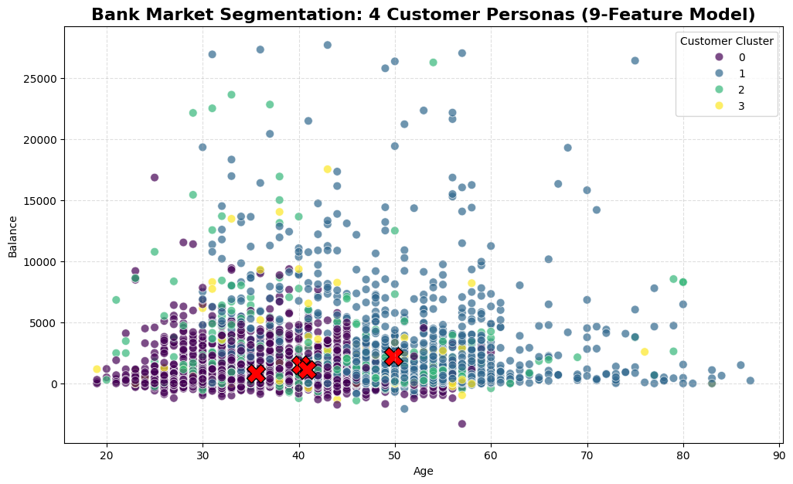
Bonus 2: K-Means Customer Segmentation
K-Means Clustering (k=4) applied to 9 demographic and behavioural features.
Identified four distinct customer personas with significantly different subscription rates.
Key differentiator for Cluster 2 (Primary Target): last contacted 272 days ago — prior engagement history is the strongest behavioural signal
Key warning for Cluster 3: 12.8 average campaign contacts — highest fatigue of any segment
Cluster | Strategy | Avg. Age | Median Balance | Top Job | Success Rate
0 | ✅ Secondary Target | 35 (30-45) | $340 | Blue-Collar | 10.1%
1 | ✅ Secondary Target | 50 (46-60) | $693 | Management | 11.8%
2 | ⭐ Primary Target | 38 (30-45) | $510 | Blue-Collar | 19.6%
3 | ❌ Cease Contact | 39 (30-45) | $340 | Management | 3.0%
Notes:
K-Means clustering was applied to the prepared df_model using 9 features: age_group, education, log_balance, log_duration, campaign, pdays, previous, day, and month. Features were standardised using StandardScaler before clustering. The resulting four clusters were synced back to df_prep to enable interpretation using the original readable attribute values.
Cluster 2 is the most actionable finding from this analysis. These are Early Mid-Age (30–45) Blue-Collar customers who were contacted approximately 9 months ago (272 days). Their 19.6% conversion rate is nearly double the dataset average and nearly 7× the rate of Cluster 3. The common factor is prior engagement — they have been in the bank's pipeline before and have not yet converted, making them warm leads rather than cold contacts.
Cluster 3 is the most important negative finding. At 12.8 average contacts and a 3.0% conversion rate, these customers are the definition of campaign fatigue. Every additional call to this segment costs agent time and risks brand damage. They should be automatically flagged in the CRM and excluded from active campaign lists for at least two campaign cycles.
The radar chart (9-dimension customer DNA) visualises all four clusters across the full feature space simultaneously, confirming that Cluster 2's differentiating characteristic is its pdays value (prior contact recency) and that Cluster 3 is uniquely high on campaign (contact frequency).

Slide 31
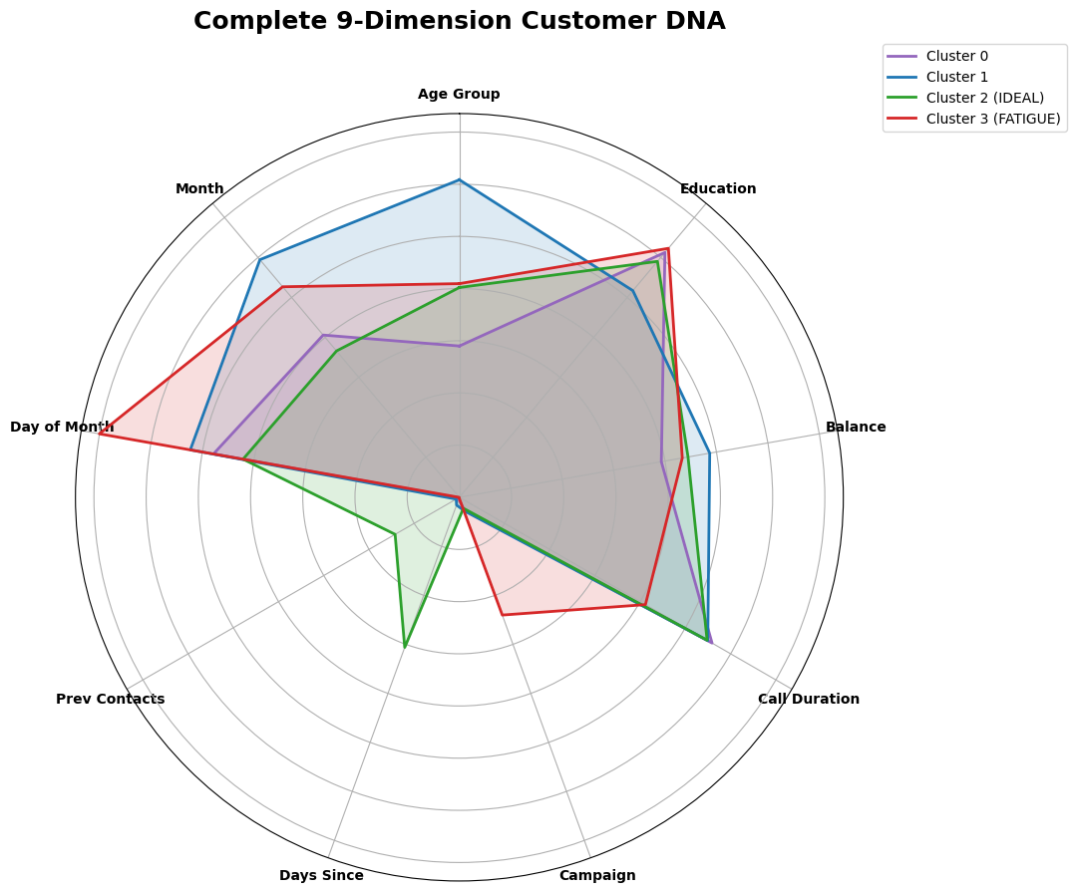
Bonus 2: K-Means Customer Segmentation
Notes:
The radar chart (9-dimension customer DNA) visualises all four clusters across the full feature space simultaneously, confirming that Cluster 2's differentiating characteristic is its pdays value (prior contact recency) and that Cluster 3 is uniquely high on campaign (contact frequency).

Slide 32

Recommendation (cont’d)
Notes:
The K-Means cluster analysis (Bonus 2) identified four distinct customer personas from the data:
Target secondary segments strategically based on cluster profiles.
Cluster 0 customers (Blue-Collar, avg. age 35, 10.1% success rate) represent the largest volume group and long-term pipeline potential. Maintain low-cost automated engagement.
Cluster 1 customers (Management, avg. age 50, 11.8% success rate) represent the most financially stable segment with the highest median balances ($693) and lower housing debt (43.4%) — ideal for "wealth preservation" deposit messaging.
Cluster 2 is the "Gold Mine" — despite being Blue-Collar workers with moderate balances, they have a prior engagement history (272 days since last contact) and convert at 19.6%, nearly double the overall rate. Prior contact is the key differentiator for this cluster.
Cluster 3 is the inverse — these are over-contacted customers who have tuned out. Their 3.0% conversion rate combined with 12.8 average contacts represents a negative ROI per call and should trigger an automatic exclusion rule in the bank's CRM system.
Recommendations based on the bonus K-means Clustering Analysis:
Prioritise Cluster 2 customers as the primary contact list.
K-Means clustering identified Cluster 2 — Early Mid-Age (avg. 38), Blue-Collar, with a prior contact 272 days ago — as the highest-conversion segment at 19.6% subscription rate. These customers have demonstrated prior engagement and should be exhausted before any cold outreach begins.
Cease contact with Cluster 3 customers immediately.
Cluster 3 customers have received an average of 12.8 campaign contacts and convert at only 3.0%. Continued outreach is actively damaging brand perception. A 6–12 month cooling-off period is recommended before any re-engagement.
Segment outreach lists by cluster before dialling.
Prioritise Cluster 2 → Cluster 1 → Cluster 0 in that order. Exclude Cluster 3 from active campaigns entirely.

Slide 33
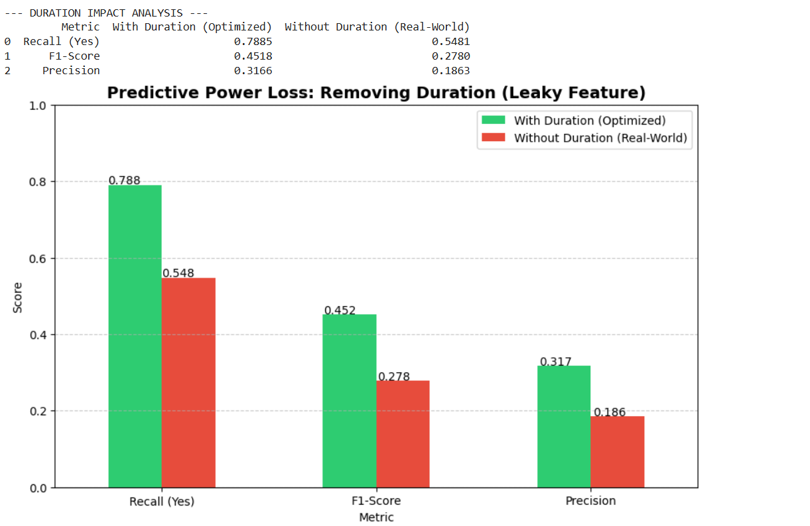
Bonus: Real World Model
Notes:
"To close out my section, we performed a stress test on our results. As you saw earlier, log_duration was our most powerful predictor, but in the world of telemarketing, duration is what we call a 'leaky feature.' You don't know how long a call will last until the call is already over, which makes it less useful for pre-call targeting."
"We ran a shadow model completely excluding duration to see if our other features could hold the line. While our Recall dropped from 79% to 55% and our F1-Score took a hit, a 55% Recall is still significantly better than random guessing. This confirms that our other 'Golden Ticket' features—like prior campaign success and contact method—provide a solid, non-leaky foundation for the bank to build on, even when we remove the most dominant variable."
“While Precision dropped, catching 55% of subscribers (Recall) without knowing the call length is still a massive operational win for a cold-calling campaign.”

Slide 34
Workload Distribution
Member Name | List of Tasks Performed
Carman Fan | Data Preparation. Milestone and Report Authoring.
Carlos Elizondo | Predictive Modelling. Milestone and Report Authoring.
Thanos Paschalis | Statistical Analysis. Milestone and Report Authoring.

