Slide 1
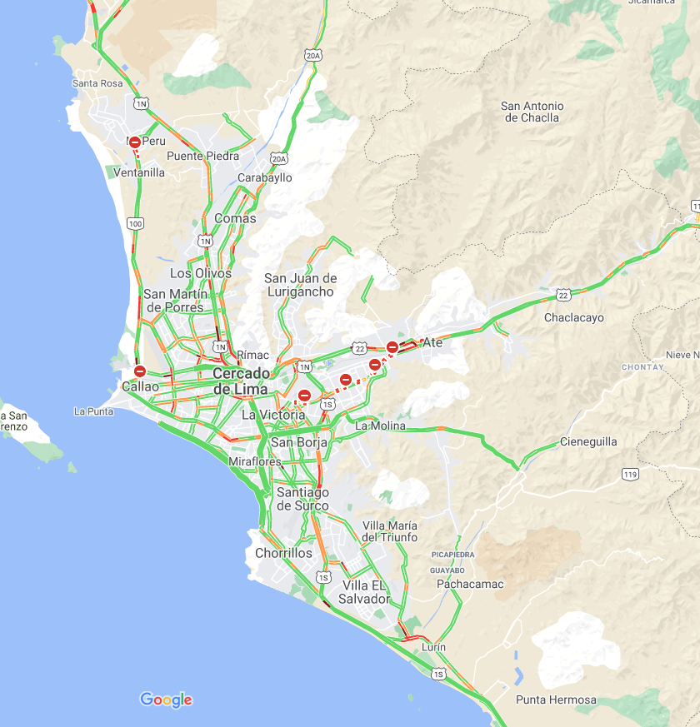
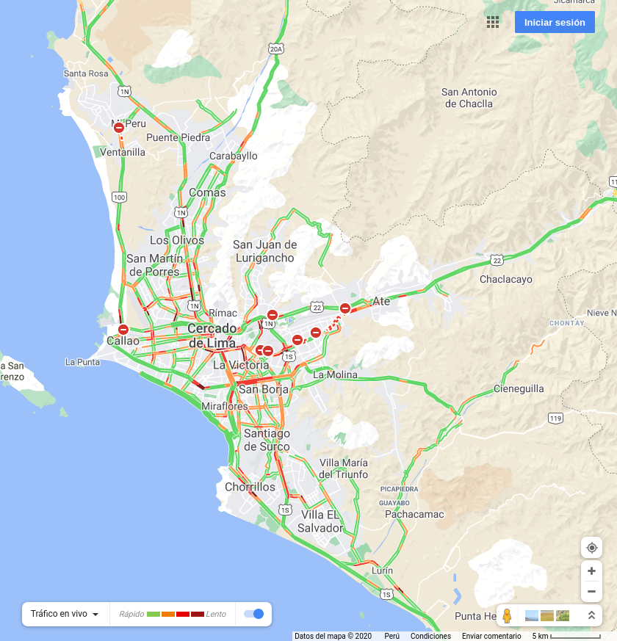

2020-12-16 07:00:00
2020-12-16 12:00:00
2020-12-16 19:00:00

Slide 2


2020-12-17 07:00:00
2020-12-17 12:00:00

