Slide 1
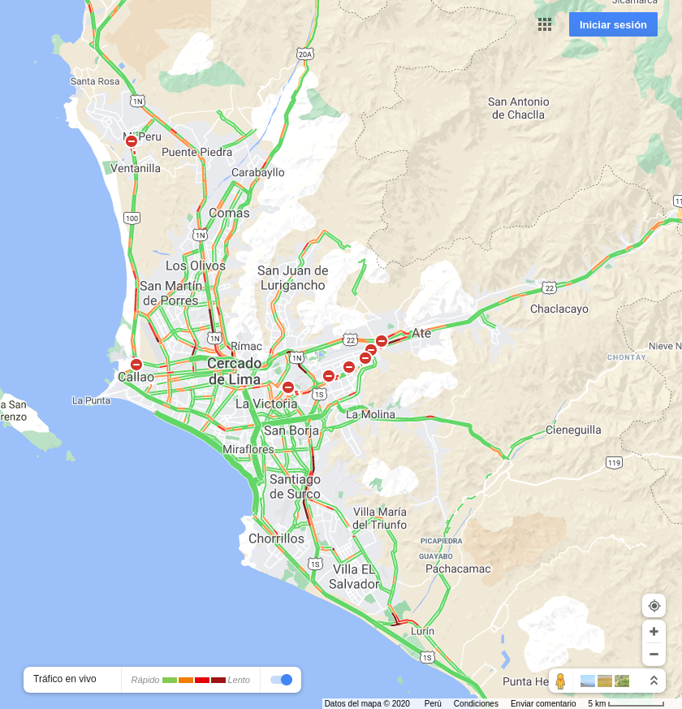

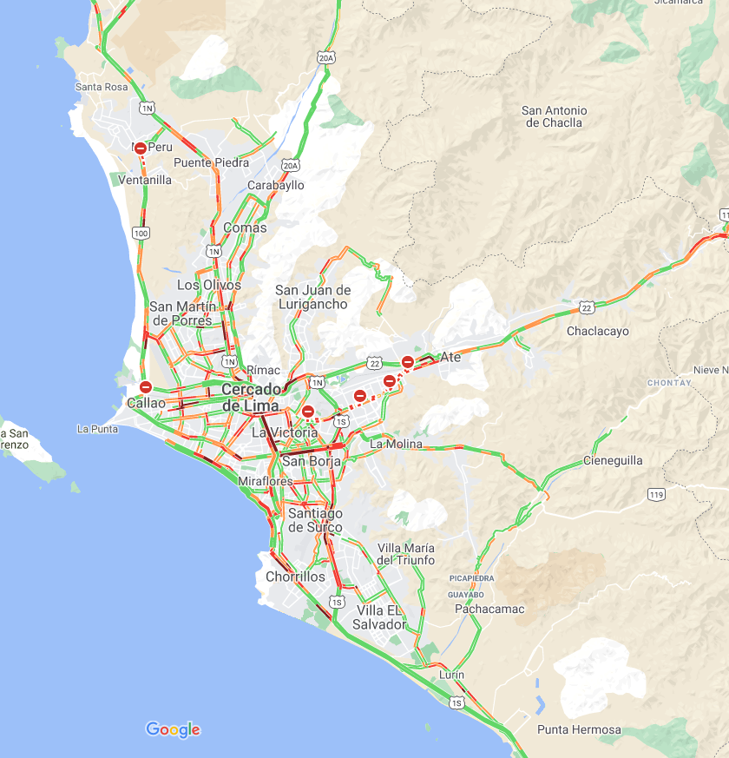
2020-12-17 07:00:00
2020-12-17 12:00:00
2020-12-17 19:00:00

Slide 2
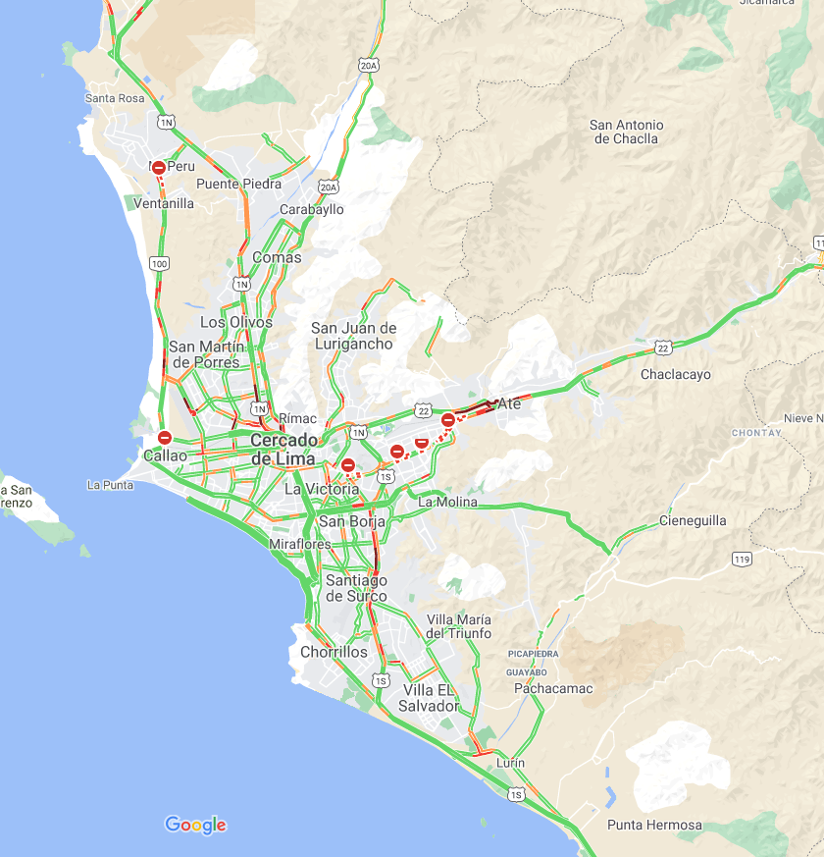

2020-12-18 07:00:00
2020-12-18 12:00:00

