Slide 1
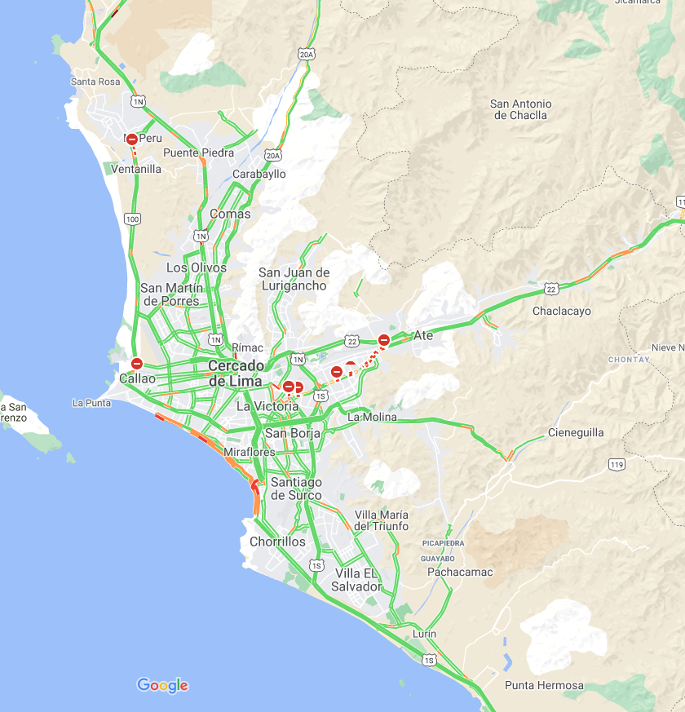
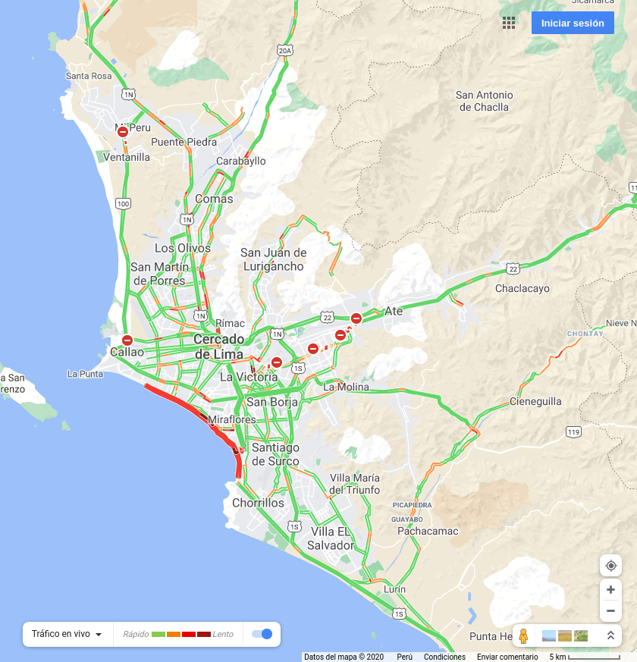

2020-12-27 07:00:00
2020-12-27 12:00:00
2020-12-27 19:00:00

Slide 2


2020-12-28 07:00:00
2020-12-28 12:00:00

