Slide 1
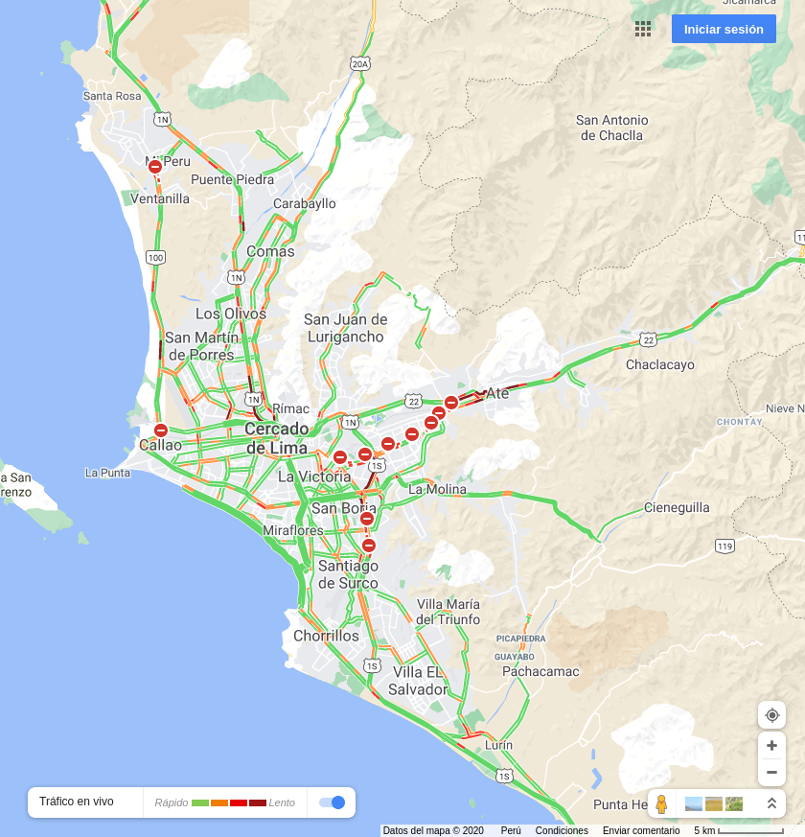


2020-12-15 07:00:00
2020-12-15 12:00:00
2020-12-15 19:00:00

Slide 2
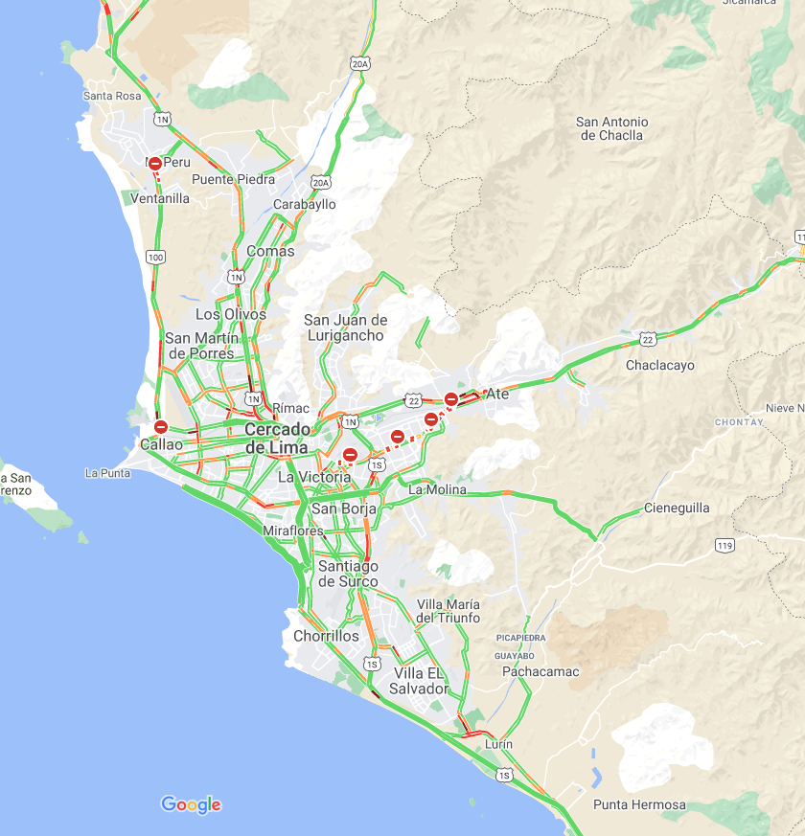

2020-12-16 07:00:00
2020-12-16 12:00:00

