Slide 1
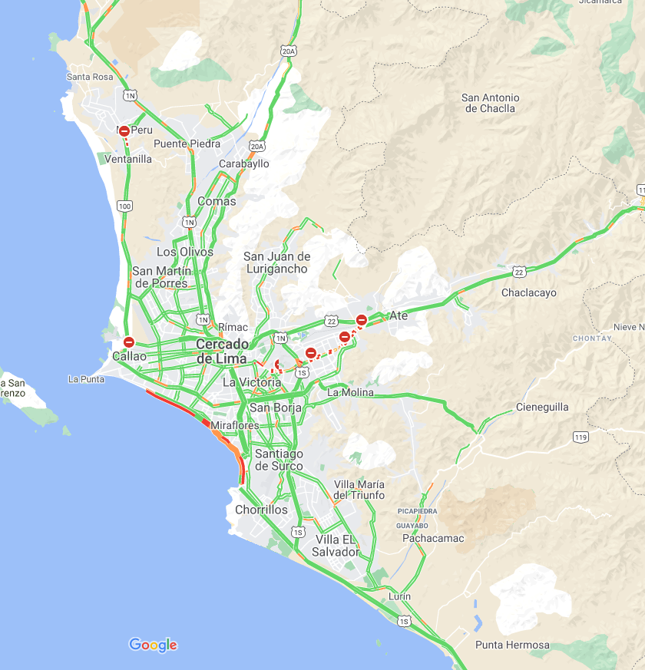
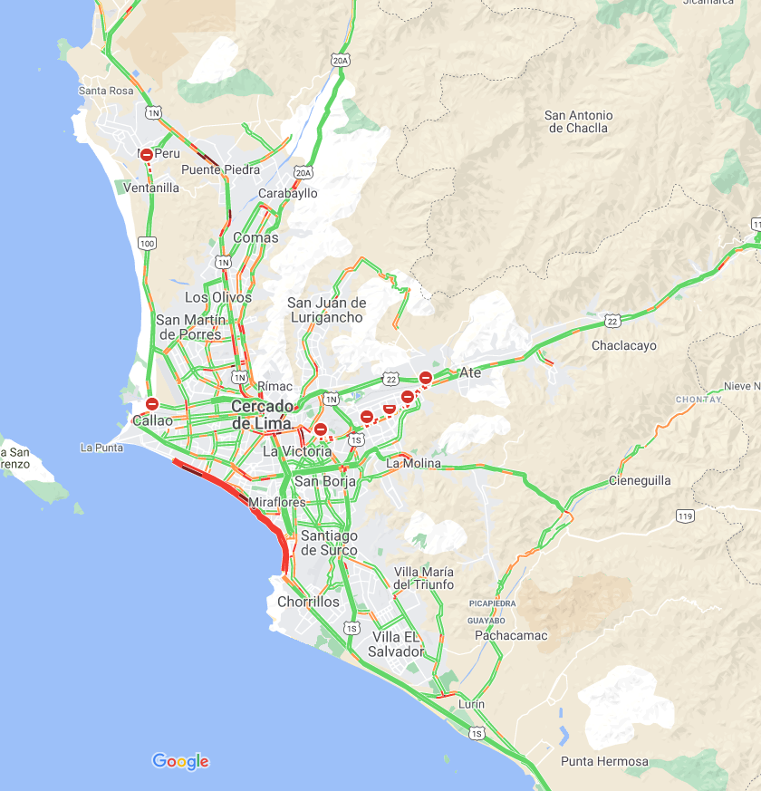
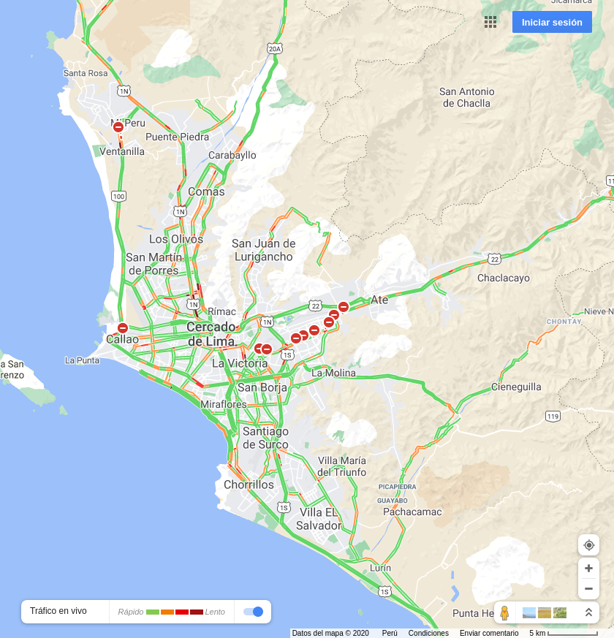
2020-12-20 07:00:00
2020-12-20 12:00:00
2020-12-20 19:00:00

Slide 2

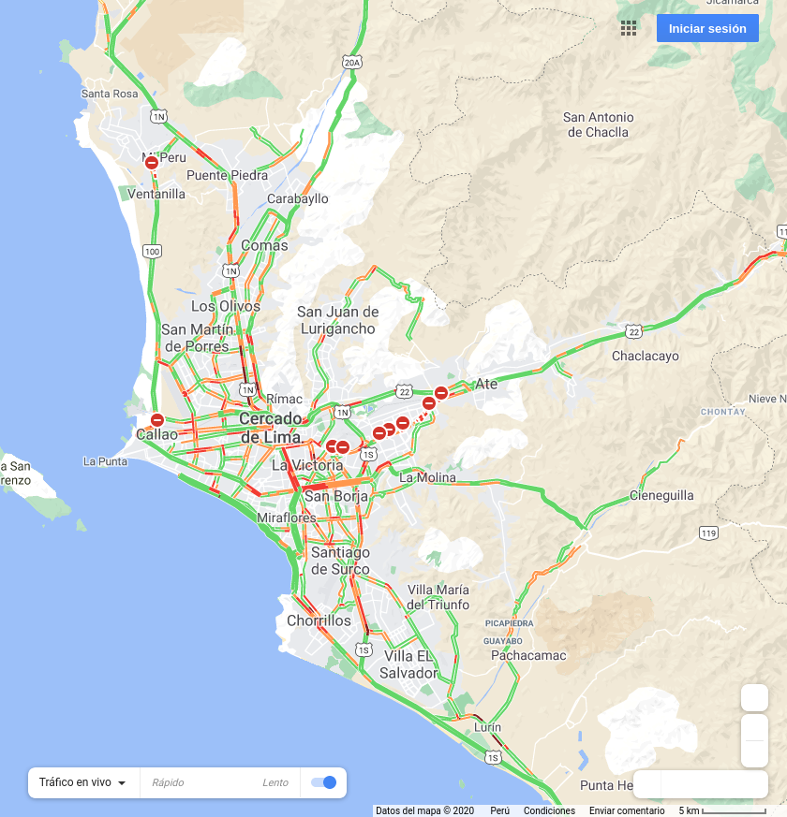
2020-12-21 07:00:00
2020-12-21 12:00:00

