Slide 1
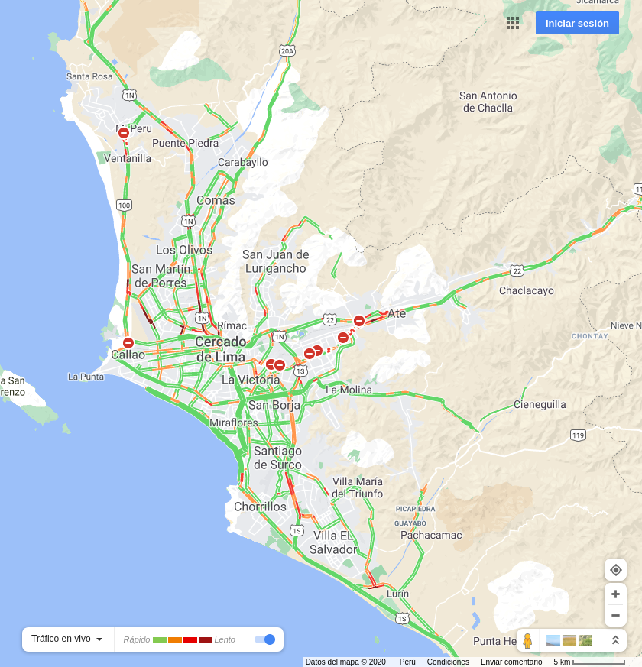


2020-12-22 07:00:00
2020-12-22 12:00:00
2020-12-22 19:00:00

Slide 2


2020-12-23 07:00:00
2020-12-24 07:00:00

