Slide 1
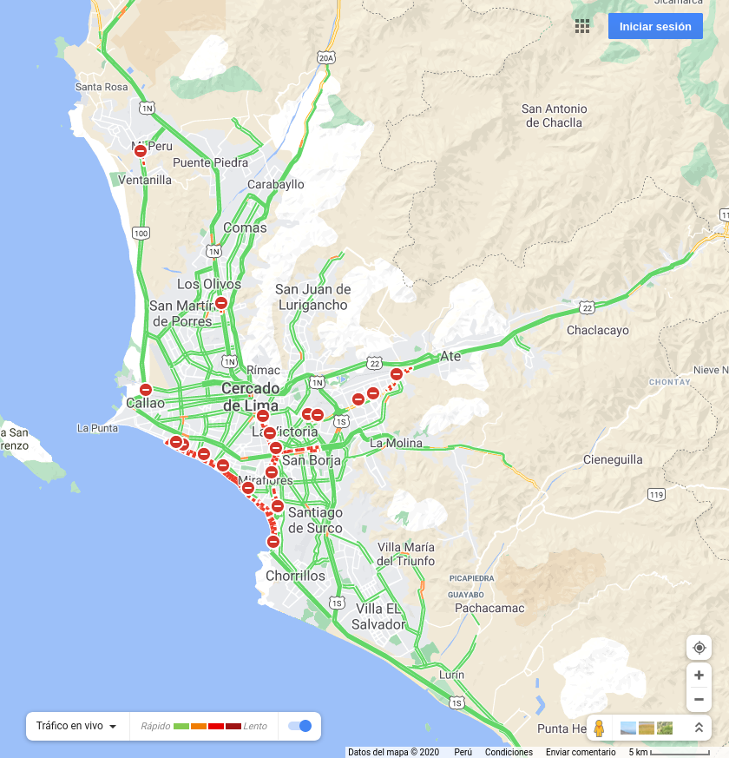
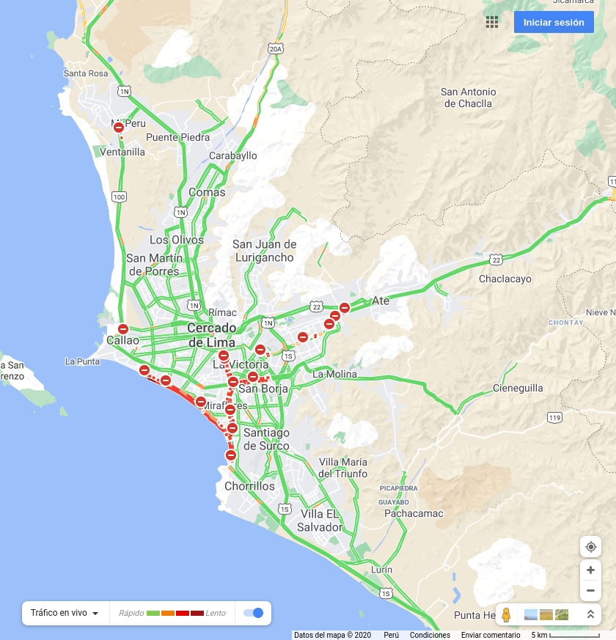

2020-12-25 07:00:00
2020-12-25 12:00:00
2020-12-25 19:00:00

Slide 2
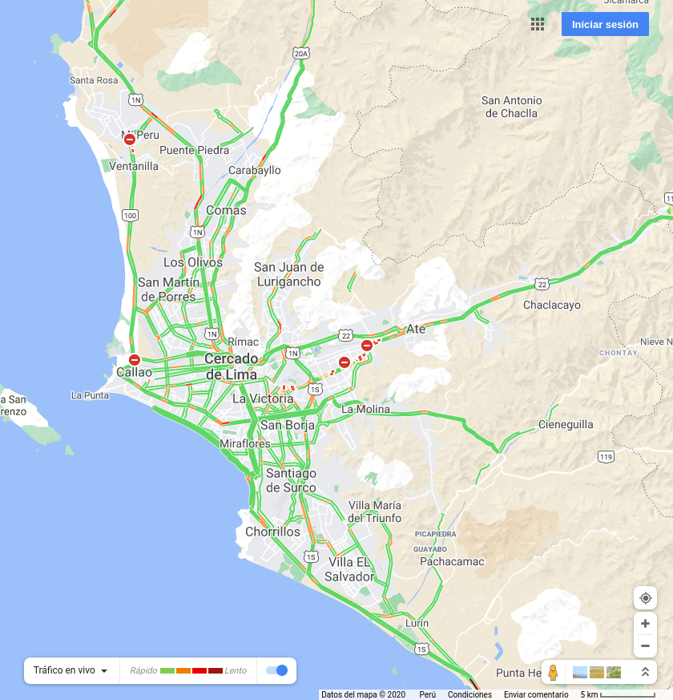
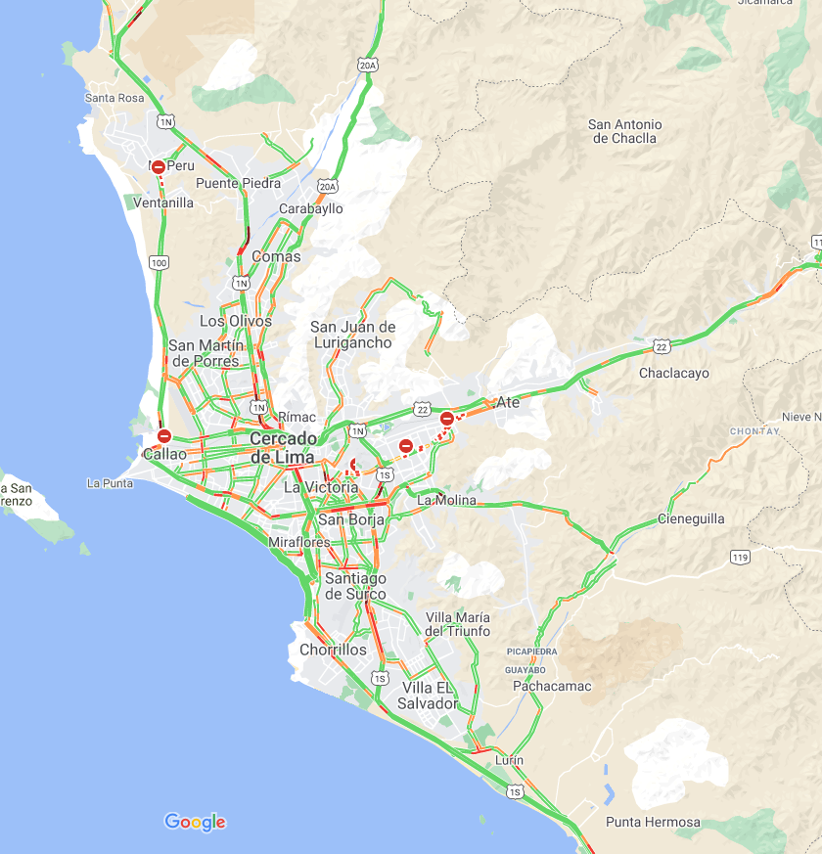
2020-12-26 07:00:00
2020-12-26 12:00:00

