Slide 1
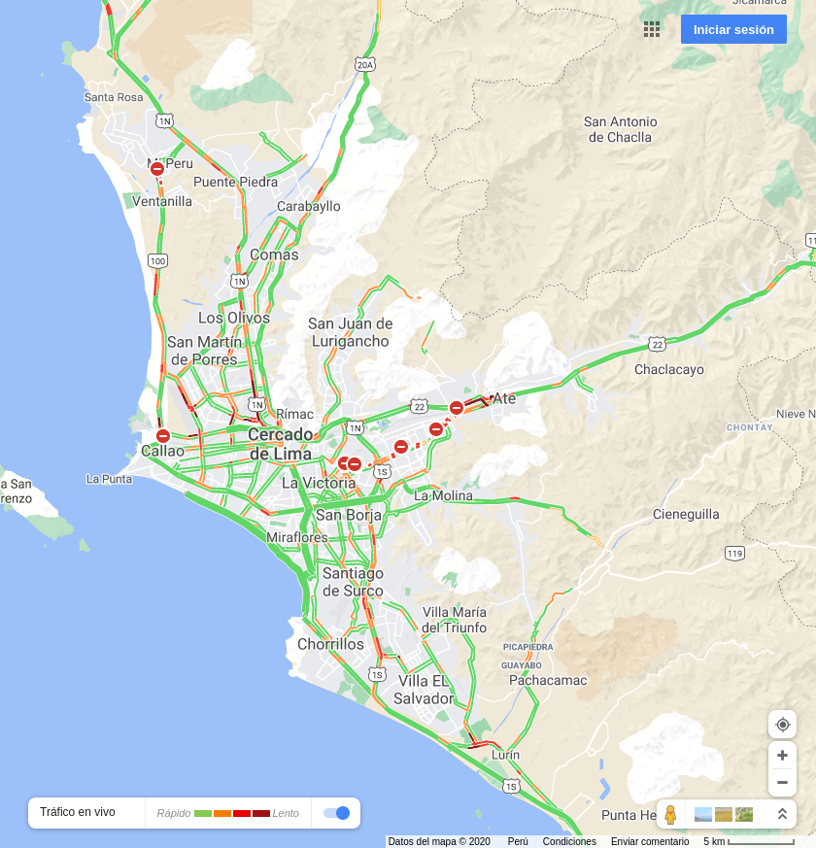

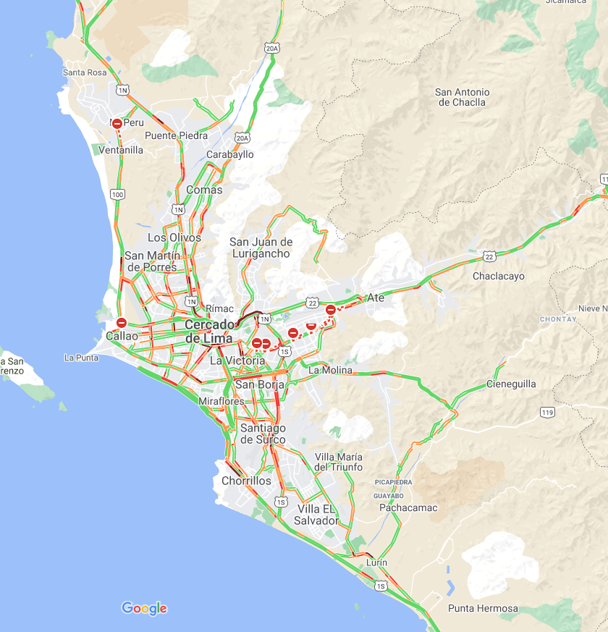
2020-12-14 07:00:00
2020-12-14 12:00:00
2020-12-14 19:00:00

Slide 2


2020-12-15 07:00:00
2020-12-15 12:00:00

