Slide 1
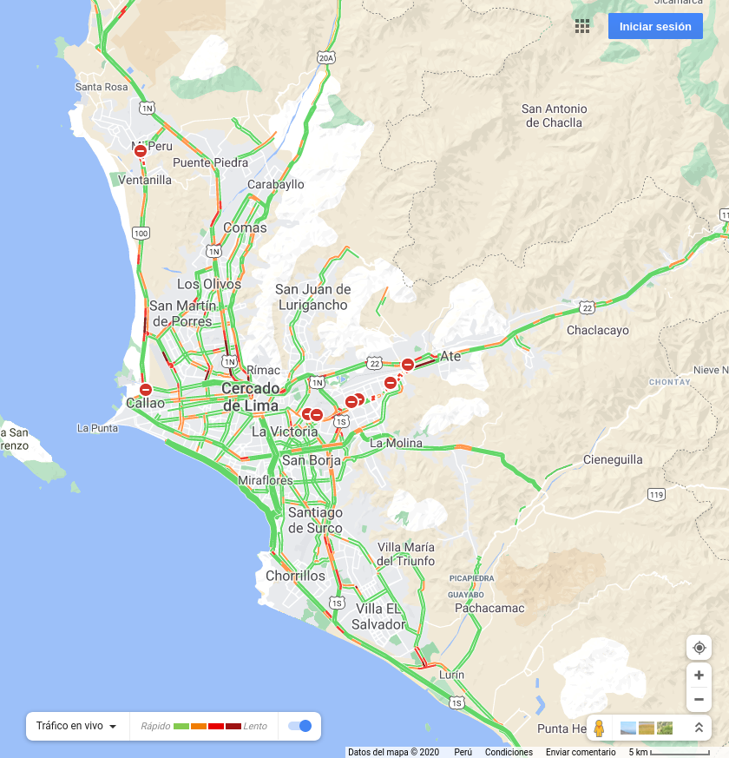
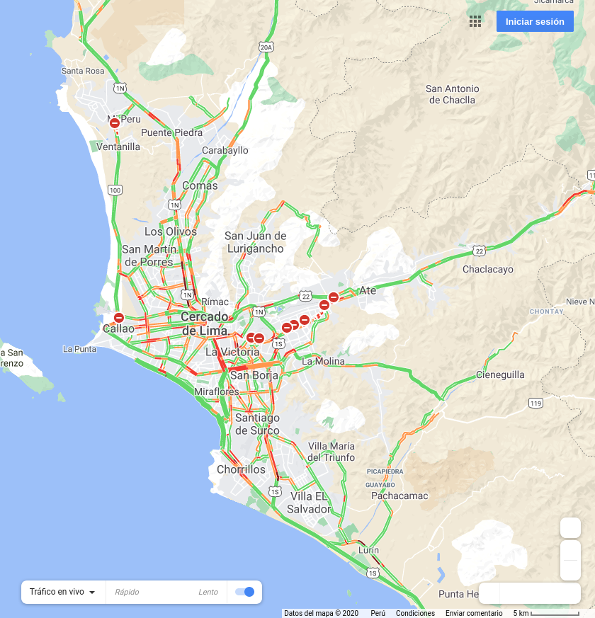

2020-12-21 07:00:00
2020-12-21 12:00:00
2020-12-21 19:00:00

Slide 2


2020-12-22 07:00:00
2020-12-22 12:00:00

