Slide 1
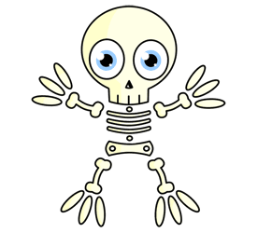
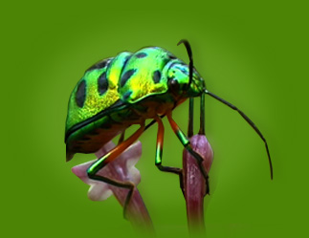
Classifying Animals
Vertebrates
Invertebrates
Animals with a Backbone or Spinal Column
Most animals at the zoo are vertebrates.
There are 5 main groups!
Animals without a Backbone or Spinal Column
There are more invertebrates on earth than vertebrate on Earth! 98% of animals on earth are invertebrates.

Slide 2
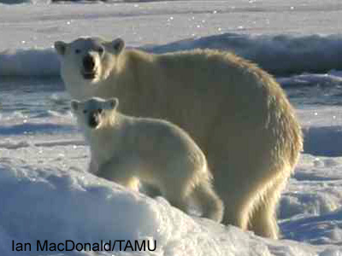
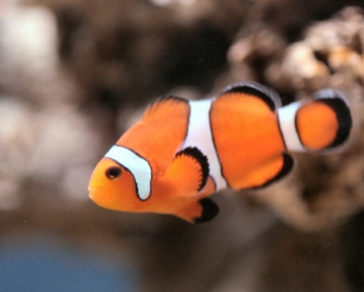
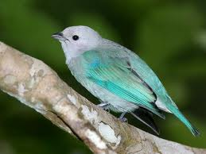
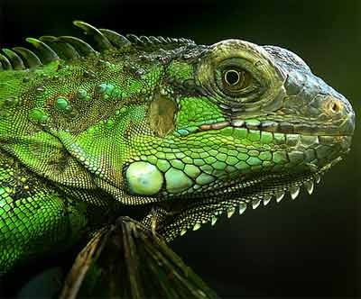
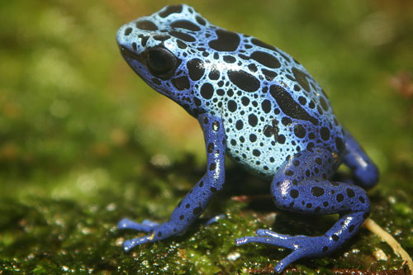
Vertebrates
Mammals
Fish
Birds
Reptiles
Amphibians
Classifying Animal

Slide 3
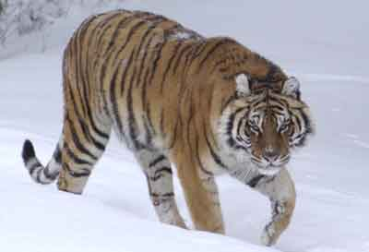
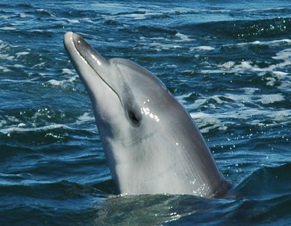
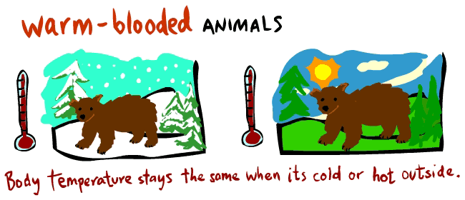
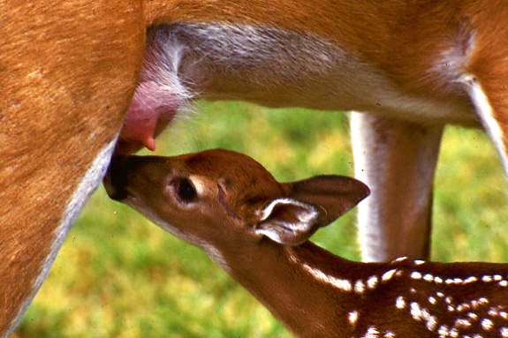
Mammals https://www.youtube.com/watch?v=FMfziR-VTPc http://www.neok12.com/video/Mammals/zX6d6165767b617e5b075273.htm
Have hair or fur
Give birth to live young
Mammal mothers nurse their young milk
Have lungs and need air to breathe
Are warm blooded
Fast and smart
Are vertebrates
Classifying Animal

Slide 4
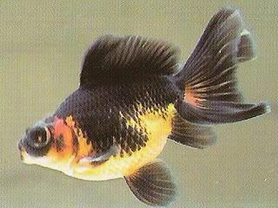
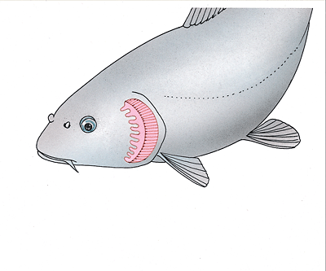
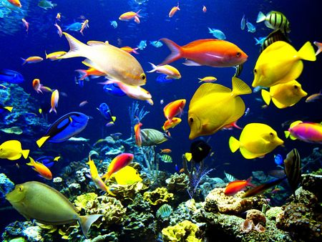
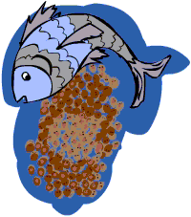
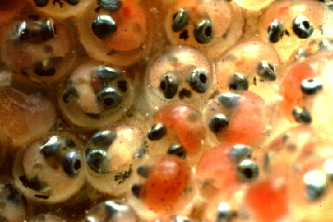
Fish
Breathe underwater using gills.
Have scales and fins that help them move underwater.
Are cold blooded.
Lay eggs to their babies.
Not all living things that live underwater are fish!
Have scales
Are vertebrates
Classifying Animal

Slide 5
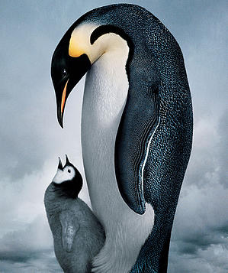
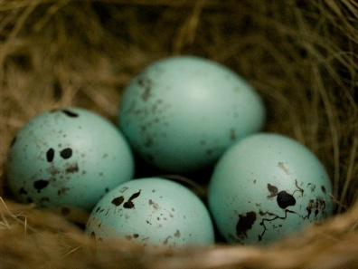
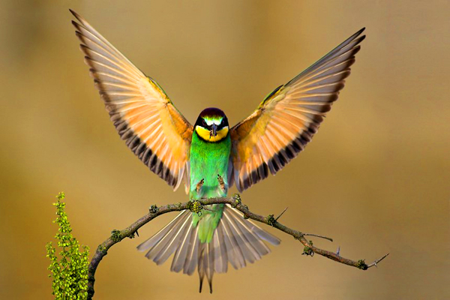
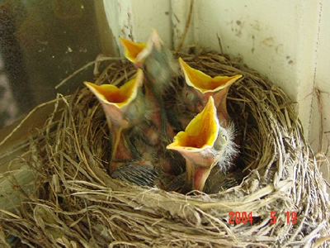
Birds https://www.youtube.com/watch?v=8vL_2rF8JHU
Have feathers, two wings, four limbs, and a beak.
Breathe using their lungs.
Lay eggs.
Are warm blooded.
Most birds fly!
Are vertebrates
Classifying Animal

Slide 6
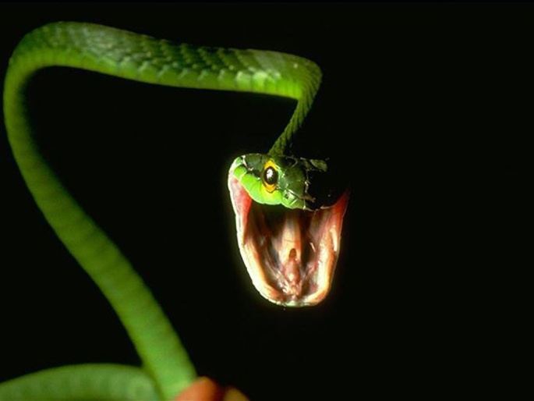
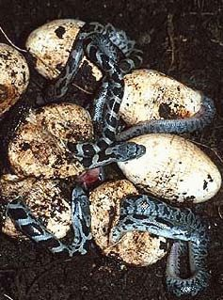
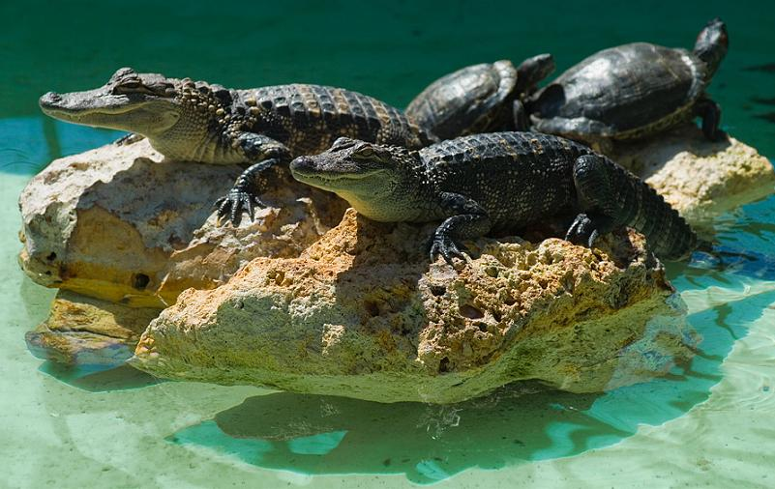
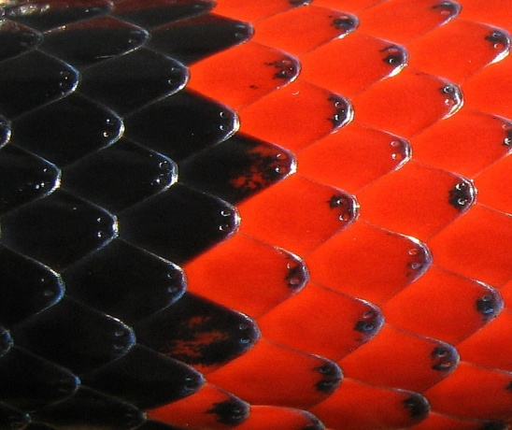
Reptiles
Have scales to cover body
Have lungs
Lay eggs on land
Are cold blooded
Use the sun to keep warm
Do not have ears
Are vertebrates
Most hibernate
Live on land and water
Most live in warm places
Some can be venomous

Slide 7
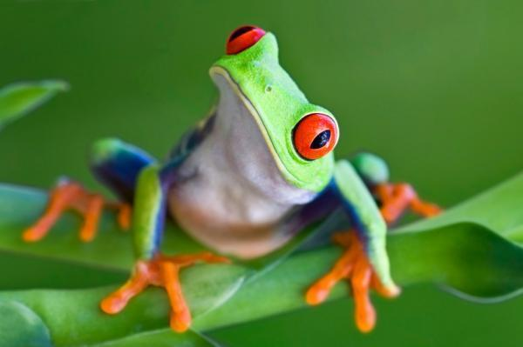
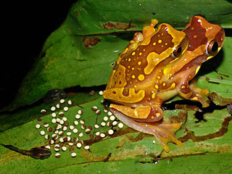
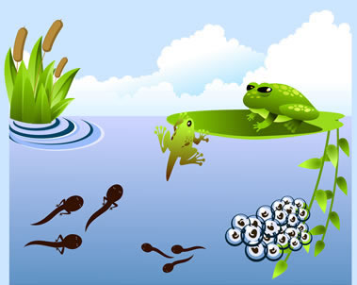
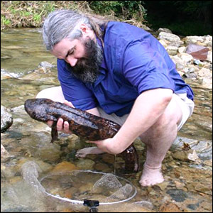
Amphibians
Live in land and water
Many undergo metamorphosis – start living underwater and using gills, and develop lungs to live in land
Are cold-blooded
Use the sun to keep warm
Lay eggs in water
Have moist skin
Have webbed feet
Breath through the skin
Are vertebrates
Amphibians mean double life
Camouflage
Some can be poisonous

Slide 8
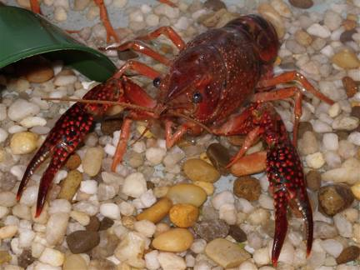
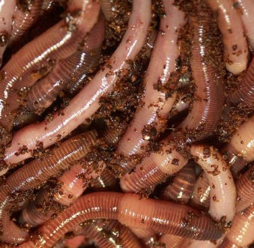
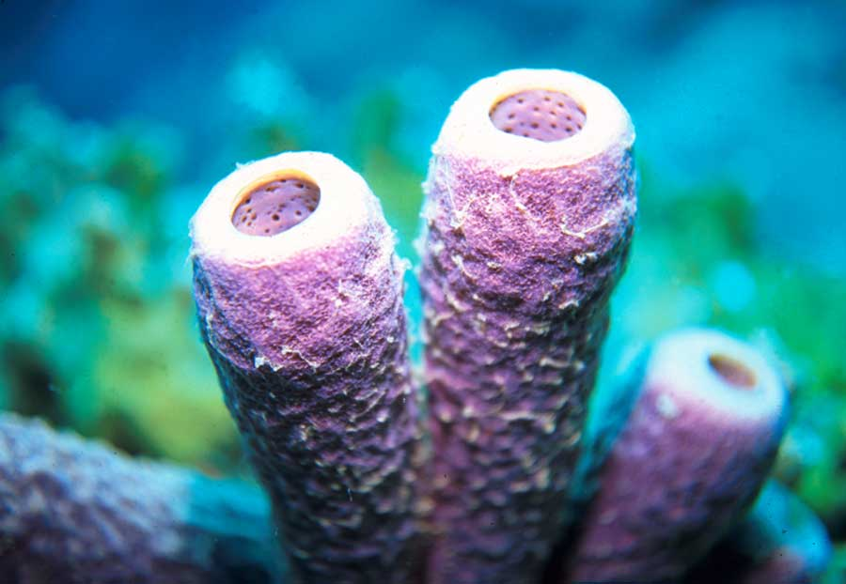
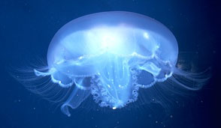
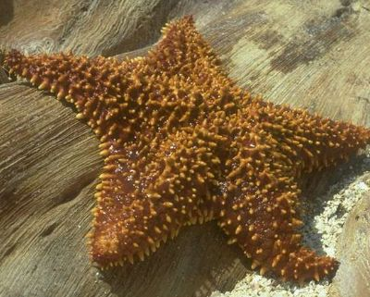
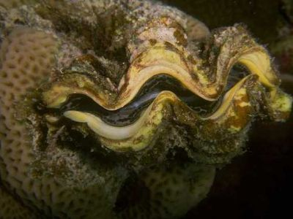
Invertebrates
Arthropods
Worms
Sponges
Coelenterates
Echinoderms
Mollusks
Classifying Animal

Slide 9
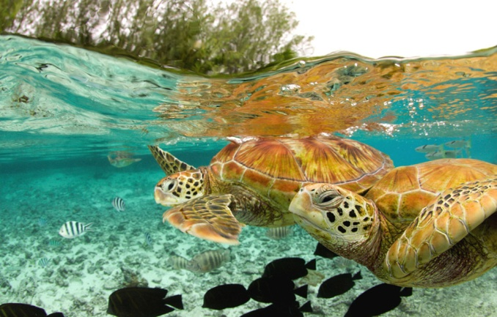
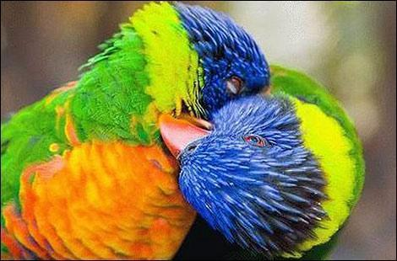

Activity
Create your own animal!
Write a “Fact Sheet” about your animal (5 characteristics).
Draw a picture.
Write a story about your animal.

