Slide 1
Deep Neural Networks and Applications with Tensorflow STEEL DEFECT DETECTION
Team Members
Divya Sankar
Sonali Shintre
Carlos Tavarez
Deepak Kumar

Slide 2
OUTLINE
In this project, we will classify and detect defects on a steel surfaces.
Defect Classification
Binary Classification – 0 – No defects, 1 - Defect
Multi-class classification – From the images with defects, we will do a multi class classification with the number of defects in each image.
Defect Detection
Using u-net to do defect detection through segmentation.

Slide 3
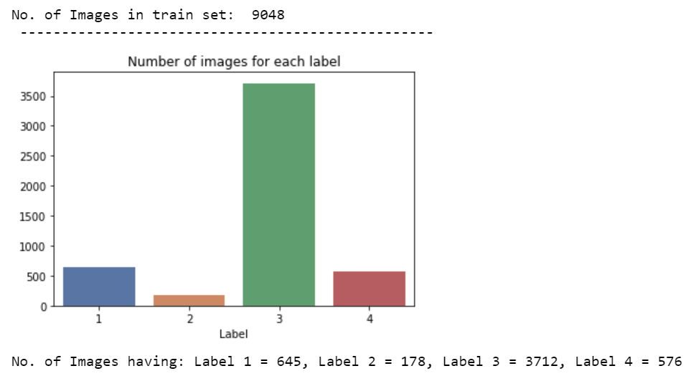
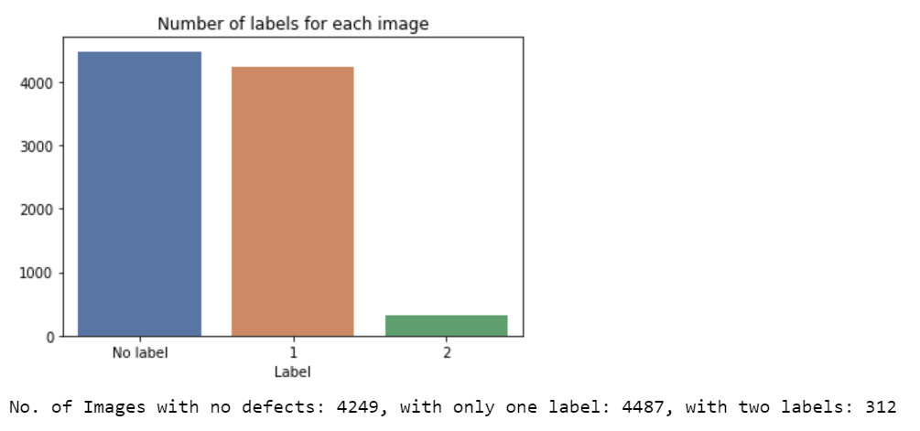
DATASET
Link to dataset - https://www.kaggle.com/c/severstal-steel-defect-detection/data
Dataset – 18076 images (~2GB)
Training images – 12569
Test images – 5507
Of the training 12569 images, only 7095 images have defects, rest have no defects.

Slide 4
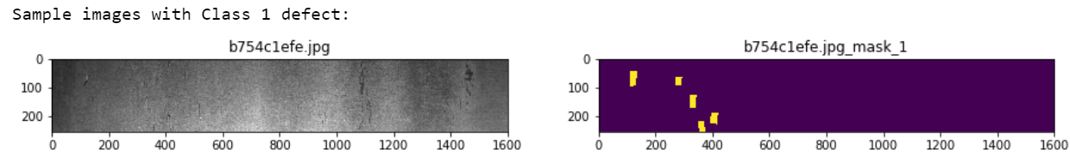
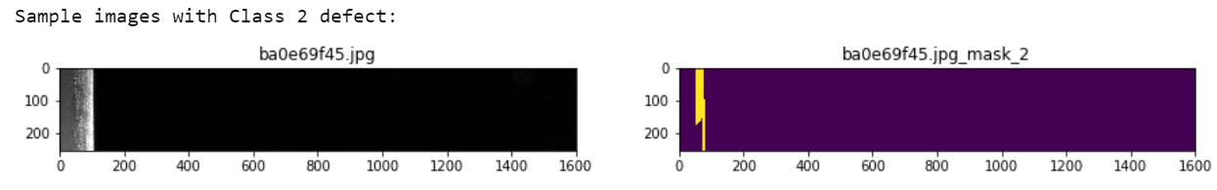
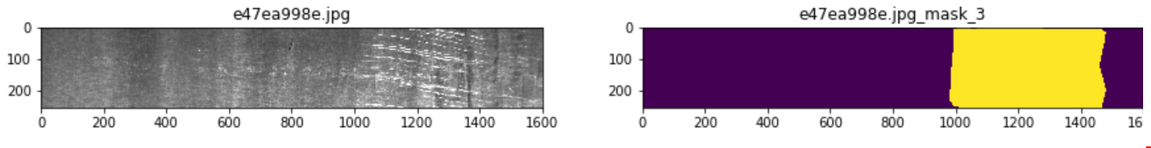
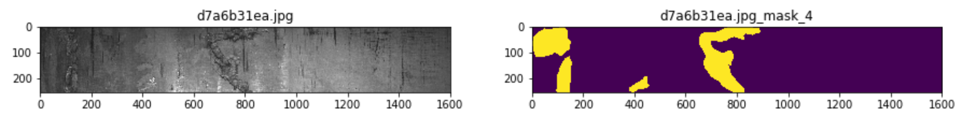
DATASET
Sample images with defects.
Visualized the segmentation maps for each defect using run length encoding.
These maps will be used as ground truth for training.

Slide 5
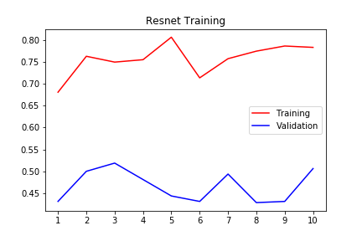
CLASSIFICATION
Binary Classifier
The classification is done in two stages
Binary classification
Multi Class Classification
Accuracy
epochs
It seems a small convolutional model learns to identify defects while a more complex model memorizes the images.

Slide 6
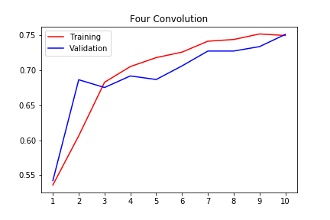
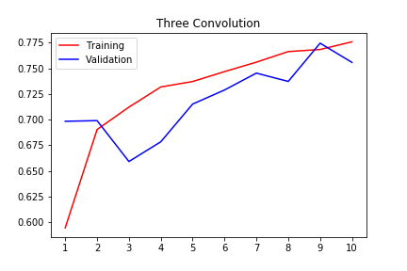
CLASSIFICATION
Accuracy
The classification is done in two stages
Binary classification
Multi Class Classification
Accuracy
epochs

Slide 7
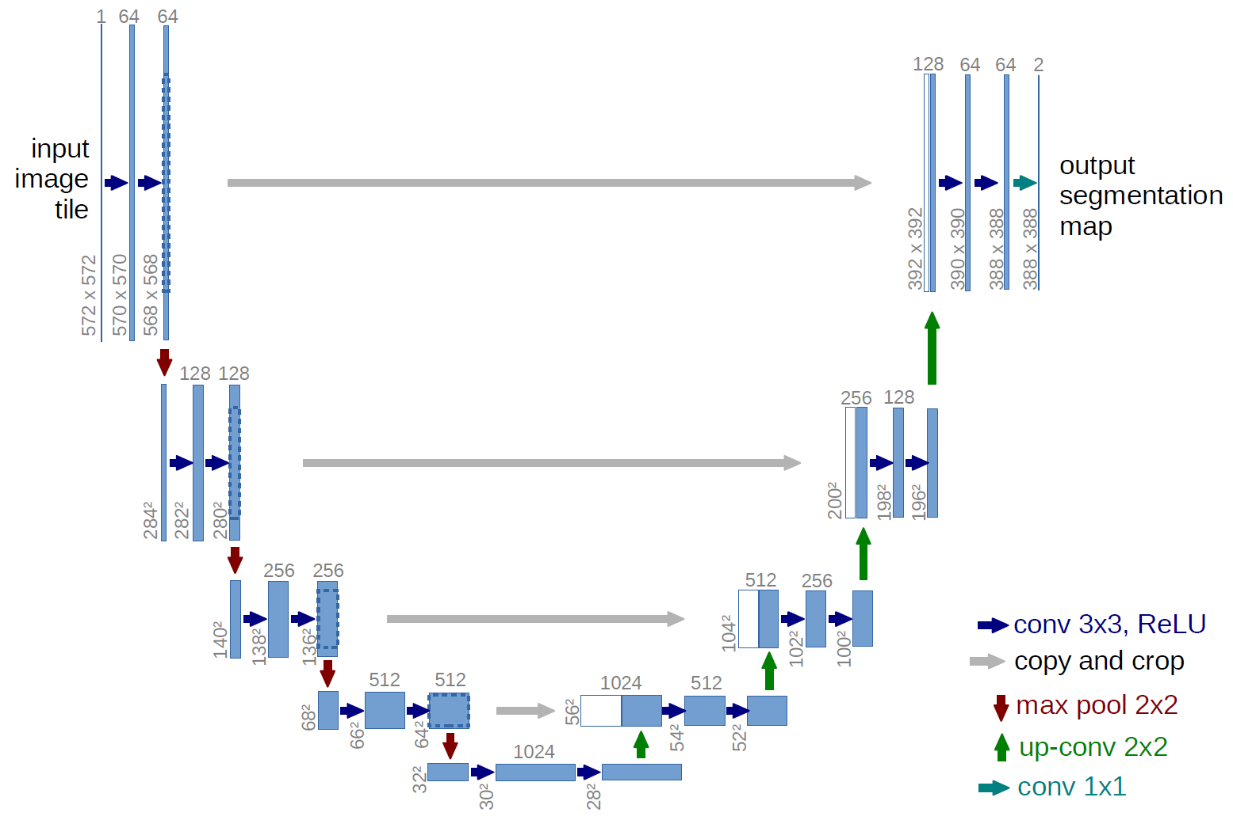
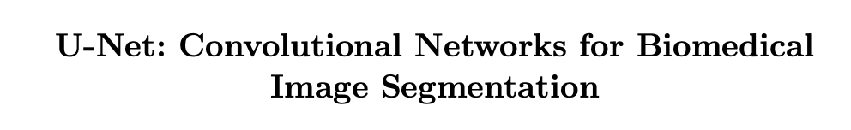
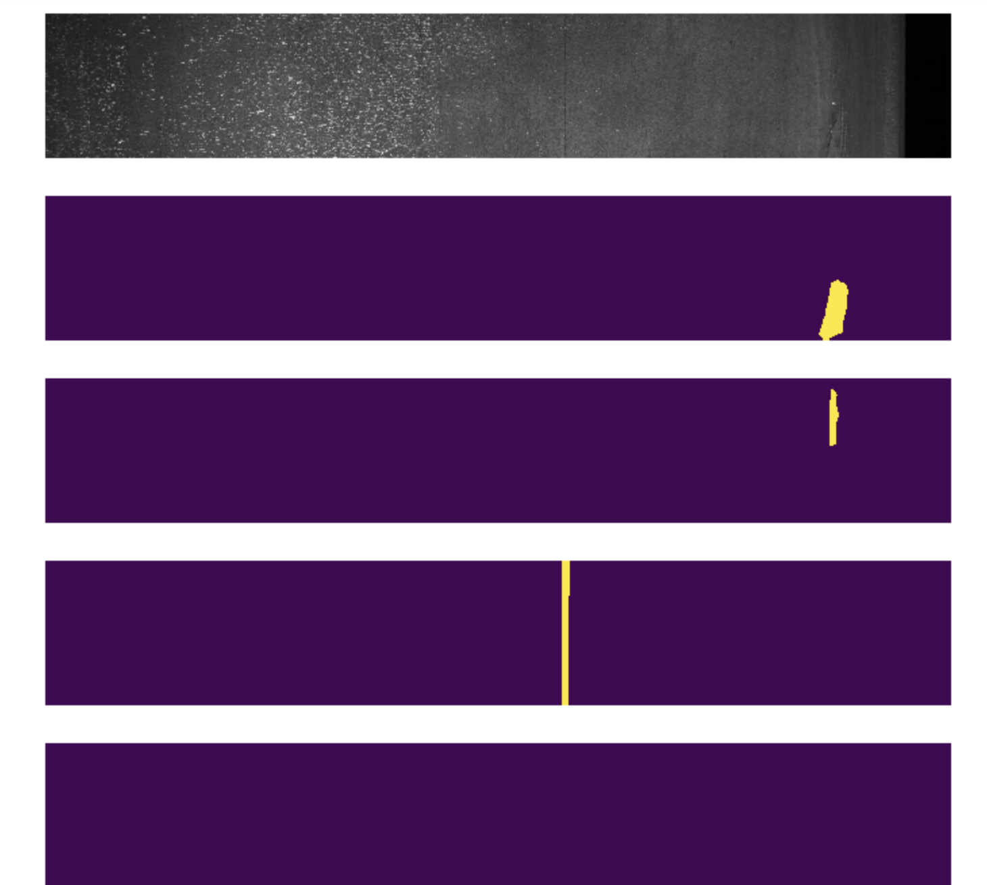
DEFECT DETECTION
U-net architecture
Doing defect detection through using u-net.
The u-net model produces segment maps of defect images of 4 classes.
Trained a u-net model with 23 convolutional layers and 5 dilated convolutional layers for 5 epochs.
Will super impose the defect images and color code them based on the defect class.
Reference
Segment map with the defects of different classes for a single image

Slide 8
REFERENCES
A Steel Surface Defect Recognition Algorithm Based on Improved Deep Learning Network Model Using Feature Visualization and Quality Evaluation
U-Net: Convolutional Networks for Biomedical Image Segmentation
Real-time Detection of Steel Strip Surface Defects Based on Improved YOLO Detection Network

