Slide 1
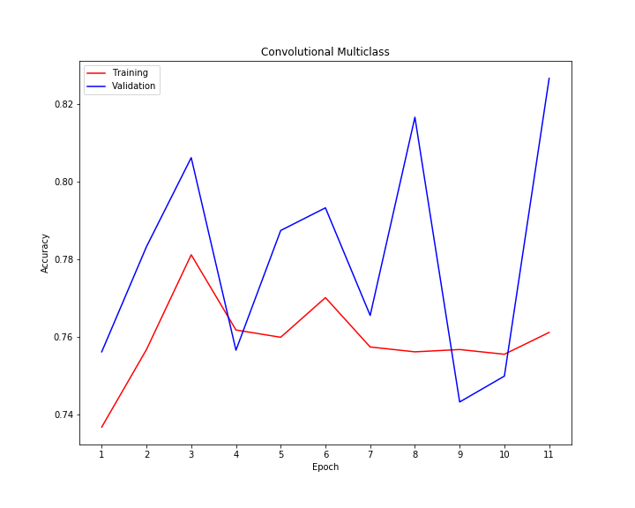
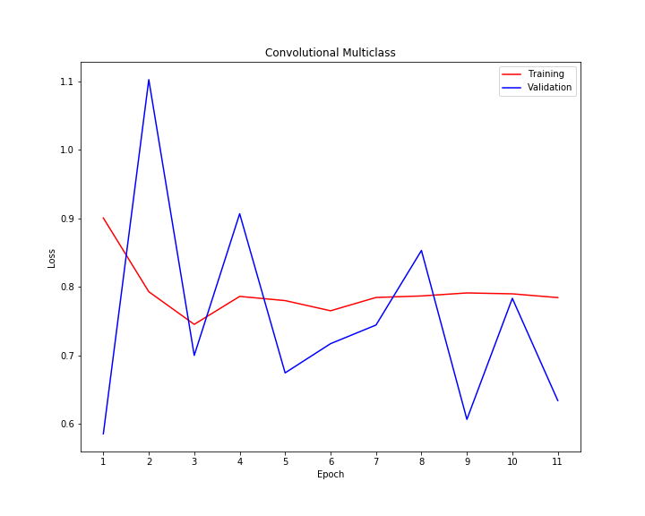
Multi-Class Classification of Unbalanced Defects
Train Accuracy: 0.76
Validation Accuracy: 0.78
Predicted
Predicted
How to deal with Unbalanced Image Dataset in less than 20 lines of code
0 | 0 | 630 | 0
0 | 0 | 157 | 0
0 | 0 | 3850 | 0
0 | 0 | 422 | 0
0 | 0 | 62 | 0
0 | 0 | 19 | 0
0 | 0 | 433 | 0
0 | 0 | 42 | 0
True
True
Sequence from Keras Utils
Balanced_batch_generator from imblean keras
RandomOverSampling from imblearn keras
Table 1. Confusion Matrix for training set.
Table 2. Confusion Matrix for validation set.
Source: https://medium.com/analytics-vidhya/how-to-apply-data-augmentation-to-deal-with-unbalanced-datasets-in-20-lines-of-code-ada8521320c9

Slide 2
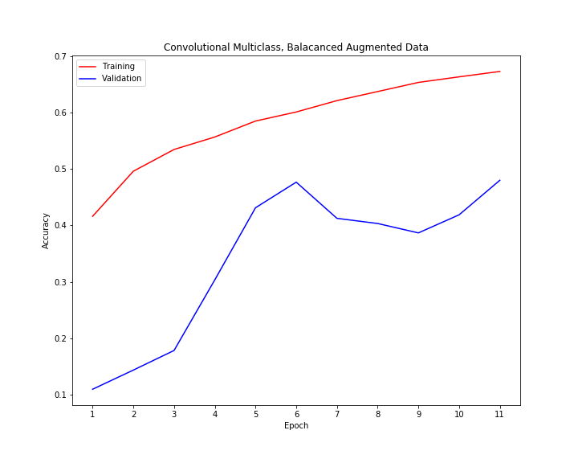
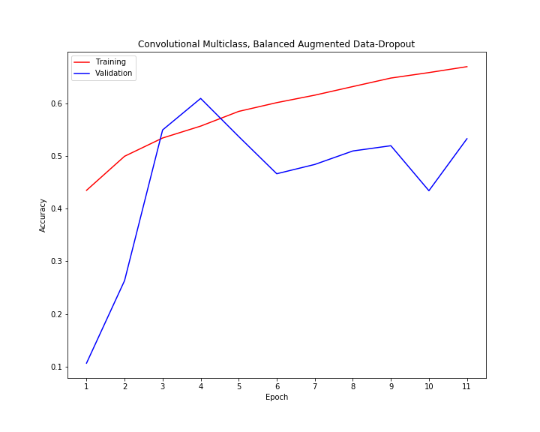
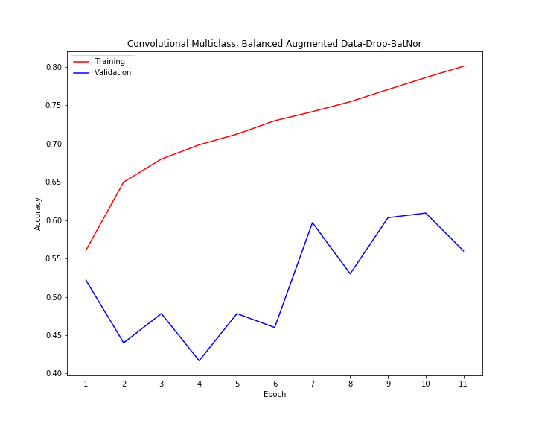
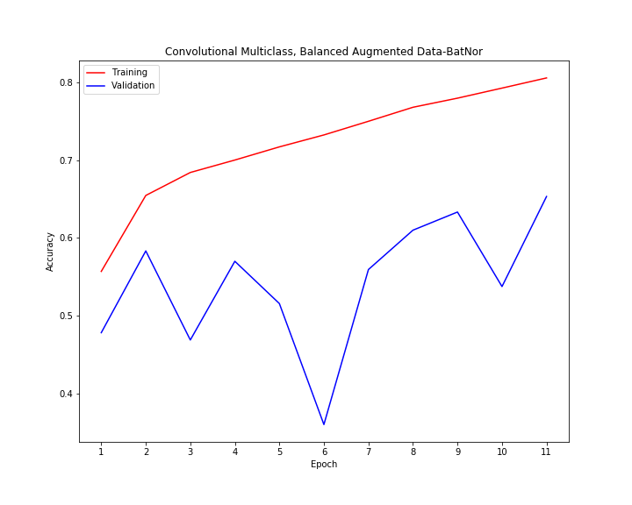
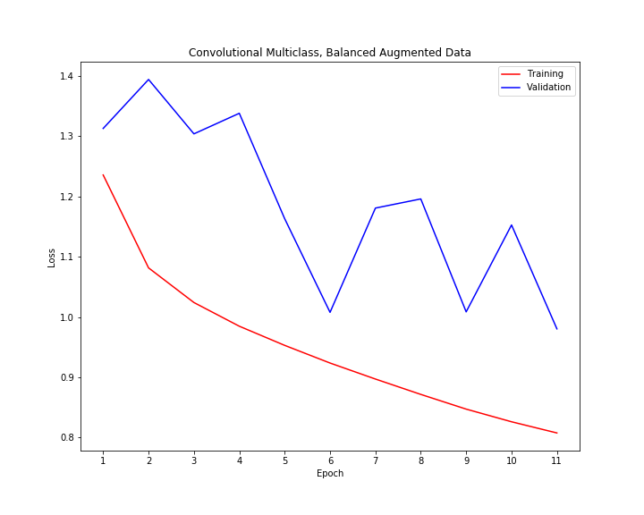
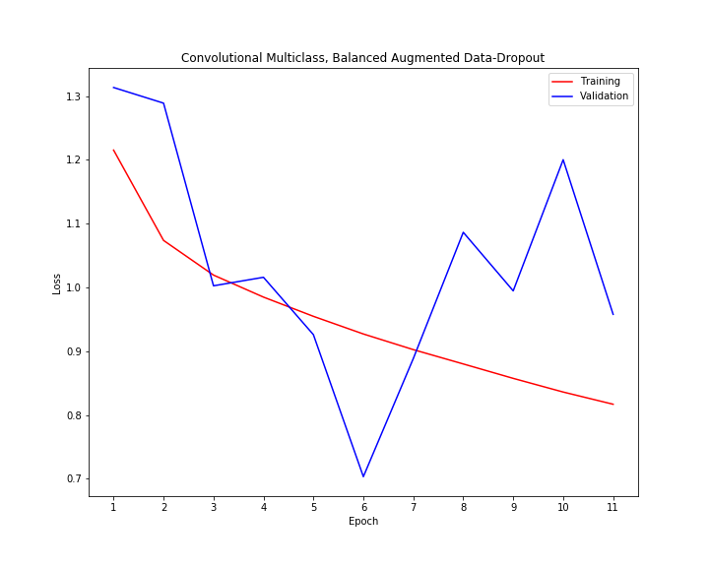
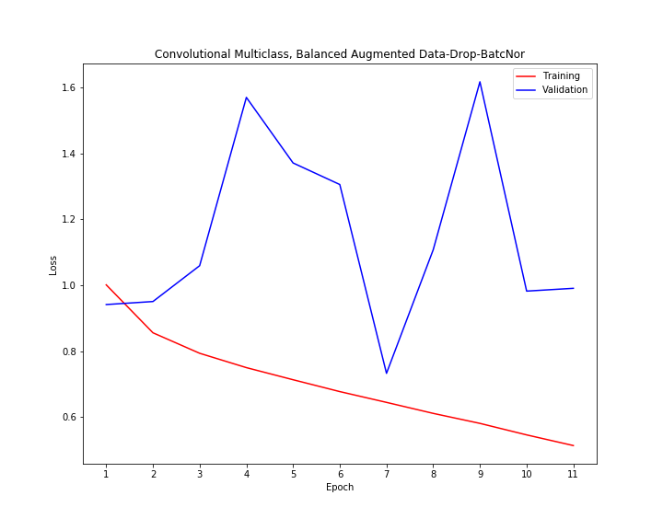
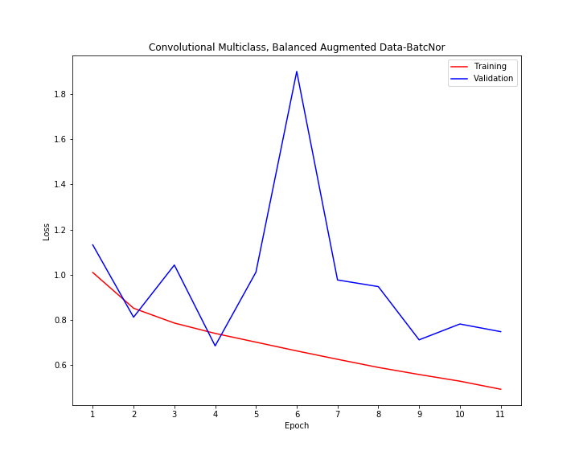
Multi-Class Classification of Balanced Defects
Train Accuracy: 0.47
Validation Accuracy: 0.47
Train Accuracy: 0.55
Validation Accuracy: 0.55
Train Accuracy: 0.55
Validation Accuracy: 0.51
Train Accuracy: 0.7
Validation Accuracy: 0.66
Predicted
Predicted
Predicted
Predicted
36 | 5 | 5 | 16
0 | 19 | 0 | 0
88 | 51 | 173 | 121
3 | 1 | 1 | 37
45 | 4 | 7 | 6
1 | 18 | 0 | 0
115 | 38 | 212 | 68
5 | 1 | 4 | 32
46 | 1 | 8 | 7
1 | 18 | 0 | 0
74 | 15 | 249 | 95
5 | 0 | 3 | 34
33 | 3 | 14 | 12
0 | 19 | 0 | 0
22 | 18 | 283 | 110
1 | 0 | 8 | 33
True
True
True
True

Slide 3
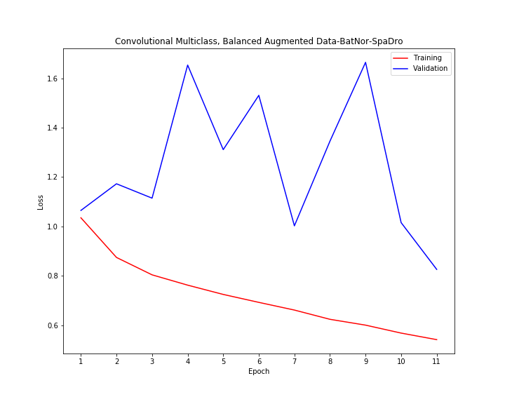
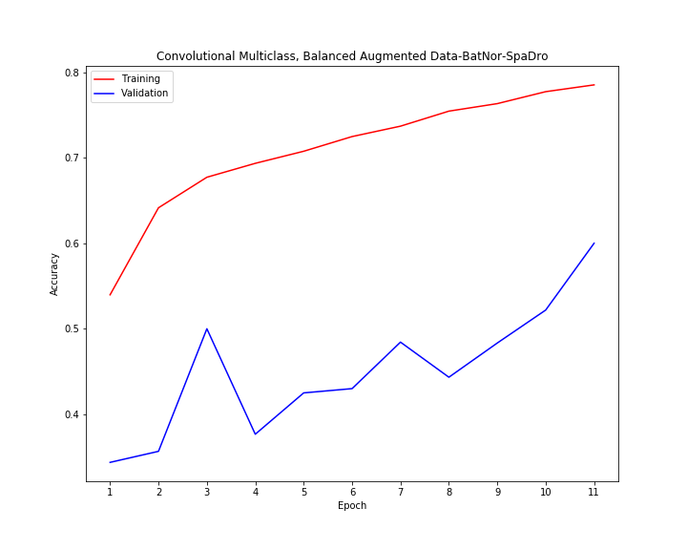

Defects Classification Model
Convolution
(150, 150, 32)
Batch Normalization
(150, 150, 32)
Convolution
(150, 150, 64)
Max-Pooling
(75, 75, 64)
Convolution
(75, 75, 128)
Max-Pooling
(37, 37, 32)
Spatial-Dropout
(37, 37, 128)
Predicted
Predicted
Predicted
Convolution
(37, 37, 256)
440 | 43 | 57 | 90
1 | 154 | 2 | 0
529 | 277 | 2185 | 859
21 | 4 | 56 | 341
38 | 5 | 6 | 13
0 | 19 | 0 | 0
52 | 36 | 247 | 98
1 | 0 | 10 | 31
44 | 8 | 7 | 18
1 | 17 | 1 | 0
64 | 28 | 273 | 111
3 | 1 | 10 | 38
True
True
True
Max-Pooling
(18, 18, 256)
Flatten
Train Accuracy: 0.62
Validation Accuracy: 0.6
Test Accuracy: 0.6
Dense, 512
Dense, 4

