Slide 1
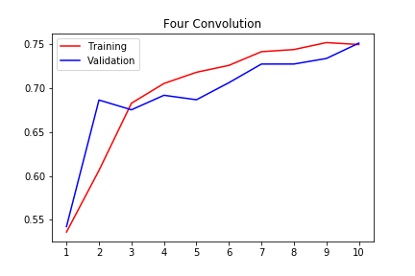
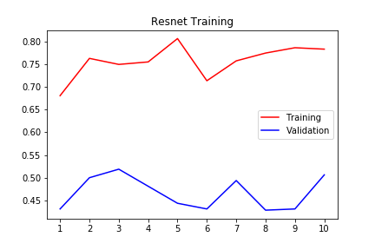
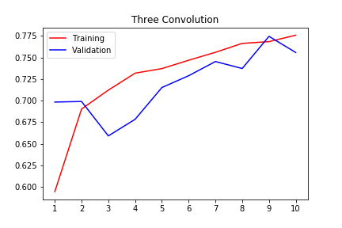
Binary Classifier
It seems a small convolutional model learns to identify defects while a more complex model memorizes the images.

