Slide 1
STEEL DEFECT DETECTION
Deep Neural Networks and Applications with Tensorflow
City College of New York
Prof. Michael Grossberg
Team Members
Carlos Tavarez
Deepak Kumar
Divya Sankar
Sonali Shintre

Slide 2
OBJECTIVE
The goal of this project is to classify and detect defects on steel sheets based on image input.
We breakdown our project into 3 components:
Identify whether an input image has a defect
This is a binary classification problem
Identify the number of types of defects an image contains
Multi-class classification problem, where each image can have up to 4 types of defects corresponding to classes [1,2,3,4]
For each defect type, identify regions of the image that has this defect
This is a image segmentation problem, where each pixel is labeled as having no defect or a defect of a particular type

Slide 3
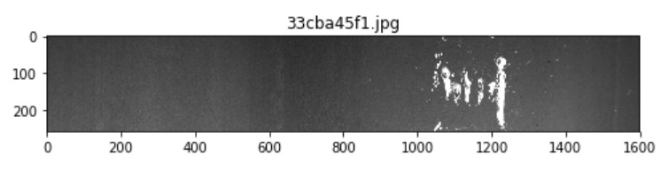
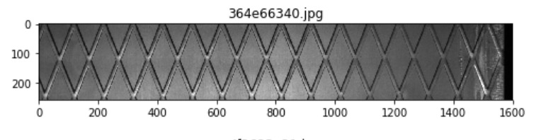
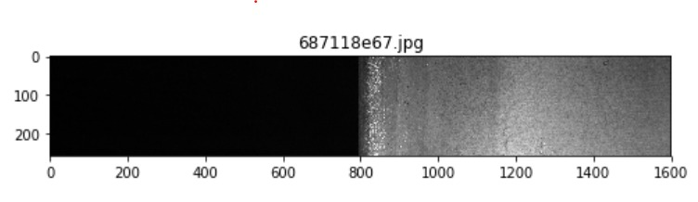
DATASET
The dataset is of size ~2GB and consists of 18076 images.
There are 12568 images in the train set.
There are 5506 images in the test set.
Of the training 12568 images, only 7095 images have defects, rest have no defects.
Each image is of size 1600*256
The location of the defects we given as encoded pixels. We has to decode them using a mask function to get the defect location.
Link to dataset - https://www.kaggle.com/c/severstal-steel-defect-detection/data

Slide 4
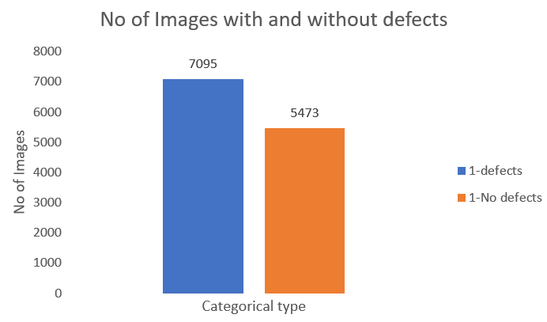
Exploratory Data Analysis (EDA)
5473 images with no defects
7095 images have defects
Formed the dataset with labels 0 and 1 denoting no defects and defects respectively.
Inference – The number of images with and without defects are proportionate and the data seems quite balanced.

Slide 5
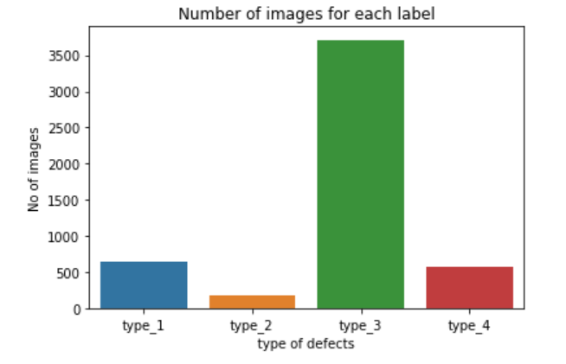
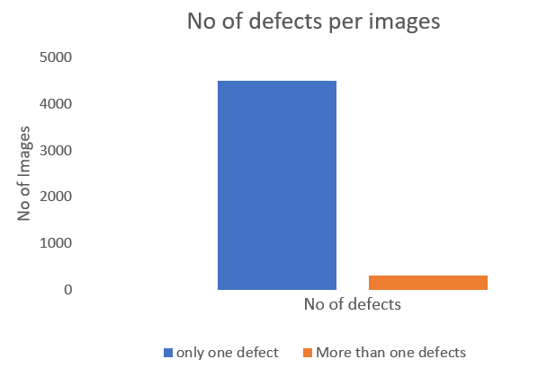
Exploratory Data Analysis (EDA)
There are 4 categories of defects – Type 1 , Type 2, Type 3, Type 4.
Lot of images with defects belong to Type 3 defect.
Most of images with defects contain the defects of only one type;
In rare cases an image contains more than one defect
Inference
The dataset is very imbalanced.
Data augmentation has to be performed before training.
Used resampling techniques for data augmentation

Slide 6
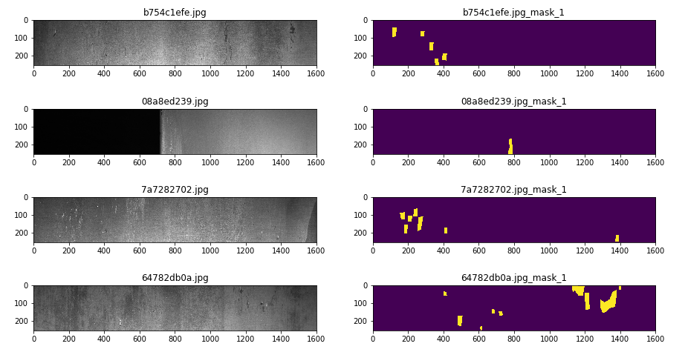
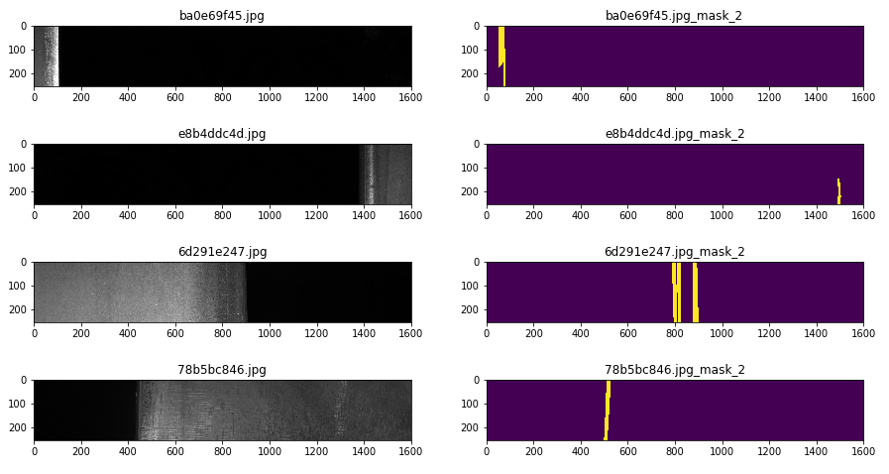
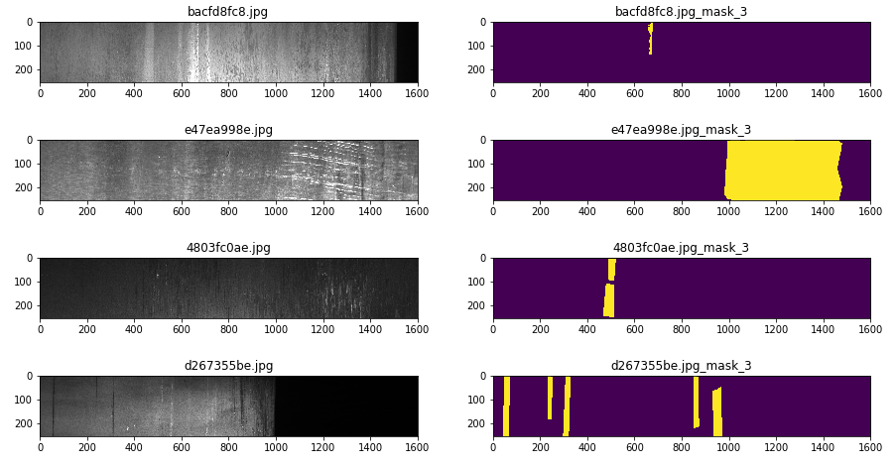
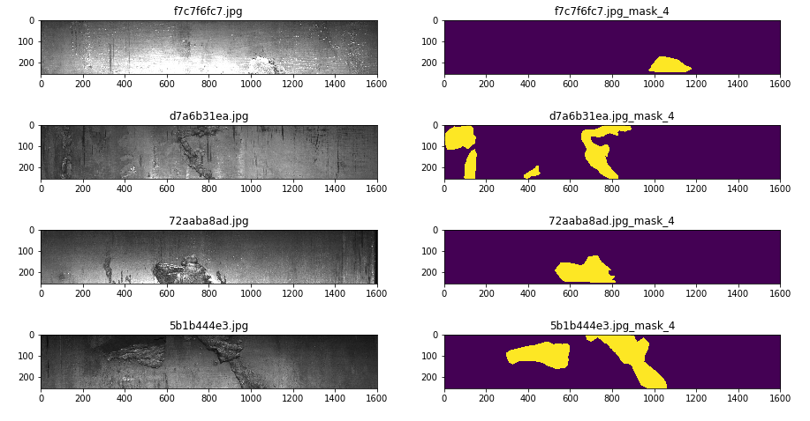
Segmentation
Type 1 defects
Type 2 defects
Type 3 defects
Type 4 defects

Slide 7
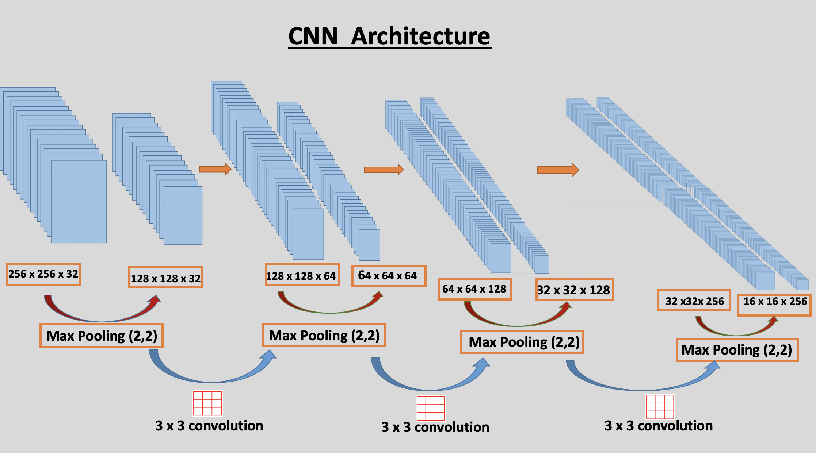
Binary Classification
Using CNN to classify images with and without defects
Resized images into (256,256,3)
4 convolutional layers, 4 maxpool and 1 Dense layer.
Used binary cross entropy for loss

Slide 8
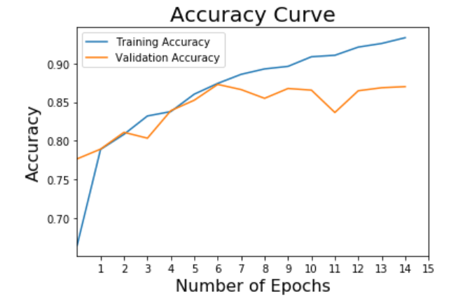
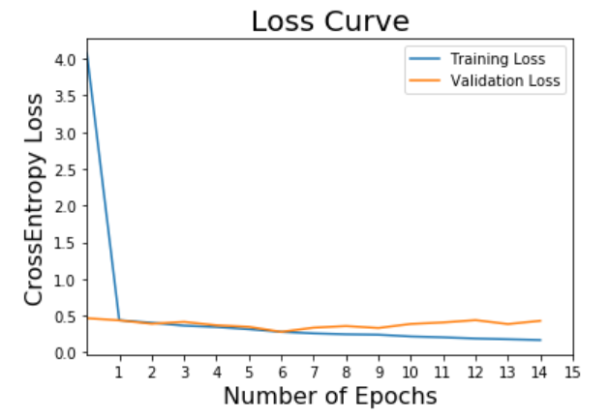
Binary Classification - Results
The model works quite well with training accuracy of 92% and testing accuracy of 87% with 15 epochs
The model generalizes well
The validation accuracy increases till 10 epochs after which it drops.
The loss keeps decreasing with the increase in number of epochs

Slide 9
Binary Classification - Results
Confusion Matrix
 | True No-Defect | True Defect
Predicted No-Defect | 1039 | 142
Predicted Defect | 181 | 1152
Precision-Recall Matrix
 | Precision | Recall
No-Defect | 0.85 | 0.88
Defect | 0.89 | 0.86

Slide 10
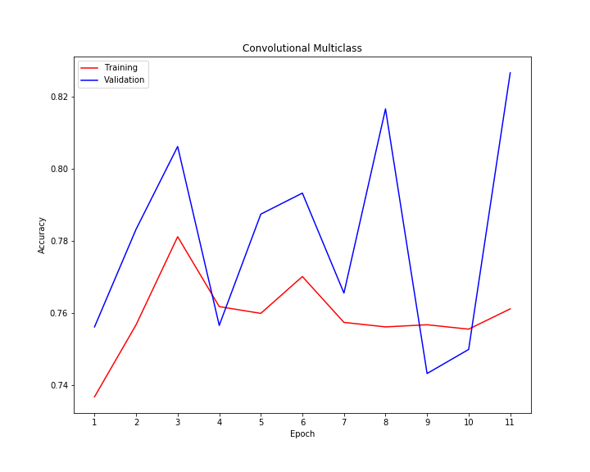
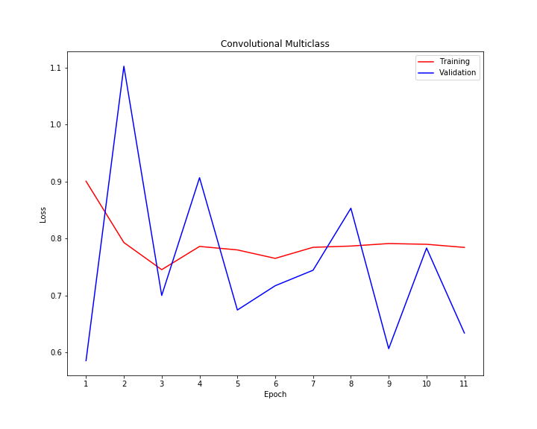
Multi Class Classification – Unbalanced classes
CNN model with 10 layers with 4 Conv2D, 4 maxpool and 2 Dense layers
Trained the model for 11 epochs – 50steps for each epoch
Got 76% accuracy for training and 78% for testing
The model was predicting only defect type 3
Predicted
0 | 0 | 630 | 0
0 | 0 | 157 | 0
0 | 0 | 3850 | 0
0 | 0 | 422 | 0
True
Table 1. Confusion Matrix for training set.
Predicted
0 | 0 | 62 | 0
0 | 0 | 19 | 0
0 | 0 | 433 | 0
0 | 0 | 42 | 0
True
Table 2. Confusion Matrix for training set.

Slide 11
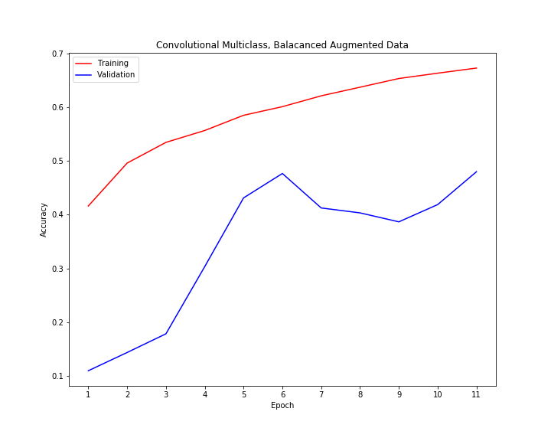
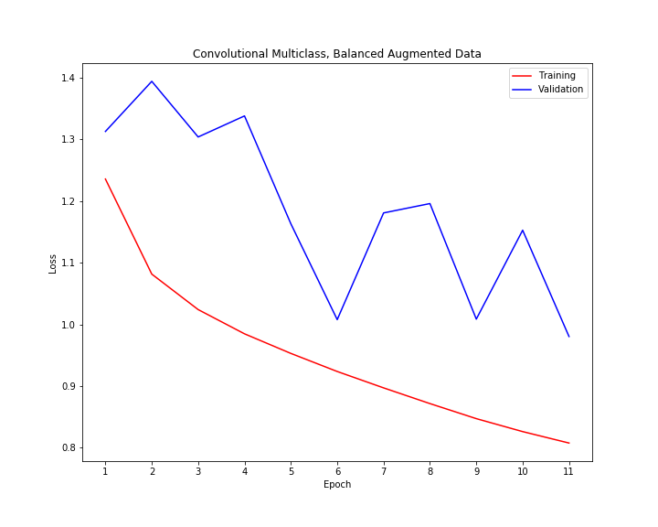
Multi Class Classification – balanced classes
After using the balanced data generator started generalizing and looking for differences between classes.
The model gave 47% accuracy for training and testing images.
Despite the training improved using balanced image generator we had low accuracy.
Confusion matrix
Predicted
36 | 5 | 5 | 16
0 | 19 | 0 | 0
88 | 51 | 173 | 121
3 | 1 | 1 | 37
True
Source: https://medium.com/analytics-vidhya/how-to-apply-data-augmentation-to-deal-with-unbalanced-datasets-in-20-lines-of-code-ada8521320c9

Slide 12
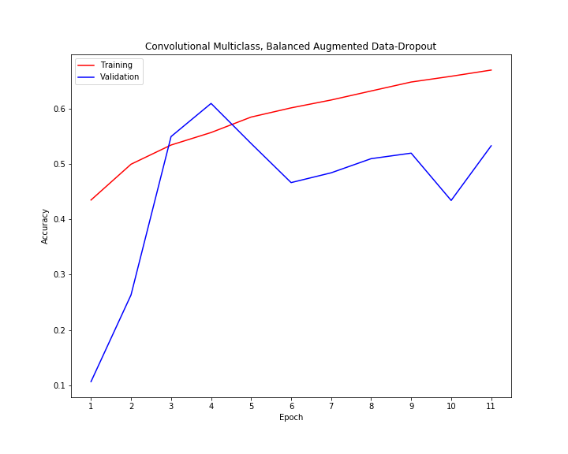
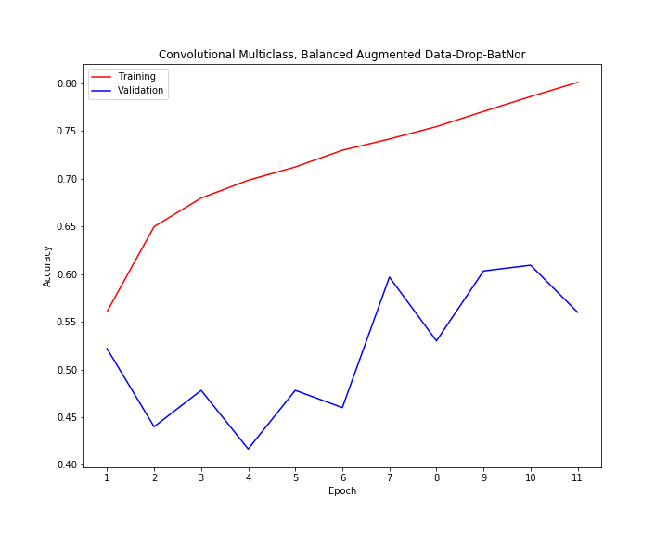
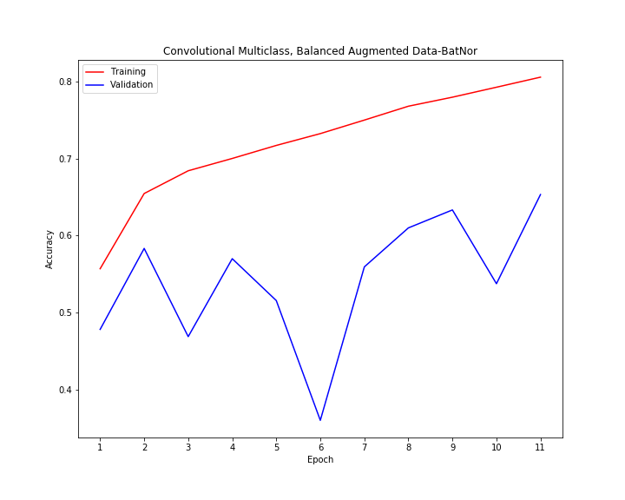
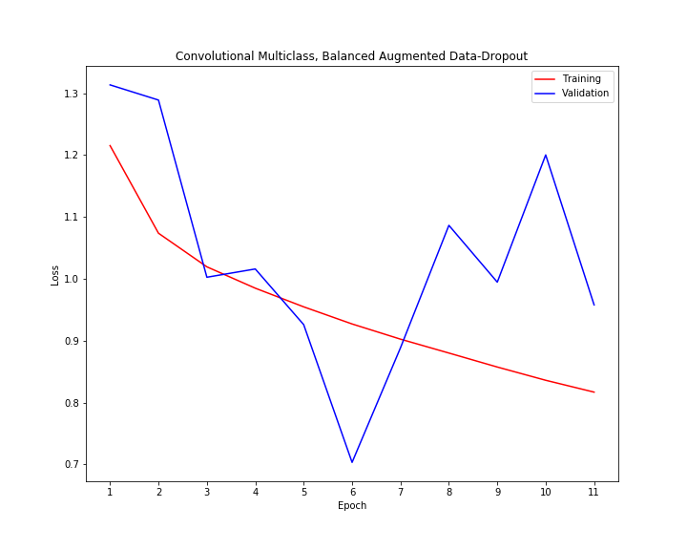
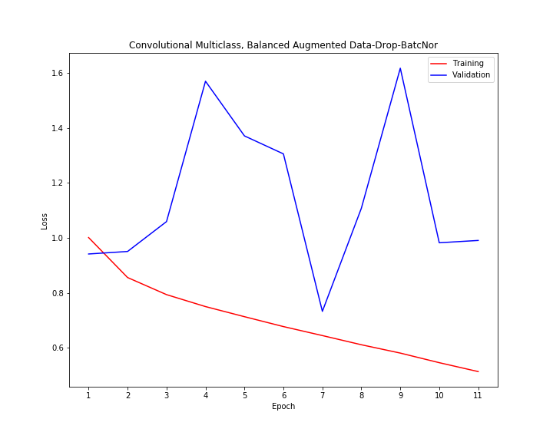
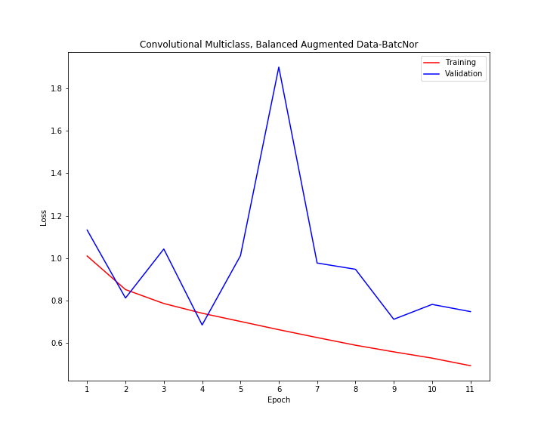
Multi Class Classification – Fine tuning model
Train Accuracy: 0.55
Validation Accuracy: 0.55
Train Accuracy: 0.55
Validation Accuracy: 0.51
Train Accuracy: 0.7
Validation Accuracy: 0.66
Predicted
Predicted
Predicted
45 | 4 | 7 | 6
1 | 18 | 0 | 0
115 | 38 | 212 | 68
5 | 1 | 4 | 32
46 | 1 | 8 | 7
1 | 18 | 0 | 0
74 | 15 | 249 | 95
5 | 0 | 3 | 34
33 | 3 | 14 | 12
0 | 19 | 0 | 0
22 | 18 | 283 | 110
1 | 0 | 8 | 33
True
True
True

Slide 13
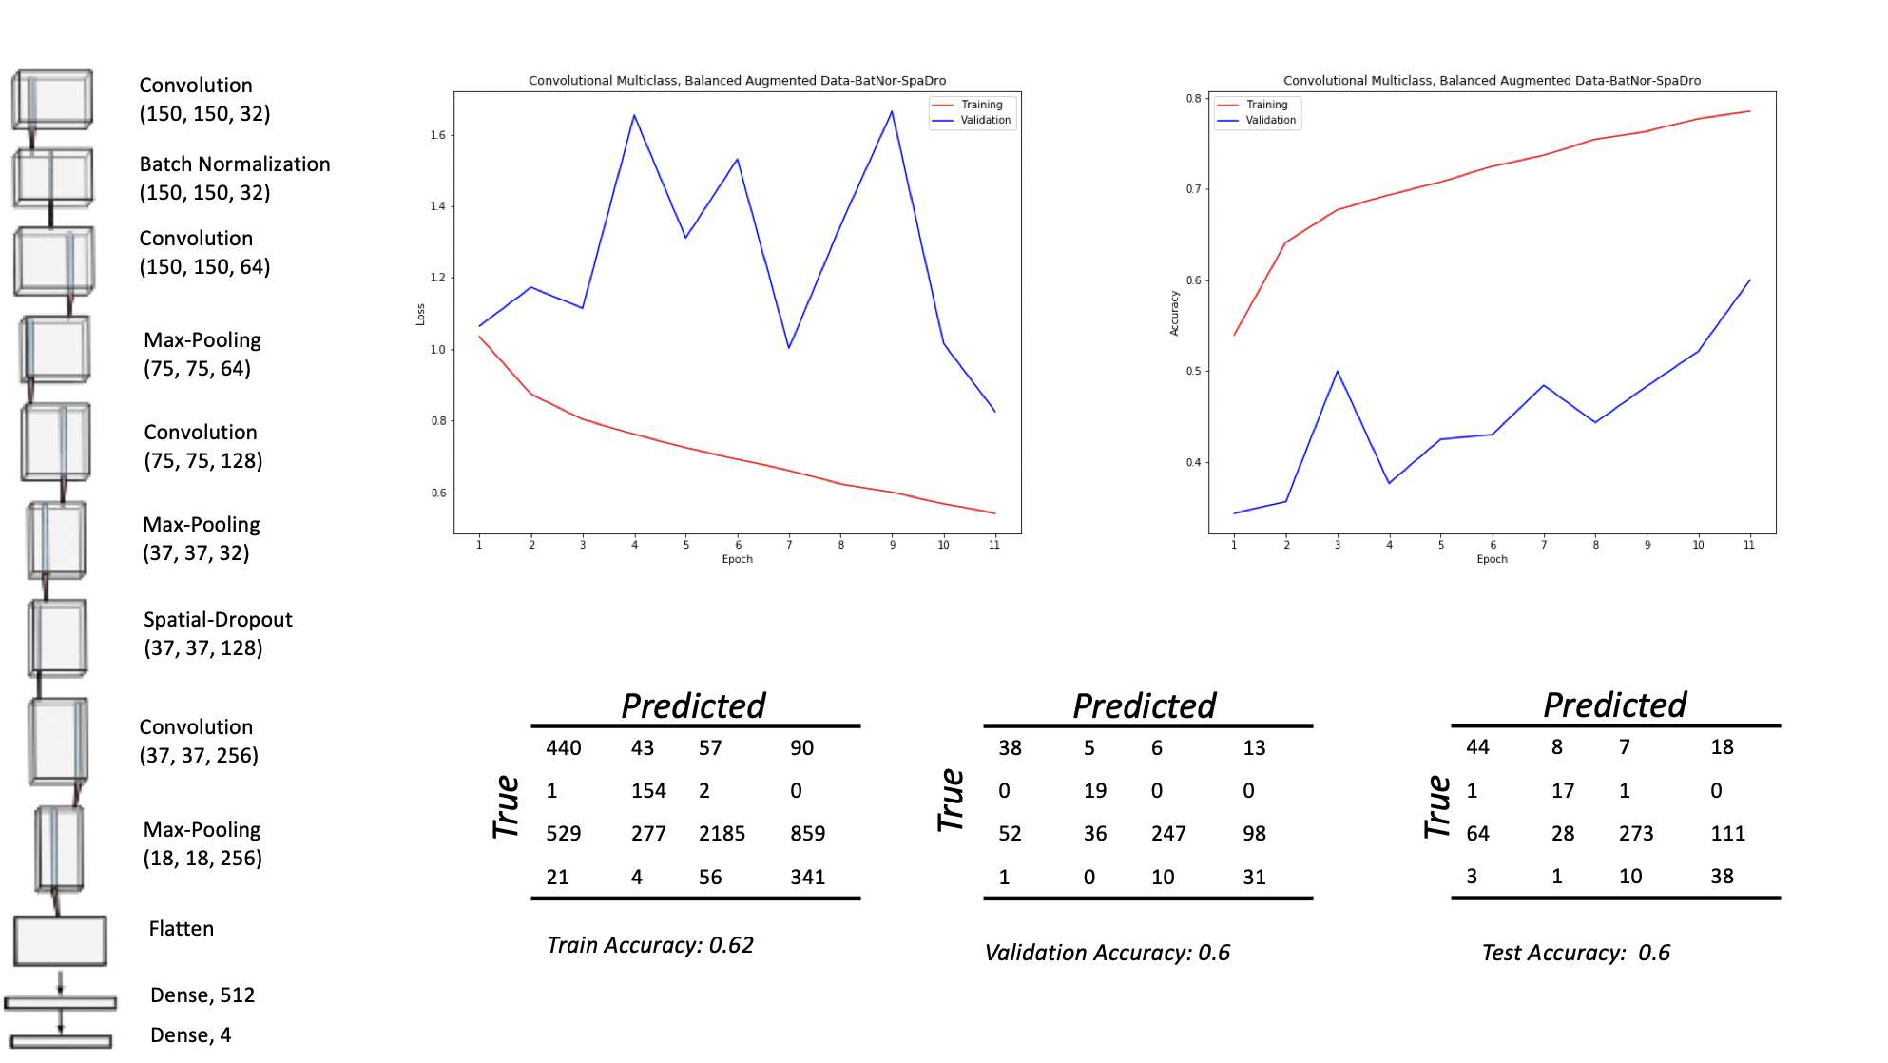
Multi Class Classification – Final Model

Slide 14
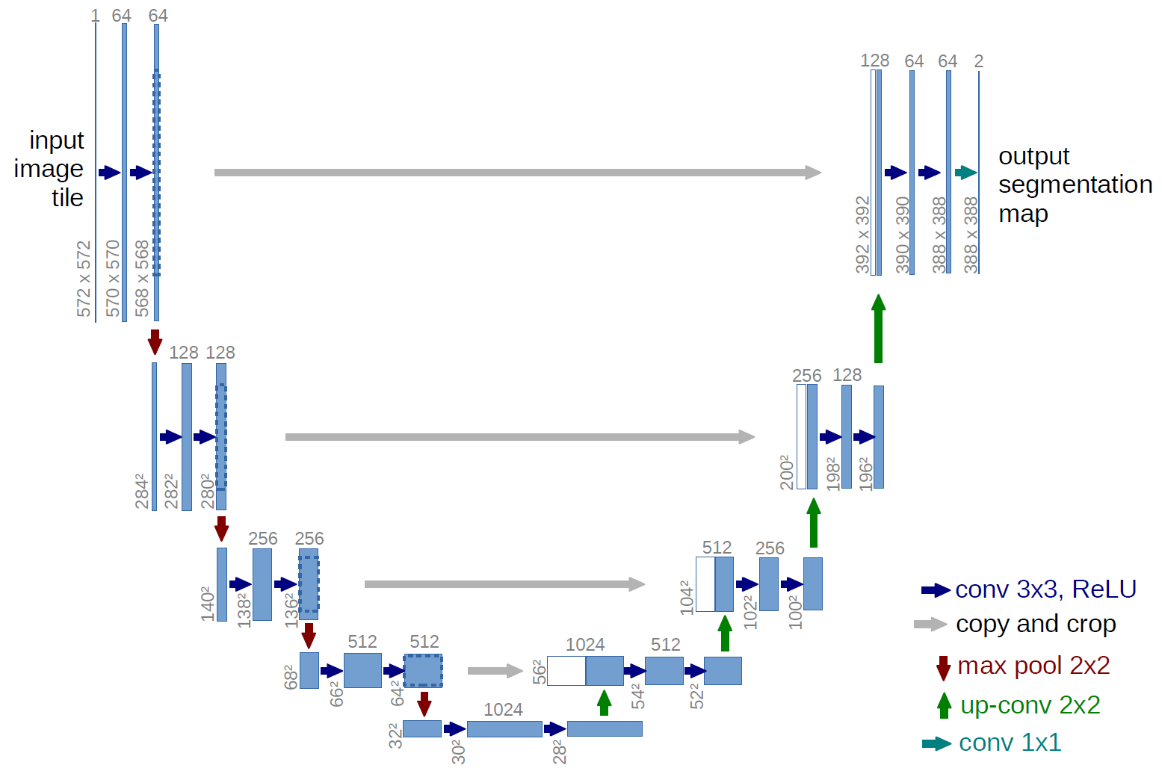
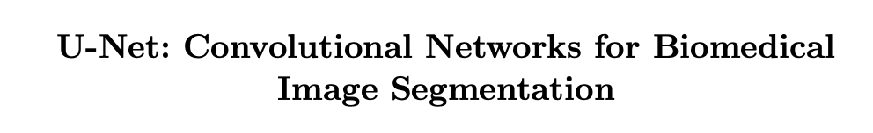
Defect Detection Through Image Segmentation
We perform defect detection using image segmentation i.e., label every pixel of the input as no defect or defect of a specific type
To perform image segmentation, we use the U-net architecture (first proposed for medical imaging)
An popular architecture in a class of DNNs called Fully-Convolutional Nets (FCNs)
FCNs or U-net comprises of 2 parts:
The first part is similar to image classification CNNs, that have a sequence of CONV/ReLU/MaxPool layers
In the second part, instead of classification layers, transpose convolution is performed to gradually upsize the features and get the final segment map for each class
Transpose convolution also uses feature from the first part of the model
This gives the U-shape to the architecture
U-net architecture
Model adapted from:

Slide 15
Model Architecture - Specifics
The input image is a 256*1600 image with 3 channels.
The model has 33 layers
23 Conv2D layers
5 Maxpool layers
5 Conv2DTranspose layers
The total number of trainable parameters is 600,612.
The output is segment maps of the image for each defect class type.
3 channels
4 channels
One for each defect type
256x1600
8 channels
16 channels
128x800
32 channels
64x400
64 channels
32x200
16x100
128 channels

Slide 16
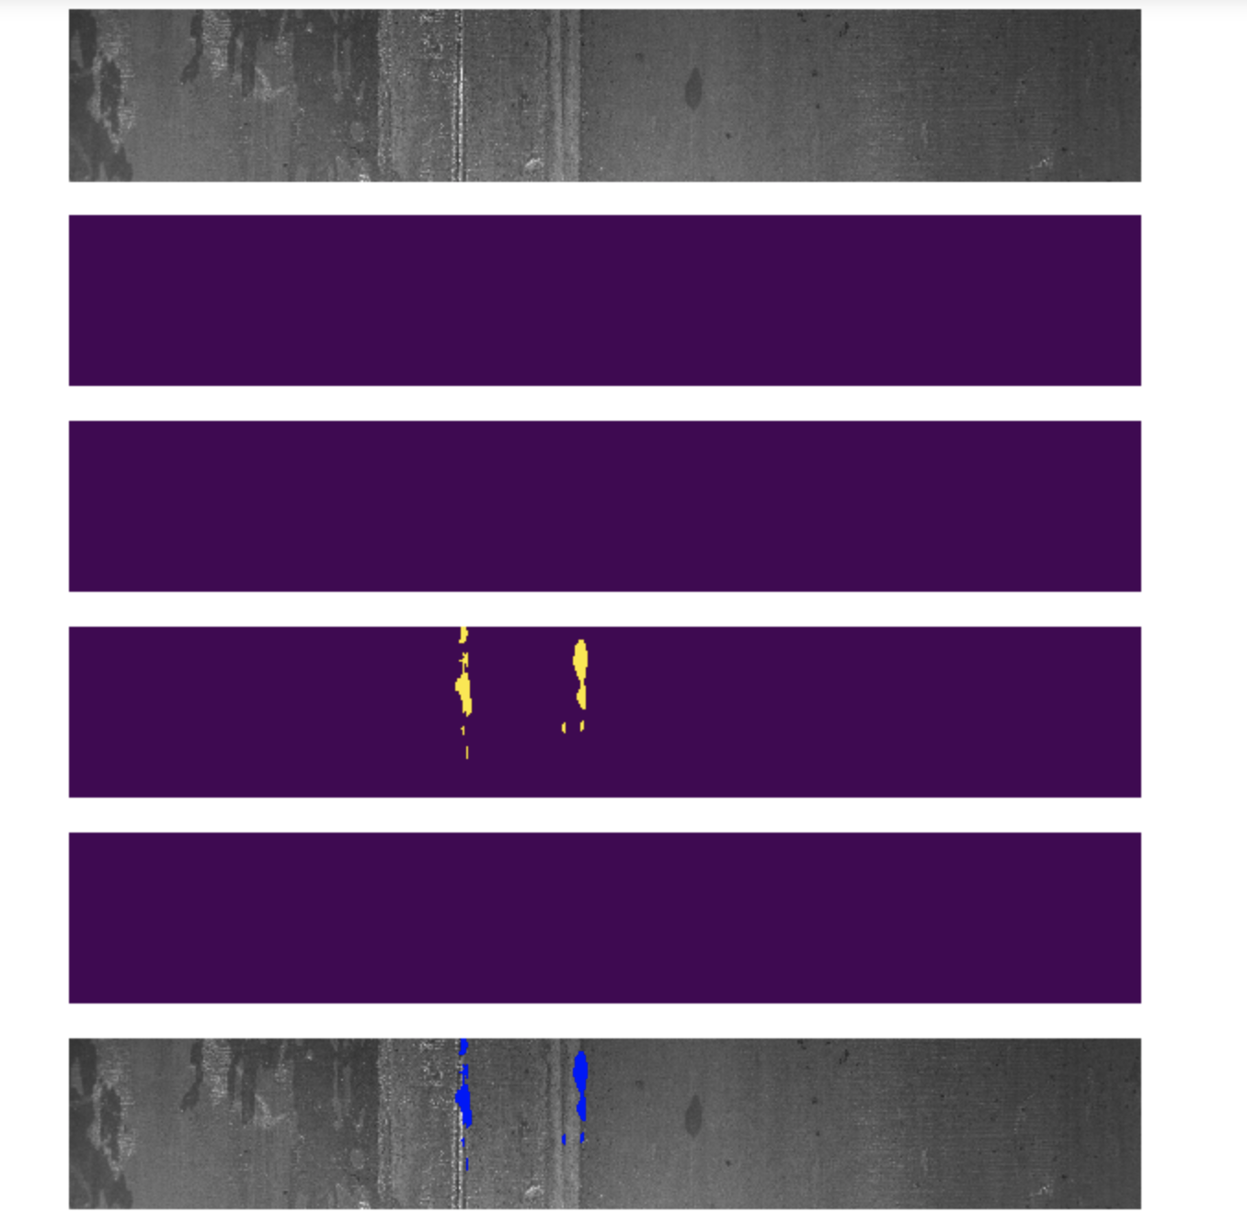
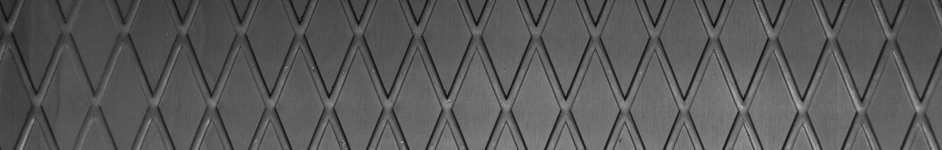
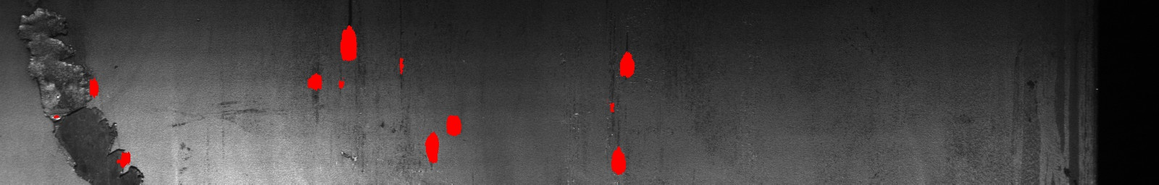
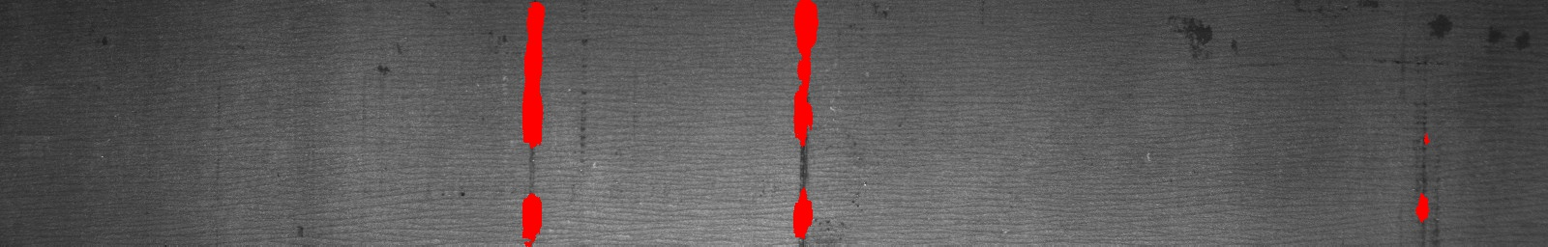
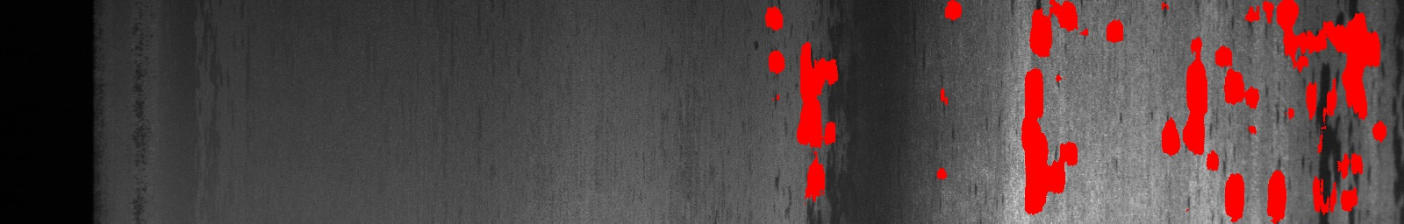
Defect Detection - Results
Output Images
Original image
No defect
Training vs. Validation Loss
Segment map- type 1
Segment map- type 2
Defect Images
Loss
Segment map- type 3
Segment map- type 4
Final Output
Epochs
Inference
Due to the imbalance in data the model predicts the defects as type 3.
Tried doing data augmentation with lesser number of images. Gave better results but again the model was biased towards the defect class with more number of images.

Slide 17
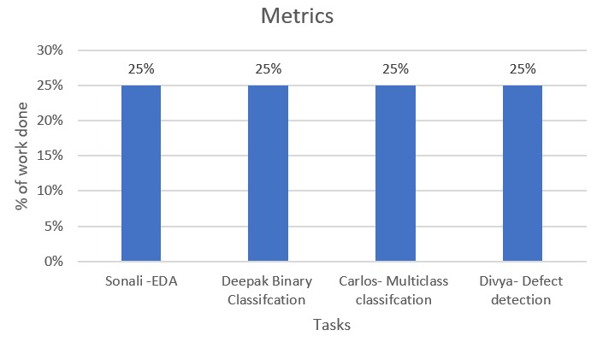
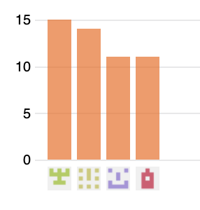
Contributions
Sonali – EDA and data augmentation
Deepak – Binary Classification using CNNs.
Carlos – Multi-Class classification and balancing the data.
Divya – Defect Detection through segmentation and managing the github repo.
The team members 2-3 every week for about an hour and discussed the issues and further steps.
We were in constant communication with each other through whatsapp group and blackboard and helped each other
Carlos
Divya
Deepak
Sonali

Slide 18
THANK YOU!

