Slide 1


Binary Classification
Purpose : To Classify the Defect Steel from the Non-Defect Steel
Defect
Non-Defect

Slide 2
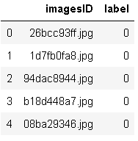
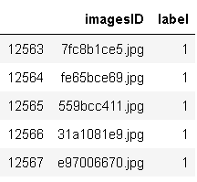
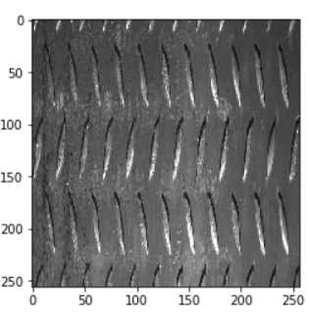
Pre-processing Data
1. Preparing the CSV file with binary labels
Non-Defect labels (‘0’)
Defect labels (‘1’)
2. Resizing the image

Slide 3
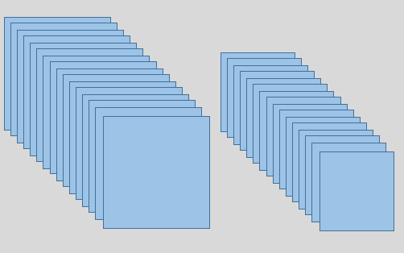
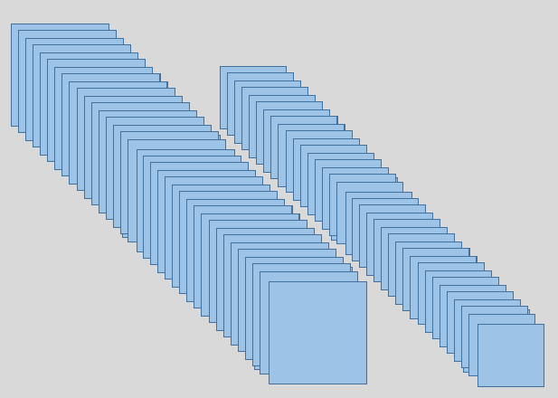
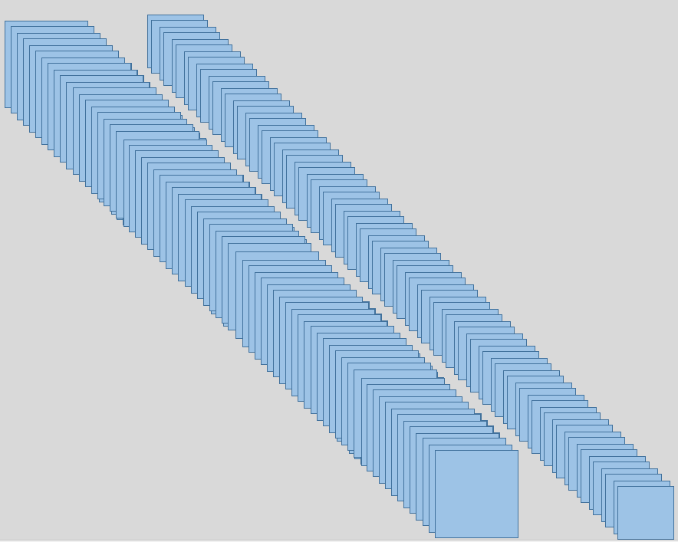
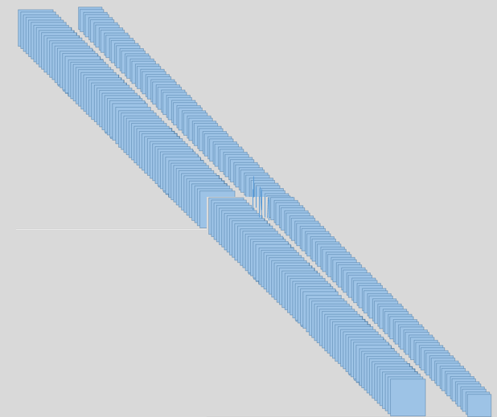
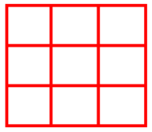
CNN Architecture
256 x 256 x 32
128 x 128 x 32
128 x 128 x 64
64 x 64 x 64
64 x 64 x 128
32 x 32 x 128
32 x32x 256
16 x 16 x 256
Max Pooling (2,2)
Max Pooling (2,2)
Max Pooling (2,2)
Max Pooling (2,2)
3 x 3 convolution
3 x 3 convolution
3 x 3 convolution

Slide 4
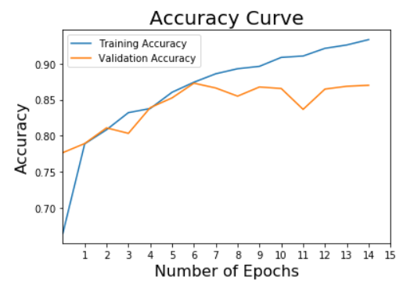
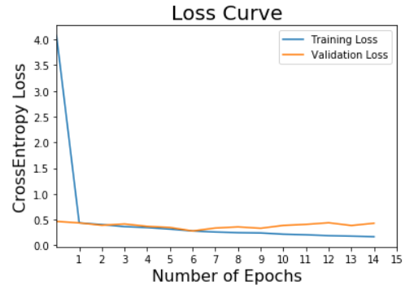
RESULTS
Training Curves

Slide 5
RESULTS
Confusion Matrix
 | True No-Defect | True Defect
Predicted No-Defect | 1039 | 142
Predicted Defect | 181 | 1152
Precision-Recall Matrix
 | Precision | Recall
No-Defect | 0.85 | 0.88
Defect | 0.89 | 0.86

Slide 6
Conclusion on Binary Classification
Issue: Overfitting
Following can help to increase the Performance:
reducing no of layers -> reducing parameters
same padding issue: affecting the edge defects
Image is down-sampled in layers, up-sampling can help for better training
Data augmentation (training size would increase :-> computationally expensive for now)

