Slide 1
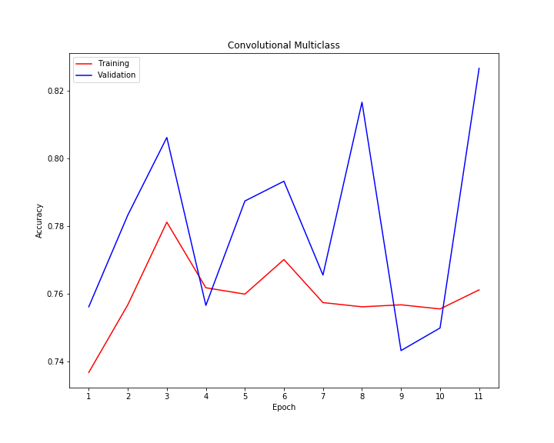
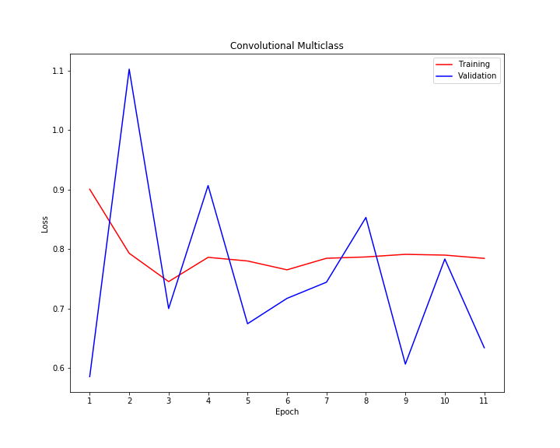
Multi-Class Classification of Unbalanced Classes
Predicted
Predicted
Dealing with Unbalanced Class Images in Twenty Lines of Code
0 | 0 | 630 | 0
0 | 0 | 157 | 0
0 | 0 | 3850 | 0
0 | 0 | 422 | 0
0 | 0 | 62 | 0
0 | 0 | 19 | 0
0 | 0 | 433 | 0
0 | 0 | 42 | 0
True
Sequence from Keras Utils
Balanced_batch_generator from imblean keras
RandomOverSampling from imblearn keras
Table 1. Confusion Matrix for training set.
Table 2. Confusion Matrix for training set.
Source: https://medium.com/analytics-vidhya/how-to-apply-data-augmentation-to-deal-with-unbalanced-datasets-in-20-lines-of-code-ada8521320c9

Slide 2
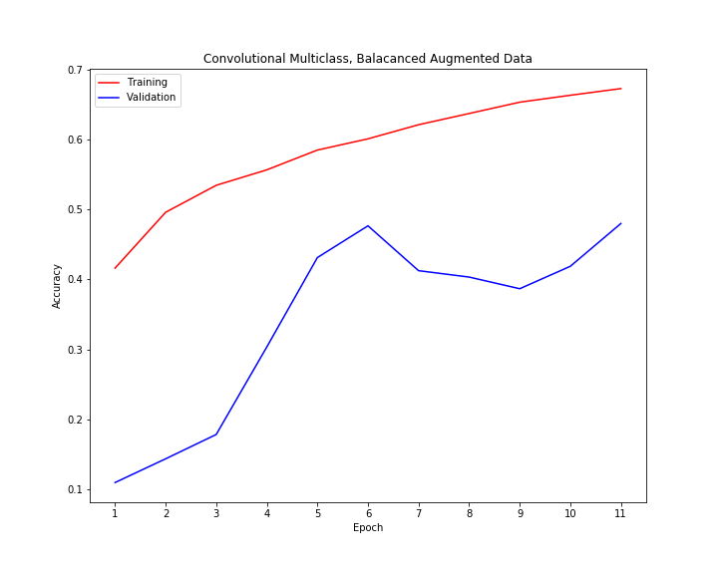
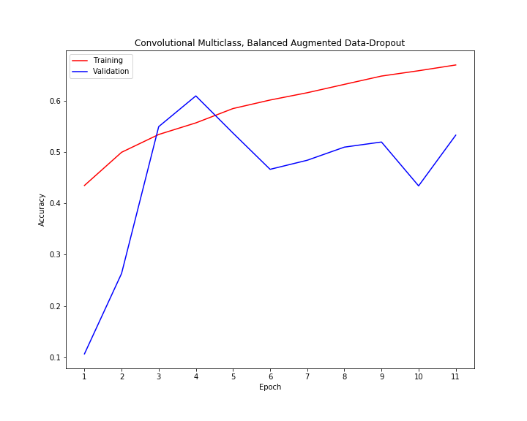
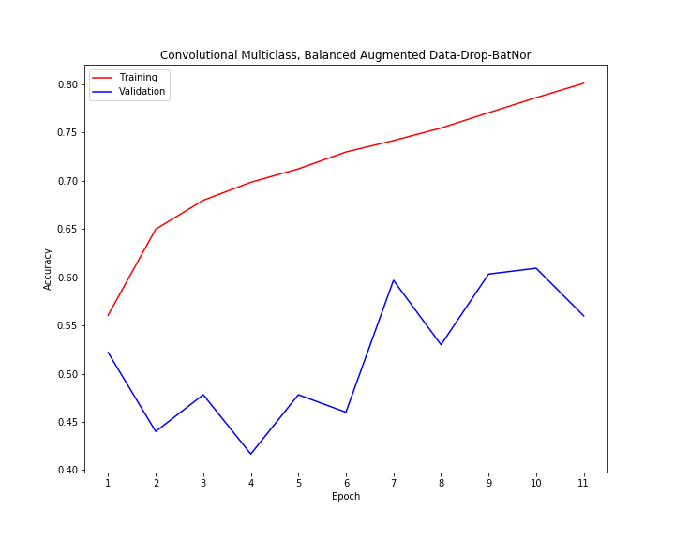
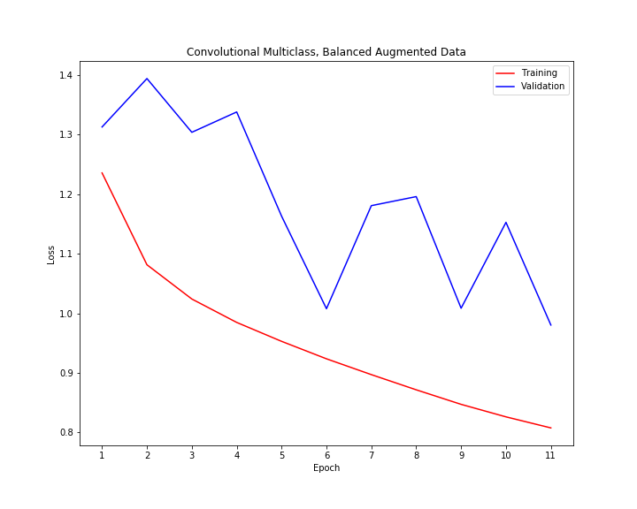
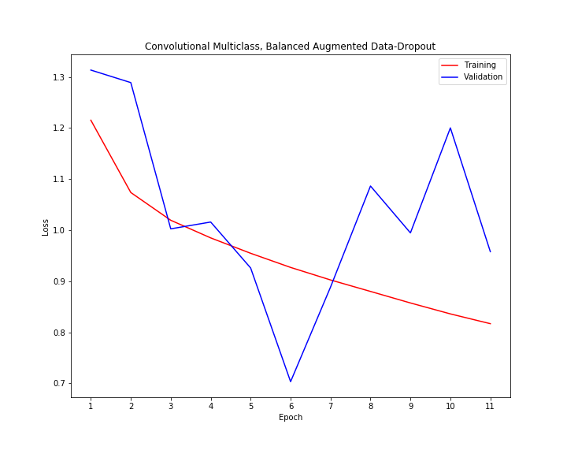
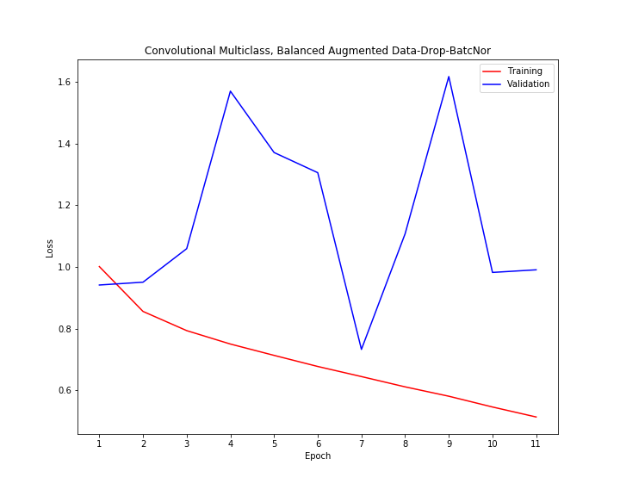
Multi-Class Classification Balanced Classes
Predicted
0 | 0 | 630 | 0
0 | 0 | 157 | 0
0 | 0 | 3850 | 0
0 | 0 | 422 | 0
True

