Slide 1


TECHNICAL ENGLISH PROJECT
SPORTCONNECT
A sports-oriented platform that connects coaches and students — built with technology, designed for performance.
Notes:
1

Slide 2
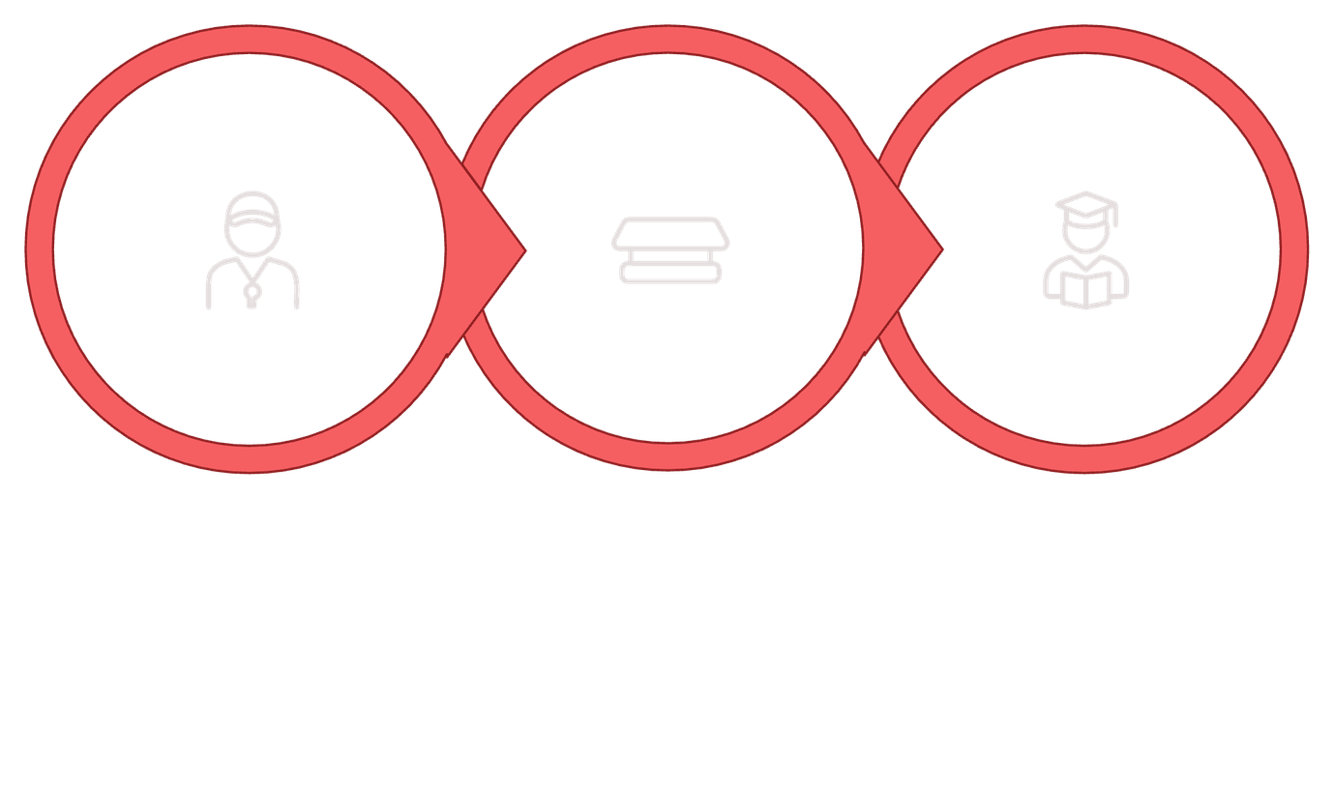



PROJECT CONCEPT
What Is SportConnect?
SportConnect is a digital platform for sports activities. Coaches create classes, publish posts, and offer products or services. Students register, join classes, and purchase services easily.
Coach
SportConnect
Student
The platform acts as the central hub — simplifying how coaches and students interact, schedule, and transact.
Notes:
2

Slide 3
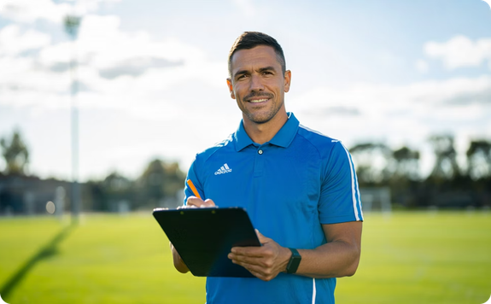

MAIN USER ROLES
Who Uses SportConnect?
🏋️ Coach
🎓 Student
Creates and manages classes
Publishes posts and updates
Sells products or services
Registers on the app
Joins classes and sessions
Buys services and products
Notes:
3

Slide 4







AREAS & CONCLUSION
Areas Worked On
Analysis & Planning
UI / UX Design
Programming
Database
Testing & Improvement
Technical English
Conclusion
SportConnect combines sport, technology, and teamwork to offer a practical, user-friendly solution for managing sports activities.
A clear, modern platform built to connect coaches and students with ease.
Notes:
4

