Slide 1
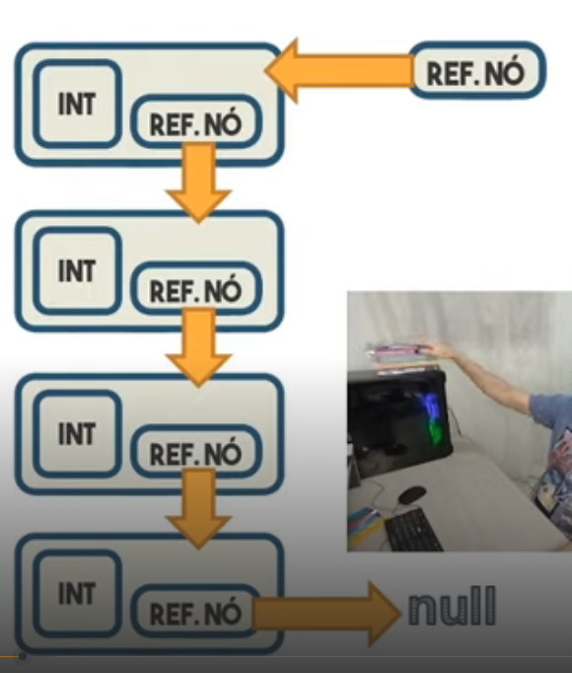
Ultimo da pilha
Primeiro a sair
Primeiro da pilha
Ultimo a sair

Slide 2
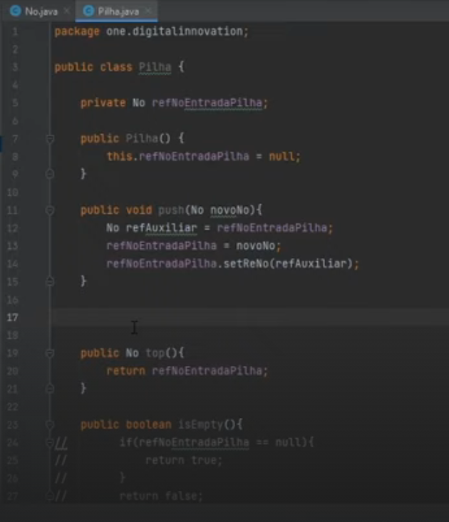

Slide 3
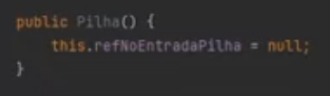
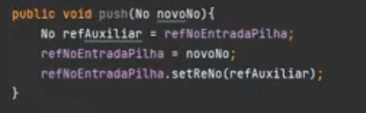

Slide 4
null
Ref nó

Slide 5
null
Ref aux
null
Ref nó

Slide 6

Ref nó
Int
null
Ref aux
Ref nó

Slide 7
Identico a: novoNo.setReNo(refAuxiliar)
Ref nó
Int
null
Ref nó

Slide 8
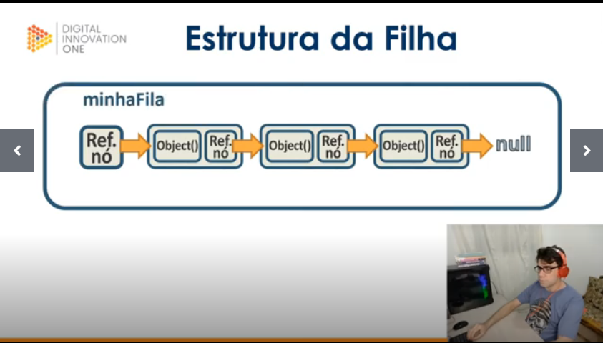
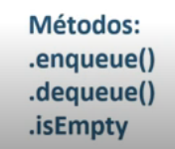
Ultimo a sair
Primeiro a sair
Ultimo da fila
Primeiro da fila
- Enfileirar
- Desenfileirar
- Esta vazio?

Slide 9
My name is Carlos Falcone, and I am 46 years old. I graduated as a Mechanical Engineer from the Federal University of Minas Gerais.
I have worked in multinational companies such as Embraer for 7 years and Fiat (now Stellantis) for 12 years.
Currently, I am undergoing a career transition to the technology sector. To facilitate this transition, I have been studying Machine Learning, Data Analysis, Python Programming, SQL, and currently, Java Programming. I am primarily interested in developing my career rather than focusing solely on a high salary.
Thank you.

