Slide 1
Social Coding with GitHub

Slide 2
What is Version Control?
Have you ever seen this?
It can be a pain to share code manually
Notes:
What is Version Control?
Version control is “a system that records changes to a file or set of files over time so that you can recall specific versions later.”
It allows you to track what you and your colleagues have worked on so you don’t clash with or override each other’s changes.
Even when developers work on each other’s files at the same time, Git’s version control system will inform them that they’re about to overwrite somebody else’s work!

Slide 3
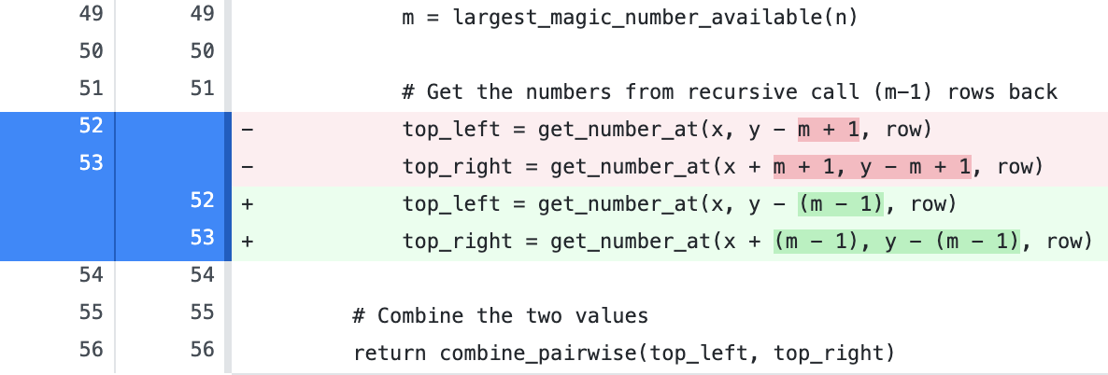
What is Version Control?
Version control tracks changes in code

Slide 4
What is Git?
commit
branch3
master
Git maintains a history of changes (commits)
Branches can be used to work on different versions
branch2
branch4

Slide 5



What is GitHub?
GitHub hosts Git repos
Allowing teams to work together more easily
Push
Pull
Commit

Slide 6
What is GitHub?
Fork
Forks are used by open source projects
This allows outside contributions
Pull Request

Slide 7
Git(Hub) Lexicon
Repository
Essentially a project folder, where all project files are stored (including documentation and revision history)
Commit
Saving an updated file to its original repository
Clone
Create a copy of a repository which sits on your computer instead of the server
Clones let you work offline
Branch
Parallel version of a repository
Contained within the repository, but doesn’t affect the primary master Branch
Lets you work freely online without disrupting the live version
Fetch
Getting the latest changes from GitHub without merging them in
Once changes are fetched, you can compare them with your local branch

Slide 8
Git(Hub) Lexicon
Fork
Personal copy of another’s user repository which is attached to the original
If the author changes something, you can always pull request to update your code with the original author’s latest change
You can learn and change from someone else’s work without changing the original repository
Push
Sending your committed changes to the original repository
Issue
Suggested improvements, tasks or questions related to the repository
Created by anyone (for public repositories), and are moderated by repository collaborators
Each issue contains its own discussion forum, can be labelled and assigned to a user
Merge
Takes changes from one branch (in the same repository or in a fork) and applies them to another
Can be done automatically via pull request
Blame
Passes blame on the version of the code file that resulted in an error occurring
Describes the last modification of each line of a file, displaying revision, author and time
Used for tracking down when a feature was added

Slide 9
What We Need to Start Working w/ GitHub?
1. Sign up for a GitHub account
github.com/join
2. Install GitHub Desktop
desktop.github.com

Slide 10
Demo
How I work with GitHub?!

Slide 11
Lab: Creating a shared repo + notebook

