Slide 1
Machine Learning for Cyber Security Part 2
Dr Carlos Moreno García
c.moreno-garcia@rgu.ac.uk
Senior Lecturer in Computing | Research Degrees Coordinator
Robert Gordon University, Aberdeen, Scotland, UK

Slide 2

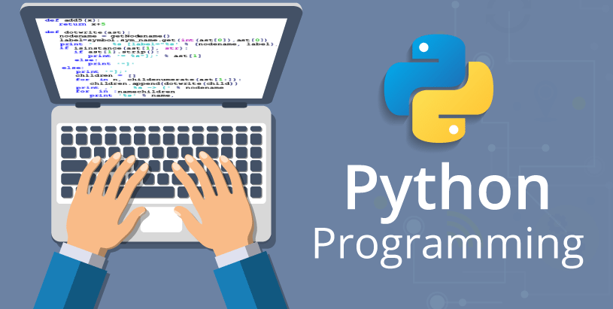
Today’s Activities (depending on time & interest)
Password generation and cracking in Python
Malware infection in Python
Bayesian poisoning in R
Biometrics
Face detection in Python
Fingerprint matching in Python
Image classification using CNNs in Python

Slide 3
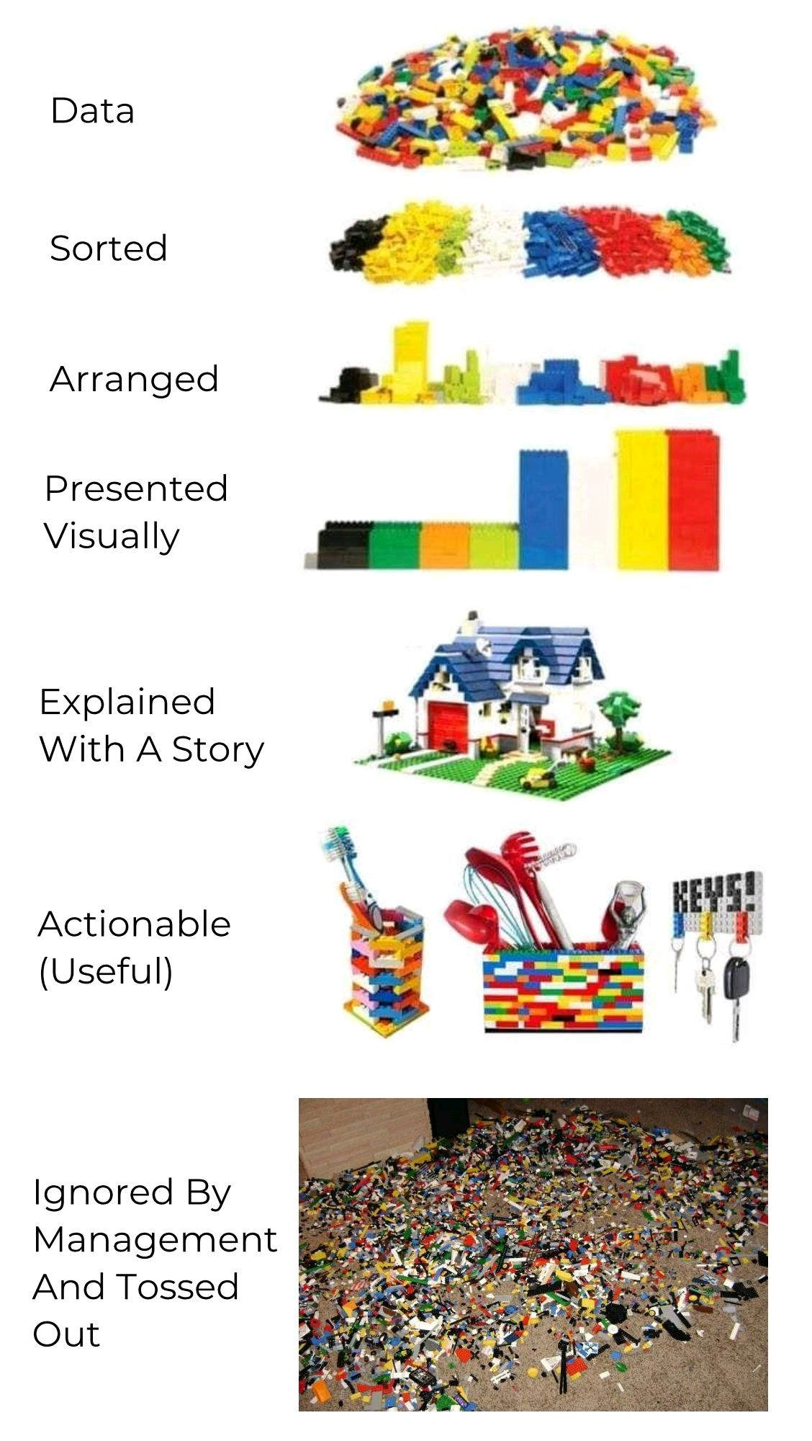

Slide 4
1. Password Generation and Cracking
https://colab.research.google.com/drive/1sLa1N09ul_RFLt0_ypAPUPZjMc_zNiR-?usp=sharing

Slide 5
2. Malware Infection
https://colab.research.google.com/drive/1hXy9srPhVN9B7D2lrjZX9ltnemVrDPVz?usp=sharing

Slide 6
3. Bayesian Poisoning
https://colab.research.google.com/drive/1_6XFtMo0N63e3ULdsDCTZbPMKzB6MiPE?usp=sharing

Slide 7
4. Biometrics
More Info:
https://www.biometricupdate.com/201802/history-of-biometrics-2

Slide 8
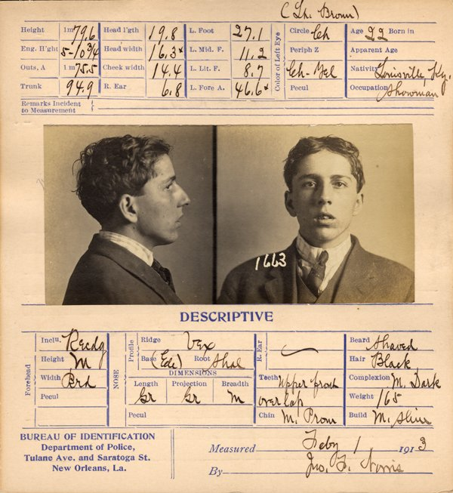
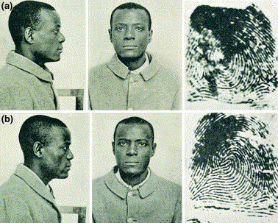
Bertillionage
The Will and William West case
https://caasbrey.com/a-fingerprint-fable-the-will-and-william-west-case/

Slide 9
Fundamentals
Everything examined with enough detail can be distinguishable
Humans have patterns that help secure systems (5 factors of authentication):
What you know
A password
What you have
Physical key
Where you are
Location
What you are
Biometrics
How you are
Behaviours (e.g. gait, handwriting, etc.)

Slide 10
4a. Fingerprint Matching
https://colab.research.google.com/drive/15mtlfOwuYygEwP9fpA1PMYJToUsnkKlh?usp=sharing

Slide 11
4b. Face detection
https://colab.research.google.com/drive/1qpk_hozXly_JTS4qarB6msGUuRdb-iVq?usp=sharing

Slide 12
5. Image Classification using Neural Networks
https://colab.research.google.com/drive/1p_r_buzwt0FBGEkVE1E91FKFrAIPDSZL?usp=sharing

Slide 13
Final Considerations

