Slide 1
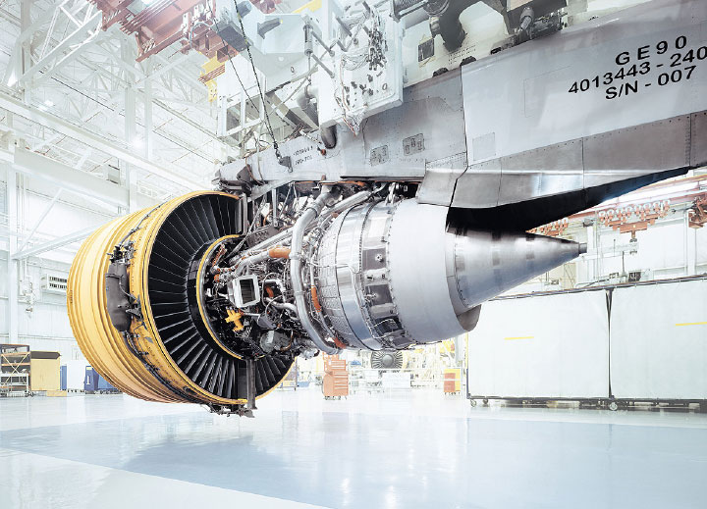
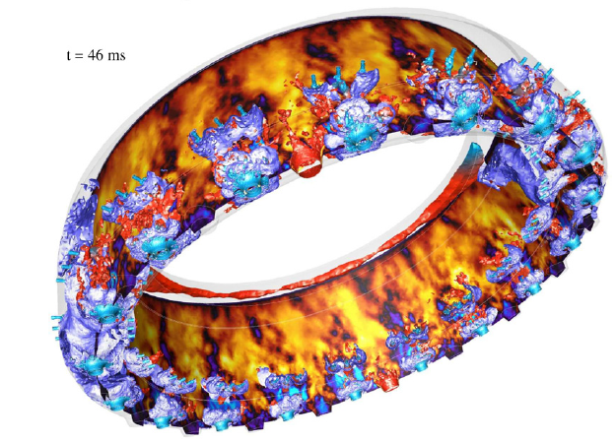
slides Carlos G. Guillamon

Slide 2

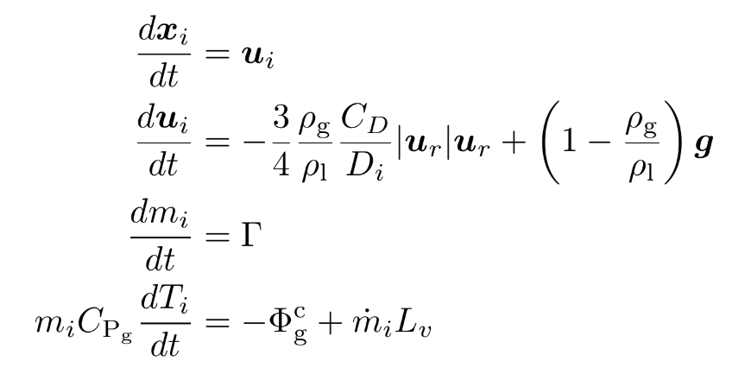



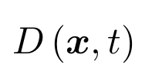



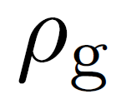
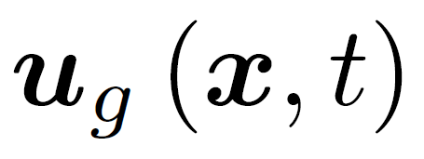




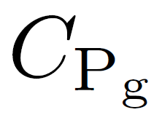

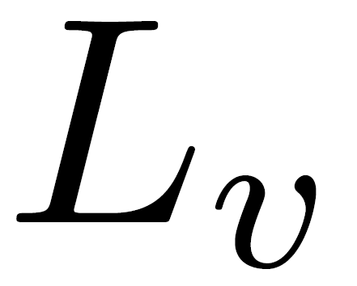
General formulation
Parameter
Symbol
Droplet’s injection location
Injection mass flow rate
Droplet location
Droplet diameter
Droplet’s velocities
Droplet’s density
Gaseous density
Gaseous velocity
Drag coefficient
Droplet temperature
Evaporation rate
Gas specific heat capacity
Conductive heat transfer
Latent heat of evaporation
Injector parameters
Spray parameters
Gas parameters
Momentum transfer
or
Mass and heat transfer

Slide 3
Parameters obtention from resolved simulations
Parameter
Symbol
Available
Obtention method
Droplet’s injection location
Injection mass flow rate
Droplet location
Droplet diameter
Droplet’s velocities
Droplet’s density
Gaseous density
Gaseous velocity
Drag coefficient
Droplet temperature
Evaporation rate
Gas specific heat capacity
Conductive heat transfer
Belongs to LGS simulation
Obtained in non-structured elements (crinkled) with IBs
Droplet’s centroid position
Equivalent diameter calculation from droplet volume
Droplets’ centroid velocities
Known (liquid property)
Known (gas property)
Belongs to LGS simulation
Belongs to LGS simulation
Injector parameters
Yes
Almost
Yes
Spray parameters
Yes
Yes
Yes
Gas parameters
Yes
Yes
Momentum transfer
Yes
No
Mass and heat transfer
or
No
No
No

Slide 4





Lagrangian injection - Hypothesis for v1
Parameter
Symbol
Hypothesis for injection
Droplet’s injection location
Injection mass flow rate
Droplet location
Droplet diameter
Droplet’s velocities
Droplet’s density
Gaseous density
Gaseous velocity
Drag coefficient
Droplet temperature
Evaporation rate
Gas specific heat capacity
Conductive heat transfer
Discretized sampling planes from revoled simulation (spray elements)
In each slement element it’s equal to average mass flow rates from IBs
Calculated on-the-fly in LGS simulations. Point-particle motion law
Follows the size histogram from resolved simulations
Mean velocity equal to centroid’s mean velocity from resolved simulations
Known (liquid property), constant
Known (gas property), constant
Calculated on-the-fly. Two-way coupling with lagrangian spray
Calculated on-the-fly. Drag’s law depending on particle Reynolds
Injector parameters
Spray parameters
Gas parameters
Momentum transfer
Not considered (non-reactive JICF)
Mass and heat transfer
or

Slide 5
Lagrangian injection
We can now perform injection with the proper mass flow rates (mass conservative injectors)
For non-reactive JICF, we can
Inject statistics from v1 at x = 5, 10, 15 mm
Get statistics from lagrangian simulations at x = 20 mm
Compare these statistics with the resolved ones at same location
Then, we can study the influence of several parameters
Droplets’ diameter: constant diameter (SMD), lognormal PDF fitting histogram
Droplets’ velocities: histograms, PDF (normal?) taking into account mean and rms values
Injectors topology: refine spatially with quadtrees, according to a droplet density of mass flow rate criterion
We can also add more physics
Dense core effect modelling : gaseous turbulence injection with numerical actuators
Swirl effect : resolved simulation of one injection multipoint hole in BIMER
… and try to derive general models (sleeping on this)

Slide 6
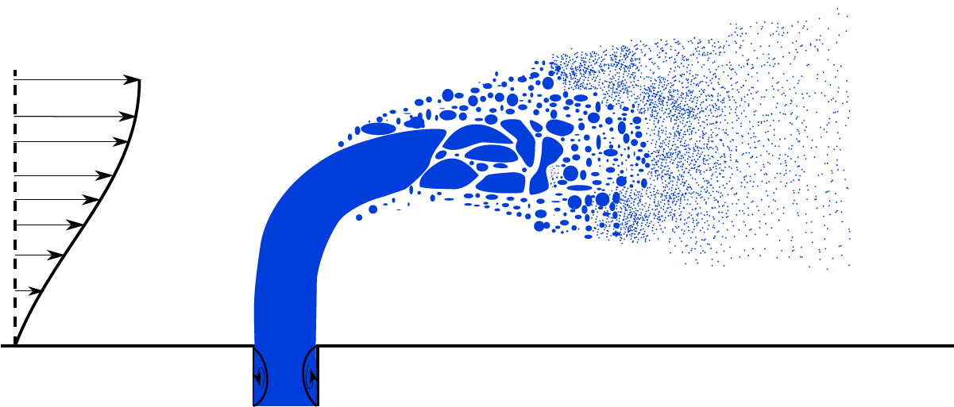
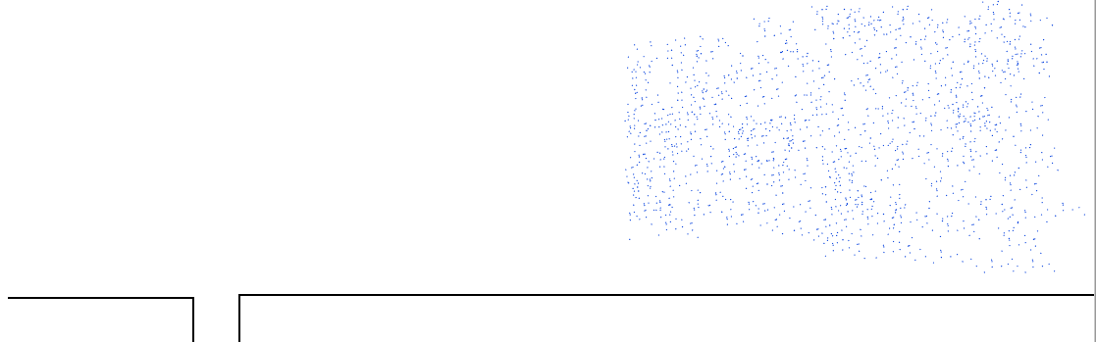
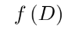




Model workflow
Resolved atomization simulation (Y2)
Development of lagrangian injectors
Lagrangian simulations (Y2/AVBP)
Sampling plane
Injection plane
Spatially integrated statistics
Sampling planes
Time integration
Spatially refined statistics

