Slide 1

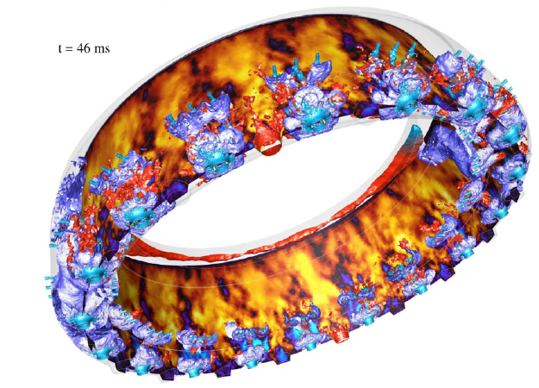
slides
Carlos G. Guillamon

Slide 2
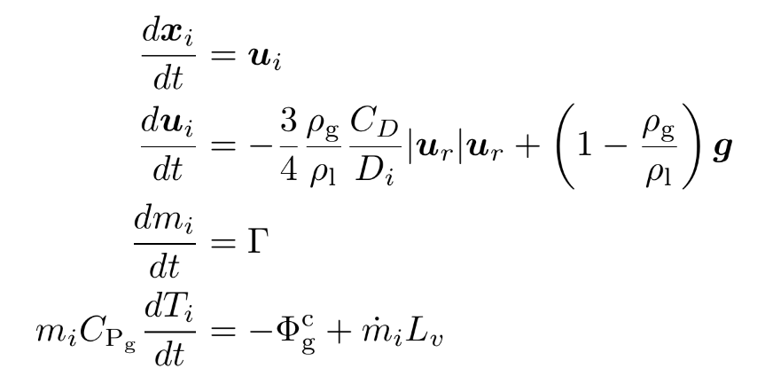









General formulation
Parameter
Symbol
Injector location
Injector morphology
Injection mass flow rate
Particle’s injection location
Particle’s injection diameter
Particle’s injection velocities
Particle’s density

Slide 3






Hypothesis for v1
*All parameters are stationary, so there’s not time dependence
Parameter
Symbol
Hypothesis for injection
Injector location
Injectors morphology
Injection mass flow rate
Particle’s injection location
Particle’s injection diameter
Particle’s injection velocities
Particle’s density
Injectors are rectangular and normal to x axis. They are represented by their center (x_{c}, y_{c}, z_{c}), their semi-length a, semi-width b, and number of injection points N_{pts}
Injection mass flow rate is constant within each element
Particle’s injection location within each element is randomly distributed according to the number of injection points N_{pts}, so there’s nothing to input here
Particle’s diameter follows a probability density function (histogram) within each element
Constant velocities (one velocity per direction) for all particles within a injector
Constant, liquid density

Slide 4
Parameters obtention from resolved simulations
Parameter
Symbol
Obtention method
Injector location
Injectors morphology
Injection mass flow rate
Particle’s injection location
Particle’s injection diameter
Particle’s injection velocities
Particle’s density
Center and dimensions are calculating by discretizing the liquid region in the plane in equally space elements where local statistics are calculated. N_{pts} is selected ad-hoc
Obtained from interior boundaries
Not obtained. Calculated internally by Y2 in lagrangian simulations
Particles sampled from droplet’s size histogram obtained from resolved simulations
Mean velocity equal to droplets centroid’s mean velocities from resolved simulations
Known

Slide 5
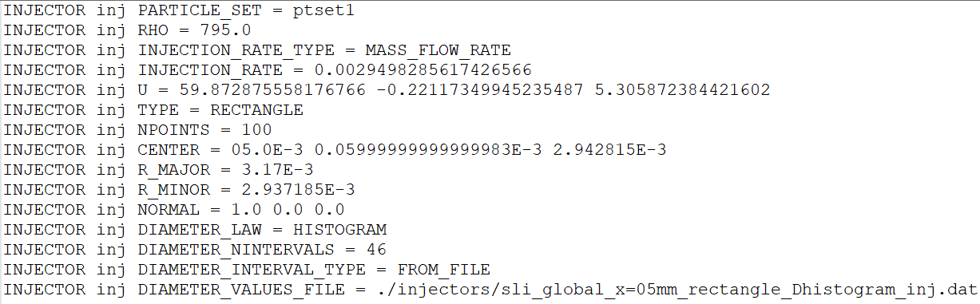
Implementation in YALES2
Injection mass flow rate
Particle’s mean velocities
Injector center location and morphology. Particle’s injection location determined by Y2 according to these parameters
Size histogram for sampling particles diameters

