Slide 1
Models workflow
Secondary atomization models
Dense core learning for liquid jet/air interaction
Resolved atomization simulation
Lagrangian injectors learning
Lagrangian simulation
Spray sampling
Spray convergence
Spatial discretization

Slide 2
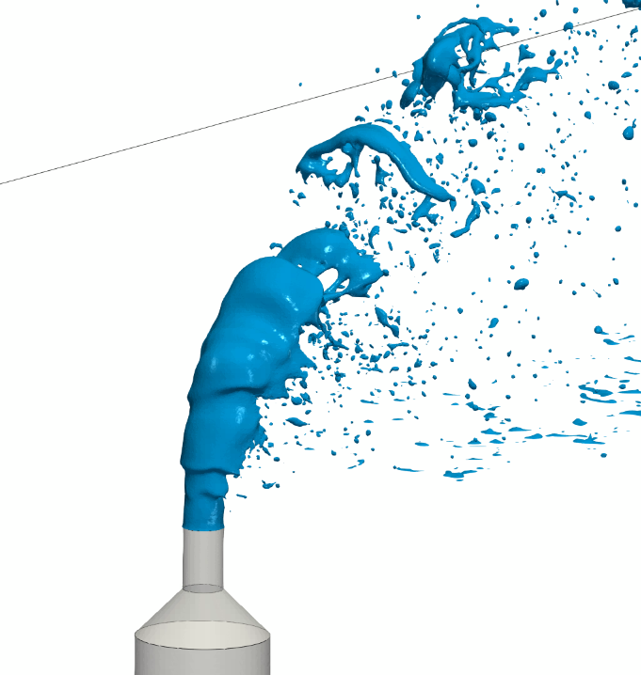
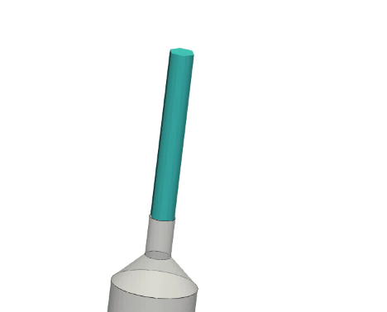

Dense core representation
a)
b)

Slide 3
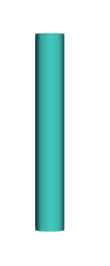
Dense core representation. Actuator modelling
F_{x}(z)
L
F_{z}(z)
Parameters
Geometry : L, c, θ
Forces : D(z), F_{z}(z)
θ
z
x
c

Slide 4
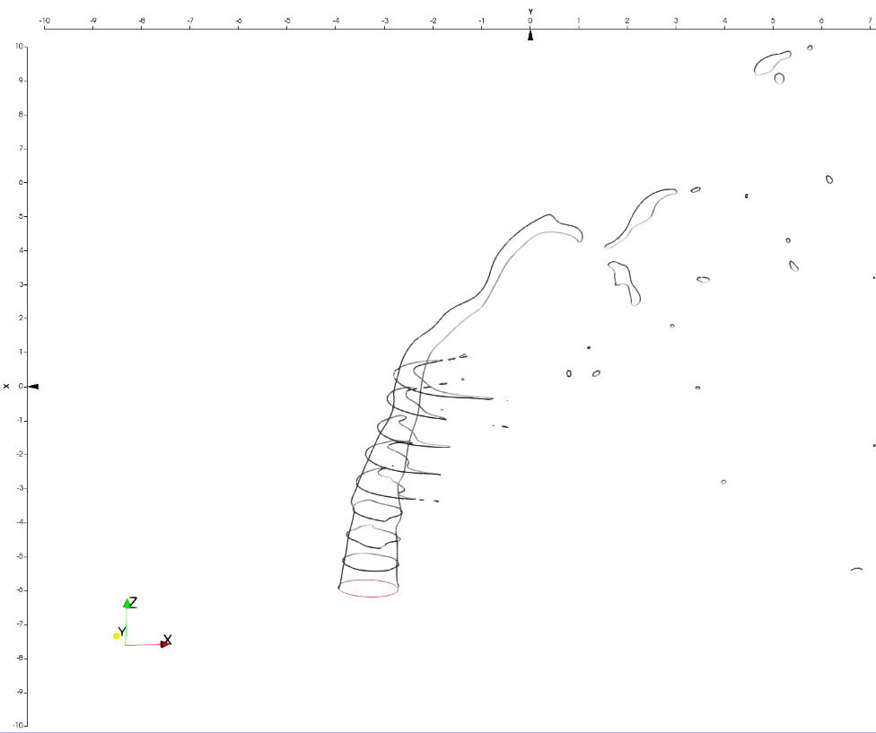
Dense core representation. JICF skeleton

