Slide 1
Mass Management & Margins
And 696-JPL Parallels

Slide 2
The Problem
WE WANT TO TRACK MASS
Throughout the design process
Prevents surprises close to launch/bag day
Allows you to redistribute allocations
We also want to maintain margins
That is, don’t design for exactly 120 lbm

Slide 3
The Problem
However, we want to avoid margin stacking
A system (SV, robot) is made up of subsystems
JPL:
Structure
Command & data handling (C&DH)
Propulsion
Guidance, navigation, and control (GNC)
696:
Drivebase
Elevator
Intake
Climber
Each subsystem has some components, which may be made up of other components, etc…

Slide 4
The Problem
Example:
LV can lift 1000 lbm
SV mass target is 900 lbm (10% margin)
3 subsystem engineers are given 300 lbm allocations
Each SS engineer sets a mass target of 270 lbm (10% margin)
Each SS is made up of boxes
Each box PDM adds 10% margin…
SV mass ends up being 600 lbm
Wastes 40% of LV capacity
Results in diminished capabilities

Slide 5

The Problem
There’s a military joke with a similar theme:
“The captain wants everyone to meet at 0600, so the master sergeant wants folks to arrive at 0545, and when it finally hits the corporal people are told to show up at midnight.”

Slide 6
The Solution
Set up clear definitions of where margins are held
Everyone doesn’t just add 10% margin to their deliverable
There’s a standard for this!
ANSI/AIAA S-120A-2015
“Mass Properties Control for Space Systems”

Slide 7
The Solution
Mission Limit
Mass Reserve
Allowable Mass
Mass Margin
Predicted Mass
Mass Growth Allowance
Basic Mass
0

Slide 8
Mission Limit
Mission Limit
Dictated by LV capacity (or FRC rules, i.e., 120 lbm)
Generally nonnegotiable
Mass Reserve
Allowable Mass
Mass Margin
Predicted Mass
Mass Growth Allowance
Basic Mass
0

Slide 9
Mass Reserve
Mission Limit
Set at the system or project level
Often fairly small, e.g. 5%
Designed to account for:
Measurement uncertainty
Non-SV stuff
E.g. SV-to-LV umbilicals
Operational contingency
LVs have slightly less lift capacity in strong winds
In our case, might also include repairs etc. at comp
Mass reserve should not be invaded by design
Mass Reserve
Allowable Mass
Mass Margin
Predicted Mass
Mass Growth Allowance
Basic Mass
0

Slide 10
Allowable Mass
Mission Limit
The mission limit minus the mass reserve
The mass that “you have to work with”
This is allocated out to subsystems
Chunks of it are then allocated out to e.g. boxes
No need to allocate less than 100% of allowable mass
That’s what mass margin is for
Mass Reserve
Allowable Mass
Mass Margin
Predicted Mass
Mass Growth Allowance
Basic Mass
0

Slide 11
Basic Mass
Mission Limit
In archaic JPL parlance, “current best estimate”
What you think the mass of your (subsystem/ box/ component) is
I.e., “if I open it in Solidworks and hit the ‘Mass Properties’ button, what does it say?”
Mass Reserve
Allowable Mass
Mass Margin
Predicted Mass
Mass Growth Allowance
Basic Mass
0

Slide 12
Mass Growth Allowance
Mission Limit
“How much heavier do I think the actual item will be than my basic mass?”
Is a combination of many factors:
Maturity of design
NASA has a standard for this
Uncertainty of what components are needed
Predicted mass of untracked items
E.g., we might estimate that cabling will add 5 lbm to the drivebase mass
Or, “fasteners will probably add 5% to the mass of the elevator”
Could be zero, e.g. with COTS parts
Mass Reserve
Allowable Mass
Mass Margin
Predicted Mass
Mass Growth Allowance
Basic Mass
0

Slide 13
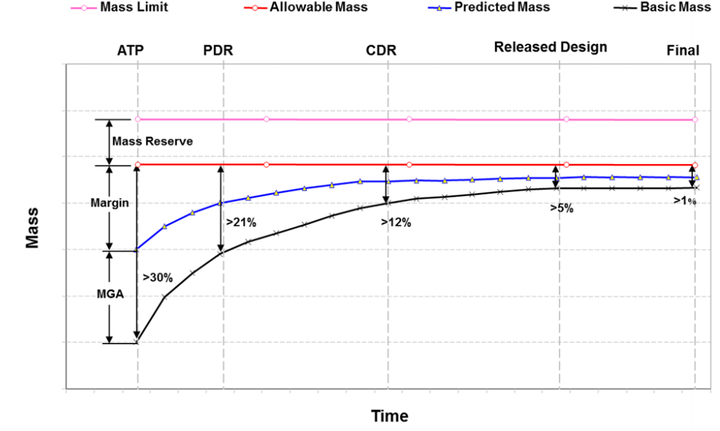
Predicted Mass
Mission Limit
Basic mass + MGA
If your estimates are good, you should be able to weigh the finished item and have it be very close to the predicted mass
Mass Reserve
Allowable Mass
Mass Margin
Predicted Mass
Mass Growth Allowance
Basic Mass
0

Slide 14
Mass Margin
Mission Limit
Mass Reserve
The difference between “how much mass you have to work with” and “how much mass you think you’ll need”
In general, negative mass margin (i.e. PM > AM) is a bad thing
However, if another subsystem is underweight, some of their AM can be reallocated to you
This needs to happen at the system or project level
Never count on someone else having mass margin to spare, though
Allowable Mass
Mass Margin
Predicted Mass
Mass Growth Allowance
Basic Mass
0

Slide 15
Margin Governance
Mission Limit
These are held at the system/project level
Mass Reserve
Allowable Mass
Mass Margin
Predicted Mass
These are held at the subsystem level or lower (recursively)
Mass Growth Allowance
Basic Mass
0

Slide 16
Extensibility
These same concepts & terms can be used for any quantifiable resource!
Time
Mission limit is 46 days, 1 hour, 30 minutes
Money
Mission limit might fluctuate based on fundraising
Power
More difficult, given steady-state vs. spike loads

Slide 17
Backup Slides

Slide 18
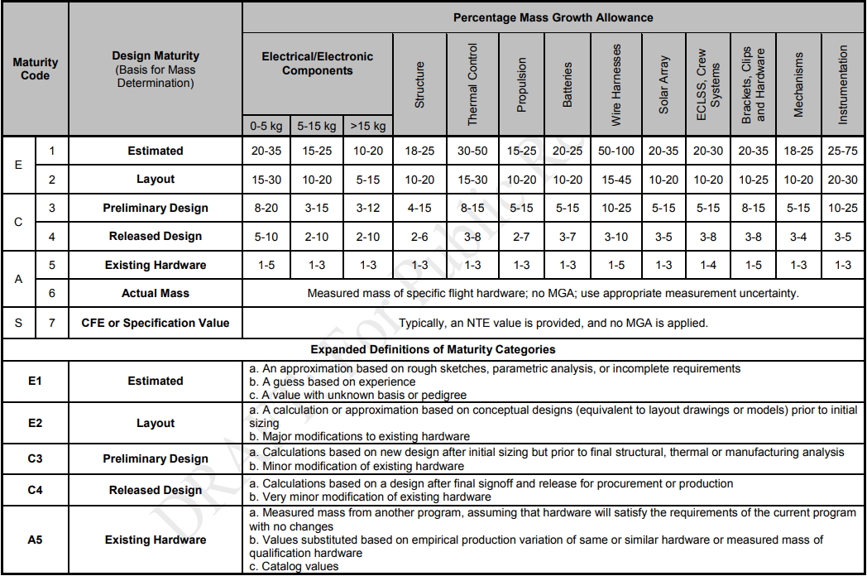
MGA Based on Maturity

