Slide 1
Statistical Navigation
Or, How to Make a Good Measurement From a Lot of Bad Measurements

Slide 2
Origins
Ca. 1966

Slide 3
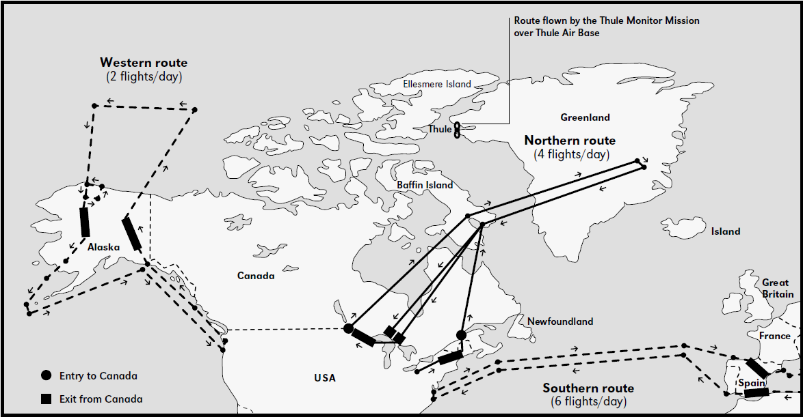
Operation Chrome Dome
US keeps nuclear-armed bombers in the air 24h/day
B-52s fly from US to USSR borders, refuelling multiple times
Notes:
1960-1968

Slide 4
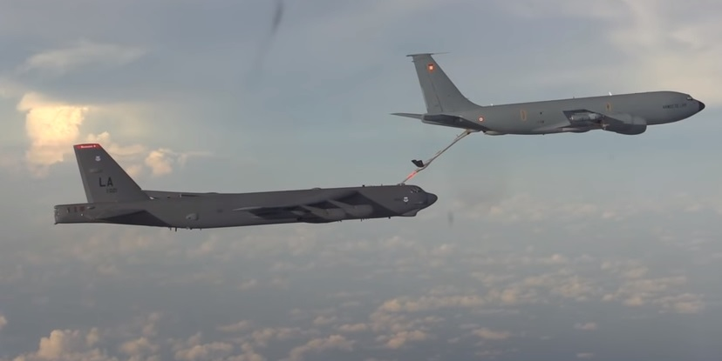
Operation Chrome Dome
In-air refuelling is hard
A nuclear-armed bomber collided with its tanker in January 1966

Slide 5
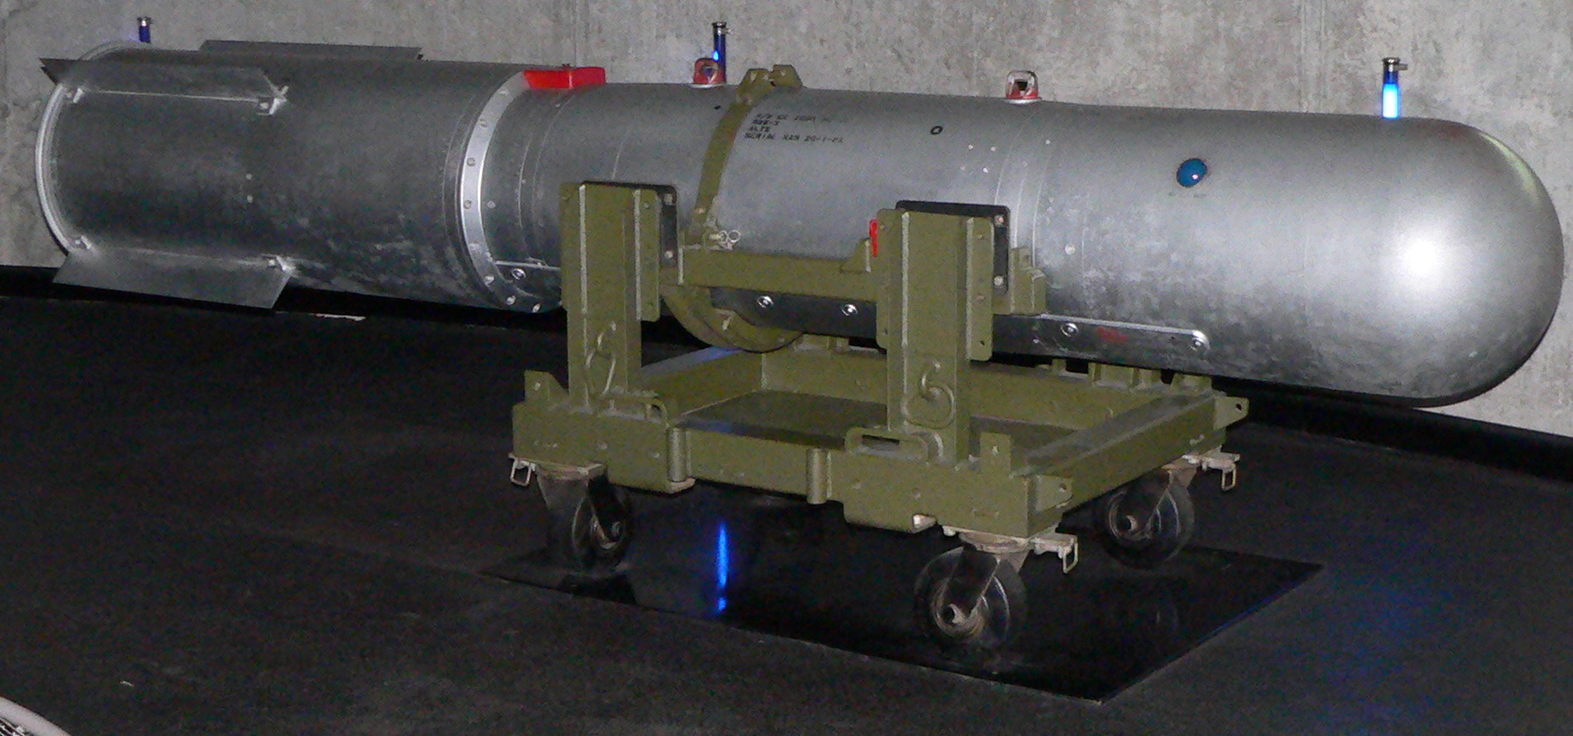
Palomares Incident
On 17 January 1966, a B-52 bomber armed with 4 B-28-RI thermonuclear bombs collided with its refueller
The bombs separated from the bomber during its uncontrolled descent
The bomber, bombs, and surviving crew all came down near Palomares, Spain

Slide 6
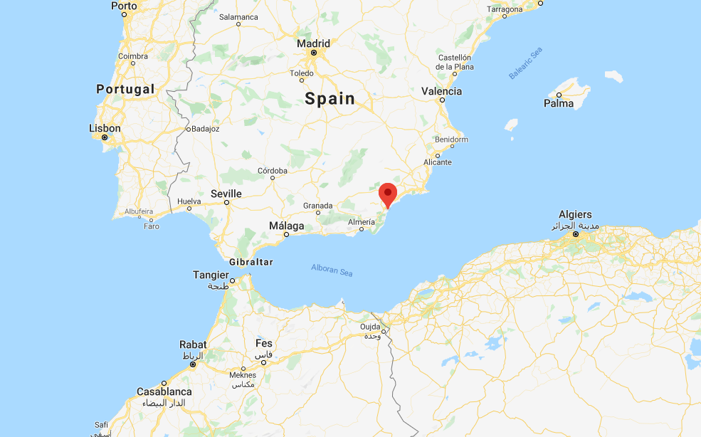
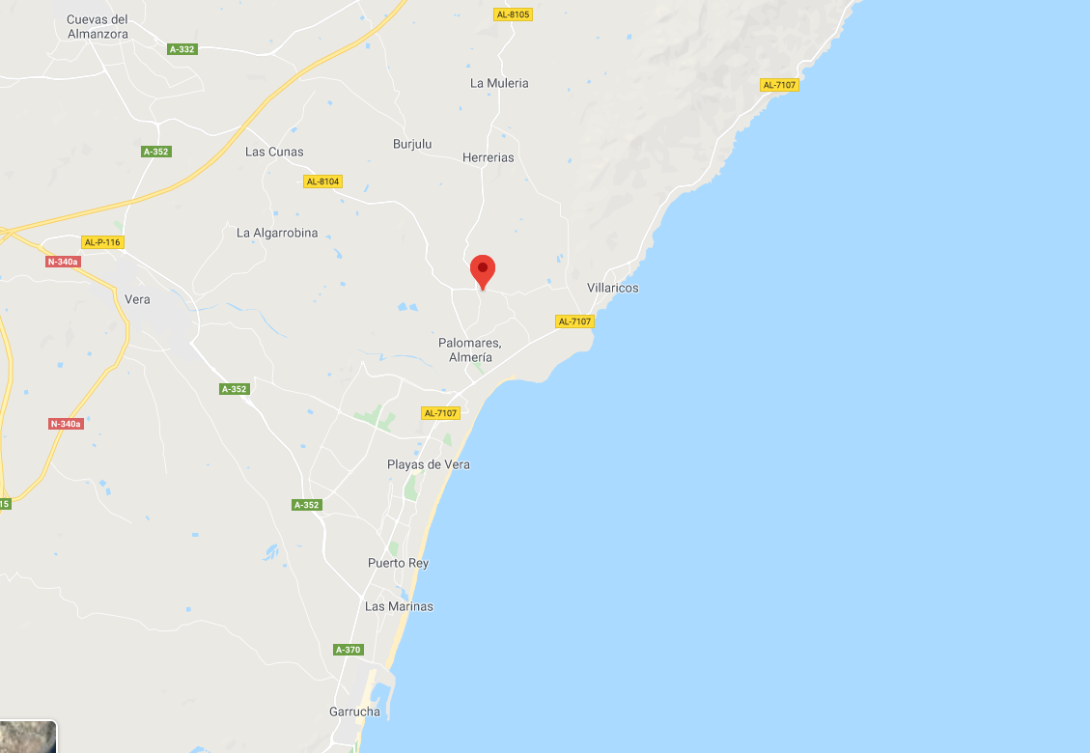
Palomares Incident
Two of the four bombs hit the ground, detonating the high explosive and contaminating a wide area with plutonium
Another fell into a river, and was recovered relatively intact
The fourth bomb could not be found
Evidence suggested that its retarding parachute had deployed, and allowed the bomb to be carried out to sea

Slide 7
Palomares Incident
Thus, we have a lot of different hints (incomplete information) about the position of the bomb
For example, we get some hints from physics:
If the parachute did not deploy, the bomb followed a ballistic path to Earth from the breakup of the plane
If the parachute deployed, we can use knowledge of wind patterns to work out where the bomb was likely to have landed
We can use this knowledge to build up a probability map of where the bomb might have landed

Slide 8
Palomares Incident
We get other hints from basic deduction
If the bomb had landed near a town, we would have heard gossip about it
The bomb didn’t land next to any of the others, or we would have seen it when we recovered them
We can use these to modify the probability map

