Slide 1
Statistical Navigation
Or, How to Make a Good Measurement From a Lot of Bad Measurements

Slide 2
Origins
Ca. 1966

Slide 3
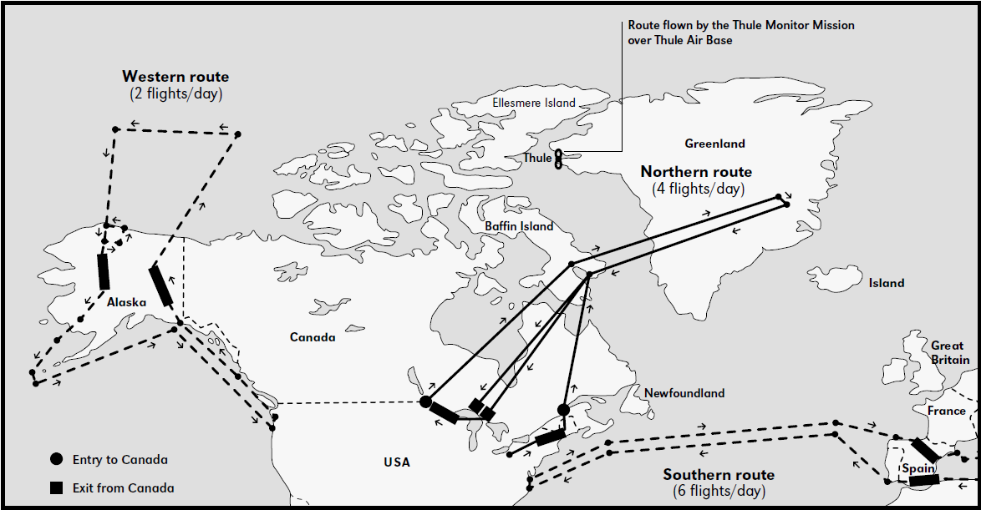
Operation Chrome Dome
US keeps nuclear-armed bombers in the air 24h/day
B-52s fly from US to USSR borders, refuelling multiple times
Notes:
1960-1968

Slide 4
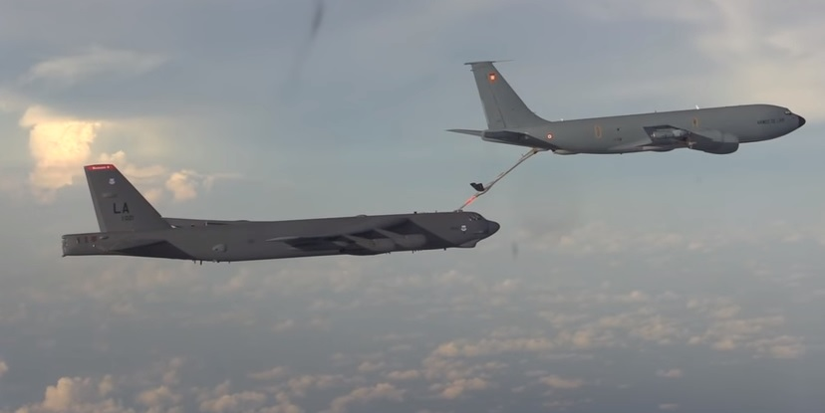
Operation Chrome Dome
In-air refuelling is hard
A nuclear-armed bomber collided with its tanker in January 1966

Slide 5
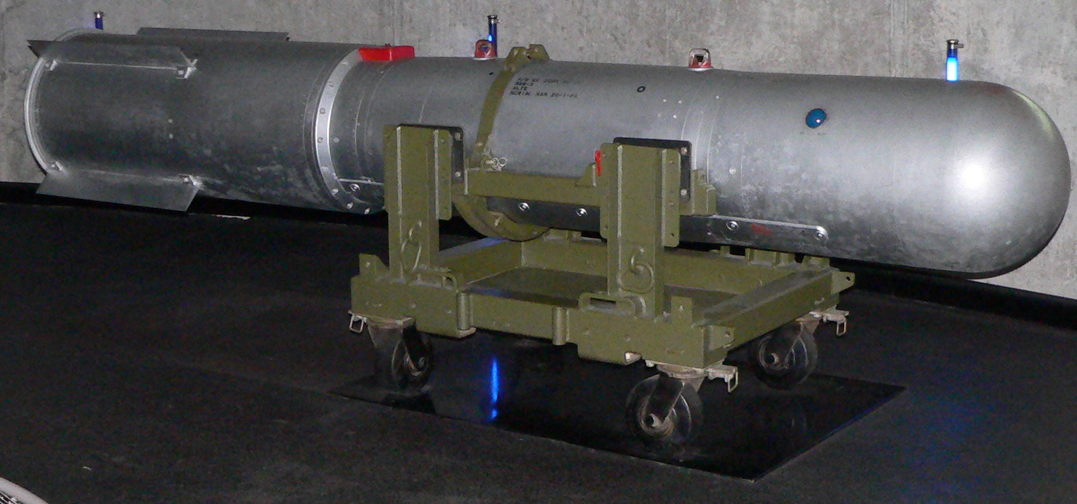
Palomares Incident
On 17 January 1966, a B-52 bomber armed with 4 B-28-RI thermonuclear bombs collided with its refueller
The bombs separated from the bomber during its uncontrolled descent
The bomber, bombs, and surviving crew all came down near Palomares, Spain

Slide 6
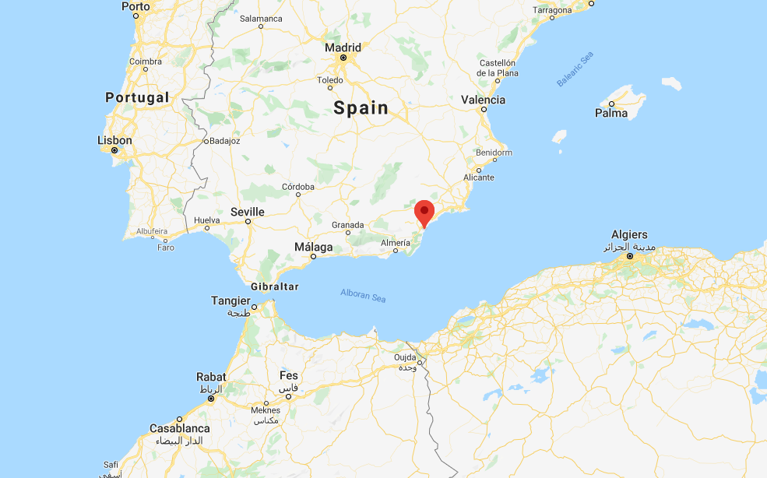
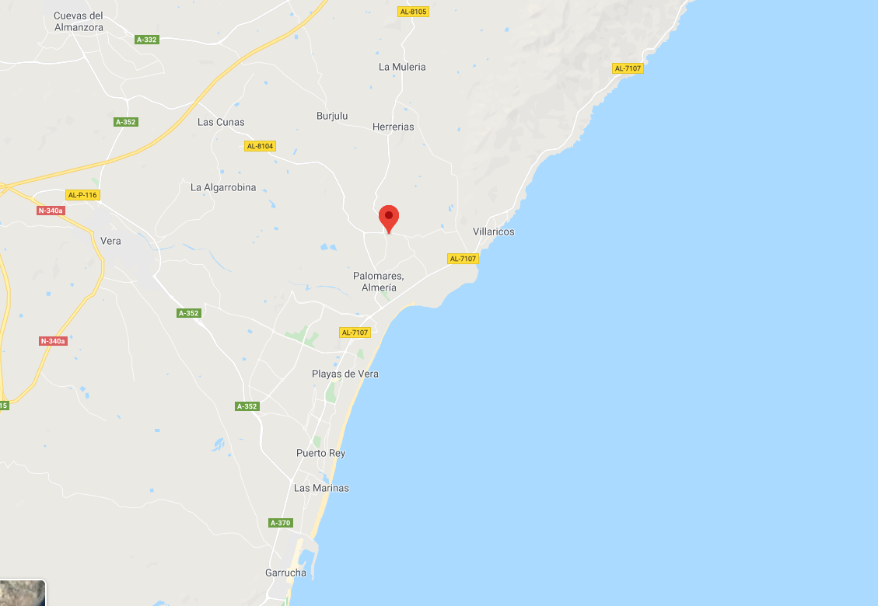
Palomares Incident
Two of the four bombs hit the ground, detonating the high explosive and contaminating a wide area with plutonium
Another fell into a river, and was recovered relatively intact
The fourth bomb could not be found
Evidence suggested that its retarding parachute had deployed, and allowed the bomb to be carried out to sea

