Slide 1
MULTIROLE
Why building a robot that does everything might not be bad
(or why it might be)

Slide 2
The Problem
For all of the (~2) years I’ve been on 696, there have been heated discussions about “how much we should do”
A great example of trying to do too much is 2017
We expended way to much money, metal, and man-hours on shooting
Did it detract from our gear-scoring ability? Maybe…
The expenditure bought us nothing
After the 2017 season, we recognized that we shouldn’t have tried to do everything

Slide 3
The Problem
After the 2018 kickoff, there were strong opinions that we shouldn’t try to do everything (exchange, switch, scale, climb) again
I disagreed with that!
Why?

Slide 4
Analogy: USAF
As an analogy, I’ll be describing two combat aircraft of the US Air Force: the B-52 and the F-35

Slide 5
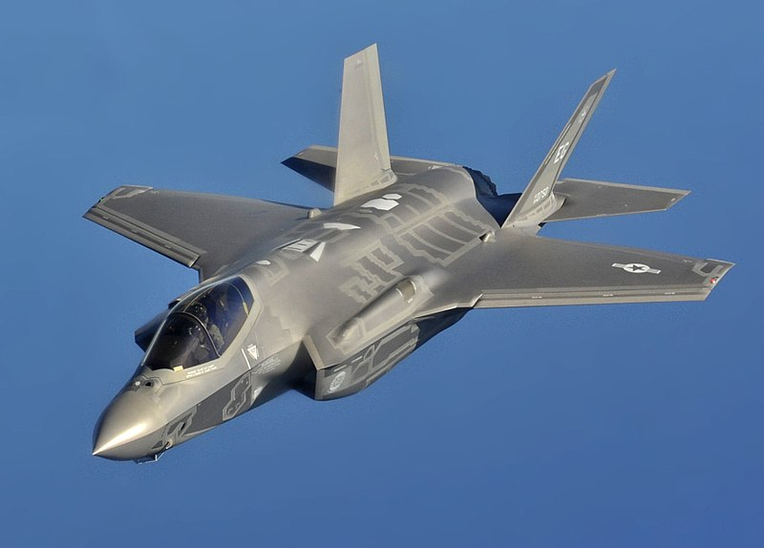
F-35
“Lightning II”
Fighter/attack aircraft
In service 2016-present

Slide 6
F-35
The F-35 gets a lot of deservedly-strong criticism
(Also a lot of criticism that it doesn’t deserve, but that’s beside the point)
It’s widely considered a “jack of many trades, master of none”
It was primarily designed as a stealthy fighter
Requires precise shaping, high tech, smooth fuselage
However, it was touted as a “multirole aircraft”
Stealth fighter
Ground attack
Close Air Support (CAS)
Electronic intelligence (ELINT)
Command, Control, Communications and Intelligence (C4I)
Is also capable of short takeoff, vertical landing (STOVL) for use on carriers
Etc…

Slide 7
F-35
As a result, the F-35 has a lot of contradictions
Doesn’t have an internal gun, to save weight and space
However, a gun pod can be fitted under a wing
However, this ruins stealth
Has stealthy, but limited bomb bays
Munitions carried internally don’t degrade stealth
But there isn’t too much room in the slim fuselage
More weapons can be carried externally
These reduce stealth
Requirements of stealth and maneuverability dictate small size
Can’t carry as much armor and arms as an A-10
More wing loading than an F-14
Etc…
So, “multirole” is bad… right?

Slide 8
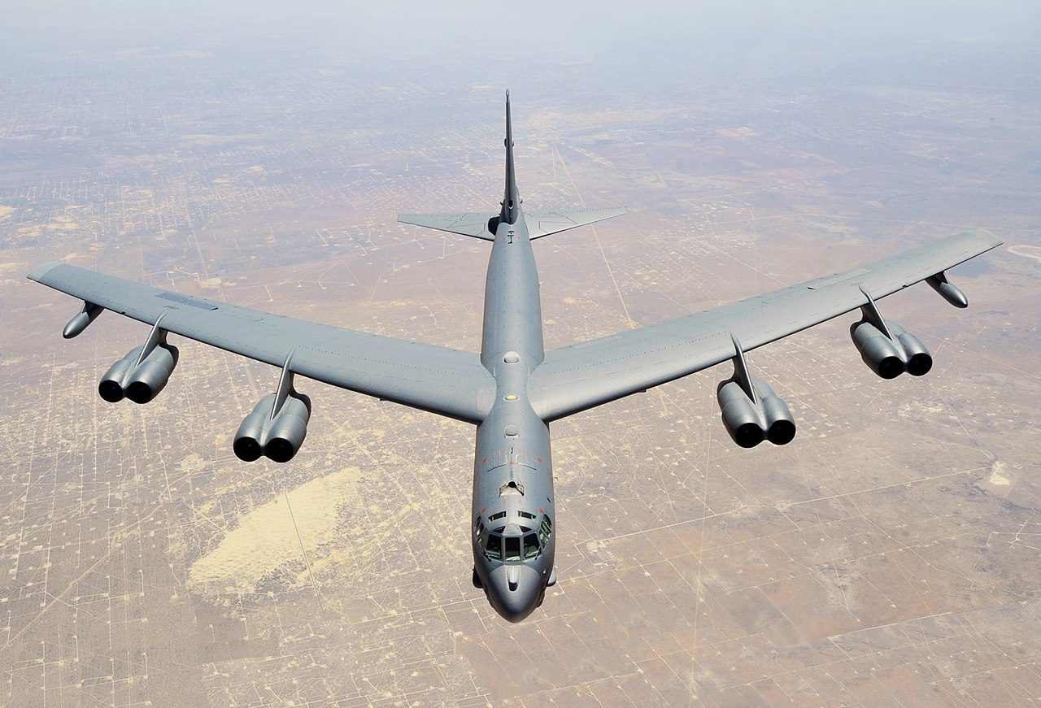
B-52
“Stratofortress”
Strategic bomber
In service 1954-present

Slide 9
B-52
Designed for one purpose:
Carry a lot of nuclear bombs deep inside Soviet territory
At the time, nuclear bombs were very big and heavy
Do so with “reasonable” speed
I.e., their cities get annihilated no later than ours
Fly at high altitudes
Beyond the range of early surface-to-air missiles (SAMs)

Slide 10
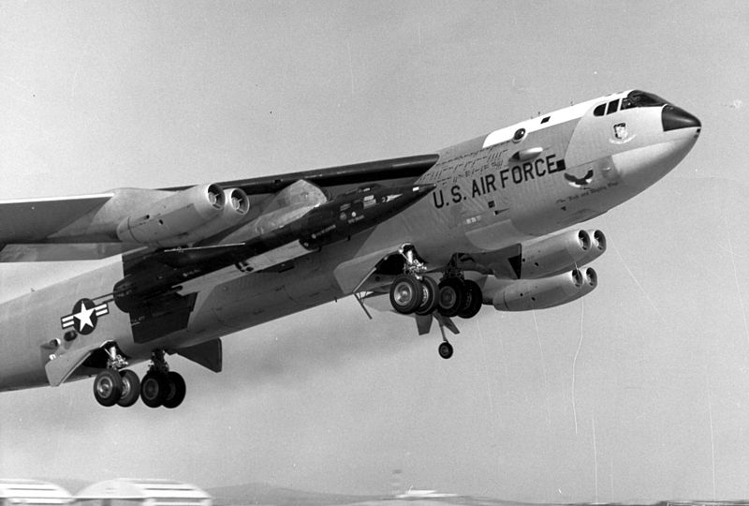
B-52
However, the B-52 was repurposed for other missions
Low-level penetrating nuclear bomber
Conventional strike
Carry a bunch of small conventional bombs
Carry a few big conventional bombs
Carry nuclear or conventional cruise missiles
ELINT
Strategic reconnaissance (RB-52C)
Basically pods full of cameras
“Mothership” launch platforms
>60 years of service
And still going strong
Its original mission no longer exists

Slide 11
Comparisons
So what’s the difference?
Well, for one thing, the F-35 was designed to be multirole, whereas the B-52 grew into it
You can’t really control that, though
The B-52 only really has one strength
Lots of wing
Lots of engine
Lots of fuel
It doesn’t care what its cargo is
The F-35 was designed to have lots of (eventually contradictory) strengths
Small and stealthy
Fast and maneuverable
Well-armed
“Smart”

Slide 12
Lessons
Back to robotics… what can we learn from this?
What matters isn’t “how many things (goals, objectives, capabilities) the system can do”
What matters is how many strengths you’re trying to pack into one system
Consider orthogonality
A common term in math
Geometrically, “two things at right angles”
More generally, if A and B are orthogonal, changing A doesn’t affect B

Slide 13
Lessons
2017: 3 orthogonal tasks: balls, gears, climbing
For example, no matter how good your shooter is, it won’t affect how good you are at placing gears
Getting really good at shooting may hurt your gear ability
Draws away resources: volume, mass, man-hours, etc.
2018: 2 orthogonal tasks: cubes, climbing
Technically, there were 4 tasks: exchange, switch, scale, climb
However, they weren’t orthogonal
If your intake can grab a cube to place it on the scale, it can grab a cube to place it in the switch

Slide 14
Lessons
The great mistake in 2018 was to think, “do I want to do switch or scale?”
“We’ve learned our lesson about ‘trying to do everything’! Let’s just do switch and climbing!”
If switch and scale are not orthogonal, doing scale does not necessarily detract from your switch game
Any robot that can place cubes on the scale can also play switch and exchange

Slide 15
Conclusions
Decide how many strengths you think you can cram into a system
Don’t worry about if you’re “trying to do everything”
If you can build a robot that accomplishes 4 tasks well, it shouldn’t matter if there are 4 or 24 tasks in the game
Remember… engineering is weighing goals against constraints
Any idiot could put a rover on Mars given enough time and money
It takes engineers to do it on time and in budget

