Slide 1
Statistical Navigation
Or, How to Make a Good Measurement From a Lot of Bad Measurements

Slide 2
Origins
Ca. 1966

Slide 3
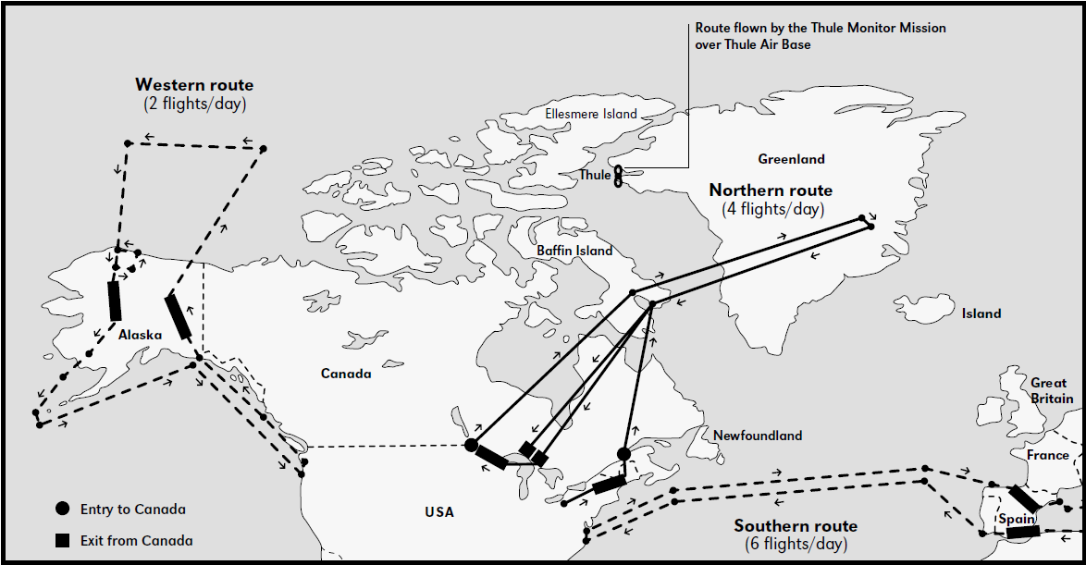
Operation Chrome Dome
US keeps nuclear-armed bombers in the air 24h/day
B-52s fly from US to USSR borders, refuelling multiple times
Notes:
1960-1968

Slide 4
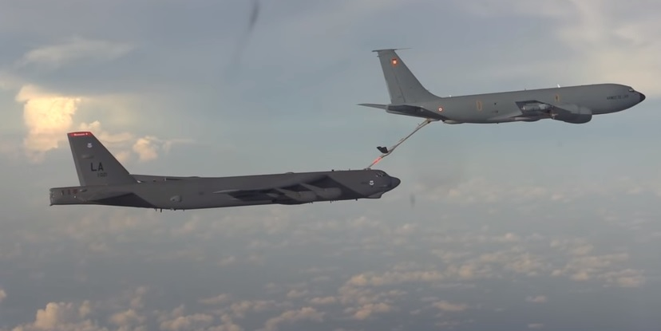
Operation Chrome Dome
In-air refuelling is hard
A nuclear-armed bomber collided with its tanker in January 1966

Slide 5
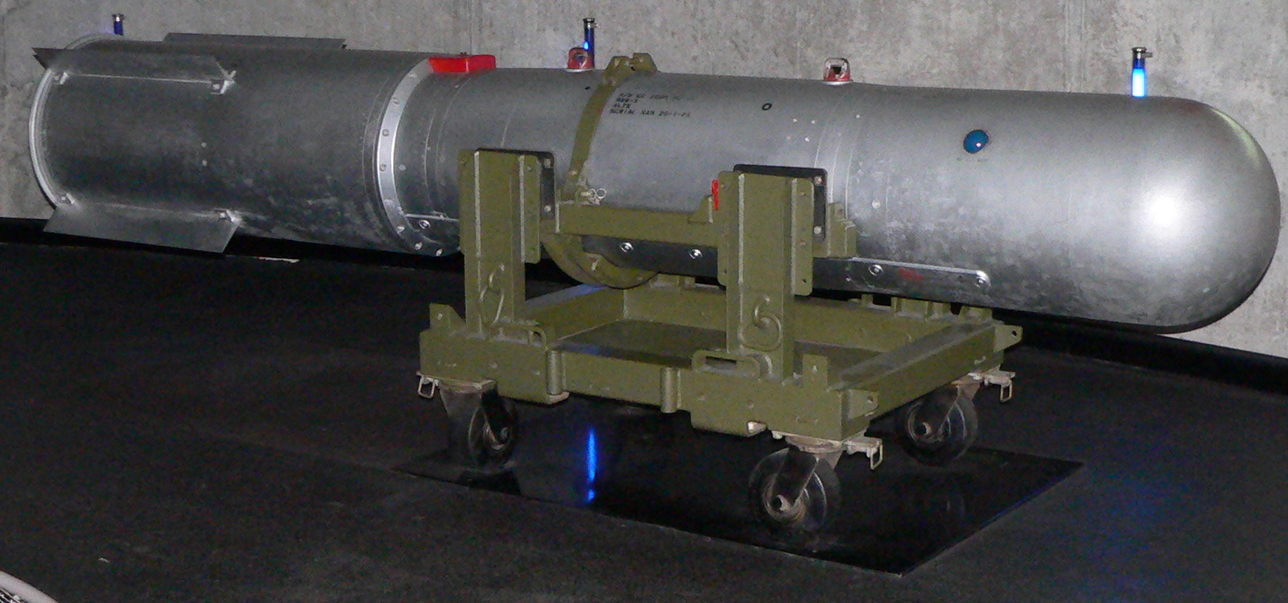
Palomares Incident
On 17 January 1966, a B-52 bomber armed with 4 B-28-RI thermonuclear bombs collided with its refueller
The bombs separated from the bomber during its uncontrolled descent
The bomber, bombs, and surviving crew all came down near Palomares, Spain

Slide 6
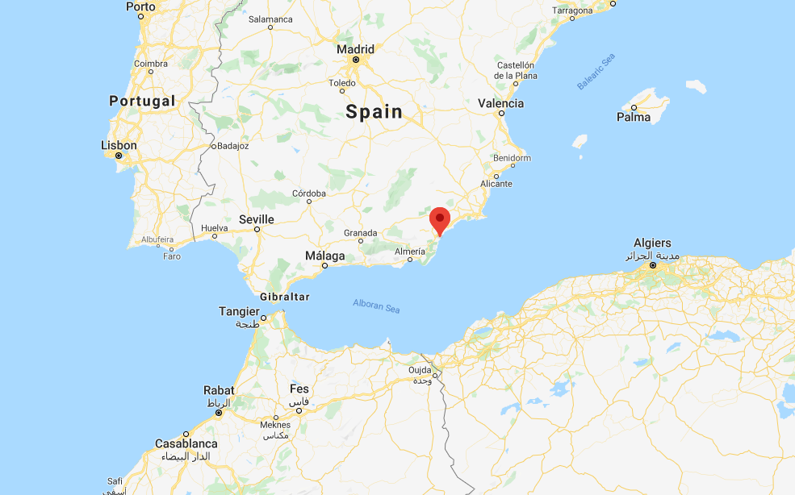
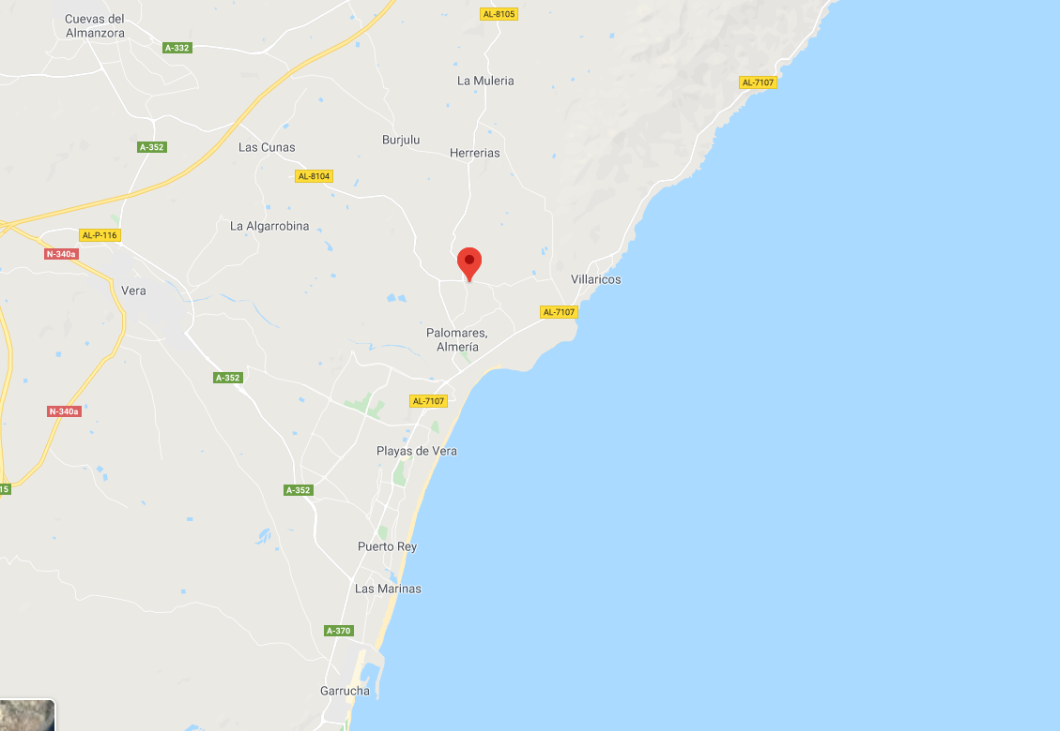
Palomares Incident
Two of the four bombs hit the ground, detonating the high explosive and contaminating a wide area with plutonium
Another fell into a river, and was recovered relatively intact
The fourth bomb could not be found
Evidence suggested that its retarding parachute had deployed, and allowed the bomb to be carried out to sea

Slide 7
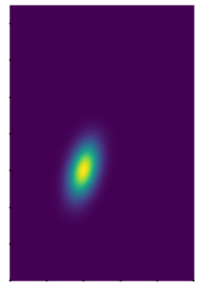
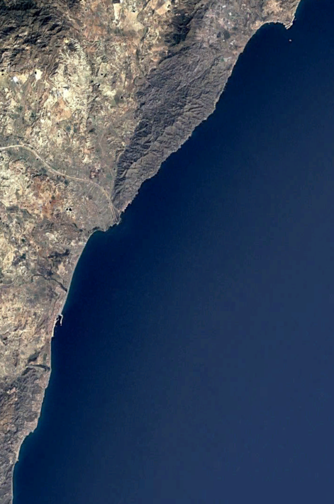
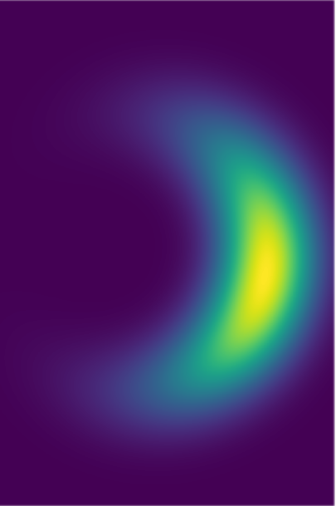
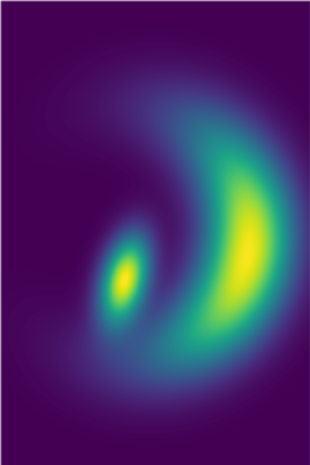
Palomares Incident
Thus, we have a lot of different hints (incomplete information) about the position of the bomb
For example, we get some hints from physics:
If the parachute did not deploy, the bomb followed a ballistic path to Earth from the breakup of the plane
If the parachute deployed, we can use knowledge of wind patterns to work out where the bomb was likely to have landed
We can use this knowledge to build up a probability map of where the bomb might have landed
Wind
Direction of Flight
Collision

Slide 8
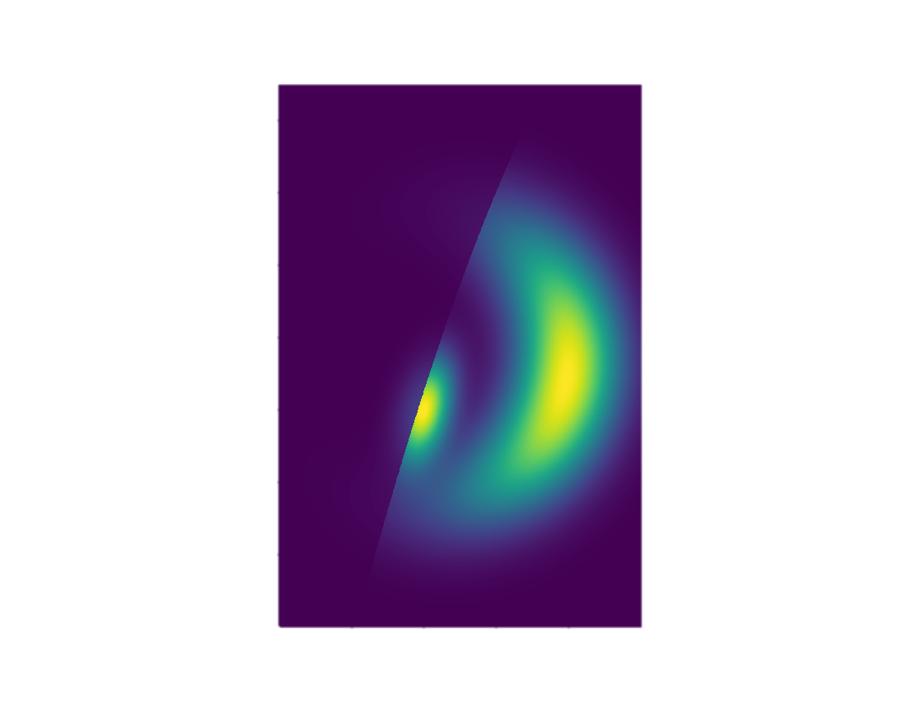

Palomares Incident
We get other hints from basic deduction
If the bomb had hit the ground, it likely would have exploded
We can use these to modify the probability map

Slide 9
Palomares Incident
We then pick the highest-probability area(s) to search

Slide 10

Palomares Incident
Did we find the bomb?
If so, we’re done!
If not, we can now say that the probability of the bomb being in the places we searched is very low
Not zero– there’s a small chance we might have missed it

Slide 11
Palomares Incident
Now, the maximum probability values are in different places
We conduct new searches at the new maximums, and repeat
The bomb was eventually found this way, under 2500 feet of water, and recovered

Slide 12
Bayesian Search
This is a method called Bayesian search
First, generate an initial probability map
Next, search in the locations of highest probability
Anywhere you searched and didn’t find anything, now has a low probability
Update the probability map
You can also insert external information. For example, if you receive a fisherman saw a large object fall into the water, that area of ocean now has a much higher probability
Repeat

