Slide 1

Sentiment Analysis with AWS Managed Services
Carlos Ramos | AWS Professional Services
November 2018
Notes:
Carlos Ramos - Consultant for AWS
Previous meeting we talked about our infrastructure, our services and our value proposition. Today I’d like to go deeper into Commercial Cloud Services.

Slide 2

Sentiment Analysis with AWS
The Use Case
The Dataset
The Services
Data Pipeline
Project Overview

Slide 3
The Use Case
Today consumers are encouraged to express their satisfaction or frustration with a company or product through social media, blogs, and review platforms.
Sentiment analysis can help companies better understand their customers’ opinions and needs and make more informed business decisions. It allows them to identify substandard products, or substandard suppliers.

Slide 4
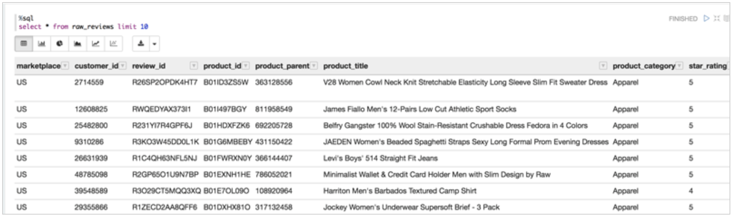
The Dataset
Amazon released a dataset to the public with over 130 million product reviews in multiple categories and languages. The dataset includes the columns below:

Slide 5
The Services
Service | Role
S3 | Object Storage - Used to store the data set, and to store the results of the ETL job
Glue | Managed Apache Spark- Used to load and perform operations on the dataset (similar to Pandas)
Comprehend | NLP- language of the text; key phrases, places, people, brands, or events; sentiment. Analyzes text using tokenization and parts of speech.
Athena | Interactive query service that makes it easy to analyze data in Amazon S3 using standard SQL
Quicksight | Visualization Engine
Notes:
AWS Glue - Apache Spark
Consists of Resilient Distributed Dataset (RDD), the basic abstraction in Spark.
Represents an immutable, partitioned collection of elements that can be operated on in parallel.
Internally, each RDD is characterized by five main properties:
A list of partitions
A function for computing each split
A list of dependencies on other RDDs
Optionally, a Partitioner for key-value RDDs (e.g. to say that the RDD is hash-partitioned)
Optionally, a list of preferred locations to compute each split on (e.g. block locations for an HDFS file)
AWS Comprehend
Amazon Comprehend analyzes text and tells you what it finds, starting with the language, from Afrikans to Yoruba, with 98 more in between. It can identify different types of entities (people, places, brands, products, and so forth), key phrases, sentiment (positive, negative, mixed, or neutral), and extract key phrases, all from text in English or Spanish. Finally, Comprehend‘s topic modeling service extracts topics from large sets of documents for analysis or topic-based grouping.

Slide 6
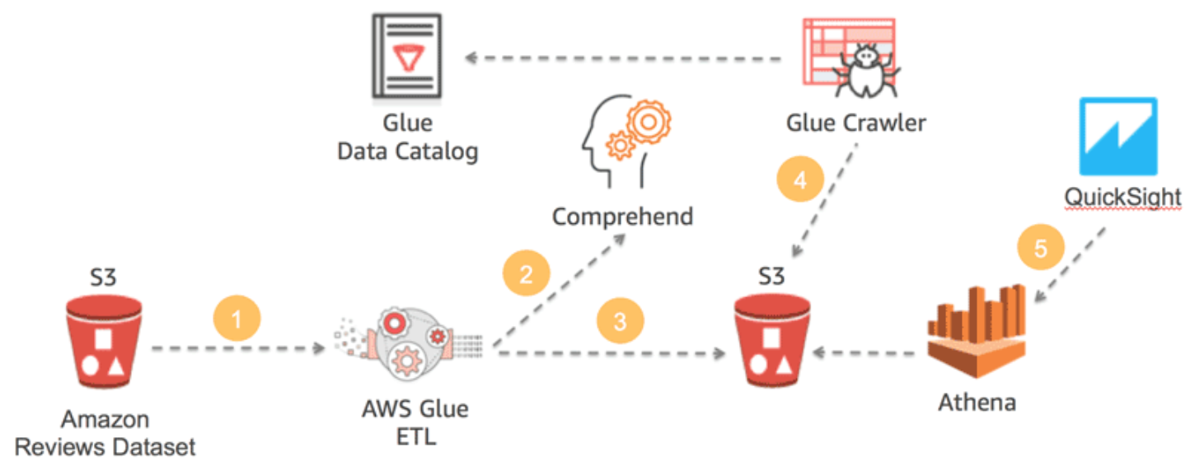
Data Pipeline
Notes:
Read dataset from public bucket
Use glue to process dataset, get 10000 records
Send the 10000 reviews for analysis by comprehend
Load transformed dataset into S3
Use glue crawler to get metadata about the data
Use Athena to run queries against the data
Use quicksight to visualize the data

Slide 7
Project Overview

