Slide 1


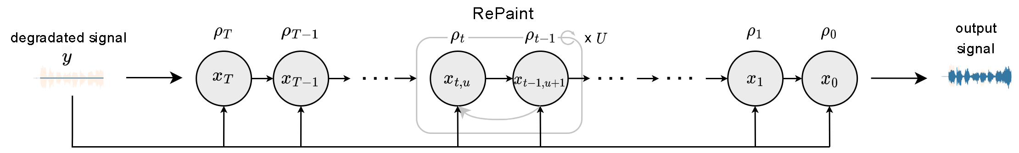
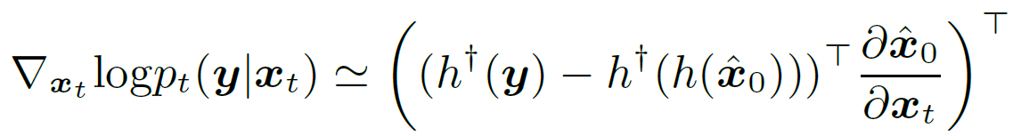

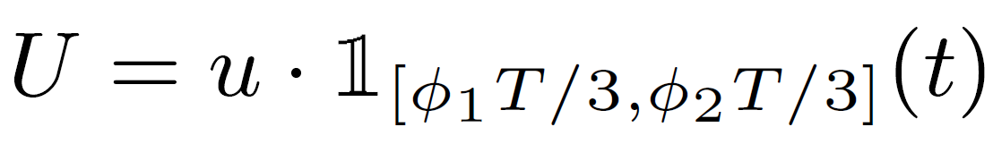
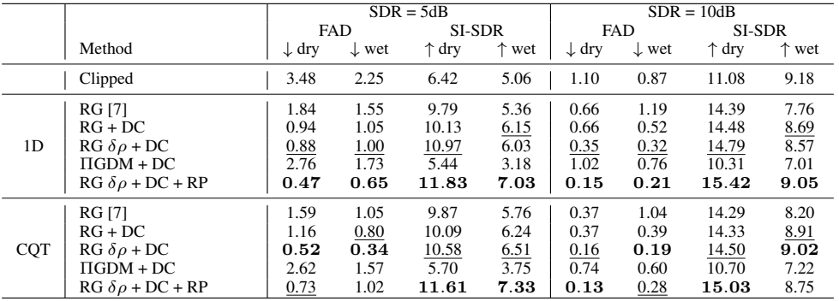

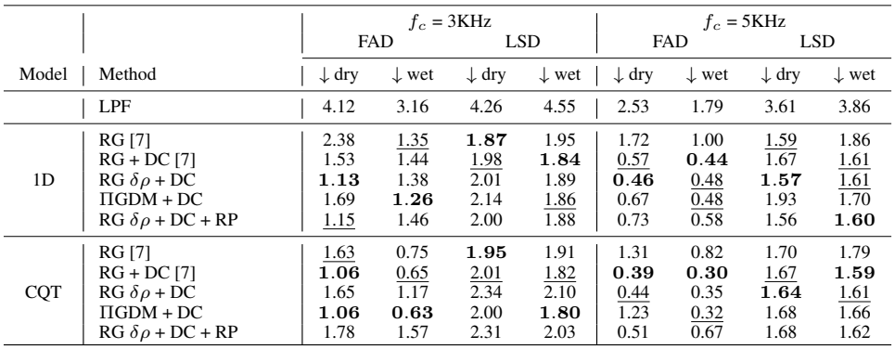
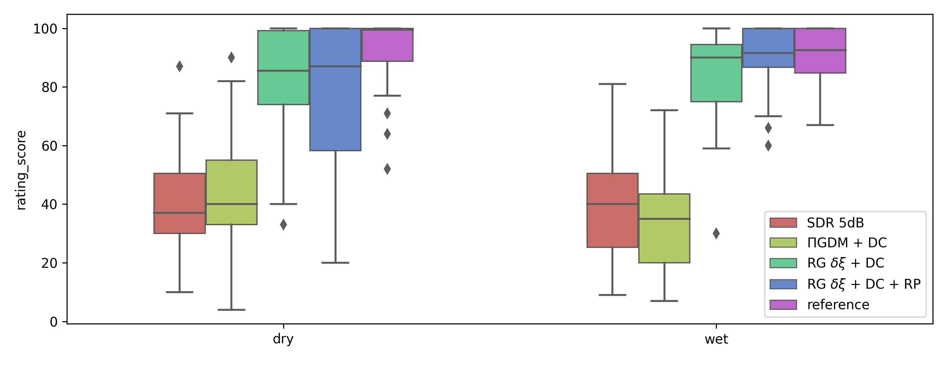
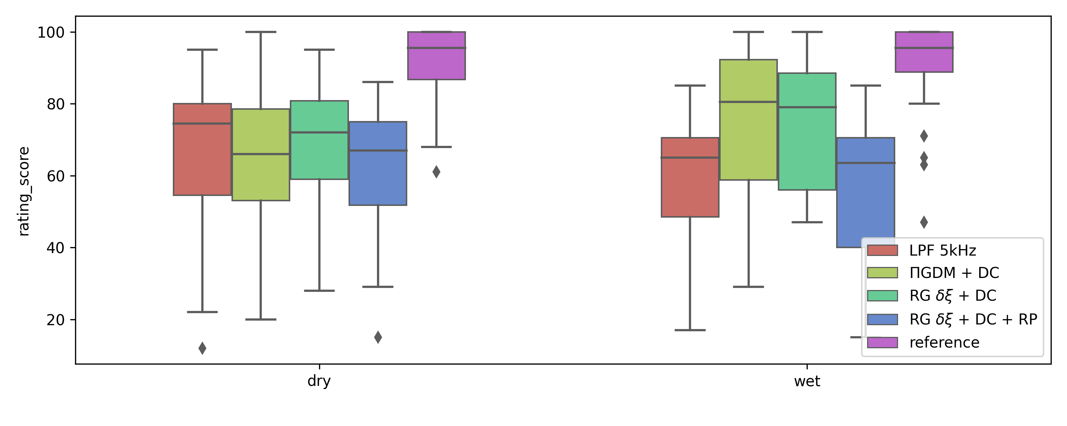







VRDMG: Vocal Restoration via Diffusion Posterior Sampling with
Multiple Guidance
Carlos Hernandez-Olivan, Koichi Saito, Naoki Murata, Chieh-Hsin Lai, Marco A. Martínez-Ramírez, Wei-Hsiang Liao, Yuki Mitsufuji
University of Zaragoza, Sony AI, Sony Group Corporation
Music Restoration using Unsupervised Diffusion Models
Inverse Problem via Posterior Sampling
Music restoration framed as inverse problem: Recovering a clean signal from a degraded one (inpainting, declipping, etc.).
Motivation: Explore vocal dry and wet restoration with different sampling methods.
Challenges: Ill-posed problems: Multiple possible solutions exist.
Traditional methods: Require task-specific assumptions and paired data (clean & degraded). Not well generalization to unseen data.
Deep generative models for music restoration: Trained on clean signals only.
Data-driven assumptions about clean music.
Adaptable to various restoration tasks.
CQT-Diff [3]: A diffusion-based approach. Good performance on piano declipping, bwe, and inpainting.
Areas for improvement:
Semantic consistency: DC method may lead to nonsensical results.
Generalizability: Performance on diverse data not explored.
Reconstruction Guidance (RG)
Compute the likelihood term in the conditional score function.
Measures the difference between the observed data and the predicted clean signal after applying the degradation function to it.
Pseudo-Inverse Guidance (ΠGDM)
An alternative method for calculating the likelihood term, applicable even for non-differentiable degradation functions.
It leverages the pseudo-inverse of the degradation function.
Improving Data Consistency with RePaint (RP) Strategy
RP resamples the intermediate prediction during the inference process, promoting semantic consistency. To avoid excessive computation, we propose applying RP cycles during a specific phase inspired by FreeDoM.
Score-based Generative Modeling with Diffusion Processes
Results
Inverse Problem via Posterior Sampling
Recovering a clean vocal signal (x₀) from a degraded observation (y) considering a degradation function ( ) and measurement noise.
Posterior sampling: It leverages the relationship between the prior distribution of clean signals and the likelihood of observing the degraded signal given the clean one.
Conditional score function: Combines the score function and the likelihood term based on the degradation function.
cONCLUSIONS
Table 1. Objective metrics for declipping with pre-trained CQT and 1D models.
Conditional score
density
likelihood
Table 2. Objective metrics for bandwidth extension with pre-trained CQT and 1D models
Tasks
Model: CQT-Diff [3] trained on vocal dry and wet data: NHSS dataset, NUS, MUSDB18 (vocals). 22.05KHz.
Declipping
Bandwidth Extension
Declipping
BWE
Contributions
Conslusions
1D model beats CQT one and it is 15 times faster in inference time.
Further explore posterior sampling techniques especially for bwe.
Enhanced Diffusion Posterior Sampling (DPS)
RP strategy with time scheduling for improved semantic consistency.
Refine Reconstruction Guidance (RG) with time-dependent scaling.
Integrate Pseudoinverse-Guided Diffusion Models for broader applicability.
Systematic Evaluation
Conduct experiments to identify the most effective combination of these approaches.
Achieve comparable performance to the CQT model using the 1D SaShiMi-Diff architecture with a 15x faster inference speed.
References
[1] Song, Y., & Ermon, S. (2019). Generative modeling by estimating gradients of the data distribution. In Advances in Neural Information Processing Systems (Vol. 32).
[2] Song J, Vahdat A, Mardani M, Kautz J. Pseudoinverse-guided diffusion models for inverse problems. In International Conference on Learning Representations 2022.
[3] Moliner, E., Lehtinen, J., & Välimäki, V. (2023). Solving audio inverse problems with a diffusion model. In 2023 IEEE International Conference on Acoustics, Speech and Signal Processing (ICASSP) (pp. 1-5). IEEE.
[4] Yu, J., Wang, Y., Zhao, C., Ghanem, B., & Zhang, J. (2023). FreeDoM: Training-free energy-guided conditional diffusion model. In Proceedings of the IEEE/CVF International Conference on Computer Vision. 2023. p. 23174-23184.
[5] Lugmayr, A., Danelljan, M., Romero, A., Yu, F., Timofte, R., & Van Gool, L. (2022). RePaint: Inpainting using denoising diffusion probabilistic models. In Proceedings of the IEEE/CVF Conference on Computer Vision and Pattern Recognition (pp. 11451-11461).
: Gradient operator
: Degradation function
: Denoiser
Paper
Demos
Scholar
CV

