Slide 1




Bases de datos Relacionales
Y lenguaje SQL
Maestría en Ciencias de Datos Facultad de Ingeniería Universidad Icesi
Ángela Villota Gómez apvillota@icesi.edu.co

Slide 2
1 Introducción
2 Sql(DDL)
3 SQL(DDL)
4
SQL(DML)
Contexto, la clase pasada, la de hoy
Preguntas - dudas- quiz
Restricciones, inserts
Select From Where

Slide 3
Introducción

Slide 4
La semana pasada
Temas
Contexto del curso
Modelo relacional
SQL (1)
Tareas:
Tarea: Construya un archivo de texto con las instrucciones SQL que permiten crear la base de datos del problema del hotel.
Material extra
Introducción a SQL de Khan Academy [link]
Modificar bases de datos con SQL de Khan Academy [link]
Herramienta para hacer pruebas [link]
Herramienta de codificación
Oracle live[link]

Slide 5

Preguntas?
Does anyone have any questions?

Slide 6
Recursos de esta clase
En la carpeta de la Sesión 2
Lectura: CH7_Connolly-Begg (en la carpeta)
Lectura: CH6_Connolly-Begg (en la carpeta)
DDL del ejemplo: Ejemplos SQL (en la carpeta)
Editores de SQL online
Oracle Live [link]

Slide 7
SQL(2)

Slide 8
SQL - OVERVIEW
Data Definition Language (DDL) for defining the database structure and controlling the access to data.
CREATE TABLE
ALTER TABLE
DROP TABLE
Data Manipulation Language (DML) for retrieving and updating data.
INSERT
UPDATE
DELETE
SELECT (Álgebra relacional)
Notes:
Objectives:
Create the database structure
Perform basic management tasks, such as insertion, modification and deletion
Perform both simple and complex queries
Characteristics
Few keywords, in english and simple structure, make the language to be usable for a wide range of users: as programmers, management personnel, DBA, and other stakeholders
Importance
Is the first and so far only standard database language

Slide 9
UPDATE - Delete
Branch (branchNo, street, city, postcode)
Staff (staffNo, fName, lName, position, sex, DOB, salary, branchNo)
UPDATE table_name
SET column1 = value1, column2 = value2, ...
WHERE condition;
DELETE FROM table_name WHERE condition;
UPDATE Branch SET city = 'Cali' WHERE branchNo= 'B005';
DELETE FROM Branch WHERE branchNo= 'B005';

Slide 10
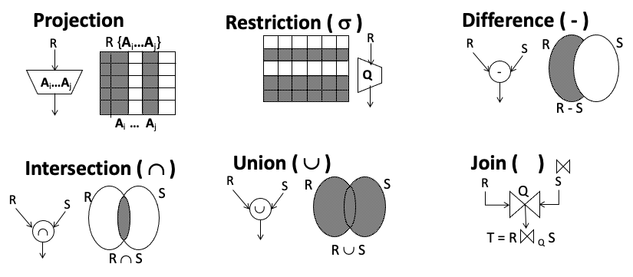
Queries- Relational Algebra

Slide 11
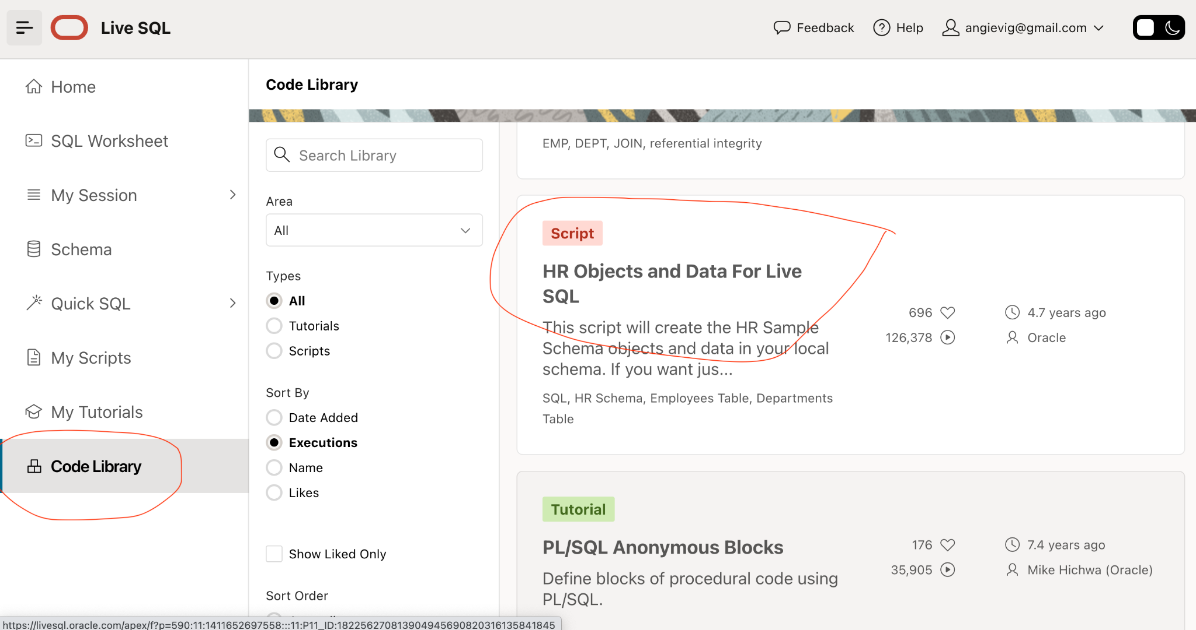
Select examples

Slide 12
Ejemplos de consultas
select count(*) from Employees
where FIRST_NAME like 'A%';
select count(EMAIL) from Employees
where FIRST_NAME like '%a';
select * from Employees
where FIRST_NAME like '%A%';
select * from Employees
where FIRST_NAME like 'A%';
select * from Employees
where FIRST_NAME like '%a';
select * from Employees
where FIRST_NAME like '%A%';
select * from Employees
where FIRST_NAME like 'A___';
select * from Employees
where FIRST_NAME like'%a%' AND FIRST_NAME like'%A%';
select SUM(salary) from Employees
SELECT * FROM EMPLOYEES WHERE SALARY = (SELECT MIN(SALARY) FROM Employees);
SELECT * FROM EMPLOYEES WHERE SALARY in (2400, 3000, 10000, 6500);

Slide 13
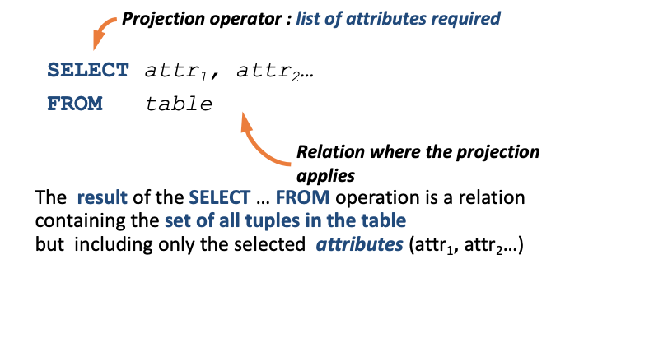
Projection

Slide 14
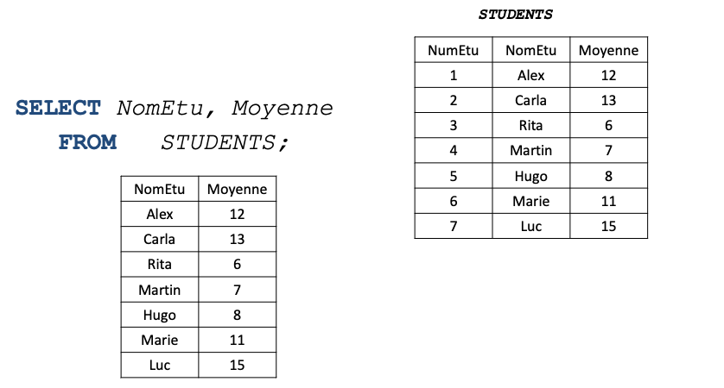
PROJECTION

Slide 15
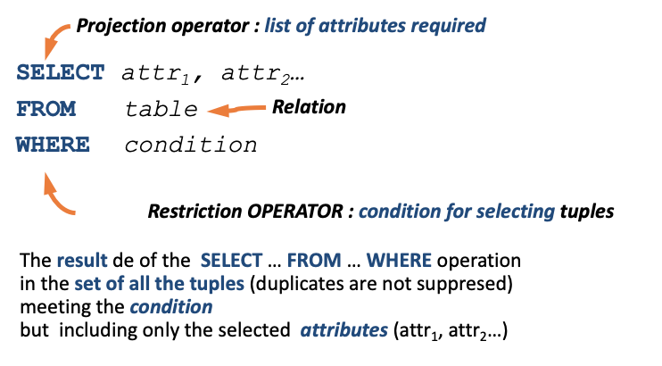
RESTRICTION

Slide 16
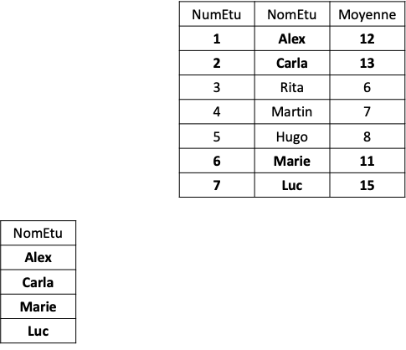
RESTRICTION
SELECT NomEtu
FROM Students
WHERE Moyenne > 10;
Expresión regular: Cadena que representa un conjunto de cadenas.
Patrón: 1. Concatenaciones 2. * + ? → %, _ *Cali* %Cali%

Slide 17
Where
Where contains a condition that restrict the retrieved tuples. WHERE may contains
Comparisons with
Relational operators: <, <=, =, <>, >=, >
Arithmetic operators: +, -, *, /
Logic operators: AND, OR, NOT
Ranges: Between, not between
Set membership.
Pattern match.
Null.
Promedio_Acumulado BETWEEN 4.0 AND 5.0
Nombre_Programa IN ('Ingenieria Telematica', 'Ingenieria de sistemas')

Slide 18
Pattern match - Like
Pattern matching allow the usage of regular expressions to find values represented as strings (char, varchar). Pattern matching symbols
% (percent) any sequence of zero and more characters
_ (underscore) any single character
Examples
Salon LIKE ‘2%’ the first character is 2 and the others can be anything (cursos que se dictan en un segundo piso)
Salon LIKE ‘%L’ the last character is L(cursos que se dictan en el L)
NOMBRE_CUR LIKE '%Algoritmos%' contains the string ‘Algoritmos’

Slide 19
SQL Aggregate Functions
Aggregate functions cannot be part in where clauses
Having clauses include restrictions over groups
Functions
Count
SUM
AVG
MIN - MAX
Operates Non-Null Values, except Count(*)

Slide 20
Aggregate functions and Null values
Count IGNORE Null values (Exceptions)
select count(*) from employees;
select count(COMMISSION_PCT)
from employees;
Min - Max IGNORE Null values
select
Min(COMMISSION_PCT) AS Min_Comission,
MAX(COMMISSION_PCT) AS Max_Comission
from employees;
SUM - AVG IGNORE Null values
select EMPLOYEE_ID, FIRST_NAME, LAST_NAME, JOB_ID,
(salary + salary * COMMISSION_PCT) AS Total_Salary
from employees;
Distinct NULL counts!!
If Distinct is no specified, ALL is assumed
Cannot use Distinct on Count(*)
No value to use with MIN-MAX
Select Distinct COMMISSION_PCT
from employees;

Slide 21
Ejercicio
Después de ejecutar las consultas del slide anterior, ¿Encuentra alguna correlación en los datos en los que esté involucrada la comisión?
Utilice algunas consultas/resultados para sustentar su respuesta

Slide 22
Some advices
Use ORDER BY to improve the results’ readability
Filter data is a good idea to reduce the size of the dataset before applying more complex operations.
Indent correctly your code or use Poor SQL to make the job for you [link]

Slide 23
Select-From - Where
General form - Syntax
SELECT [DISTINCT | ALL]{*|[attributeName [AS newName]] [,] } FROM tableName [alias] [WHERE condition] [GROUP BY attributeList] [HAVING condition] [ORDER BY attributeList]
Notation: [optional] {mandatory}

Slide 24
Select-From - Where
General form - Semantics
FROM table(s) to be used WHERE filters the rows subject of the condition GROUP BY forms groups of rows with the same column value HAVING filters the groups subject to some condition SELECT specifies which columns will appear in the output ORDER BY specifies the order of the output

Slide 25
Taller en Clase
Consultas simples
Genere la lista con todos los datos de los hoteles
Genere la lista con todos los datos de los hoteles dada una ciudad (elegir una)
Genere la lista con los nombres y direcciones de todos los huéspedes que se han hospedado en hoteles localizados en la ciudad del punto anterior, ordenados de forma alfabética por el nombre.
Genere el listado de todos los cuartos familiares o dobles con un precio menor a 80 dólares por noche, en orden ascendente del precio.
4. Consultas con funciones agregadas
¿Cuántos hoteles hay registrados?
¿Cuál es el precio promedio de un cuarto?
¿Cuántos huéspedes diferentes se llaman Juan (o tienen el nombre Juan, por ejemplo Juan Felipe también es correcto)?
¿Cuál podría ser el ingreso total por noche, por todos los cuartos de tipo doble.
¿Cuál es el ingreso total por noche, por todos los cuartos de tipo double que han sido reservados?

Slide 26
Para la próxima clase
Terminar los ejercicios propuestos en los slides
Continuar con los problemas de HackerRank
Estudiar el material de estudio sobre modelos de datos de la carpeta de la sesión 3 [link]

Slide 27
Delete Update-
Constraints
Branch (branchNo, street, city, postcode)
Staff (staffNo, fName, lName, position, sex, DOB, salary, branchNo)
Referential integrity FOREIGN KEY (branchNo) REFERENCES Branch
ON DELETE ON UPDATE
CASCADE, delete the row from the parent table and automatically delete the matching rows in the children table. (And the others linked)
SET NULL, delete the row from the parent table and set the foreign key values to null
SET DEFAULT, set a default value in the children tables
NO ACTION, reject the deletion

Slide 28
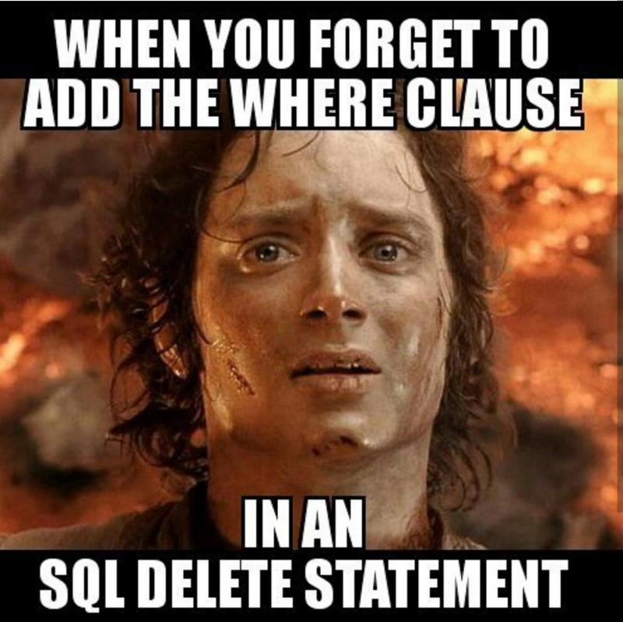
Semantics of Delete and Update
didn’t get the joke? Let’s do this optional activity [link]

