Slide 1




Bases de datos Relacionales
Y lenguaje SQL
Maestría en Ciencias de Datos Facultad de Ingeniería Universidad Icesi
Ángela Villota Gómez apvillota@icesi.edu.co

Slide 2
1 Introducción
2 Sql(DDL)
3 SQL(DDL)
4
SQL(DML)
Contexto, la clase pasada, la de hoy
Preguntas - dudas- quiz
Restricciones, inserts
Select From Where

Slide 3
Introducción

Slide 4
La semana pasada
Temas
Contexto del curso
Modelo relacional
SQL (1)
Tareas:
Actividad de diagnóstico: competencia de programación [link]
Tarea: Construya un archivo de texto con las instrucciones SQL que permiten crear la base de datos
Material extra
Introducción a SQL de Khan Academy [link]
Modificar bases de datos con SQL de Khan Academy [link]
Herramienta para hacer pruebas [link]

Slide 5

Preguntas?
Does anyone have any questions?

Slide 6
Recursos de esta clase
En la carpeta de la Sesión 1
Lectura: CH7_Connolly-Begg (en la carpeta)
Lectura: CH6_Connolly-Begg (en la carpeta)
DDL del ejemplo: Ejemplos SQL(en la carpeta)
Taller Modelado SQL-1
Editores de SQL online
SQL Fiddle[link]
Oracle Live [link]
MyCompiler [link]

Slide 7
SQL(1)

Slide 8
SQL - Introduction
SQL stands for Structured Query Language.
SQL is the standard relational database language that can be used as
Data Definition Language (DDL) for defining the database structure and controlling the access to data.
Data Manipulation Language (DML) for retrieving and updating data.
SQL is a declarative language where you specify what you wanna do (create, consult) instead of how to do it
Notes:
Objectives:
Create the database structure
Perform basic management tasks, such as insertion, modification and deletion
Perform both simple and complex queries
Characteristics
Few keywords, in english and simple structure, make the language to be usable for a wide range of users: as programmers, management personnel, DBA, and other stakeholders
Importance
Is the first and so far only standard database language

Slide 9
SQL - OVERVIEW
Data Definition Language (DDL) for defining the database structure and controlling the access to data.
CREATE TABLE
ALTER TABLE
DROP TABLE
Data Manipulation Language (DML) for retrieving and updating data.
INSERT
UPDATE
DELETE
SELECT (Álgebra relacional)
Notes:
Objectives:
Create the database structure
Perform basic management tasks, such as insertion, modification and deletion
Perform both simple and complex queries
Characteristics
Few keywords, in english and simple structure, make the language to be usable for a wide range of users: as programmers, management personnel, DBA, and other stakeholders
Importance
Is the first and so far only standard database language

Slide 10
Create table
Branch (branchNo, street, city, postcode)
Staff (staffNo, fName, lName, position, sex, DOB, salary, branchNo)
CREATE TABLE table_name(
attributes, constraints);
Staff CREATE TABLE Staff (
staffNo CHAR(4),
fname VARCHAR(30),
DOB DATE,
salary NUMERIC(7,2)
);

Slide 11
Identifiers and data types
Identifiers
No longer than 128 characters → restricted
Must start with a letter
Does not contain spaces
Avoid uppercases (for keywords only)-->
Data Types
Data Type | Declarations
boolean | BOOLEAN
String | CHAR(N), VARCHAR(N)
Exact Numeric | NUMERIC(P,S), DECIMAL(P,S), INTEGER
Approximate Numeric | FLOAT(P), REAL
date , time | DATE, TIME
Notes:
Boolean
Valores de verdad: TRUE, FALSE. NULL es interpretado como desconocido. Cualquier operación lógica con null da desconocido.
Strings.
Secuencia de caracteres (cada implementación tiene un conjunto de caracteres que soporta)
VAR viene del inglés varying. Quiere decir que la longitud del string no es fija (máximo hasta)
Exact Numeric: números con una representación exacta (precision, escala)
Approximate numeric: PARA DEFINIR NÚMERO QUE NO TIENEN UNA REPRESENTACIÓN EXACTA, USANDO NOTACIÓN CIENTÍFICA

Slide 12
Examples
staffNo CHAR(4) → a string whose length is exactly four
fname VARCHAR(20) → a string whose length is 20 at most
salary NUMERIC(7,2) → a number with 7 digits, 2 decimal
salary DECIMAL(7,2) → another way to declare 99,999.99
DOB DATE → a Date TIME, TIMESTAMP

Slide 13
Integrity constraints
Entity integrity PRIMARY KEY (staffNo)
Referencial integrity FOREIGN KEY (branchNo) REFERENCES Branch
ON DELETE ON UPDATE
CASCADE, delete the row from the parent table and automatically delete the matching rows in the children table. (And the others linked)
SET NULL, delete the row from the parent table and set the foreign key values to null
SET DEFAULT, set a default value in the children tables
NO ACTION, reject the deletion

Slide 14
Constraints
General constraints may be linked to a name or are anonymous
CONSTRAINT genre CHECK (sex IN ('M', 'F'))
Other
→ Required data: position VARCHAR(20) NOT NULL
→ unique data: position VARCHAR(20) NOT NULL UNIQUE

Slide 15
Insert
Branch (branchNo, street, city, postcode)
Staff (staffNo, fName, lName, position, sex, DOB, salary, branchNo)
INSERT INTO nom_table ( attr_1 , attr_2, attr_3… ) VALUES (valeur_1 , valeur_2, value_3… );
Examples
INSERT INTO Staff (staffNo, fname, lname, sex, DOB, salary) VALUES ('SL21', 'Juan David', 'Gomez', 'M','1-Oct-1945', 30000, 'B005');
INSERT INTO Staff VALUES ('SL21', 'Juan David', 'Gomez','manager', 'M','1-Oct-1945', 30000, 'B005');

Slide 16
Insert- Constraints
Branch (branchNo, street, city, postcode)
Staff (staffNo, fName, lName, position, sex, DOB, salary, branchNo)
Entity integrity PRIMARY KEY (staffNo)
Referencial integrity FOREIGN KEY (branchNo) REFERENCES Branch
General constraints CHECK (sex IN ('M', 'F'))
INSERT INTO Staff VALUES ('SL21', 'Juan David', 'Gomez','Manager', 'M', '1-Oct-1945', 30000.02, 'B005')

Slide 17
Ejercicio en clase
Definir en SQL el esquema de la base de datos del caso de estudio

Slide 18
SQL(2)

Slide 19
SQL - OVERVIEW
Data Definition Language (DDL) for defining the database structure and controlling the access to data.
CREATE TABLE
ALTER TABLE
DROP TABLE
Data Manipulation Language (DML) for retrieving and updating data.
INSERT
UPDATE
DELETE
SELECT (Álgebra relacional)
Notes:
Objectives:
Create the database structure
Perform basic management tasks, such as insertion, modification and deletion
Perform both simple and complex queries
Characteristics
Few keywords, in english and simple structure, make the language to be usable for a wide range of users: as programmers, management personnel, DBA, and other stakeholders
Importance
Is the first and so far only standard database language

Slide 20
Insert
Branch (branchNo, street, city, postcode)
Staff (staffNo, fName, lName, position, sex, DOB, salary, branchNo)
INSERT INTO nom_table ( attr_1 , attr_2, attr_3… ) VALUES (valeur_1 , valeur_2, value_3… );
Examples
INSERT INTO Staff (staffNo, fname, lname, sex, DOB, salary) VALUES ('SL21', 'Juan David', 'Gomez', 'M','1-Oct-1945', 30000, 'B005');
INSERT INTO Staff VALUES ('SL21', 'Juan David', 'Gomez','manager', 'M','1-Oct-1945', 30000, 'B005');

Slide 21
Insert- Constraints
Branch (branchNo, street, city, postcode)
Staff (staffNo, fName, lName, position, sex, DOB, salary, branchNo)
Entity integrity PRIMARY KEY (staffNo)
Referencial integrity FOREIGN KEY (branchNo) REFERENCES Branch
General constraints CHECK (sex IN ('M', 'F'))
INSERT INTO Staff VALUES ('SL21', 'Juan David', 'Gomez','Manager', 'M', '1-Oct-1945', 30000.02, 'B005')

Slide 22
UPDATE - Delete
Branch (branchNo, street, city, postcode)
Staff (staffNo, fName, lName, position, sex, DOB, salary, branchNo)
UPDATE table_name
SET column1 = value1, column2 = value2, ...
WHERE condition;
DELETE FROM table_name WHERE condition;
UPDATE Branch SET city = 'Cali' WHERE branchNo= 'B005';
DELETE FROM Branch WHERE branchNo= 'B005';

Slide 23
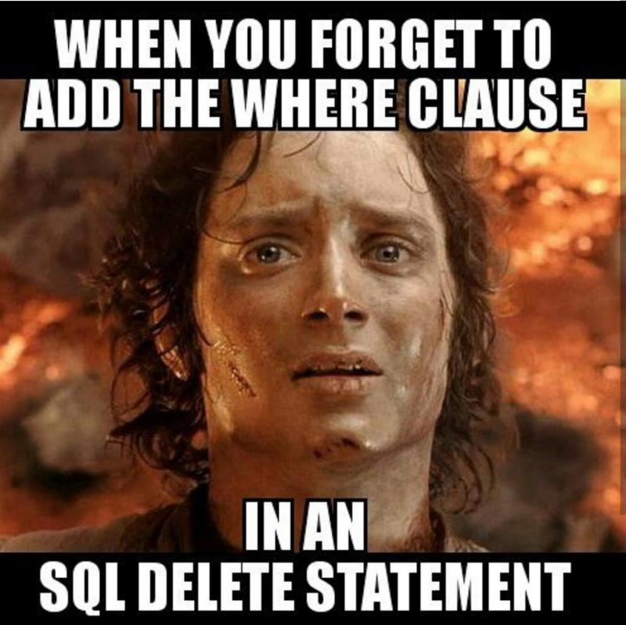
Semantics of Delete and Update
didn’t get the joke? Let’s do this optional activity [link]

Slide 24
Delete Update-
Constraints
Branch (branchNo, street, city, postcode)
Staff (staffNo, fName, lName, position, sex, DOB, salary, branchNo)
Referential integrity FOREIGN KEY (branchNo) REFERENCES Branch
ON DELETE ON UPDATE
CASCADE, delete the row from the parent table and automatically delete the matching rows in the children table. (And the others linked)
SET NULL, delete the row from the parent table and set the foreign key values to null
SET DEFAULT, set a default value in the children tables
NO ACTION, reject the deletion

Slide 25
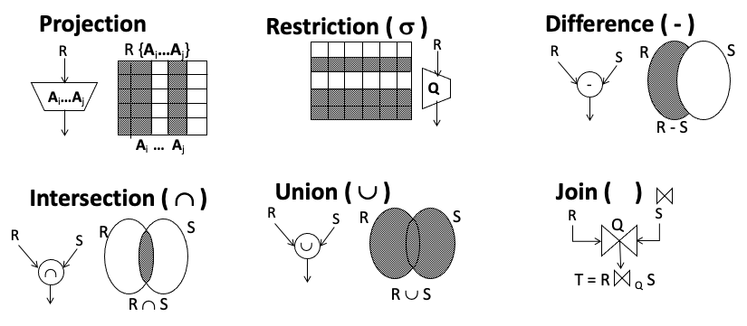
Queries- Relational Algebra

Slide 26
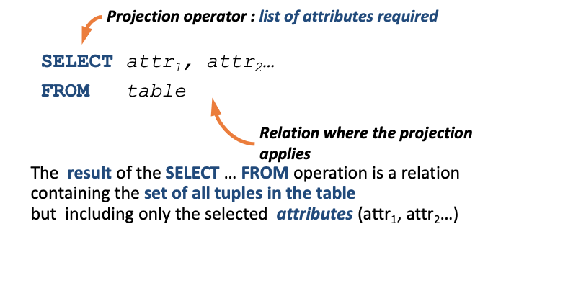
Projection

Slide 27
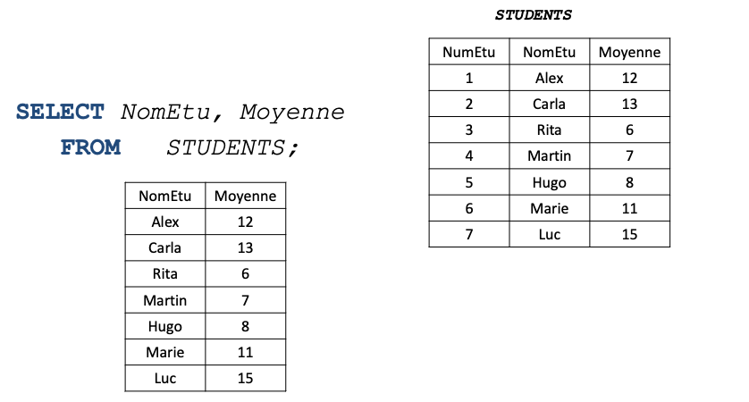
PROJECTION

Slide 28
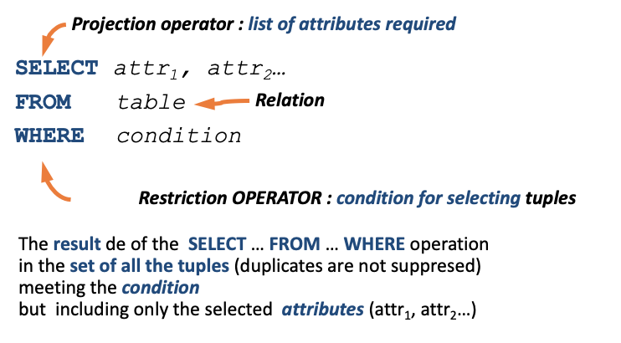
RESTRICTION

Slide 29
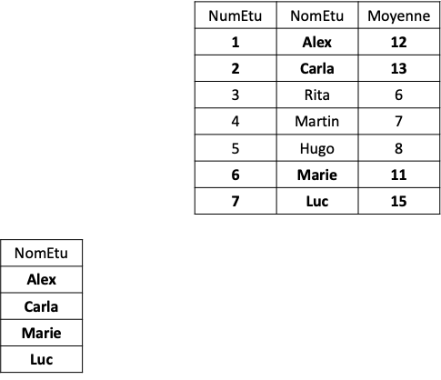
RESTRICTION
SELECT NomEtu
FROM Students
WHERE Moyenne > 10;
Expresión regular: Cadena que representa un conjunto de cadenas.
Patrón: 1. Concatenaciones 2. * + ? → %, _ *Cali* %Cali%

Slide 30
Where
Where is a condition over the tuples, the searched information
WHERE is a condition, it may contains
Relational operators: <, <=, =, <>, >=, >
Arithmetic operators: +, -, *, /
Logic operators: AND, OR, NOT
Others: LIKE, BETWEEN, IS NULL, IN, EXISTS…
Expresión regular: Cadena que representa un conjunto de cadenas.
Patrón: 1. Concatenaciones 2. * + ? → %, _ *Cali* %Cali%

Slide 31
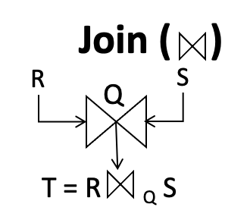
Join
The join operation allows the information extraction from two or more relations in a database.
The information extraction exploits the connection among relations in a database
In relational algebra, the join is a subset of a more general combination of tables: Cartesian product

Slide 32
Join
Cartesian Product Semantics R1 R2: 1. create a table with the attributes from both relations
2. For each tuple in R1, create a tuple with each tuple in R2.

Slide 33
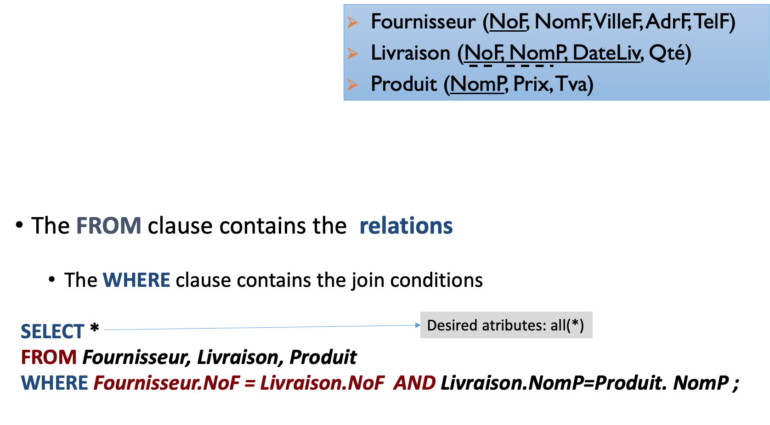
Join

Slide 34
Select-From - Where revisited
The SELECT-FROM-WHERE clause can perform in a single statement, the three operations from the relational algebra: Projection, Restriction and Join.
The select is a closed operation as it is applied over tables and produces another table.

Slide 35
Select-From - Where revisited
General form - Syntax
SELECT [DISTINCT | ALL]{*|[attributeName [AS newName]] [,] } FROM tableName [alias] [WHERE condition] [GROUP BY attributeList] [HAVING condition] [ORDER BY attributeList]
Notation: [optional] {mandatory}

