Slide 1
Parallelizing Stencil Codes: Acoustic 2D
Hermes Senger

Slide 2
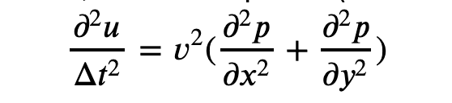
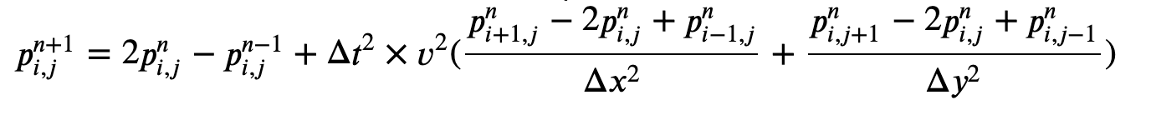
Acoustic wave equation
The equation
Discretization

Slide 3
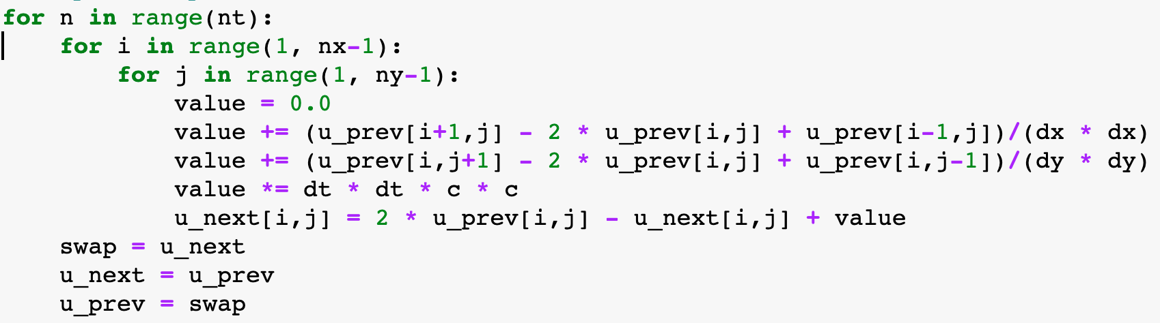
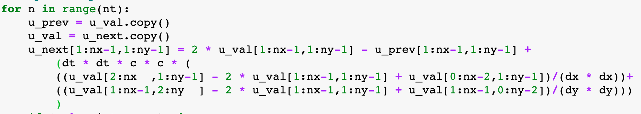
Python implementation
With nested loops
Using numpy array
 | MacBook Air Core i5 2-cores @ 1.6GHz | Intel Xeon Silver 4208 8 Cores @ 2.10GHz
nested loops – 3 arrays | 36.3 sec | 13.6 sec
nested loops – 2 swapped arrays | 26.5 sec | 14.0 sec
Numpy arrays | 2.1 sec | 1.2 sec
https://github.com/hsenger1969/StencilCodes4GPUs/blob/master/conteudo/jupyter-notebooks/tut_01-acoustic-wave-loop_vs_numpy-array-plot2d.ipynb

Slide 4
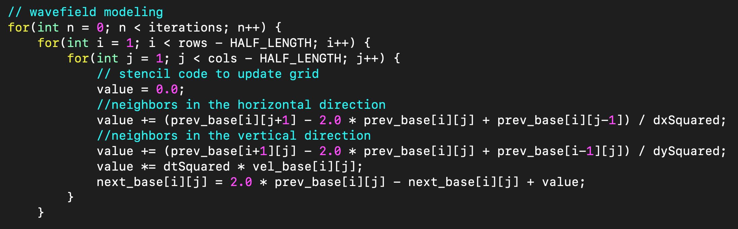
Baseline
GCC compiler
Baseline code in C
Cmd line | flags | Makespan. (sec)
gcc iso2d.c -o iso2d-gcc (no flag) | no optimization | 4.419
gcc iso2d-array2d.c -o iso2d-array2d-gcc | no optimization | 7.28
gcc -O3 iso2d.c -o iso2d-gcc-O3 | -O3 | 1.072
gcc -O3 iso2d-array2d.c -o iso2d-array2d-gcc-O3 | -O3 | 1.155
gcc -Ofast iso2d.c -o iso2d-gcc-Ofast | -Ofast | 0.874
gcc -Ofast iso2d-array2d.c -o iso2d-array2d-gcc-Ofast | -Ofast | 0.974
https://gcc.gnu.org/onlinedocs/gcc/Optimize-Options.html

Slide 5
Intel compiler vs. PGI
Cmd line | flags | Makespan. (sec)
icc iso2d.c -o iso2d-icc | no optimization | 0.794
icc iso2d-array2d.c -o iso2d-array2d-icc | no optimization | 0.966
icc -O3 iso2d.c -o iso2d-icc-O3 | -O3 | 0.864
icc -O3 iso2d-array2d.c -o iso2d-array2d-icc-O3 | -O3 | 0.915
icc -Ofast iso2d.c -o iso2d-icc-Ofast | -Ofast | 0.833
icc -Ofast iso2d-array2d.c -o iso2d-array2d-icc-Ofast | -Ofast | 0.837
Intel icc
-O3, -Ofast = vectorizatio + others
PGI
Compiler | flags | implem | Makespan
pgi | -fast | linear array | 0.519
pgi | -fast | 2D array | 0.634

Slide 6
OpenAcc
#pragma acc kernels
{
for(int n = 0; n < iterations; n++) {
for(int i = 1; i < rows - HALF_LENGTH; i++) {
for(int j = 1; j < cols - HALF_LENGTH; j++) {
value = 0.0;
value += (prev_base[i][j+1] - 2.0 * prev_base[i][j] +
prev_base[i][j-1]) / dxSquared;
value += (prev_base[i+1][j] - 2.0 * prev_base[i][j] +
prev_base[i-1][j]) / dySquared;
value *= dtSquared * vel_base[i][j];
next_base[i][j] = 2.0 * prev_base[i][j] - next_base[i][j] +
value;
}. // loop j
}. // loop i
// swap arrays for next iteration
float temp;
for(int i = 0; i < rows; i++) {
for(int j = 0; j < cols; j++) {
temp = prev_base[i][j];
prev_base[i][j] = next_base[i][j];
next_base[i][j] = temp;
}
}
} // end of kernel region
Kernel constructs:
“This directive informs the compiler of the programmer’s desire to accelerate loops within a given region, but places the responsibility on the compiler to identify which loops can be safely parallelized and how to do so.“

Slide 7
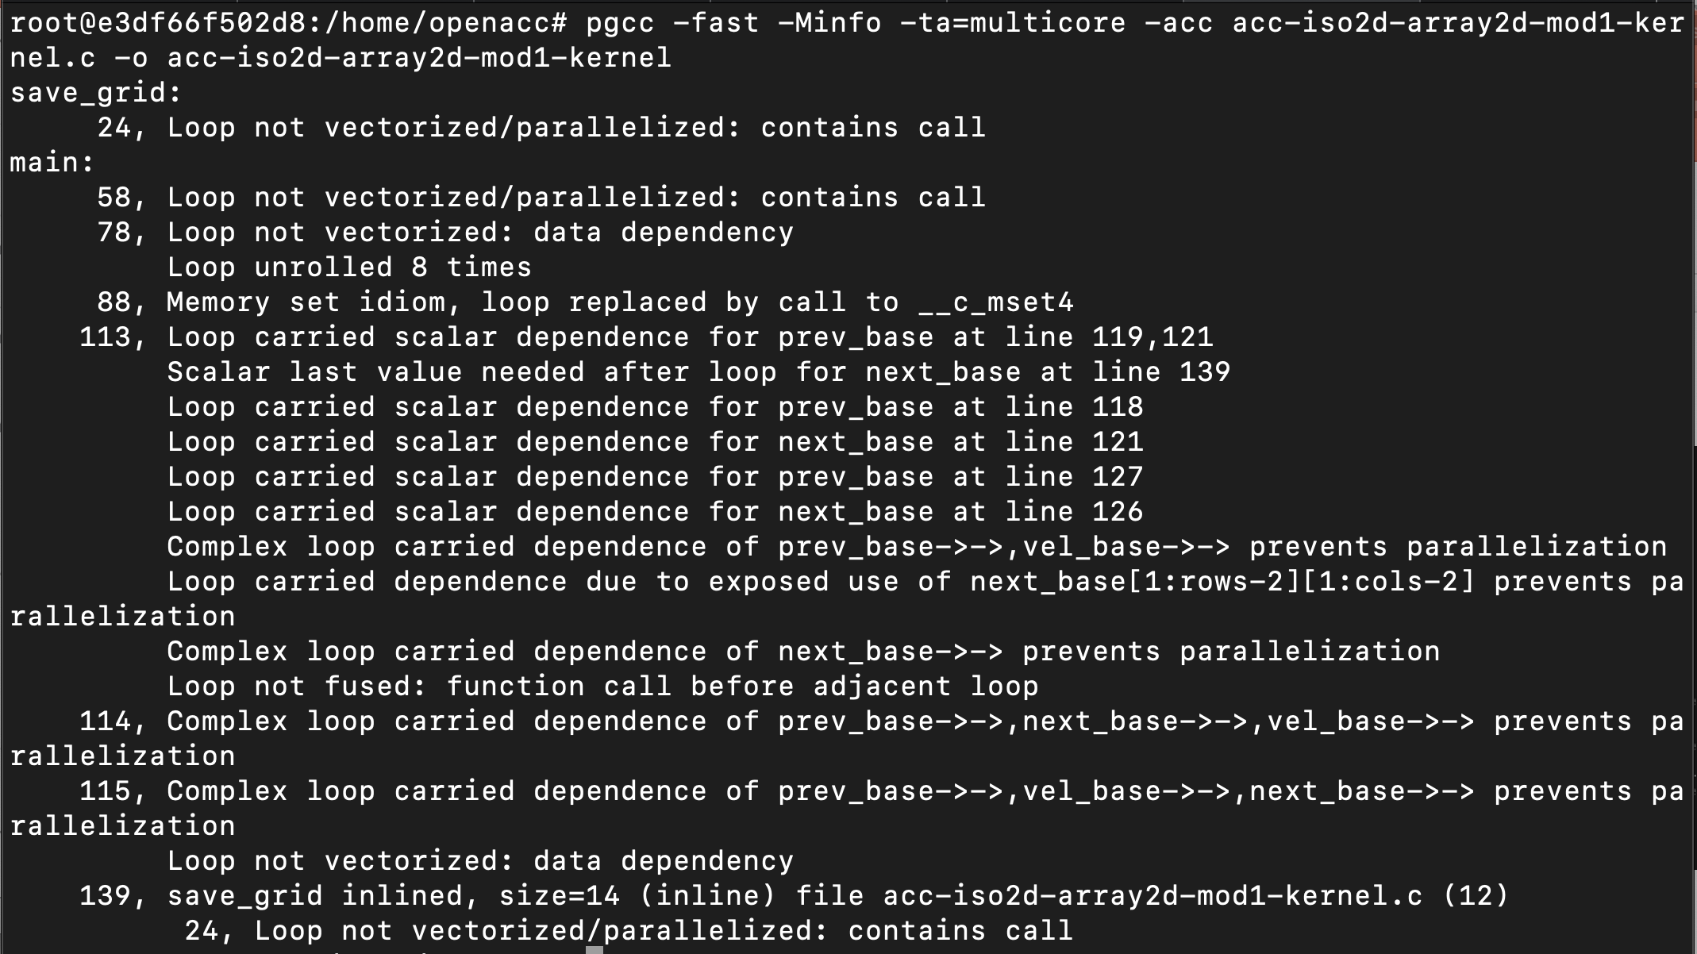
pgcc -fast -Minfo -ta=multicore -acc acc-iso2d.c -o acc-iso2d-cpu
for n
for i
for j

Slide 8
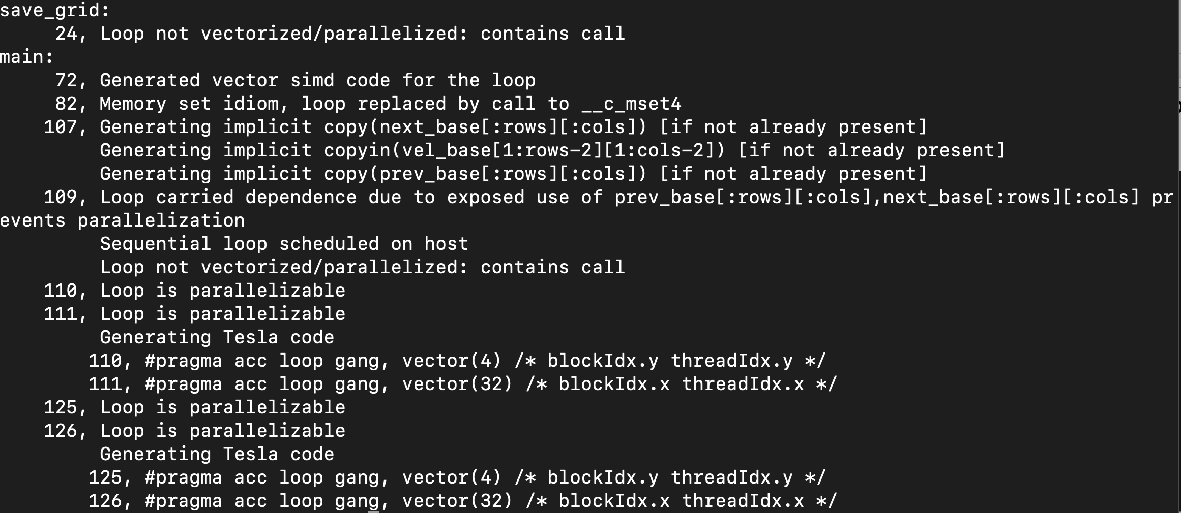
pgcc -fast -Minfo -ta=tesla -acc acc-iso2d-array2d.c -o acc-iso2d-array2d-gpu
for n
for i
for j

Slide 9
Compiling for GPU
pgcc -fast -Minfo -ta=tesla -acc acc-iso2d-array2d.c -o acc-iso2d-array2d-gpu
Cmd line | flags | Makespan. (sec)
pgcc -fast -Minfo -ta=multicore -acc acc-iso2d.c -o acc-iso2d-cpu | -fast -Minfo -ta=multicore | 0.618
pgcc -fast -Minfo -ta=tesla -acc acc-iso2d-array2d.c -o acc-iso2d-array2d-gpu | -fast -Minfo -ta=tesla | 0.421

Slide 10
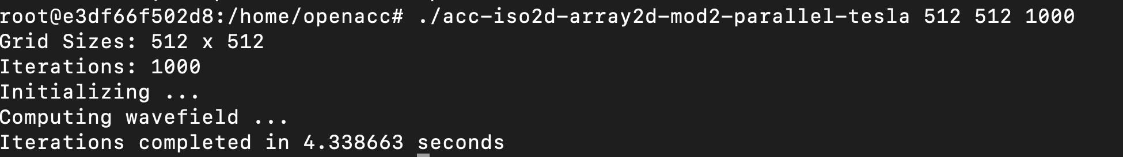
OpenAcc
#pragma acc data copyin(next_base[:rows][:cols]) copy(prev_base[:rows][:cols])
for(int n = 0; n < iterations; n++) {
#pragma acc parallel loop collapse(2)
for(int i = 1; i < rows - HALF_LENGTH; i++) {
for(int j = 1; j < cols - HALF_LENGTH; j++) {
value = 0.0;
value += (prev_base[i][j+1] - 2.0 * prev_base[i][j] + prev_base[i][j-1]) / dxSquared;
value += (prev_base[i+1][j] - 2.0 * prev_base[i][j] +
prev_base[i-1][j]) / dySquared;
value *= dtSquared * vel_base[i][j];
next_base[i][j] = 2.0 * prev_base[i][j] –
next_base[i][j] + value;
}}. // loop j
}. // loop i
// swap arrays for next iteration
float temp;
for(int i = 0; i < rows; i++) {
for(int j = 0; j < cols; j++) {
temp = prev_base[i][j];
prev_base[i][j] = next_base[i][j];
next_base[i][j] = temp;
}
}
} // end of kernel region
Parallel directive:
When the parallel directive is used the programmer declares that the compiler should generate parallelism and when combined with the loop directive, makes assertions about the feasibility of loops for acceleration without requiring detailed analysis by the compiler.
the collapse clause declares that, not only the outer loop is free of data races and available to parallelize, but the direc- tive should apply to the inner loop too
4,33 sec

Slide 11
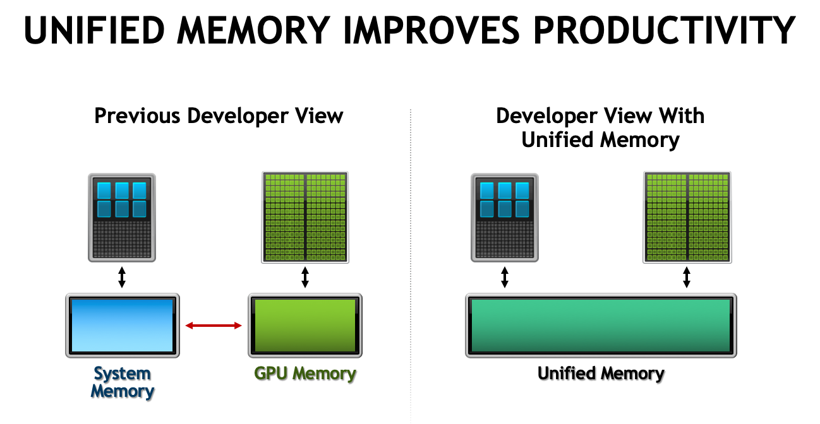

Slide 12
#pragma acc data copyin(next_base[:rows][:cols]) copy(prev_base[:rows][:cols])
for(int n = 0; n < iterations; n++) {
#pragma acc parallel loop collapse(2)
for(int i = 1; i < rows - HALF_LENGTH; i++) {
for(int j = 1; j < cols - HALF_LENGTH; j++) {
value = 0.0;
value += (prev_base[i][j+1] - 2.0 * prev_base[i][j] + prev_base[i][j-1]) / dxSquared;
value += (prev_base[i+1][j] - 2.0 * prev_base[i][j] +
prev_base[i-1][j]) / dySquared;
value *= dtSquared * vel_base[i][j];
next_base[i][j] = 2.0 * prev_base[i][j] –
next_base[i][j] + value;
}}. // loop j
}. // loop i
// swap arrays for next iteration
float temp;
for(int i = 0; i < rows; i++) {
for(int j = 0; j < cols; j++) {
temp = prev_base[i][j];
prev_base[i][j] = next_base[i][j];
next_base[i][j] = temp;
}
}
} // end of kernel region
pgcc -fast -Minfo -ta=tesla:managed –acc. <prog.c> -o <prog.o
$ ./acc-iso2d-array2d-mod3-parallel-tesla-managed 512 512 1000
Grid Sizes: 512 x 512
Iterations: 1000
Initializing ...
Computing wavefield ...
Iterations completed in 0.119912 seconds

Slide 13
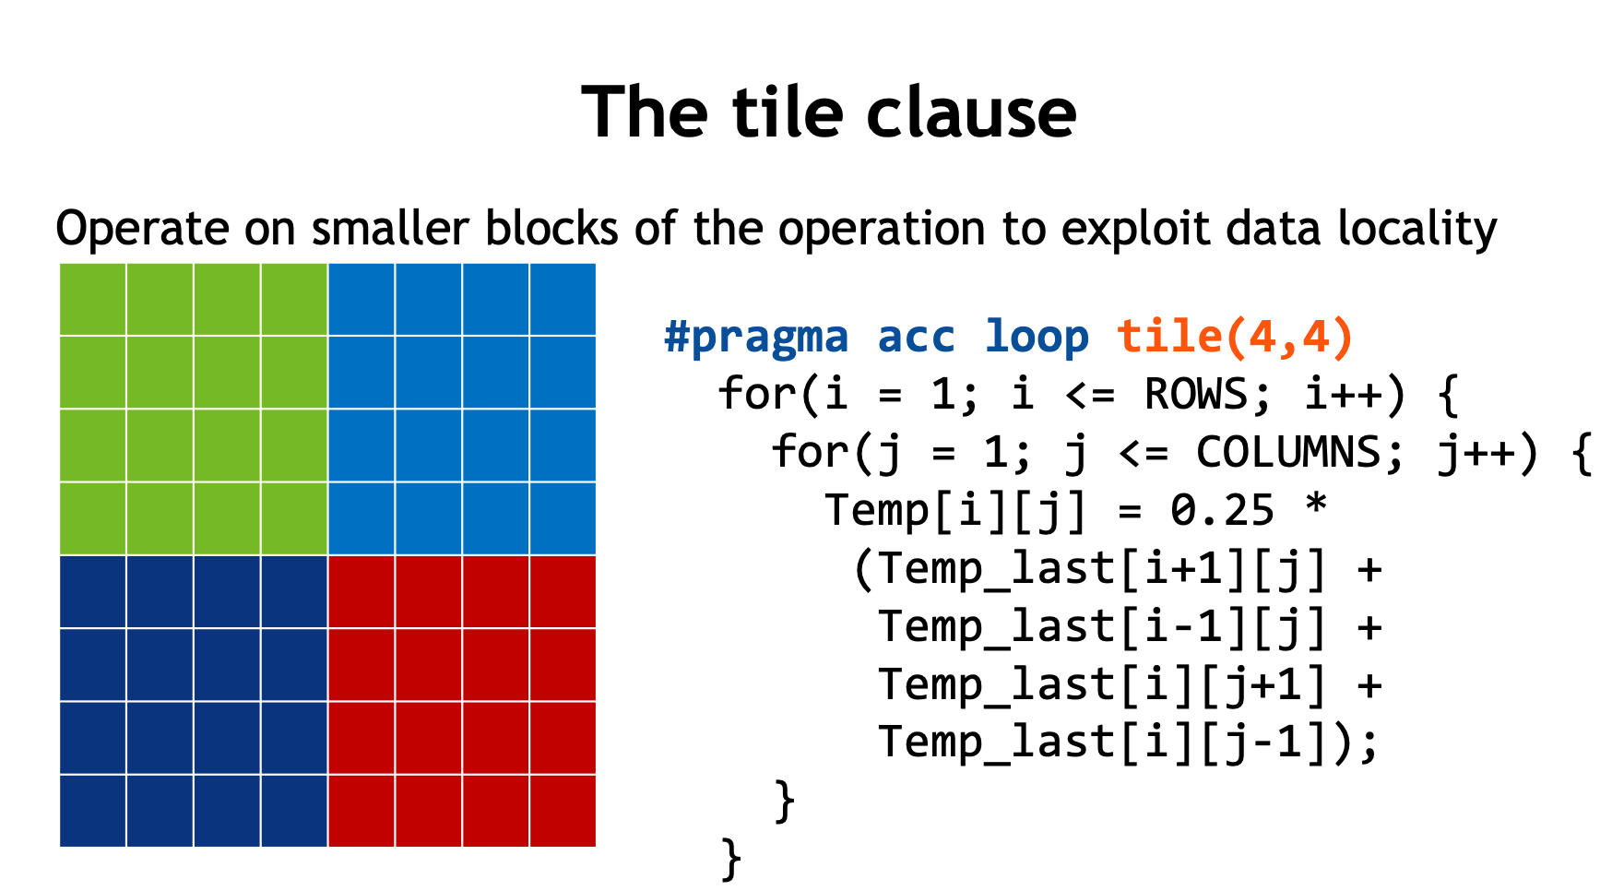

Slide 14
for(int n = 0; n < iterations; n++) {
#pragma acc parallel loop device_type(nvidia) tile(32,4)
for(int i = 1; i < rows - HALF_LENGTH; i++) {
Tiles | Exec.time
32,16 | 0,121
32,32 | 0,131
32,64 | 0,080
32,128 | 0,055
32,256 | 0,032
32,512 | 0,032
128,512 | 0,032
256,512 | 0,032
512,512 | 0,032
1024,1024 | 0,021
2048,2048 | 0,032

