Slide 1
AeroFlight 2020 An analysis of this new company’s data for their first year of trading
By Carlos nassim Khalili boukai – London, 05/07/2024

Slide 2
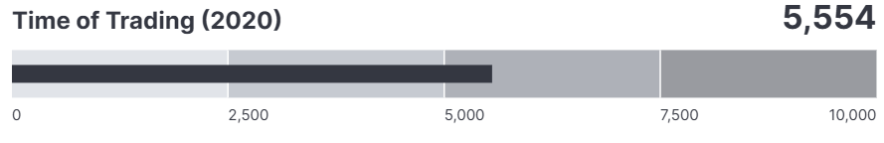
The context for this study & data overview
The dataset provided includes the following:
Year range: 2020
Month range: from January to December of 2020.
Breakdown of month per weeks and days.
Departure and arrival times
Flight duration.
List of departure airports (40 in total).
List of destinations offered (43 in total).
Data about cancellations and their codes.
Data about flights diverted.
AeroFlight Ltd. is a new charter company offering cheaper charted flights. They started trading in January 2020, and after a year of trading they decided to analyse the data they have gathered in order to make business and marketing decisions for the new year.
AeroFlight operates mainly from USA airports, but they look forward to extend their service to other locations.
Carlos was hired as a data analyst for this project.

Slide 3
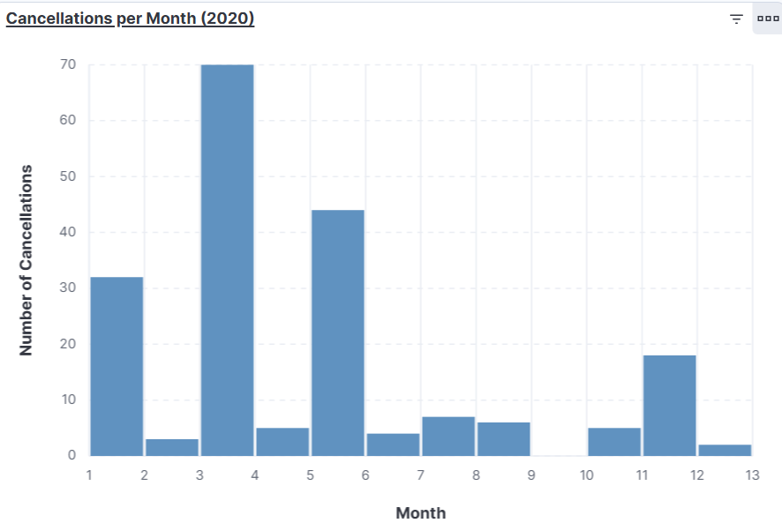
Quality and consistency of service
Quality of service:
96% of all flights booked were delivered.
3% of flights were cancelled due to code ‘A’.
1% of flights were cancelled due to codes ‘B’ and ‘C’.
Insights:
In general, AeroFlight provides a consistent service to its customers.
Most cancellations took place in January, March, May and November.

Slide 4
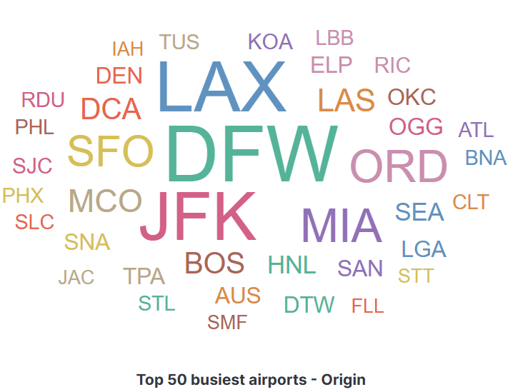
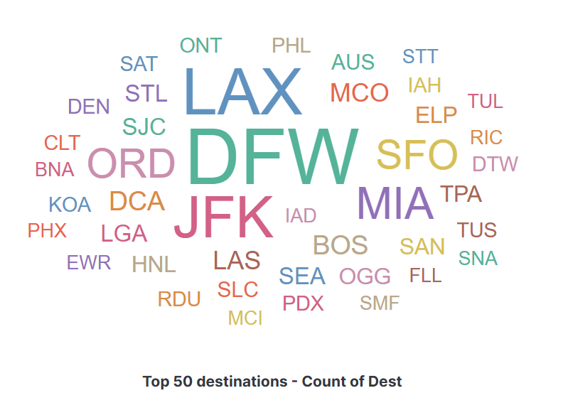
AeroFlight busiest airports and top destinations
Insight on busiest airports:
The busiest airports for AeroFlight are (in this order): Dallas, Los Angeles, New York, Miami, Chicago and San Francisco.
Insight on top destinations:
The top destination airports for AeroFlight are (in this order): Dallas, Los Angeles, New York, Miami, Chicago and San Francisco. It is exactly the same trend for both origin and destinations.

Slide 5
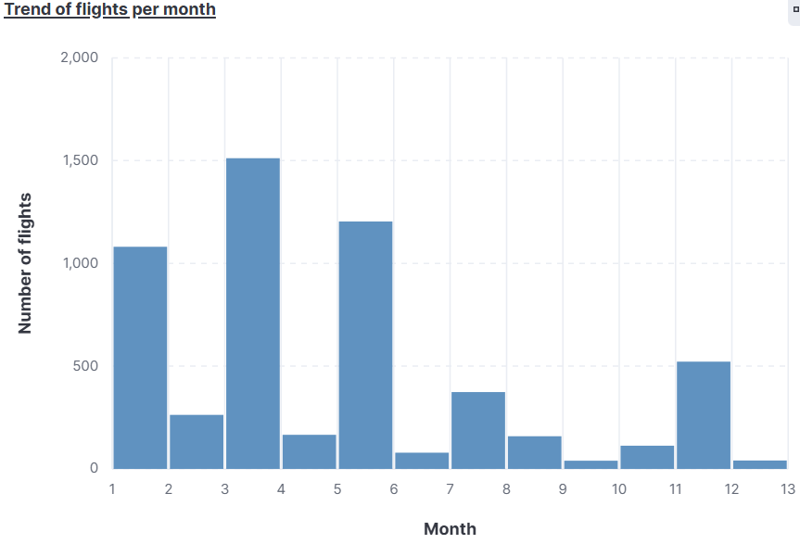
Flights booked per month
Flights booked – breakdown per month:
Jan = 19%
Feb = 5%
Mar = 27%
Apr = 3%
May = 18%
Jun = 1%
Jul = 7%
Aug = 3%
Sep = 1%
Oct = 2%
Nov = 9%
Dec = 1%
Insight:
The best trading months are (in this order): March, May, January and November.
The weakest months are June and December.

Slide 6
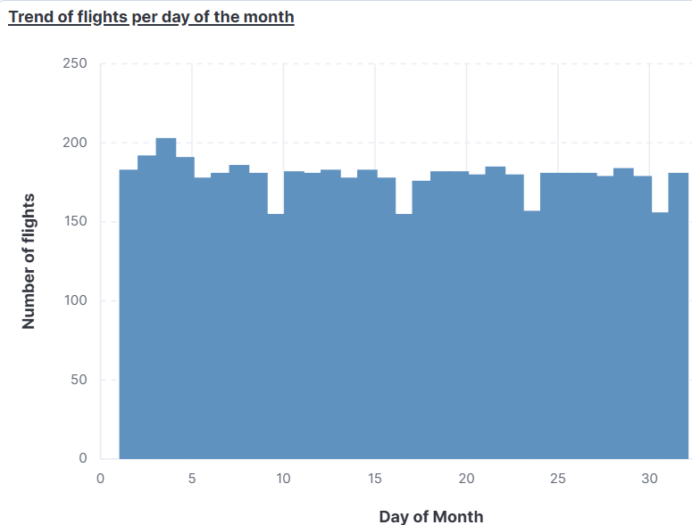
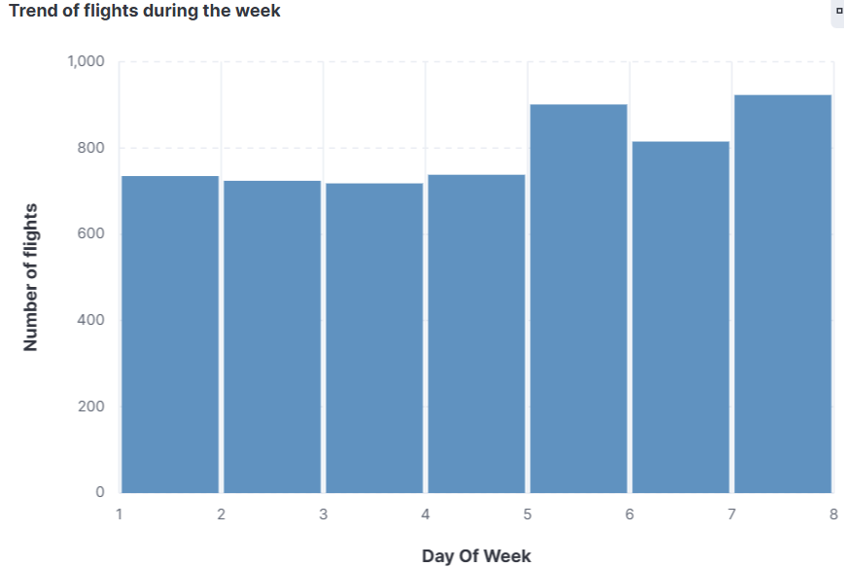
Overall trend of booking and service
Insight: The booking trend seems consistent throughout the month; however, there is a drop in sales every 7-9 days.
Insight: The booking trend seems consistent throughout the week, with an obvious increase on flights booked over the weekend.

Slide 7
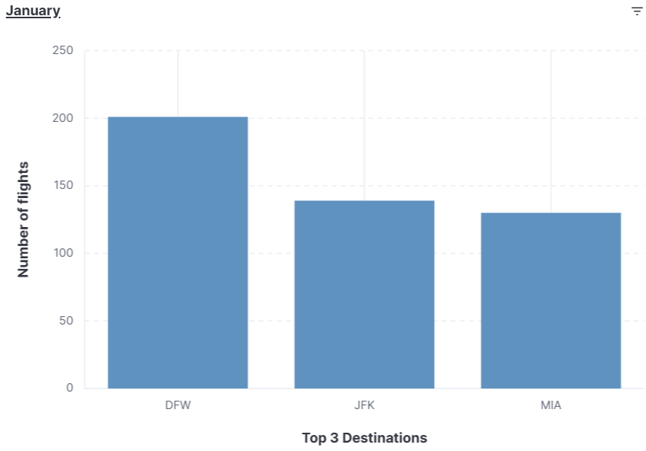
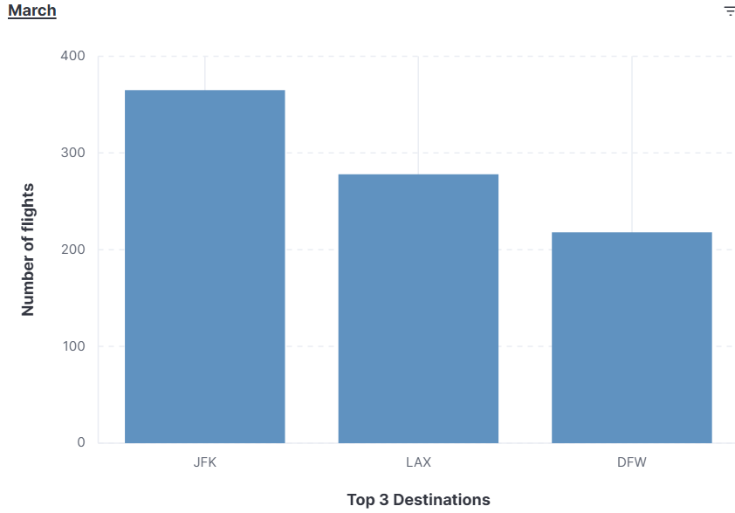
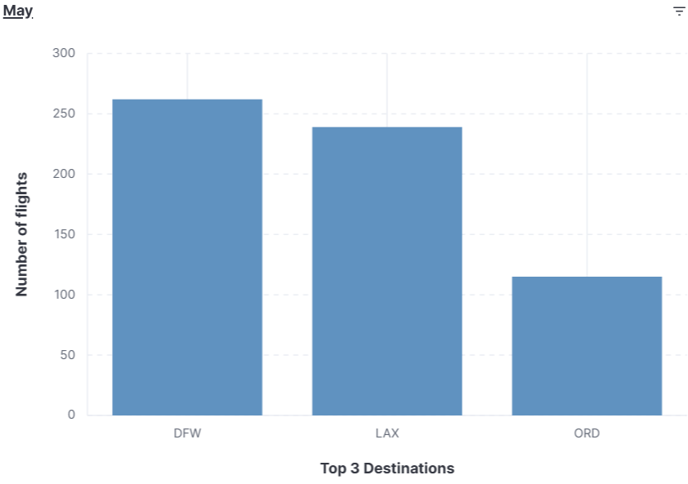
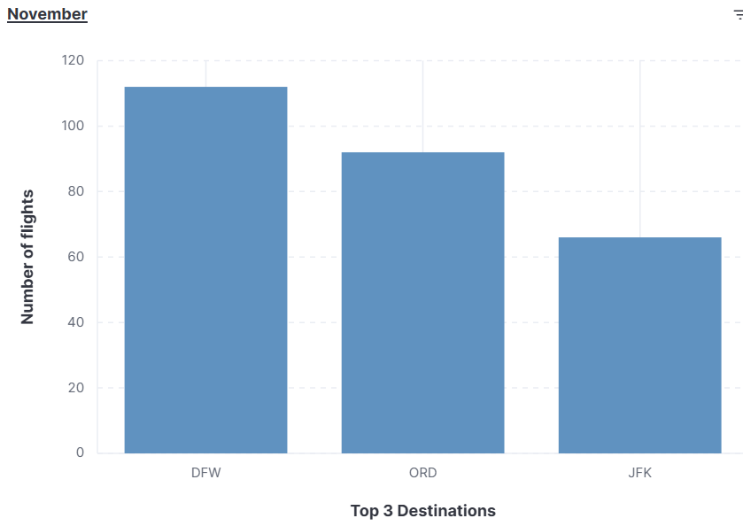
Top destinations in the busiest months
Insight:
Dallas is the busiest – and most popular – destination during the busiest months.
New York (JFK) is the second busiest destination.
Los Angeles is the third most popular destination.
NOTE: it is worth – for next year’s study – to gather data about the passengers’ reason for flight (personal or business?). It is intriguing that Dallas would be much more popular than Los Angeles (vacation) or New York (vacation/business).

Slide 8
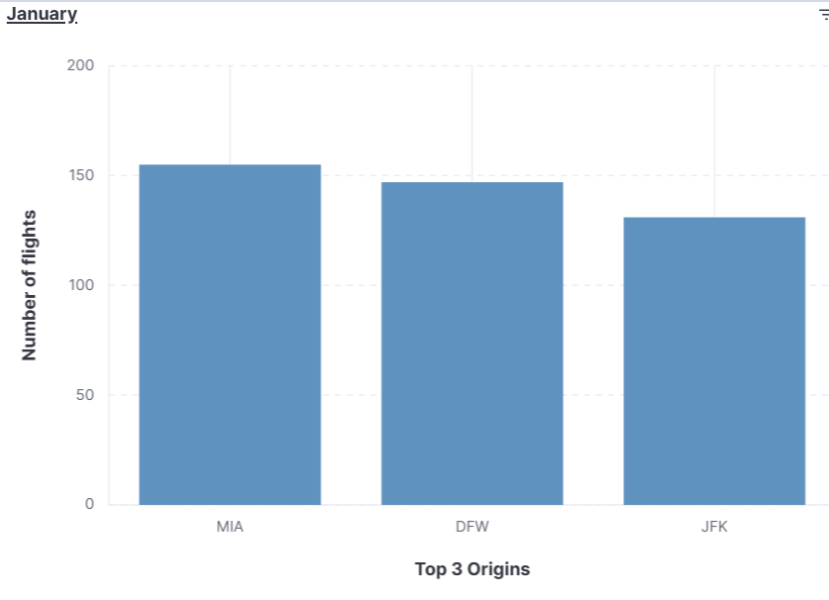
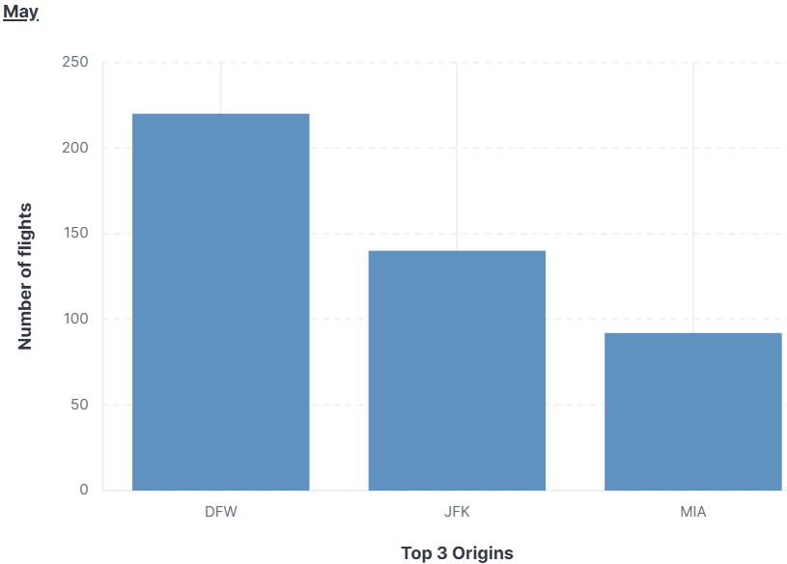
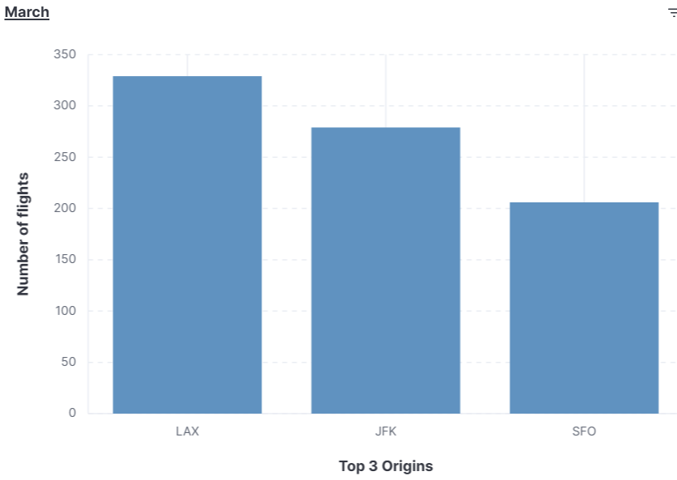
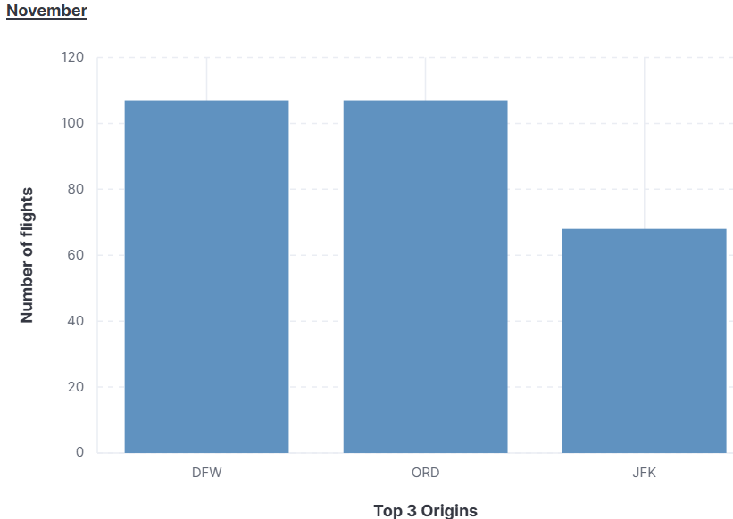
Busiest airports in the busiest months
Insight:
Although never the first on the list, New York (JFK) is the most popular in the list for the top 3.
It is followed by Dallas and Miami as second busiest.
Los Angeles is the least popular in this list, together with San Francisco.
NOTE: Although it appears only once in the list, Los Angeles in first among the top 3 for March. It is worth investigating what causes people to travel from this airport at this time of the year, so AeroFlight can use this information for their business strategy.

Slide 9
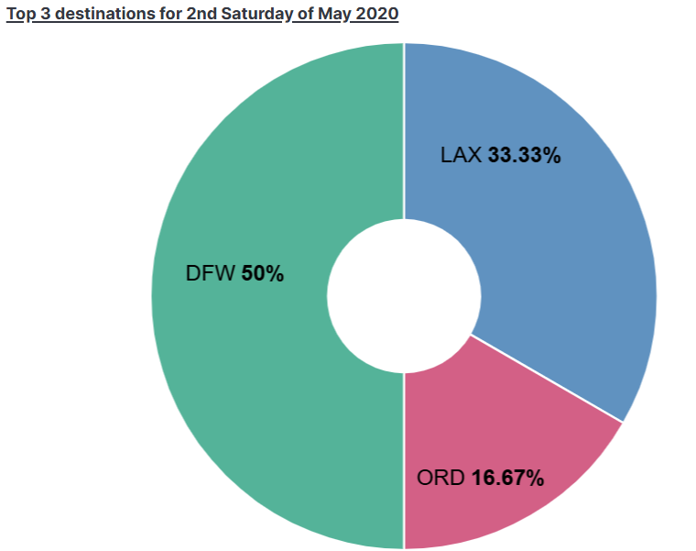
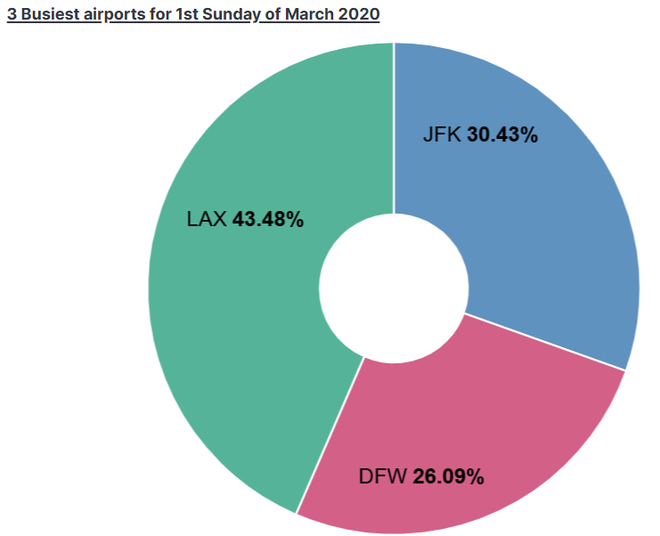
Data questions for specific dates
Insight:
The overall trend for busiest airports (in March 2020, DFW-JFK-MIA) differs from this particular date. It is worth breaking down the busiest months into weeks, to check for the trend of behaviour.
However, the trend for top destinations matches exactly that of the overall trend for that month. Still, it is worth drilling down into weeks to check for the pattern.

Slide 10
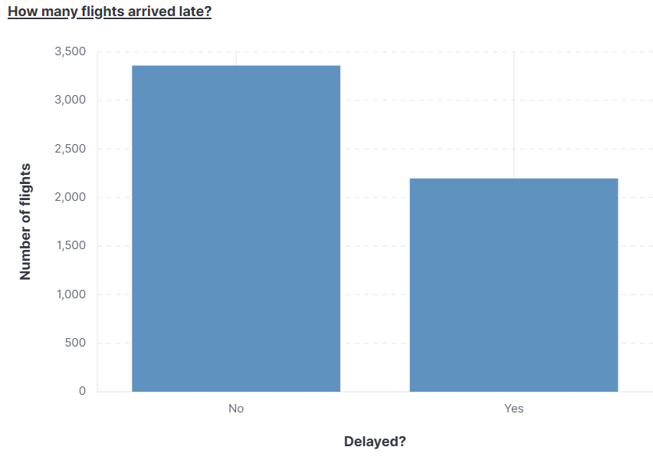
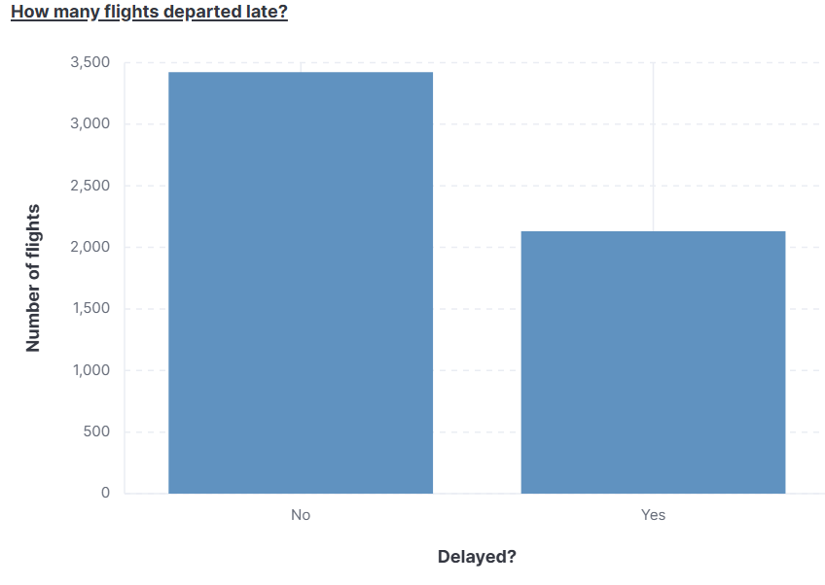
Are Aeroflight services delivered on time?
Insight:
Around 40% of all AeroFlight’s flights arrived after the declared arrival time. The average delay was of 15 minutes.
Around 39% of all Aeroflight’s flights departed after the declared departure time. The average delay was of 29 minutes.
NOTE: it is worth checking the reasons behind this delay, for both legal consequences or simply to improve customer satisfaction.

Slide 11
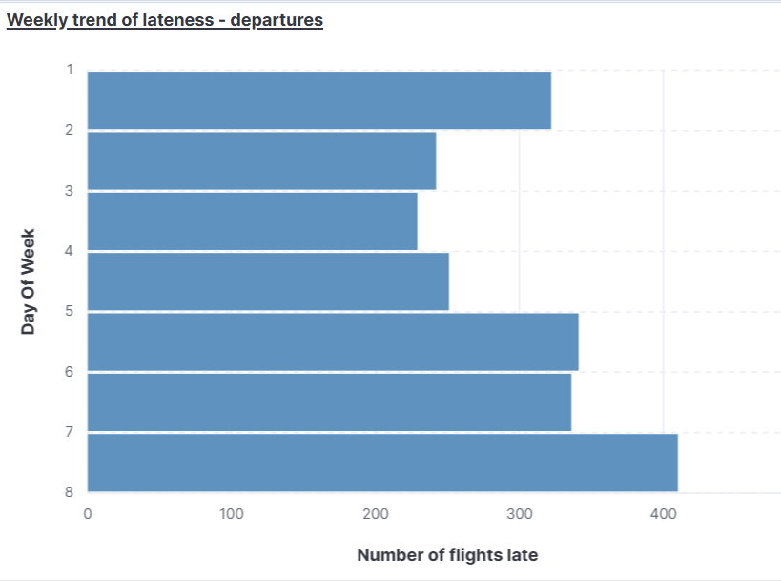
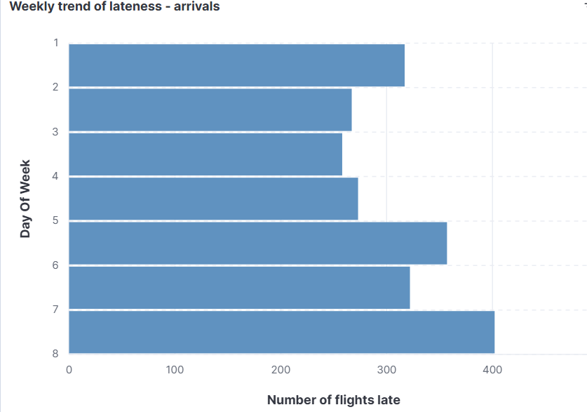
Arrival and delay trends – weekly visualisation
Insight:
In both departure and arrival delays, there is a clear pattern: their numbers are relatively lower mid-week and start to rise towards the weekend, especially on Sundays. This might explain why Monday also has a higher number of delays: it is possible that Aeroflight has a backlog of technical issues on Sunday and take a little longer to solve them.
There is a noticeable different regarding Fridays and Saturdays, when it comes to delays: while their proportions are almost equal regarding departures, Saturday presents a considerable lower number of delays for arrivals. This might indicate that leaving late is not the only reason for late arrivals.

Slide 12
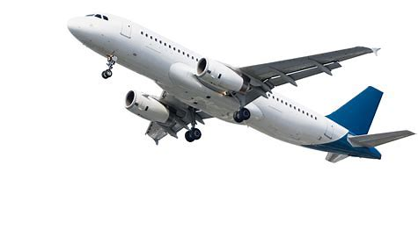
Thank you!

