Slide 1
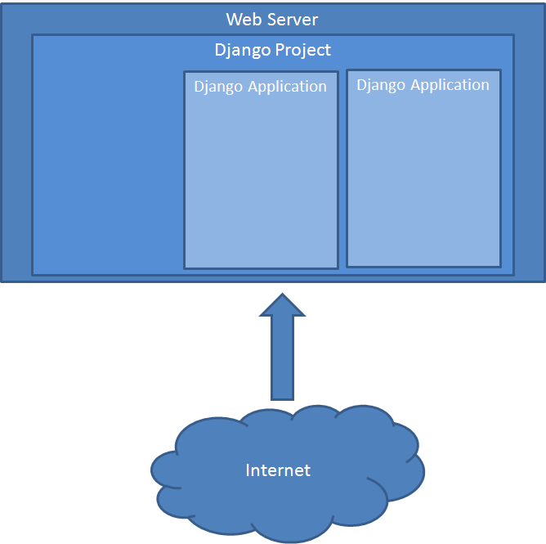
Notes:
This first picture illustrates the Django project and application concepts. The database, the root URL parser and base HTML belong to the project. An application can be plugged into the project. The database then needs to be sync’d with the application’s data model. The URL parser from the application is linked with the project URL parser and hopefully the project base HTML matches the applications’ HTML templates.

Slide 2
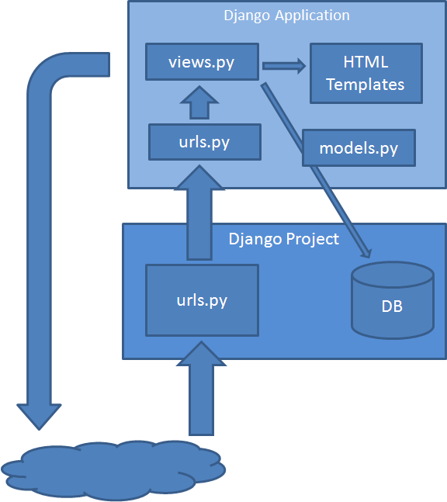
Notes:
A request comes in to the web server which transfers control to the Django project. The file urls.py analyses the URL and decides which function in views.py is called. The functions in views.py prepare the data to be presented with the HTML template and return the HTML to the client. The file models.py contains a class describing the data stored in a relational database table. This can contain as many classes as you need. It is possible to use multiple databases and to re-use existing databases.

Slide 3
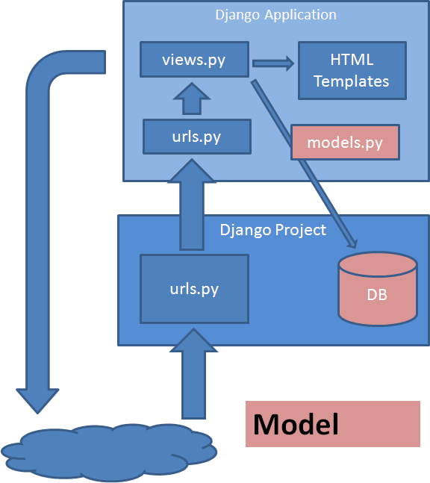
Notes:
This picture shows the “model” part of the Model View Controller pattern.

Slide 4
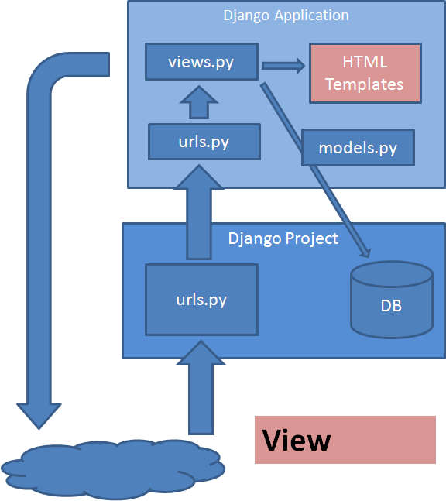
Notes:
The view part is the presentation through the HTML templates and the rest is the Controller: The url interpretation and the views.py processing. Depending on your interpretation of MVC one can argue that parts of views.py are Controller and parts are View. Let me leave it at that.

Slide 5
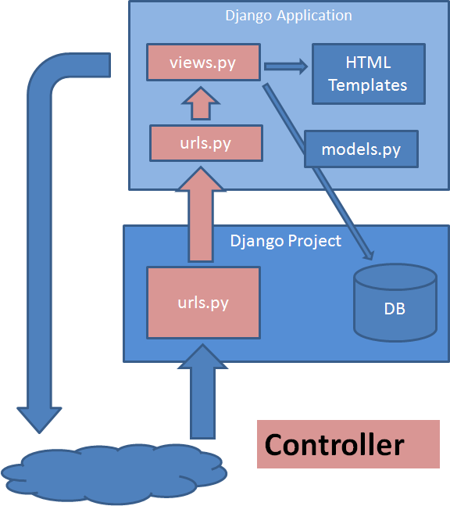
Notes:
So I’ve gone through the tutorials and started playing a bit with real life data, so I’m no expert, but I hope this overview is useful to anyone confused by the Django tutorials.

