Slide 1
Parte IV
SOA - Service Oriented Architecture
Instituto Politécnico do Cávado do Ave
Escola Superior de Tecnologia
ESI

Slide 2
Índice
Fundamentos
SOA: enquadramento e fundamentos
SOA: Arquitectura
SOA: Implementação
Fundamentos
Web Services
REST

Slide 3
Architectures
Represents the parts: components, relations, data, etc…
Frameworks
Follow architectures…
Models
Way to describe real things…
Framework is a system of rules, ideas or beliefs that is used to plan or decide something or a supporting structure around which something can be built - Cambridge Dictionary
Model is a representation of something, either as a physical object which is usually smaller than the real object, or as a simple description of the object which might be used in calculations - Cambridge Dictionary
SOMF: http://www.sparxsystems.com.au/somf

Slide 4
Arquitetura de Integração/Integration Architecture
Architecture: abstraction of reality
Components (abstração de unidade funcional)
Relations (abstração da interacção entre componentes)
Data (abstração da informação)
Architecture Types: Logical | Technical | Organizational | etc.
Enterprises
Processes
Systems
Software
etc.

Slide 5
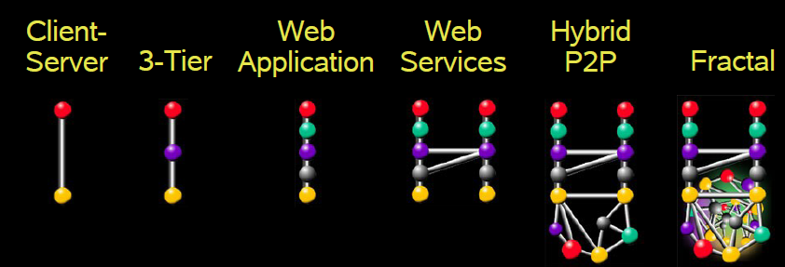
Integration Patterns
Web services Overview – Java Passion

Slide 6
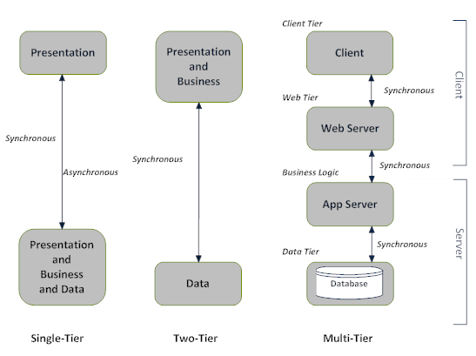
“Distribution” Patterns
CI -lufer

Slide 7
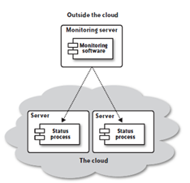
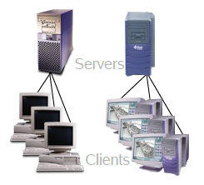
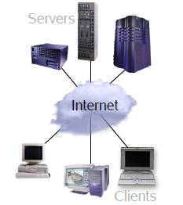
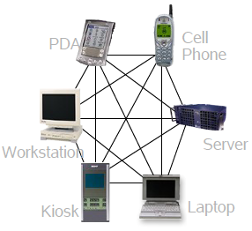
“Distribution” Patterns
Cloud
Cliente/Servidor
Web Aplication
Web Services/P2P
Web services Overview – Java Passion

Slide 8
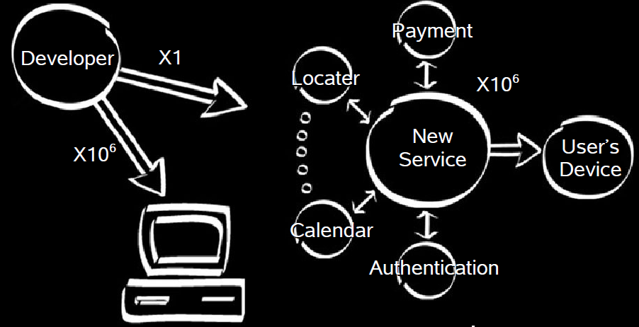
“Distribution” Patterns
SaaS - Software as a Service…
Web services Overview – Java Passion

Slide 9
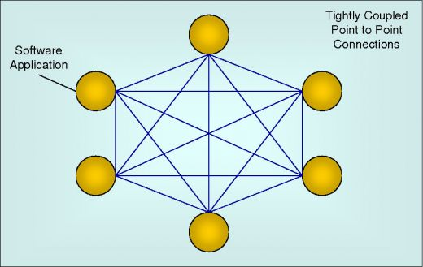
Most common "Integration" software architectures
“It derives its name from the direct, tightly bound connections that are made between applications and is the simplest of the integration architectures…”
Advantages:
Strength
Efficiency
Fast
Disadvantages:
Maintenance costs
Global Complexity
Lack of flexibility
Providers resistence
Unbalanced bandwidth
Examples: Skype
Point-to-Point Architecture
source: http://russellobrien.hubpages.com/hub/Integration-Architecture-Explained

Slide 10
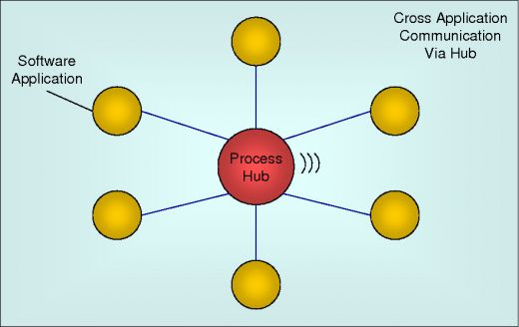
Most common "Integration" software architectures
“the hub dealt with all message processing including routing, splitting and combining of messages, mapping, and so on…”
Advantages:
Less complex
Senders and Receivers
Disadvantages:
Senders and receivers need “to know each other”
Dificult to B2B
Performance depends on Hub’s capacity
Scalability committed
Examples:
JMS, MSQueue
Hub Architecture
source: http://russellobrien.hubpages.com/hub/Integration-Architecture-Explained
Notes:
Dificult to B2B:
Entre empresas distintas é delicado Senders e Receivers acordarem...

Slide 11
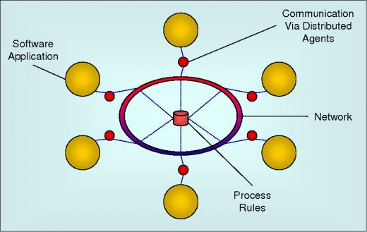
Most common "Integration" software architectures
“Agents take information from the application they are connected to, process it, and send it to any target application(s) interested in receiving that information…”
Advantages:
Great Efficiency
Great Scalability
Distributed workload
Disadvantages:
Midlewares between technologies
Complex to change
Costs
Examples:
Antes: RMI, DCOM, CORBA
Torrents
Distributed Integration Architecture/Peer2Peer
source: http://russellobrien.hubpages.com/hub/Integration-Architecture-Explained
Notes:
Dificult to B2B:
Entre empresas distintas é delicado Senders e Receivers acordarem...

Slide 12
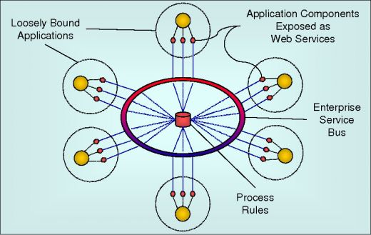
Most common "Integration" software architectures
“is essentially an enhanced version of Distributed Architecture that uses loosely coupled software services to support the requirements of business processes and software users…”
Advantages:
Great Scalability
Distributed workload
Loosely coupled
Flexibility
Disadvantages:
Reliability
Security
Examples:
ESB
Service Oriented Architecture (SOA)
source: http://russellobrien.hubpages.com/hub/Integration-Architecture-Explained
Notes:
Dificult to B2B:
Entre empresas distintas é delicado Senders e Receivers acordarem...

Slide 13
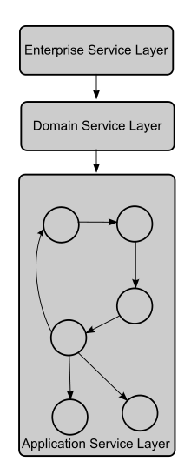
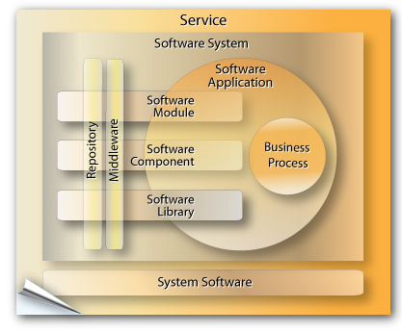
SOA
http://www.sparxsystems.com.au/somf
http://en.wikipedia.org/wiki/Service_Oriented_Architecture

Slide 14
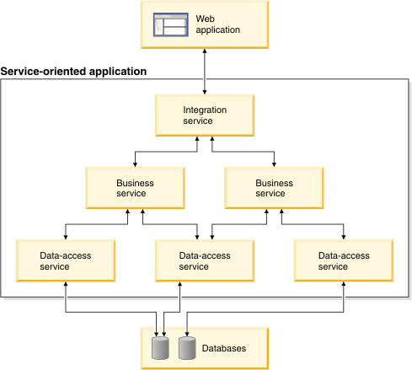
SOA
https://www.ibm.com/docs/en/rbd/9.5.1?topic=overview-service-oriented-architecture-soa

Slide 15
Architectures are changing…
Client/Server Programming
Distributed Programming
Code Portability (cross)
Applets
Servlets
Mashups
Cloud…
Software
Architecture

Slide 16
Solutions are changing …
Interpreted
Modules
Objects
Components
Services
Microservices
Software
Architecture
SaaS ← SO ← CBD ← OO
Software as a Service ← Service Orientation ← Component Based Development ← Object Oriented

Slide 17
Service-Oriented Architecture – SOA vs OO?
Like objects and components, services represent organizations of code that allow us to organize capabilities in a known and controlled way
Like objects and components, the services:
Combine information with behavior
Hide internal status from external use
Present a simple interface with the outside
Objects use type and data abstraction; services do something similar with aspect or context orientation.
Objects and components are organized into classes or hierarchies with behavior inheritance; services can be published and "consumed" simply or as hierarchies or collaborations;

Slide 18
Service-Oriented Architecture – SOA vs OO?
Reuse → processes are more "mature”
Before, the importance of reuse meant avoiding duplicate development and unnecessary maintenance of software components, now, the value is in the standardization of processes;
OO: Object Analysis & Design
SOA: Processes and Businesses are Modeled (WS-BPEL)
http://web.ipca.pt/lufer/indexME.php

Slide 19
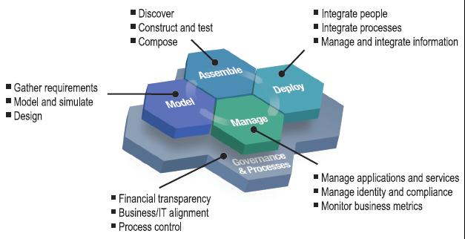
Service-Oriented Architecture – SOA vs OO?
Fonte: IBM

Slide 20
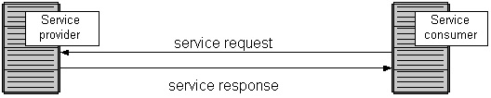
Service-Oriented Architecture - SOA
Software
Need for IS Integration
eBusiness (B2B)
Cost Reduction
Reduction of Production Times
Inter-company integration
Adaptive business models
Quick responses
Higher ROI
Software
Arquitectura SOA

Slide 21
SOA – Requirements
Merger/Integration of companies
Corporate Management
Legacy systems integration
Point solutions
Heterogeneity
OS; Hardware; LP; Middleware; DB
Quick answers
Complexity
Priority → Integrate

Slide 22
SOA – Requirements
Leverage existing resources
Support all types of integration
User; Applications; Processes; Information
Allow implementations and migration of resources in an incremental way
Enable new computing models: Grid Computing, On-Demand Computing, Cloud Computing, ...

Slide 23
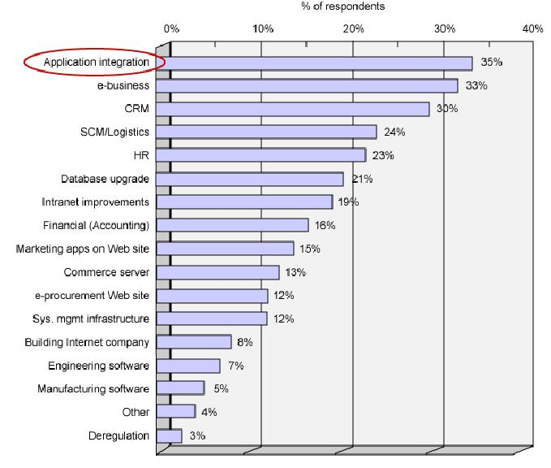
SOA – Requirements
Estratégias em projectos de software… CIO (Chief of Information Officer)

Slide 24
SOA – Definition?
An application architecture within which all functions are defined as independent services with well-defined invocation interfaces (IDL) that can be called in defined sequences to form business processes

Slide 25
SOA e WebServices
In SOA the service is the primary entity
WebServices are a set of protocols by which Services can be disclosed (published), "discovered" and used in a standard and technology independent way

Slide 26
SOA e WebServices
SOA
REST
PHP
SOAP
Serviços (Web)
.NET
J2EE
PHP
…
…
…

Slide 27
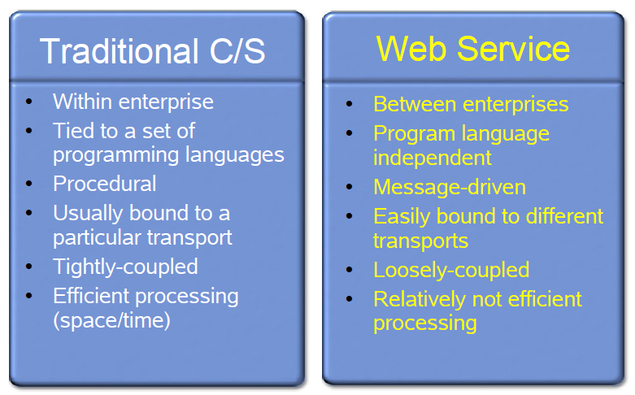
SOA e WebServices
Web services Overview – Java Passion

Slide 28
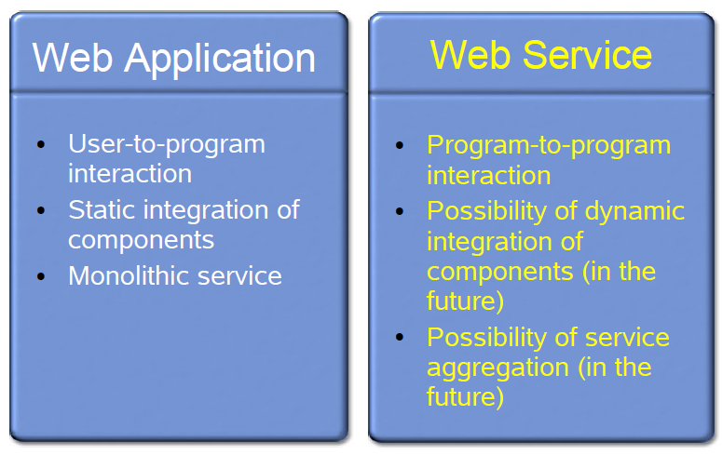
SOA e WebServices
Web services Overview – Java Passion

Slide 29
SOA e WebServices
Supported by XML (SOAP) and JSON (RESTful | RESTless)
Supported by Messages
"Independent" of Programming Ling. Programming
Dynamically "discovered
Dynamically aggregated or composed
Internet Access
Loosely Coupled
Standards-based

Slide 30
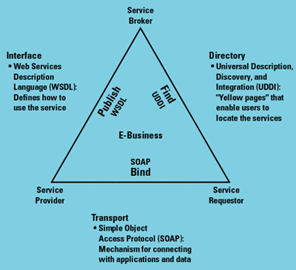
WebServices - Architecture
Transporte:
HTTP, FTP, SMTP, BEEP
Intercomunicação
XML, XML_RPC, SOAP
Descrição
WSDL
Descoberta
UUDI,

Slide 31
WebServices: Management
Browser Web
Aplicação Web
SOAP/REST
Webservice interno
HTML
SOAP/REST
Webservice externo
Aplicação Windows
SOAP/REST
Webservice externo
SOAP/REST
Webservice externo
Aplicação Mobile
Um webservice pode ser acedido por uma aplicação Web, windows, mobile ou outro tipo

Slide 32
WebServices: life cycle
Cliente
Registo
UDDI
1- Construir o WebService
Web Service
Provider
3- Localizar o WebService
2- Divulgar o WebService
4- Conseguir a descrição do webservice - WSDL
5- Construir o Proxy e cliente
6- Evocar o Webservice
Um webservice pode ser acedido por uma aplicação Web, uma aplicação windows, ou outro tipo

Slide 33
XML WebServices
WSDL
Web service
consumer
Web service
developer
Http
Soap, XML
Java, C, VB, Delphy, C#, Windows, Unix, Browser, Application
Java, C, VB, Delphy, C#, Windows, UNix
Integração de Linguagens e Plataformas
Evitar funcionalidades dependentes de GUIs. Executar operações atómicas

Slide 34
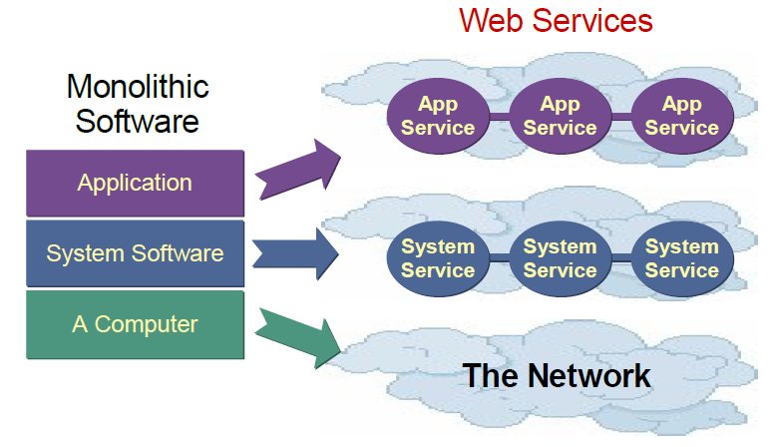
WebServices Impact
Disintegration of traditional software
Web services Overview – Java Passion

Slide 35
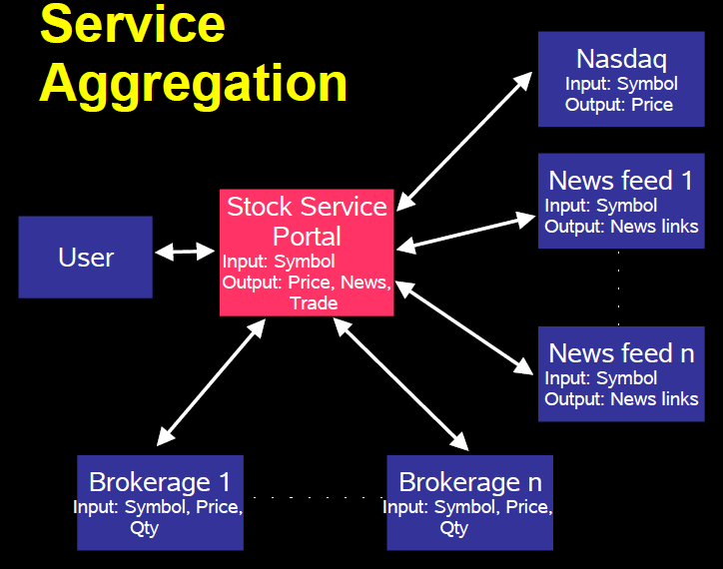
WebServices: Agregation
Desktop applications
Enterprise Portals
Mashups (EMML)⁽¹⁾; Widgets; etc.
Móveis Mobile Applications
Examples:
Google Search Engine
Currency quotation
Weather forecasts
News, etc!
⁽¹⁾EMML - Enterprise Mashup Markup Language - http://en.wikipedia.org/wiki/EMML

Slide 36
WebServices evolution
Simple WS
Múltiplos serviços isolados, autónomos, simples, “métodos”
Orientados ao utilizador
WS EAI
Destinados a integrar dentro na empresa
Business WS
Orientados ao negócio
Destinados a integrar parceiros (inter-empresas)
ebXML

Slide 37
Exercise: Research
Patterns for Systems Integration/e-Business
Patterns for Services Oriented Architectures
Imagine a Case Study (or real!)
Result:
Maximum of 5 A4 written sheets
ppt presentation for 5 minutes

Slide 38
Service Oriented Applications
https://www.ibm.com/docs/en/rbd/9.5.1?topic=overview-service-oriented-architecture-soa

Slide 39
Bibliografia essencial:
Service Design Patterns - Fundamental Design Solutions for SOAP/WSDL and RESTful Web Services, Robert Daigneau, Addison-Wesley - 2012
Service-Oriented Modeling: Analysis, Design, and Architecture, Wiley, 2008
Web Services and Service-Oriented Architectures: the Savvy Manager's Guide
The New Language of Business: SOA and Web 2.0 – ISBN=013195654X
Sebenta de ISI
Bibliografia complementar:
https://www-01.ibm.com/software/solutions/soa/
http://www.service-architecture.com/

Slide 40
Mais Referências
https://www.ibm.com/docs/en/rbd/9.5.1?topic=overview-service-oriented-architecture-soa
Tese Doutoramento : Architectural Styles and the Design of Network-based Software Architectures, Roy Thomas Fielding, http://www.ics.uci.edu/~fielding/pubs/dissertation/top.htm

