Slide 1
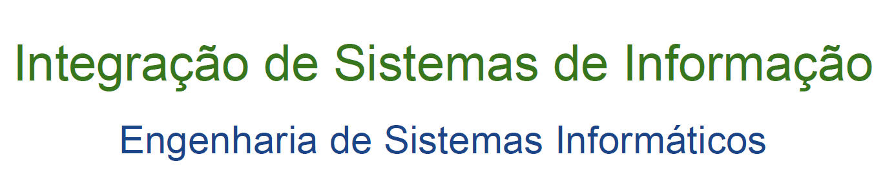
Service-Oriented Architecture(SOA) XML Web Services – Tutorial (1st Generation Services)
2021-2022

Slide 2
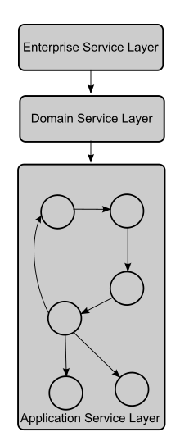
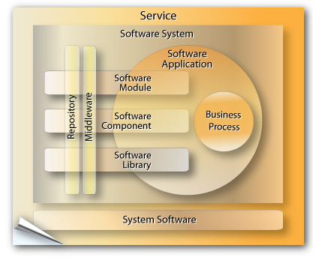
SOA (Service-Oriented Architecture)
http://www.sparxsystems.com.au/somf
http://en.wikipedia.org/wiki/Service_Oriented_Architecture

Slide 3
SOA (Service-Oriented Architecture)
SOA e WebServices
In SOA the service is the primary entity
WebServices are a set of protocols by which Services can be disclosed (published), "discovered" and used in a standard and "technology independent" way

Slide 4
SOA (Service-Oriented Architecture)
Web Service versus API
API - Application Programming Interface
API - “ (…) a set of functions and procedures” that allow you to access and build upon the data and functionality of an existing application (…)”
APIs are protocol agnostic
A Web service is a software system designed to support interoperable machine-to-machine interaction over a network.
Web Services (usually) use SOAP!

Slide 5
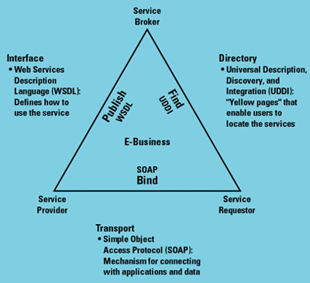
SOA (Service-Oriented Architecture)
WebServices - Architecture
Componentes Core
Transporte:
HTTP, FTP, SMTP, BEEP
Intercomunicação
XML, XML_RPC, SOAP
Descrição
WSDL
Descoberta
UUDI,

Slide 6
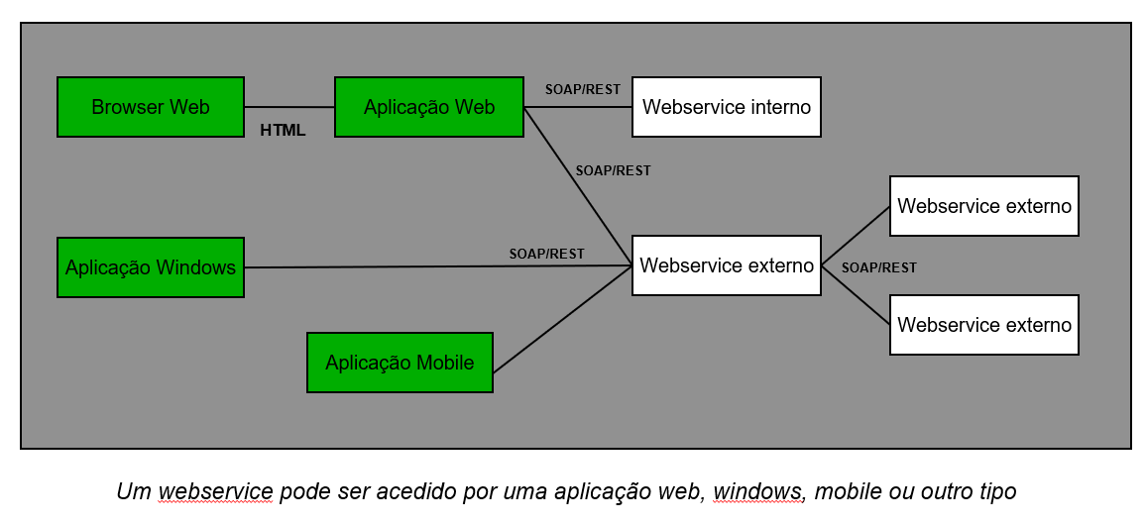
SOA (Service-Oriented Architecture)
WebServices: Management

Slide 7
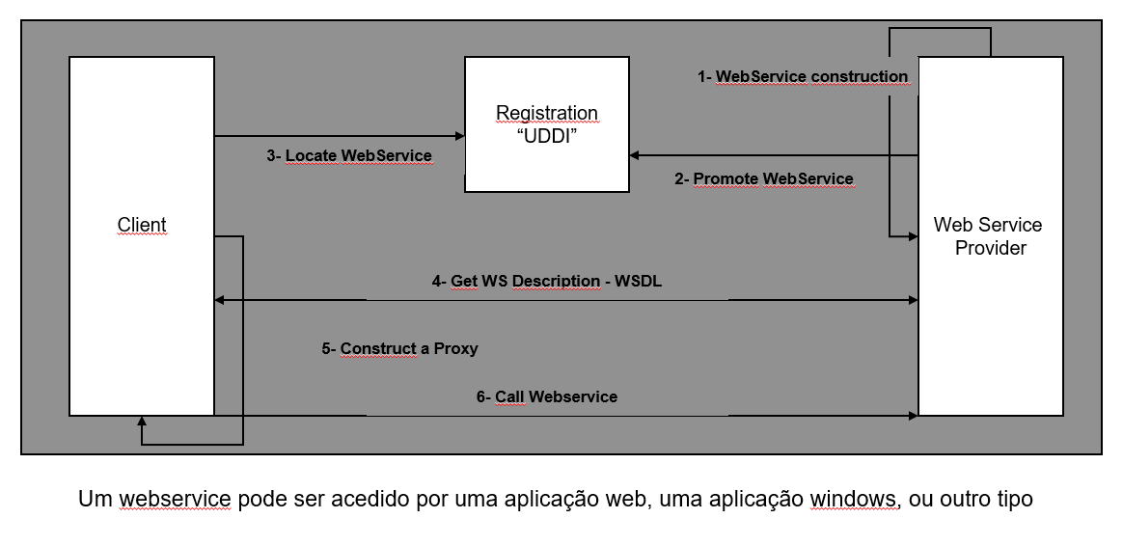
SOA (Service-Oriented Architecture)
WebServices: Life Cycle

Slide 8
Web Service - Tutorial
WebService
Also called XML Web Services or ASMX Web Services
use the extension: .asmx (making it possible to add code in .asmx.cs)

Slide 9
Web Services: Exemplo 1
Main steps for developing a distributed application based on Web Services:
Create the web service
Run and Test the web service
Deploy a client application that "consumes" the web service

Slide 10
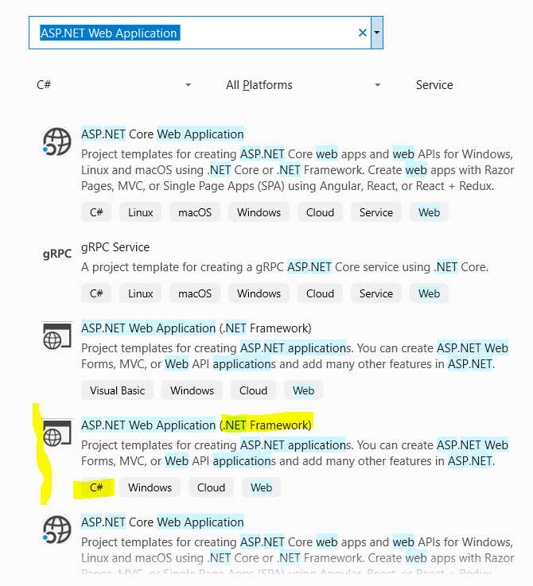
Web Services: Exemplo 1
Create the web service (using Visual Studio)
a) Create New Project >
ASP.NET Web Application
.NET Framework
Linguagem: C#

Slide 11
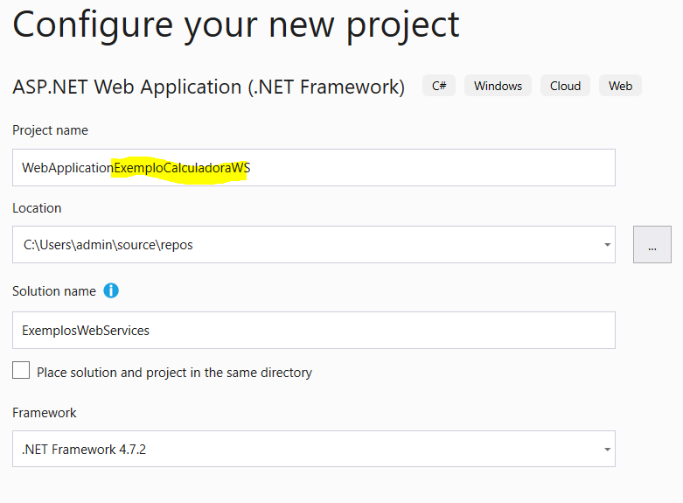
Web Services: Exemplo 1
Create the web service (using Visual Studio)
a) Create New Project
Project Name:
WebApplicationExemploCalculadoraWS

Slide 12
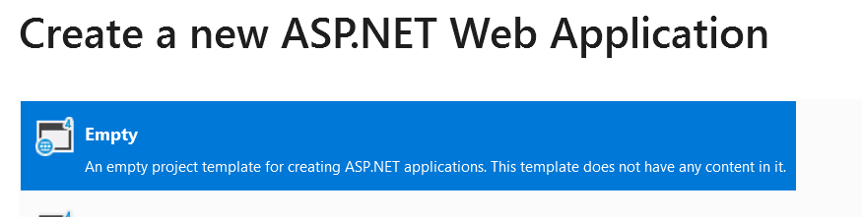
Web Services: Exemplo 1
Create the web service (using Visual Studio)
a) Create New Project
b) Select Empty project template

Slide 13
Web Services: Exemplo 1
Create the web service (using Visual Studio)
Create New Project >
Project Name:
WebApplicationExemploCalculadoraWS

Slide 14
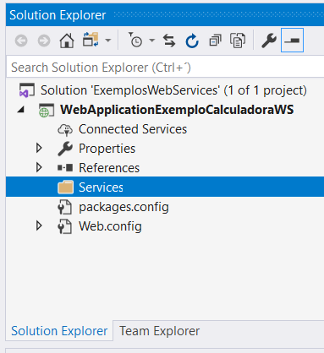
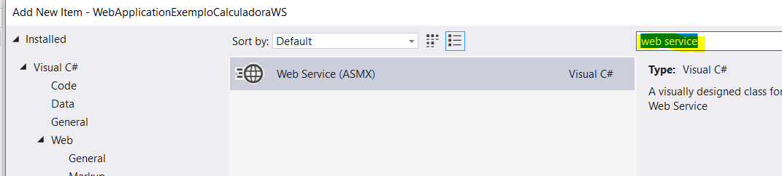
Web Services: Exemplo 1
Create the web service (using Visual Studio)
Criar novo diretório: Services
Lado Direito Rato sobre Projeto
Add > New Folder → Services
Adicionar Web Service (ASMX) ao projeto
Lado Direito do Rato sobre “Services”
Add > New Item … (Ctrl+Shft + A)
Name: CalculadoraWs.asmx
Notes:
Adding a new Web Service (ASMX) to the project

Slide 15
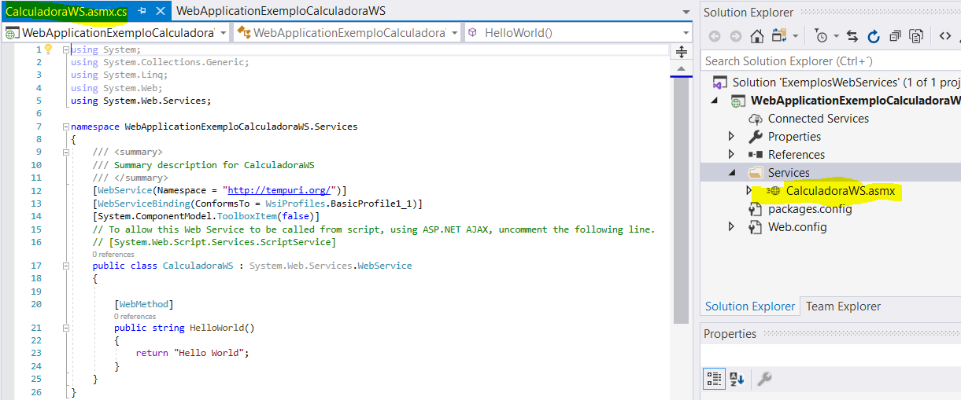
Web Services: Exemplo 1
Create the web service (using Visual Studio)

Slide 16
Web Services: Exemplo 1
Create the web service (using Visual Studio)
Adicionar Web Service (ASMX) ao projeto →
editar a documentação código e editar a descrição do Web Service
/// <summary>
/// Summary description for CalculadoraWS
/// Serviço para implementar as operações básicas de uma calculadora
/// </summary>
[WebService(Namespace = "http://www.ipca.pt/isi202122/",
Description = "ISI202122 - exemplo de XML web service")]
[WebServiceBinding(ConformsTo = WsiProfiles.BasicProfile1_1)]
[System.ComponentModel.ToolboxItem(false)]
public class CalculadoraWS : System.Web.Services.WebService

Slide 17
Web Services: Exemplo 1
Create the web service (using Visual Studio)
Add a new Soma Web Method (edit documentation and web method description)
[WebMethod]
public int Soma(int x, int y)
{
return x + y;
}
/// <summary>
/// Soma de dois valores inteiros
/// </summary>
/// <param name="x">primeiro operando da soma, valor inteiro</param>
/// <param name="y">segundo operando da soma, valor inteiro</param>
/// <returns></returns>
[WebMethod(MessageName= "Soma",
Description = "calcula a soma de dois valores inteiros“)]
public int Soma(int x, int y)
{
return x + y;
}

Slide 18
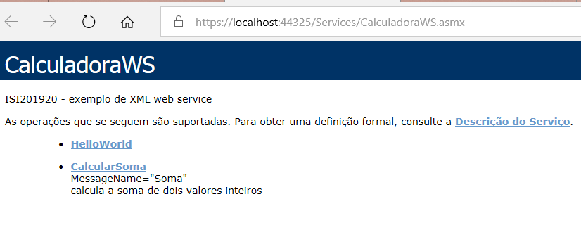
Web Services: Exemplo 1
2. Run and Test the Service
Web page set up to test the developed Web Methods

Slide 19
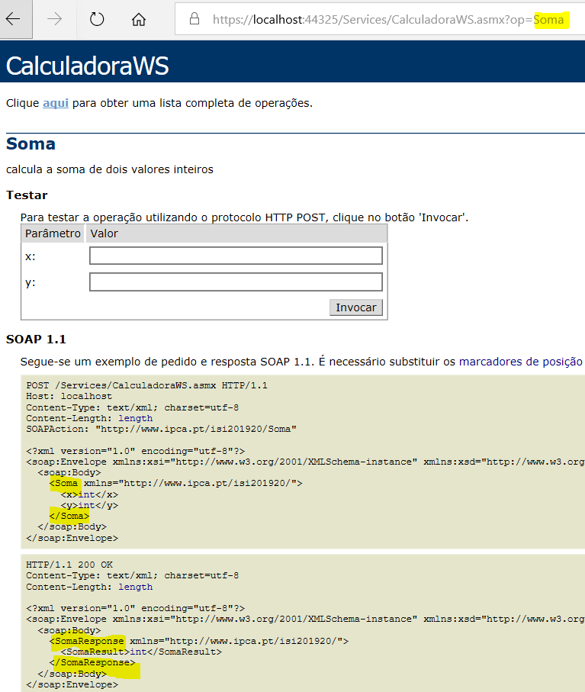
Web Services: Sample 1
2. Run and Test the Service
Web page set up to test the developed Web Methods

Slide 20
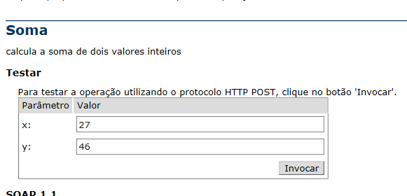
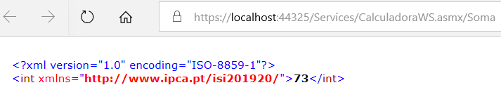
Web Services: Sample 1
2. Run and Test the Service
Web page set up to test the developed Web Methods

Slide 21
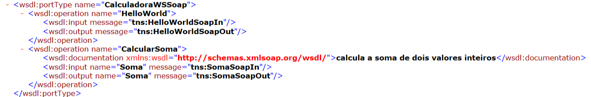
Web Services: Sample 1
2. Run and Test the Service
Web page set up to test the developed Web Methods
descrição do serviço: https://localhost:44342/Services/Calc.asmx?WSDL

Slide 22
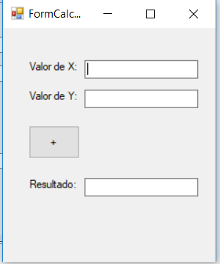
Web Services: Sample 1
3. Implement a client application that "consumes" the web service
Client is an application that uses one or more web services. A Web service can itself be a client of other services
Example of an XML Web Services Client in C#
Creating a new application
Windows Forms App (.NET Framework)
Project Name: Calculadora

Slide 23
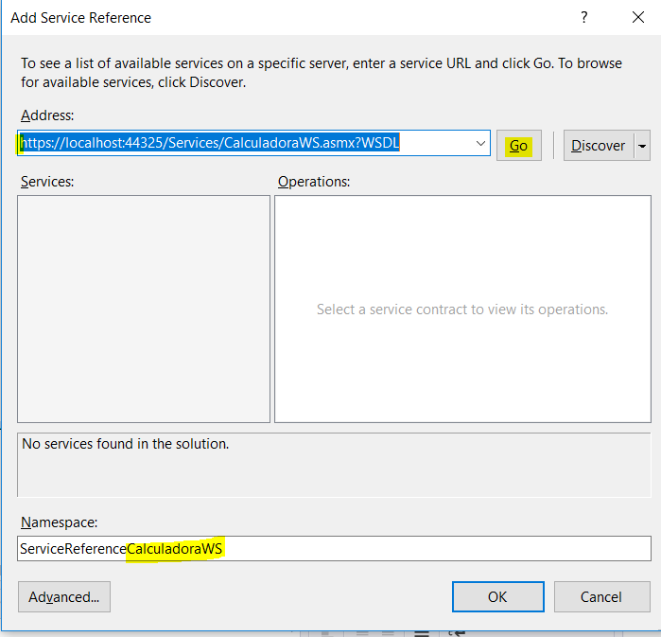
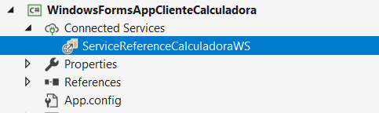
Web Services: Sample 1
Example of an XML Web Services Client in C#
Add reference to the Web Service
References > Add Service Reference
Address: put the url of the description (WSDL)
NameSpace: ServiceReferenceCalculatorWS
Reference will act as a proxy for web service access
Notes:
Add Web Reference... Testar com este método….

Slide 24
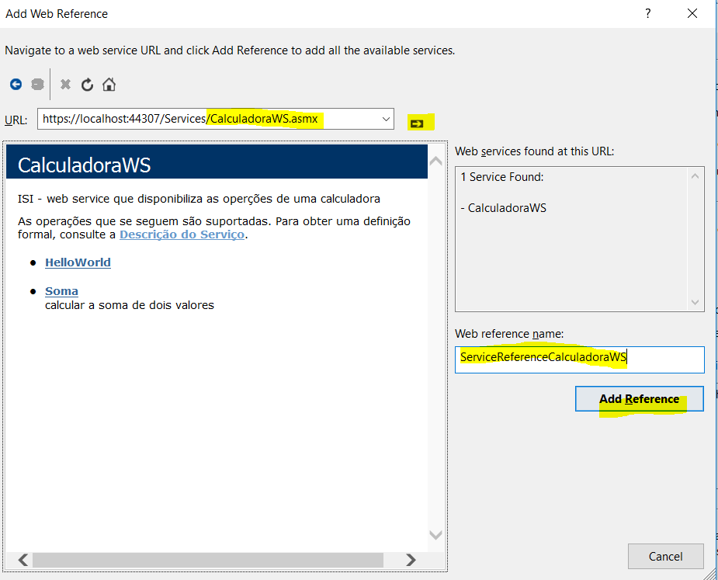
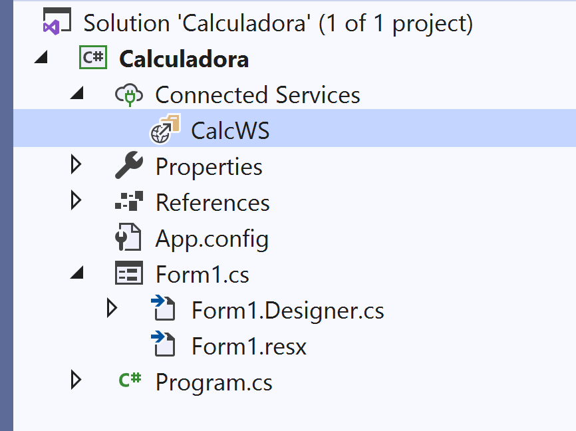
Web Services: Sample 1
Example of an XML Web Services Client in C#
Add reference to the Web Service
References > Add Service Reference
Advanced… > Add Web Reference
Address: put the url of the description (WSDL)
Web reference name:
CalcWS
Reference will act as a proxy for web service access
Notes:
Add Web Reference... Testar com este método….

Slide 25
Web Services: Sample 1
Example of an XML Web Services Client in C#
Adicionar referência para o Web Service
References > Add Service Reference
Address: put the url of the description (WSDL)
NameSpace: ServiceReferenceCalculatorWS
Reference will act as a proxy for web service access
Notes:
Add Web Reference... Testar com este método….

Slide 26
Web Services: Sample 1
Example of an XML Web Services Client in C#
Call the Web Service
private void buttonSoma_Click(object sender, EventArgs e)
{
CalcWS.CalcSoapClient ws = new CalcWS.CalcSoapClient();
// ler os valores dos operandos das respetivas caixas de texto
int valorX = int.Parse(textBoxValorX.Text);
int valorY = int.Parse(textBoxValorY.Text);
// invocação do serviço web CalculadoraWS, indicando:
// 1. a operação a invocar - "CalcularSoma"; e
// 2. o valor dos respetivos argumentos - em "ValorX" e "ValorY",
// 3. esperar pela resposta, guardando-a em "resultado"
int resultado = ws.Sum(valorX,valorY);
// mostrar o resultado, atualizar a respetiva caixa de texto
textBoxResultado.Text = resultado.ToString();
}
Notes:
Add Web Reference... Testar com este método….

Slide 27
ISI - Web Services Tutorial
Bibliografia Essencial:
Service Design Patterns - Fundamental Design Solutions for SOAP/WSDL and RESTful Web Services, Robert Daigneau, Addison-Wesley – 2012
Service-Oriented Modeling: Analysis, Design, and Architecture, Wiley, 2008
Web Services and Service-Oriented Architectures: the Savvy Manager's Guide
Service-Oriented Architecture: Concepts, Technology, and Design,Thomas Erl
Sebenta da disciplina
Notes:
Luís Ferreira (2016), Integração de Sistemas de Informação, Parte I - versão 5.0 - Janeiro 2016
, Parte II - versão 1.0 - Janeiro 2017
Bibliografia complementar:
Urls
http://www.tutorialspoint.com/webservices/
http://www.linkeddatatools.com/
http://eai.ittoolbox.com/

Slide 28
ISI - Web Services Tutorial
Bibliografia Complementar:
https://www.ibm.com/cloud/learn/soa
https://www.service-architecture.com/
http://www.tutorialspoint.com/webservices/
https://www.devmedia.com.br/web-services/2873
Notes:
https://www-01.ibm.com/software/solutions/soa
direciona para https://www.ibm.com/pt-en Privacy and encryption for hybrid cloud

