Slide 1
Parte IV
Tecnologias de Integração
SOA - WCF Web Services
Instituto Politécnico do Cávado do Ave
Escola Superior de Tecnologia

Slide 2
WCF – Windows Communication Fundation
Unificação de Tecnologias de Desenvolvimento
asmx, .Net Remoting, ES, WSE, System.Messaging, REST, etc.
Incorpora propriedades de tecnologias específicas
WCF is Microsoft’s unified programming model for building service-oriented applications. It enables developers to build secure, reliable, transacted solutions that integrate across platforms and interoperate with existing investments.
https://docs.microsoft.com/en-us/dotnet/framework/wcf/

Slide 3
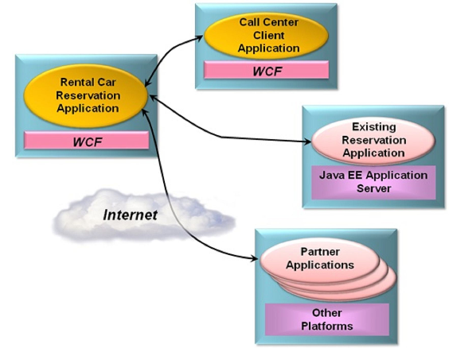
WCF – Windows Communication Fundation
fonte: Microsoft

Slide 4
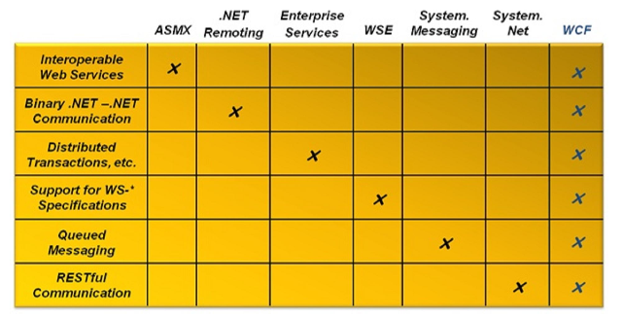
WCF – Windows Communication Fundation
Complex to implement and maintain
fonte: Microsoft

Slide 5
WCF
This "difficulty" is overcome:
Communication via Web Services (SOAP)
Performance with "enhanced" SOAP...uses binary code instead of XML
Supports distributed transactions
Incorporates several WS-*: security, reliability, others
Built-in persistent queues
Supports RESTFull Services

Slide 6
WCF Hosting
The role of the host application is to start and stop the service, listen for requests from clients, direct those requests to the service and send responses back to the clients
Use of ServiceHost class in the System.ServiceModel namespace
instantiate the service, configure endpoints, apply security and start listeners that handle requests from clientes
endpoint consists of an address, a binding and a contract. The address identifies where clients can find the service. The binding specifies how the client and service communicate. The contract specifies what operations the service supports.
create a ServiceHost object for each hosted service.
If clients can communicate with a service over more than one protocol, say HTTP and TCP, you do not need multiple ServiceHost objects. You can define multiple endpoints for the service!
https://msdn.microsoft.com/en-us/library/ee939285.aspx

Slide 7
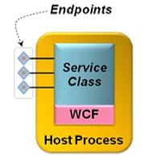
Criar um Serviço WCF
A WCF Service essentially has components:
A Service and Data "Contract"
A class that implements the methods
A process (host) that runs the service
Communication" points that allow you to use the services
fonte: Microsoft

Slide 8
Criar um Serviço WCF
1 . Implementing the Service
The Service Class is either classified with the [ServiceContract] attribute or
Implements an interface classified with the [ServiceContract] attribute
Each method to be provided is classified with the [OperationContract] attribute

Slide 9
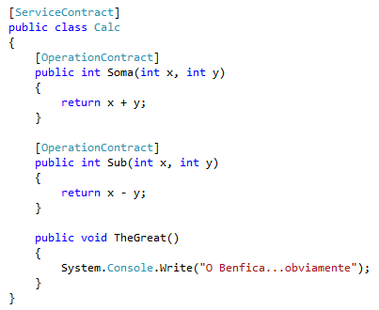
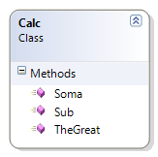
Criar um Serviço WCF
Implement Class (I)
Include NameSpace System.ServiceModel
Classify with [ServiceContract] attribute
Each method with the [OperationContract] attribute
Unclassified methods, only for use in the class
VS: Template: WCF Service ou WCF Service Application

Slide 10
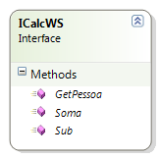
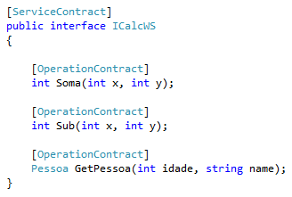
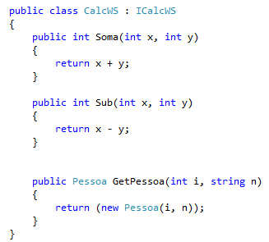
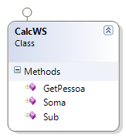
Criar um Serviço WCF
a.ii
Implement Class (II)
Include NameSpace System.ServiceModel
Set Interface with [ServiceContract] attribute
Each method with [OperationContract] attribute
Class implements Interface
Methods not referred to in interface, only for use in class
a.iii
a.iv

Slide 11
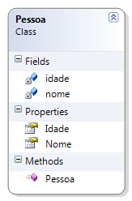
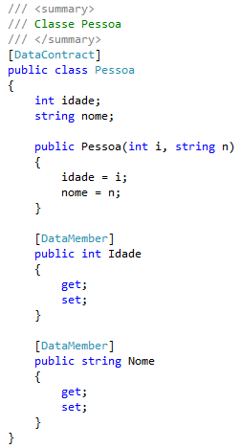
Criar um Serviço WCF
Implementing a Data Contract
NameSpace System.Runtime.Serialization is used
The [DataContract] attribute is used
Each member of the Data Type classified with [DataMember]

Slide 12
Test a WCF Service (I)
Creating a Client with Add Service Reference
Use ServiceModel Metadata Utility Tool (svcutil.exe)
C:\Program Files\Microsoft SDKs\Windows\v7.0Abin
Example: svcutil.exe /d:c:\temp http://localhost:6416/CalcWS.svc?wsdl
See http://msdn.microsoft.com/en-us/library/aa347733.aspx

Slide 13
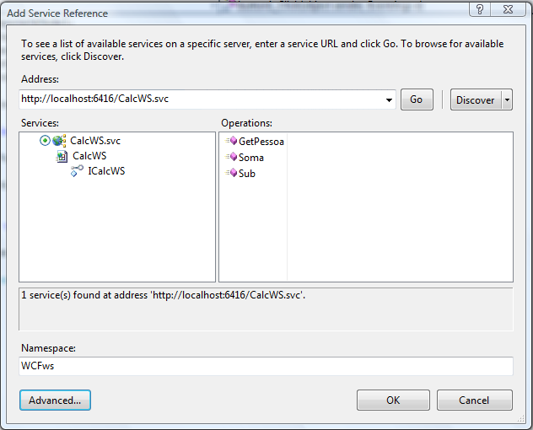
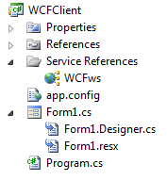
Test a WCF Service
Creating a Client with Add Service Reference
Put WCF Service Address

Slide 14

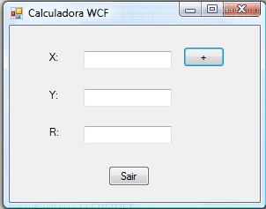
Testar Serviço WCF

Slide 15
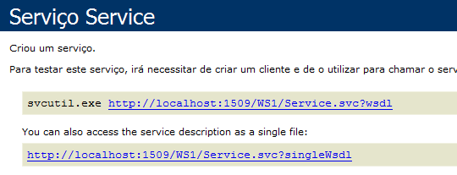
Testar Serviço WCF (II)
Iniciar a aplicação WcfTestClient
(C:\Program Files (x86)\Microsoft Visual Studio 14.0\Common7\IDE\WcfTestClient.exe)
(Fazer F5 sobre Service.svc)
Adicionar o URL do serviço pretendido
( Right click em My Service e Add Service)
Testar os métodos pretendidos
http://blogs.msdn.com/b/wcftoolsteamblog/archive/2010/01/04/tips-for-launching-wcf-test-client.aspx

Slide 16
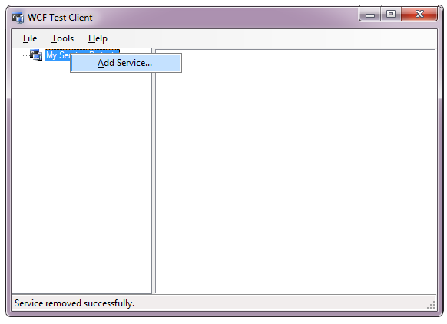
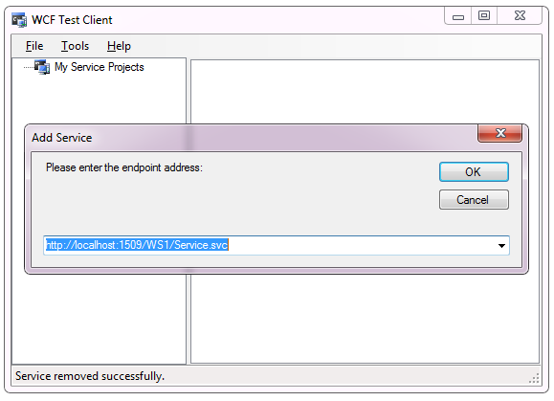
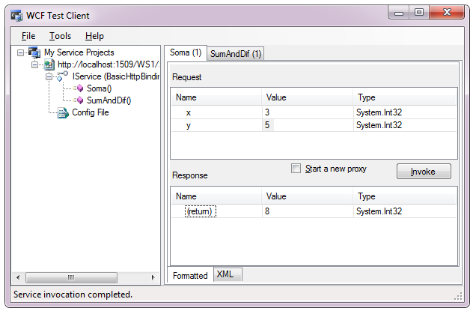
Testar Serviço WCF (II)

Slide 17
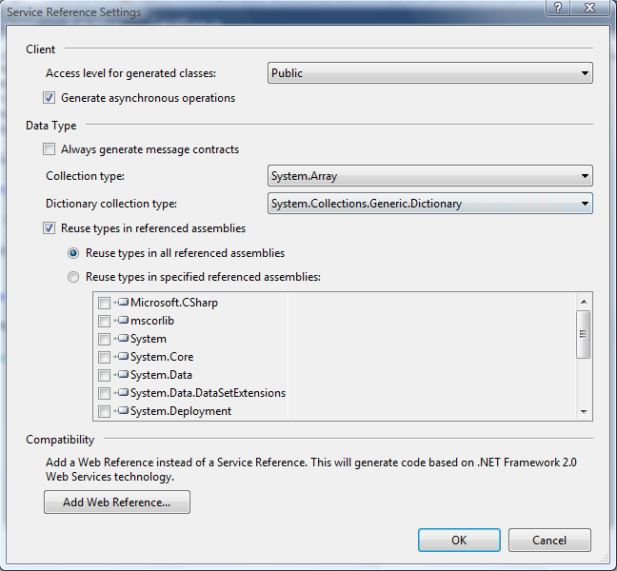
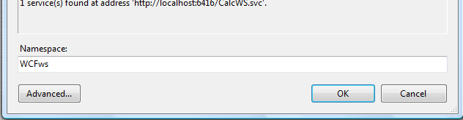
Serviço WCF Assincrono
Criar um Cliente com Add Service Reference
Advanced...
Marcar Generate asynchronous operation
c)
b)

Slide 18
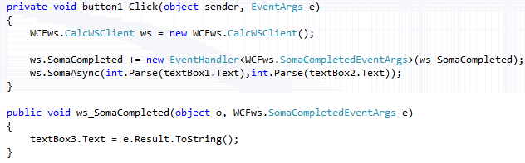
Utilizar WCF Assincrono

Slide 19
Next: WCF or Wep API?
Analisar:
https://docs.microsoft.com/en-us/dotnet/framework/wcf/wcf-and-aspnet-web-api

Slide 20
Bibliografia essencial:
Pro WCF - Practical Microsoft SOA Implementation, 4th edition, Apress, 2011
Programing WCF services, 4th Edition, O’Reilly, 2016
Bibliografia complementar:
http://msdn.microsoft.com/pt-pt/library/dd943056.aspx
http://www.service-architecture.com/

Slide 21
Mais referências
Ver slides sobre Web Services
Ver Sebenta da disciplina
https://www.infoworld.com/article/3061973/application-development/how-to-create-a-restful-service-in-wcf.html
Develop Service-Oriented Applications with WCF https://docs.microsoft.com/en-us/dotnet/framework/wcf/?redirectedfrom=MSDN

Slide 22
Next step
RESTfull Services
Universal Windows Platform (UWP)

