Slide 1


Presentation P01
Data Mart Implementation

Slide 2
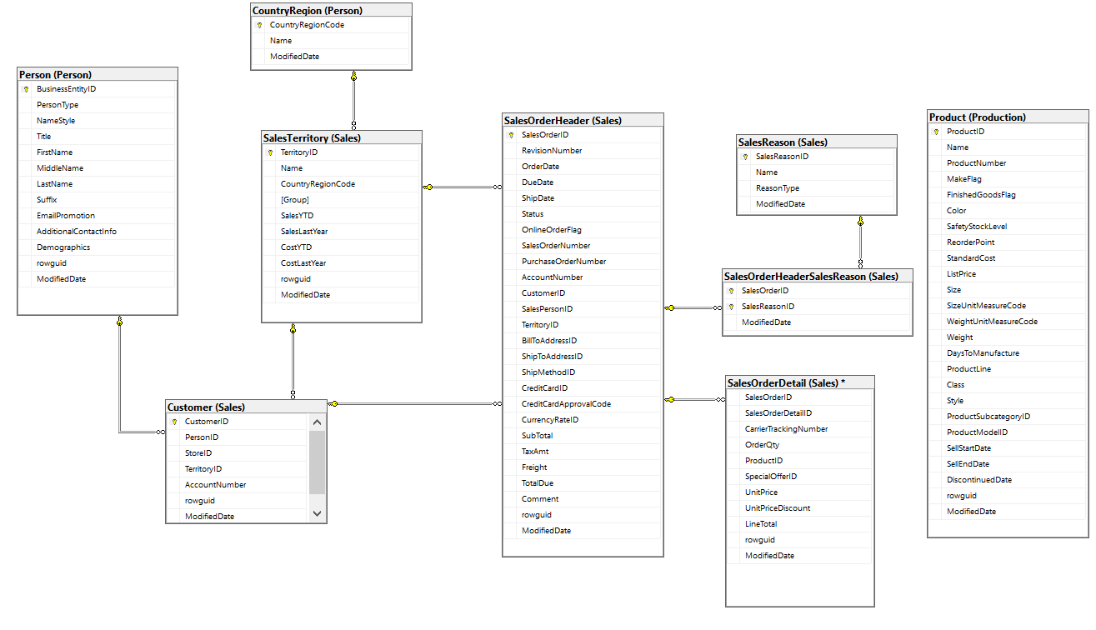
Data Schema Analasys

Slide 3
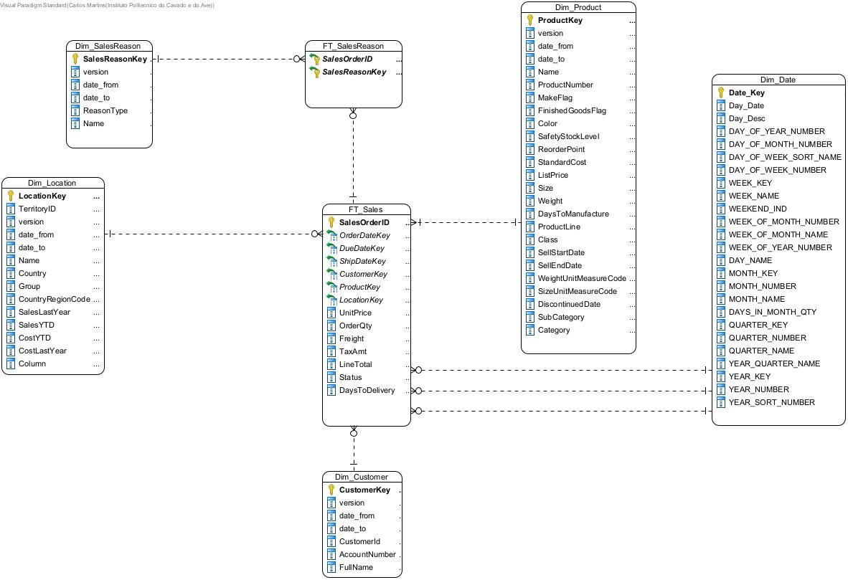
Dimensional Modelling

Slide 4

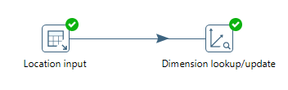
Tranformations
Location

Slide 5
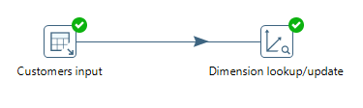
Tranformations
Customers

Slide 6

Tranformations
Product

Slide 7
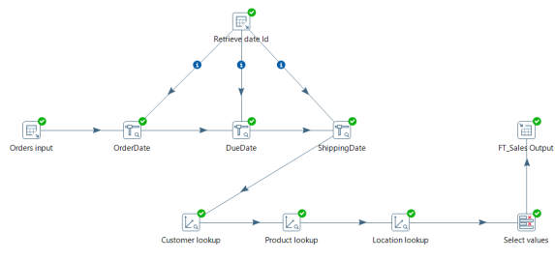
Tranformations
Fact Table Sales

Slide 8
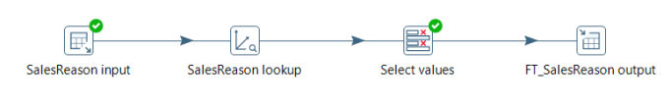
Tranformations
Fact Table SalesReason

Slide 9
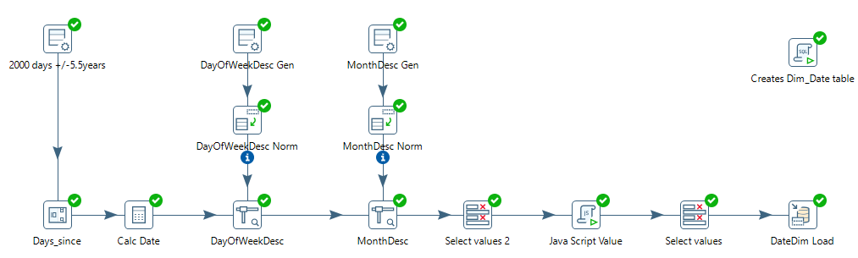
Tranformations
Date Dimension

Slide 10

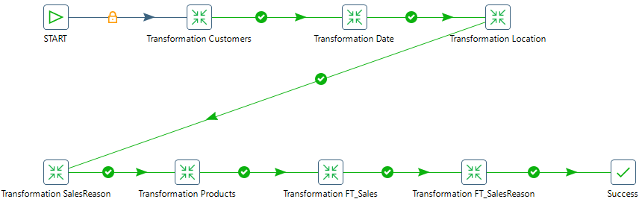
Job
Load the entire ETL process

Slide 11


Thank You!
João Fernandes 18825
Carlos Martins 18836

