Slide 1

Distributed Prime Sieve in Heterogeneous Computer Clusters
Carlos M. Costa, Altino M. Sampaio, and Jorge G. Barbosa
{carlos.costa,pro09002,jbarbosa}@fe.up.pt

Slide 2
Context
Prime number
Natural number greater than 1 that has no positive divisors other than 1 and itself
Prime number sieve
Algorithm able to find prime numbers up to a given limit
Prime number applications
Cryptography
Asymmetric public key algorithms (RSA)
Deffie-Hellman key exchange algorithm
Hash functions
Pseudo-random number generators

Slide 3
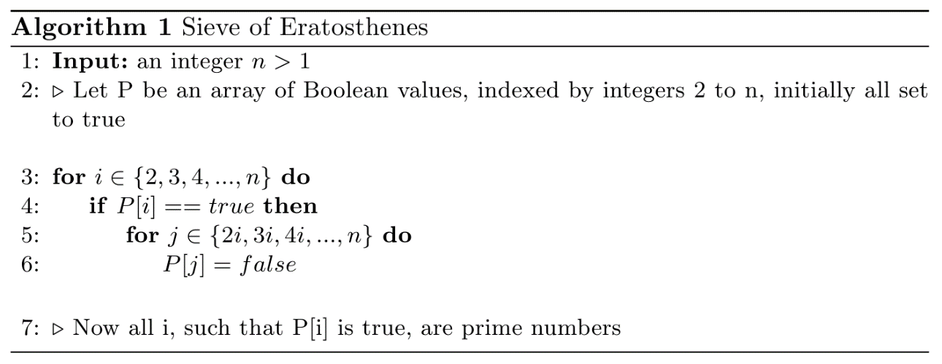
Prime number sieves
Sieve of Atkin
O(n / (log log n) operations
Sieve of Sundaram
O(n log n) operations
Sieve of Eratosthenes
O(n log log n) operations
Sieve of Eratosthenes animation

Slide 4
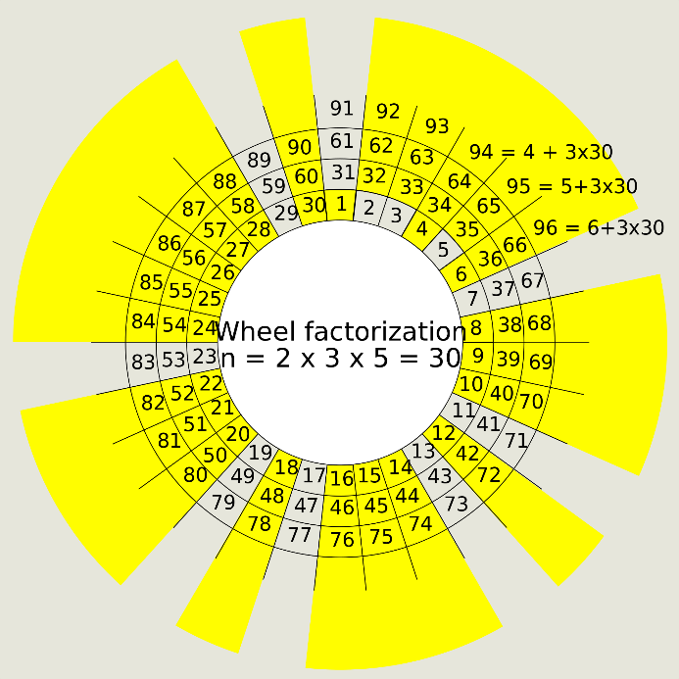
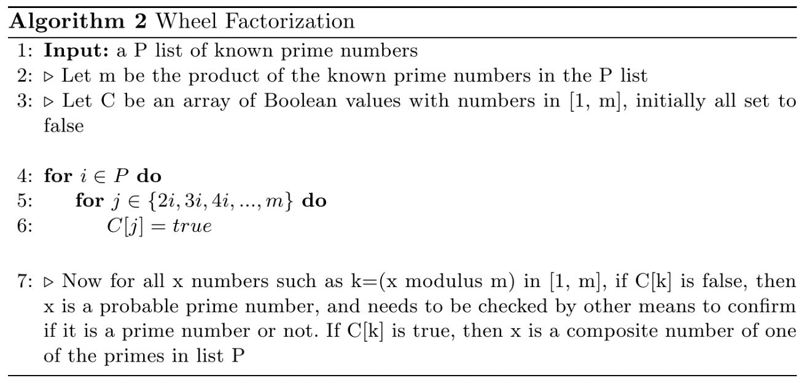
Wheel factorization
Sieving optimization that can cross off multiples of several sieving primes.
A 210 (2*3*5*7) wheel can remove as much as 77% of composite numbers.

Slide 5
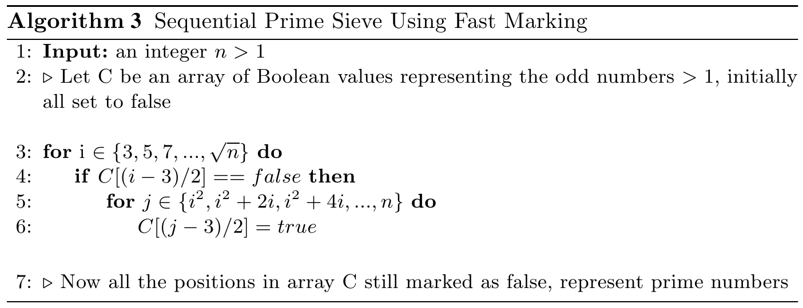

Sequential sieve with fast marking
Improvements over original Sieve of Eratosthenes:
Sieving can start at i² (instead of 2i) and stop at $\sqrt{n}$ (instead of n)
Avoids marking the same composite number multiple times
All even numbers are skipped from sieving
Reduces sieving computations and memory consumption by 50%
Uses additions instead of multiplications to reduce CPU cycles
According to the Intel optimization manual (table C-20a. General Purpose Instructions), an add instruction has a latency of 1 and a throughput of 0.33, while an imul instruction has a latency of 3 and a throughput of 1. Which means an add instruction can be much faster than an imul when using pipelining.

Slide 6
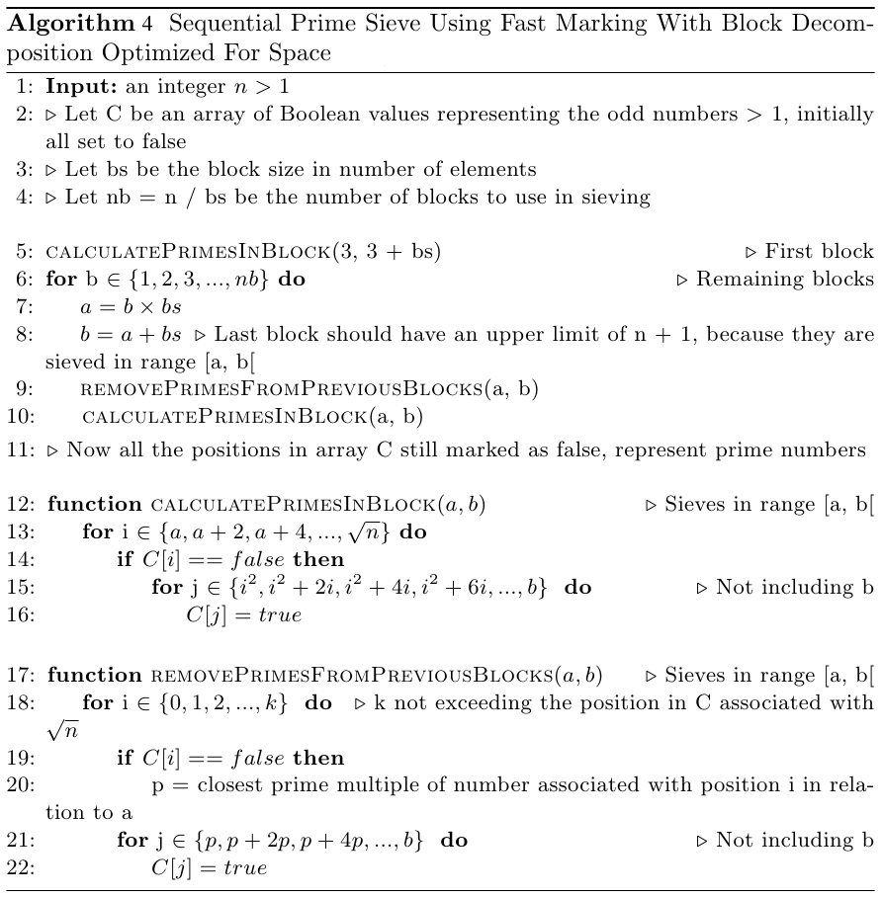
Sequential sieve with block decomposition

Slide 7
Sequential sieve with block decomposition
Improvements over previous algorithm:
Block decomposition of the sieving range greatly improves cache usage, because instead of picking a prime and removing all it’s multiples, it removes all multiples of the sieving primes block by block. This achieves better performance because the sieving primes can remain in cache memory longer, reducing cache misses.
The reduction of cache misses improves performance because cache memory access is much faster than main memory (RAM) access.

Slide 8
Sequential sieve with block decomposition
Other improvements
Line 20 of algorithm 4 spends a considerable amount of time computing the closest prime multiple to the beginning of the block. To avoid this, each sieving prime is associated with its last multiple.
Moreover, in line 18, we can see that the bitset of numbers is searched again to select the sieving primes. To avoid this extensive loop, a data structure with the sieving primes doubles and their last used multiples is kept in memory.
In algorithm 4, all numbers are stored in memory instead of only the odd ones. Both memory storage versions were implemented to test the overhead of the memory offset computations. The results show that for small ranges, direct memory access has better performance, but for large ranges, storing only the odd numbers is better. This is due to the fact that cache usage for large ranges has more impact than offset computations.
A modified 210 wheel sieved was also added to reduce the number of composites to check. In this case the wheel is used to compute the next composite number that needs to be checked (instead of being used to pre-sieve the numbers bitset).

Slide 9
Parallel segmented sieve
Given that the sequential sieve was already using block decomposition, the parallelization was achieved by assigning different groups of blocks to different threads.
This lead to the implementation of a segmented sieve, in which only the segment (group of blocks) that is being sieved is stored in memory (no longer stores all odd numbers). This allows the computation of primes to near 2⁶⁴ with minimal memory requirements.

Slide 10
Distributed sieve
Computing prime numbers to near 2⁶⁴ can take a very long time.
To speedup the processing, a computer cluster can be used.
But some clusters can have very heterogeneous hardware.
To solve this problem, it was implemented a dynamic scheduling algorithm to distribute segments across cluster nodes.
This is a hybrid implementation in which OpenMPI is employed to coordinate the workload and OpenMP is used inside each cluster node.

Slide 11
Distributed sieve
Dynamic scheduling algorithm:
Start a master process with a queue of segments for each cluster node.
Spawn slave processes (that will process the segments)
Each slave process asks the master for a new segment until all of then are processed
Every time the master process receives a request for a new segment, it replies with:
Last segment from the queue associated to the slave process
If queue is empty, selects segment from the largest queue (associated to other slave process)
Removes selected segment from the queue
After all segments are processed and results are collected, master replies to slaves that all work is done and they can terminate execution
System performance
By employing the dynamic scheduling algorithm, cluster nodes with high processing capability can keep contributing to the workload even after they have finished the processing of the segments that were initially allocated to then.
This way the system can adapt to different cluster topologies and avoids clusters node bottlenecks (in a static scheduling system, the processing time would be equivalent to the slowest cluster node).

Slide 12
Testing platforms
The sieving implementations were tested in two different platforms:
Two laptops:
Clevo P370EM
Intel i7-3630QM (quad core processor with Hyper-Threading – 2400 -> 3400 MHz clock rate)
16 GB of RAM DDR3 1600 MHz
Asus G51J
Intel i7-720QM (quad core processor with Hyper-Threading – 1600 -> 2800 MHz clock rate)
4 GB of RAM DDR3 1066 MHz
Computer cluster (Avalanche - Grid FEUP):
Each cluster node with:
16 cores -> two Intel Xeon E5-2450 (2100 -> 2900 MHz clock rate)
64 GB RAM DDR3 1600 MHz
The source code is available at:
https://github.com/carlosmccosta/Distributed-Prime-Sieve

Slide 13
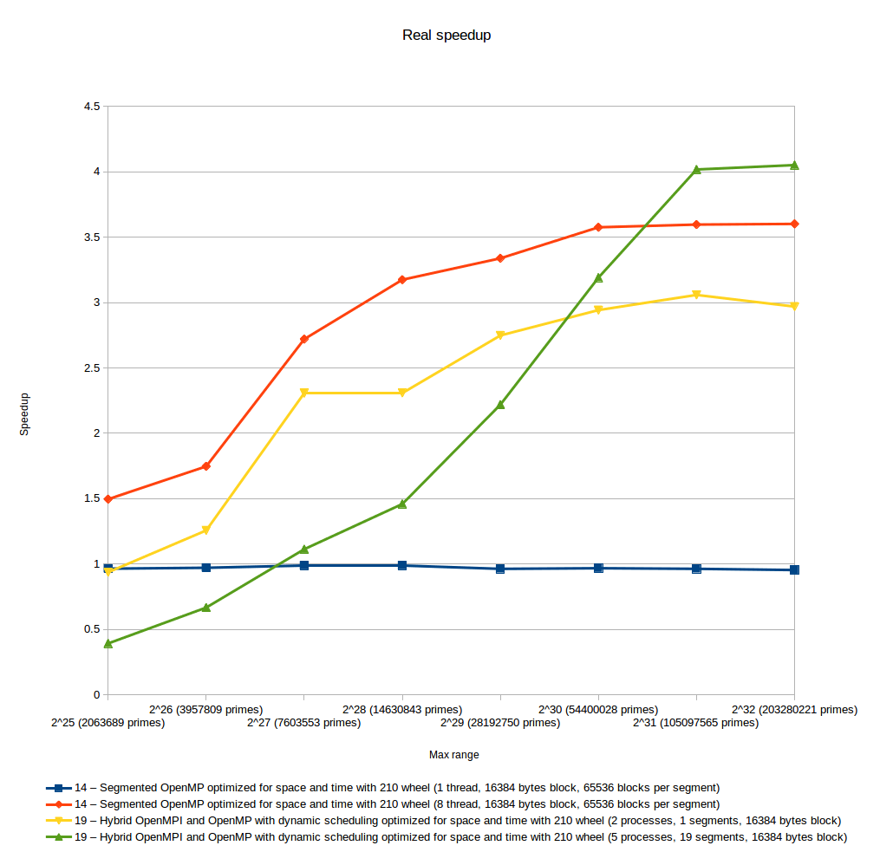
Results - speedup
Speedup achieved with 2 laptops

Slide 14
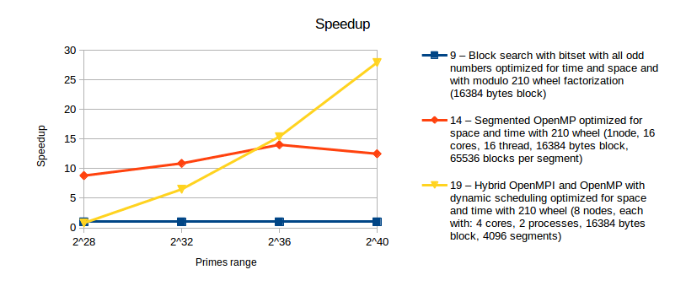
Results – cluster speedup
Speedup achieved with a computer cluster

Slide 15
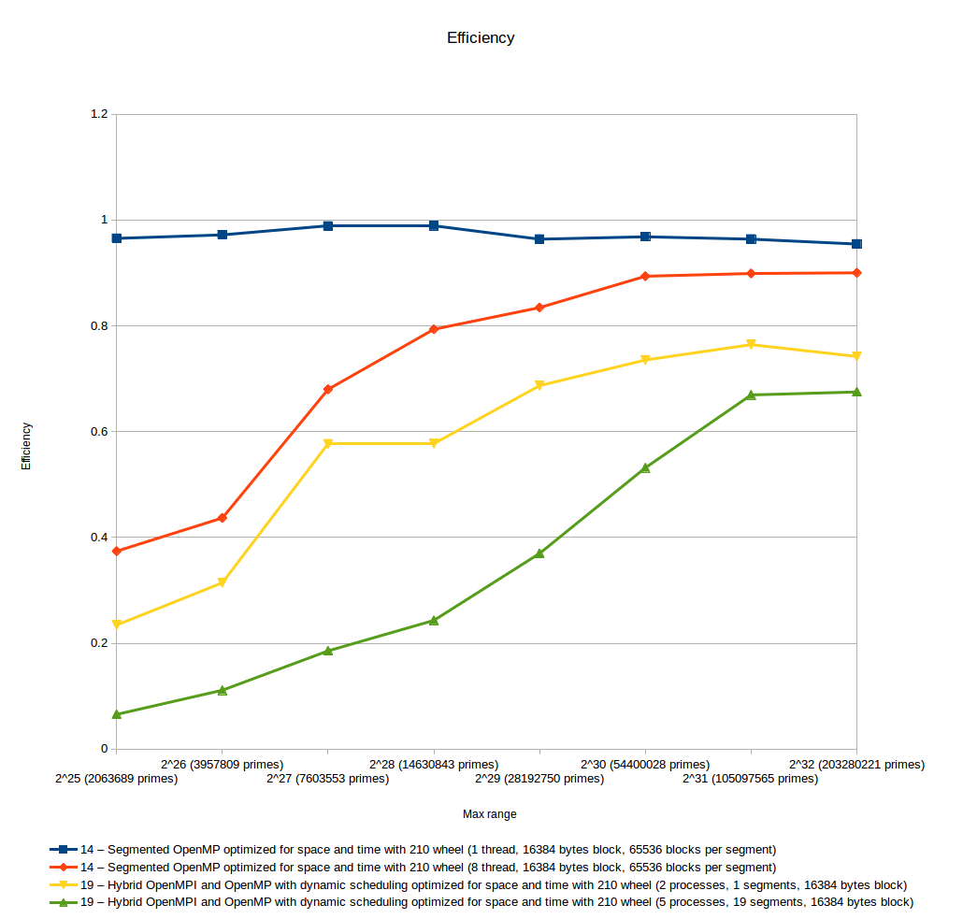
Results - efficiency
Efficiency achieved with 2 laptops

Slide 16
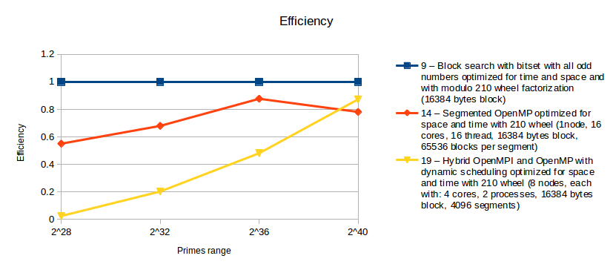
Results – cluster efficiency
Efficiency achieved with a computer cluster

Slide 17
Questions?
Thank you!

