Slide 1

ROS - Lesson 2
Teaching Assistant: Roi Yehoshua
roiyeho@gmail.com

Slide 2
Agenda
ROS development environment setup
ROS packages structure
ROS Integration with Eclipse
Writing your first Node
Running and debugging your nodes

Slide 3
ROS Development Setup
Create a new catkin workspace
Create a new ROS package
Download and configure Eclipse
Create Eclipse project file for your package
Import package into Eclipse
Write the code
Update the make file
Build the package

Slide 4
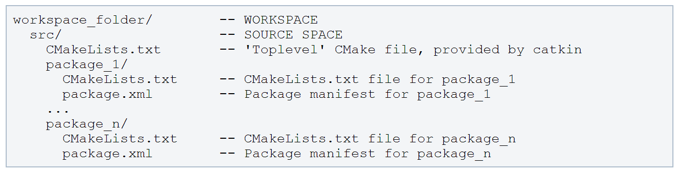
catkin Workspace
A workspace in which one or more catkin packages can be built
A basic workspace looks like this:

Slide 5
Creating a catkin Workspace
http://wiki.ros.org/catkin/Tutorials/create_a_workspace
Initially, the workspace will contain only the top-level CMakeLists.txt
catkin_make command builds the workspace and all the packages within it
$ mkdir -p ~/catkin_ws/src
$ cd ~/catkin_ws/src
$ catkin_init_workspace
cd ~/catkin_ws
catkin_make

Slide 6
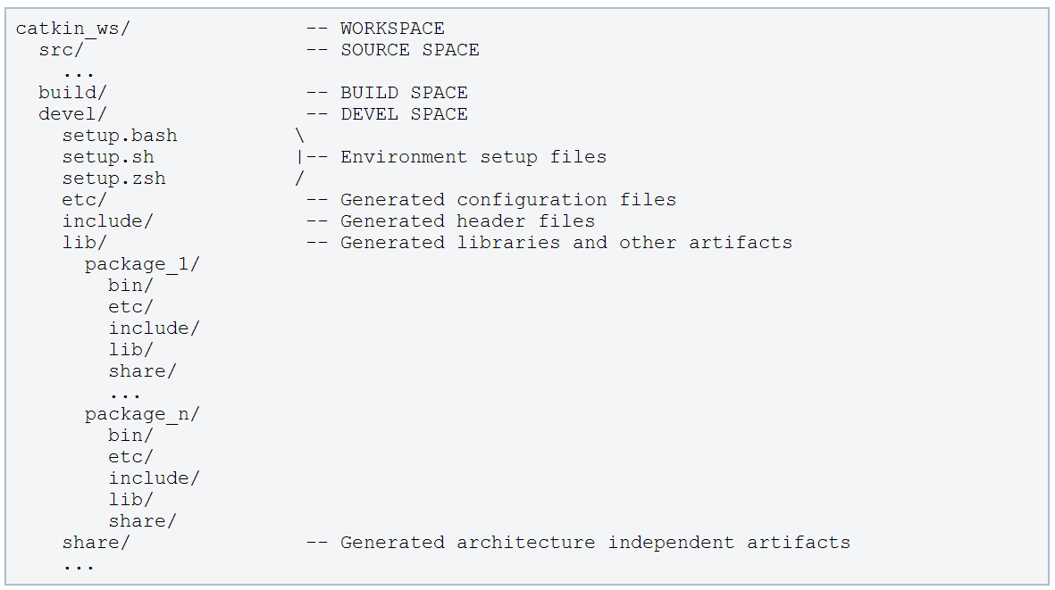
catkin Workspace
The resulting build artifacts and executables are placed into the devel space

Slide 7
ROS Package
A ROS package is simply a directory inside a catkin workspace that has a package.xml file in it.
Packages are the most atomic unit of build and the unit of release.
A package contains the source files for one node or more and configuration files

Slide 8
Common Files and Directories
Explanation | Directory
C++ include headers | include/
Source files | src/
Folder containing Message (msg) types | msg/
Folder containing Service (srv) types | srv/
Folder containing launch files | launch/
The package manifest | package.xml
CMake build file | CMakeLists.txt

Slide 9
The Package Manifest
XML file that defines properties about the package such as:
the package name
version numbers
authors
dependencies on other catkin packages

Slide 10
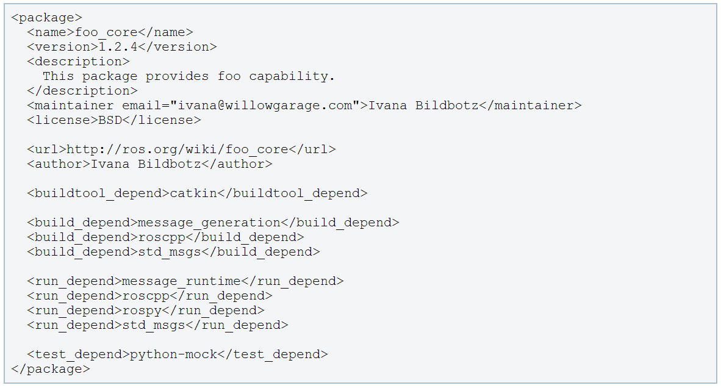
The Package Manifest
Example for a package manifest:

Slide 11
Creating a ROS Package
http://wiki.ros.org/catkin/Tutorials/CreatingPackage
Change to the source directory of the workspace
catkin_create_pkg creates a new package
Example:
$cd ~/catkin_ws/src
$ catkin_create_pkg <package_name> [depend1] [depend2] [depend3]
$ catkin_create_pkg test_package std_msgs rospy roscpp

Slide 12
ROS IDEs
http://wiki.ros.org/IDEs
For building and running ROS programs from IDEs, the ROS environment has to be set up.
Running your IDE from your ROS-sourced shell should be the easiest way
Likewise, you can enhance your IDE's launcher icon to load your shells environment.

Slide 13
Installing Eclipse
Make sure JVM is installed
$sudo apt-get install default-jre
Download eclipse IDE for C/C++ developers from http://www.eclipse.org/downloads/
Latest version of the file is: eclipse-cpp-kepler-SR1-linux-gtk.tar.gz
Extract eclipse into a folder of your choice
Move eclipse to the /opt folder.
$sudo mv eclipse /opt
Create a link to it so it can be used by all users
$sudo ln -s /opt/eclipse/eclipse /usr/bin/eclipse

Slide 14
Installing Eclipse
Make an entry in the Unity Dash for easier access
$sudo gedit /usr/share/applications/eclipse.desktop
The bash –i - c command will cause your IDE's launcher icon to load your ROS-sourced shell environment before launching eclipse
[Desktop Entry]
Name=Eclipse
Type=Application
Exec=bash -i -c "/opt/eclipse/eclipse"
Terminal=false
Icon=/opt/eclipse/icon.xpm
Comment=Integrated Development Environment
NoDisplay=false
Categories=Development;IDE
Name[en]=eclipse.desktop

Slide 15
Make Eclipse Project Files
Go to workspace directory and run catkin_make with options to generate eclipse project files:
The project files will be generated in the build/ folder (~/catkin_ws/build/.project and ~/catkin_ws/build/.cproject)
$cd ~/catkin_ws
$catkin_make --force-cmake -G"Eclipse CDT4 - Unix Makefiles“

Slide 16
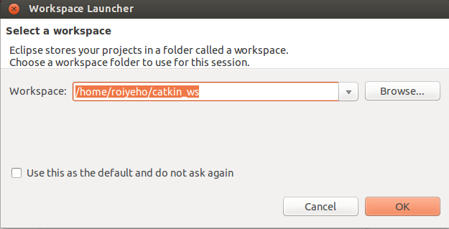
Import the Project into Eclipse
Now start Eclipse
Choose catkin_ws folder as the workspace folder

Slide 17
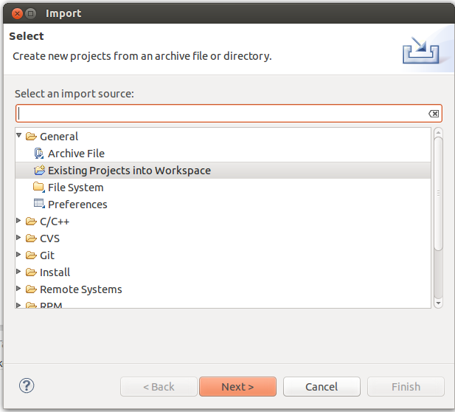
Import the Project into Eclipse
Choose File --> Import --> General --> Existing Projects into Workspace

Slide 18
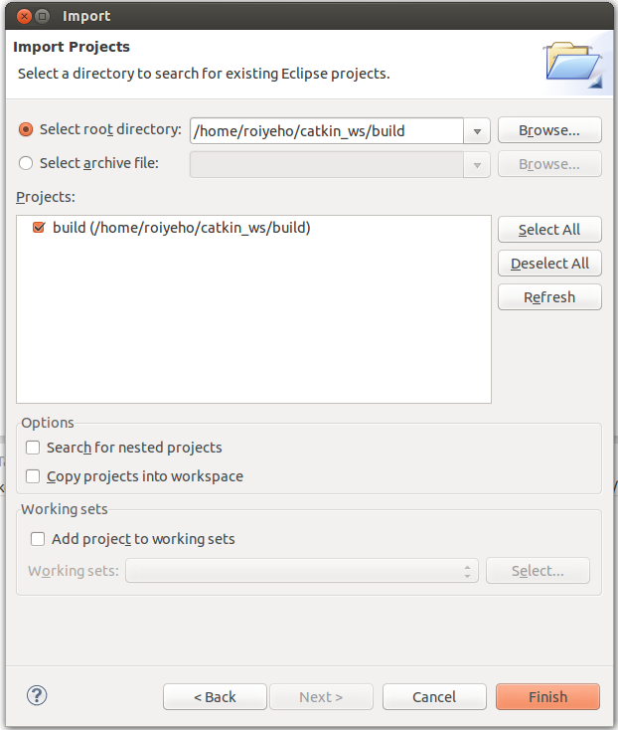
Import the Project into Eclipse
Now import the project from the ~/catkin_ws/build folder

Slide 19
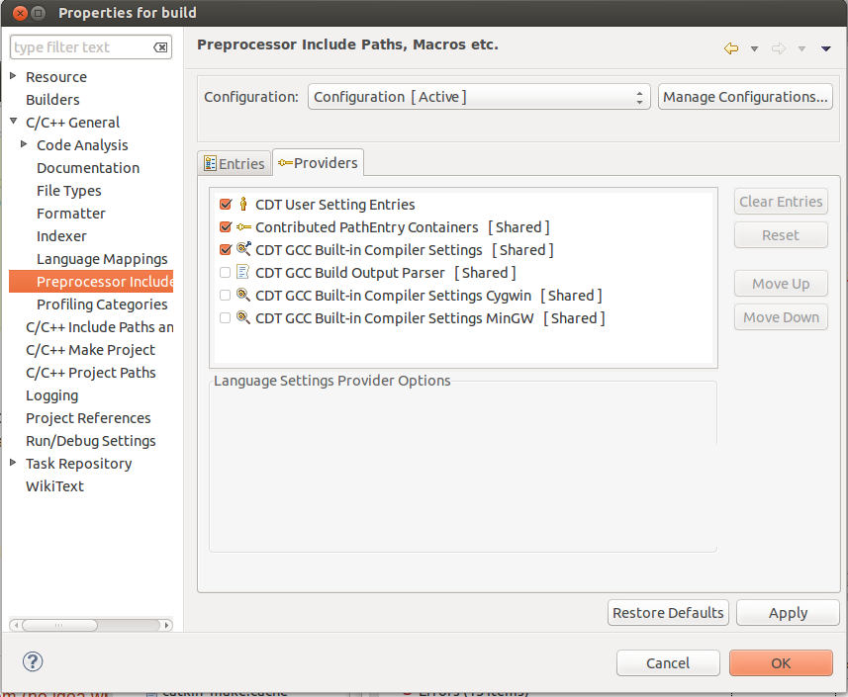
Fix Preprocessor Include Paths
By default, the intellisense in Eclipse won’t recognize the system header files (like <string>). To fix that:
Go to Project Properties --> C/C++ General --> Preprocessor Include Paths, Macros, etc. --> Providers tab
Check CDT GCC Built-in Compiler Settings

Slide 20
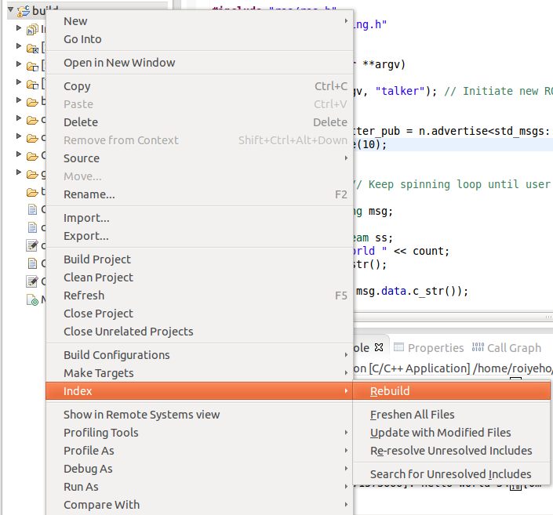
Fix Preprocessor Include Paths
After that rebuild the C/C++ index by Right click on project -> Index -> Rebuild

Slide 21
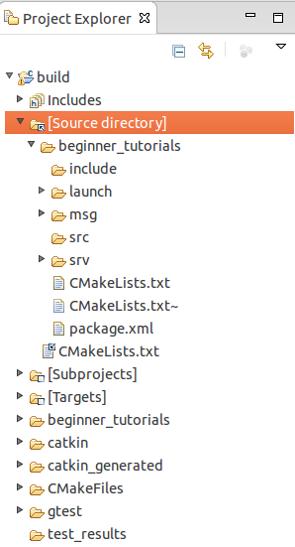
Project Structure
Eclipse provides a link "Source directory" within the project so that you can edit the source code

Slide 22
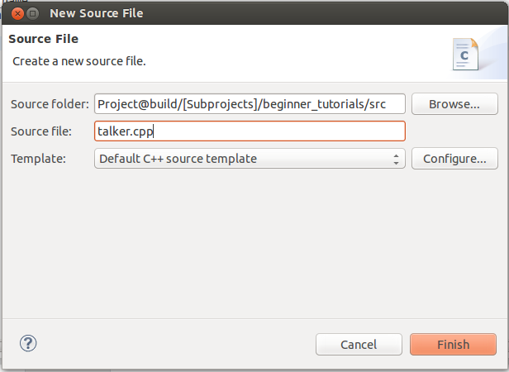
Add New Source File
Right click on src and select New –> Source File, and create a file named talker.cpp

Slide 23
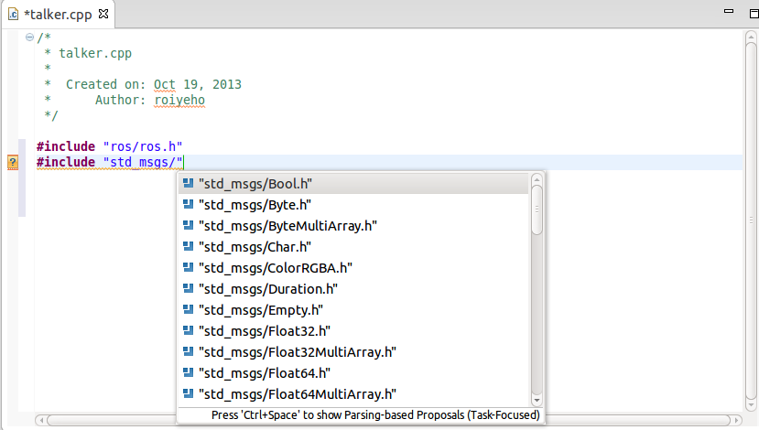
Code Completion
Use Eclipse standard shortcuts to get code completion (i.e., Ctrl+Space)

Slide 24
ROS C++ Client Library
roscpp is a ROS client implementation in C++
Library documentation can be found at:
http://docs.ros.org/api/roscpp/html/
ROS header files can be found at: /opt/ros/hydro/include
For example, /opt/ros/hydro/include/ros/ros.h
ROS core binaries are located at: /opt/ros/hydro/bin
For example, /opt/ros/hydro/bin/rosrun

Slide 25
ROS Init
A version of ros::init() must be called before using any of the rest of the ROS system
Typical call in the main() function:
Node names must be unique in a running system
ros::init(argc, argv, “Node name”);

Slide 26
ros::NodeHandle
The main access point to communications with the ROS system.
Provides public interface to topics, services, parameters, etc.
Create a handle to this process’ node (after the call to ros::init()) by declaring:
The first NodeHandle constructed will fully initialize the current node
The last NodeHandle destructed will close down the node
ros::NodeHandle n;

Slide 27
ros::Publisher
Manages an advertisement on a specific topic.
A Publisher is created by calling NodeHandle::advertise()
Registers this topic in the master node
Example for creating a publisher:
First parameter is the topic name
Second parameter is the queue size
Once all Publishers for a given topic go out of scope the topic will be unadvertised
ros::Publisher chatter_pub = n.advertise<std_msgs::String>("chatter", 1000);

Slide 28
ros::Publisher
Messages are published on a topic through a call to publish()
Example:
The type of the message object must agree with the type given as a template parameter to the advertise<>() call
std_msgs::String msg;
chatter_pub.publish(msg);

Slide 29
ros::Rate
A class to help run loops at a desired frequency.
Specify in the c’tor the destired rate to run in Hz
ros::Rate::sleep() method
Sleeps for any leftover time in a cycle.
Calculated from the last time sleep, reset, or the constructor was called
ros::Rate loop_rate(10);

Slide 30
ros::ok()
Call ros::ok() to check if the node should continue running
ros::ok() will return false if:
a SIGINT is received (Ctrl-C)
we have been kicked off the network by another node with the same name
ros::shutdown() has been called by another part of the application.
all ros::NodeHandles have been destroyed

Slide 31
C++ Publisher Node Example
#include "ros/ros.h"
#include "std_msgs/String.h"
#include <sstream>
int main(int argc, char **argv)
{
ros::init(argc, argv, "talker"); // Initiate new ROS node named "talker"
ros::NodeHandle n;
ros::Publisher chatter_pub = n.advertise<std_msgs::String>("chatter", 1000);
ros::Rate loop_rate(10);
int count = 0;
while (ros::ok()) // Keep spinning loop until user presses Ctrl+C
{
std_msgs::String msg;
std::stringstream ss;
ss << "hello world " << count;
msg.data = ss.str();
ROS_INFO("%s", msg.data.c_str());
chatter_pub.publish(msg);
ros::spinOnce(); // Need to call this function often to allow ROS to process incoming messages
loop_rate.sleep(); // Sleep for the rest of the cycle, to enforce the loop rate
count++;
}
return 0;
}

Slide 32
Building Your Nodes
Before building your node, you should modify the generated CMakeLists.txt in the package
The following slide shows the changes that you need to make in order to create the executable for the node

Slide 33
CMakeLists.txt
cmake_minimum_required(VERSION 2.8.3)
project(beginner_tutorials)
## Find catkin macros and libraries
find_package(catkin REQUIRED COMPONENTS roscpp rospy std_msgs genmsg)
## Declare ROS messages and services
# add_message_files(FILES Message1.msg Message2.msg)
# add_service_files(FILES Service1.srv Service2.srv)
## Generate added messages and services
# generate_messages(DEPENDENCIES std_msgs)
## Declare catkin package
catkin_package()
## Specify additional locations of header files
include_directories(${catkin_INCLUDE_DIRS})
## Declare a cpp executable
add_executable(talker src/talker.cpp)
## Specify libraries to link a library or executable target against
target_link_libraries(talker ${catkin_LIBRARIES})

Slide 34
Building Your Nodes
If your node generation depends on other executable targets, you need to specify them in the CMakeLists file:
This makes sure message headers are generated before being used
After changing the CMakeLists file call catkin_make
add_dependencies(talker beginner_tutorials_generate_message_cpp)

Slide 35
Running the Node Inside Eclipse
Create a new launch configuration, by clicking on Run --> Run configurations... --> C/C++ Application (double click or click on New).
Select the correct binary on the main tab (use the Browse… button)
~/catkin_ws/devel/lib/beginner_tutorials/talker
Make sure roscore is running in a terminal
Click Run

Slide 36
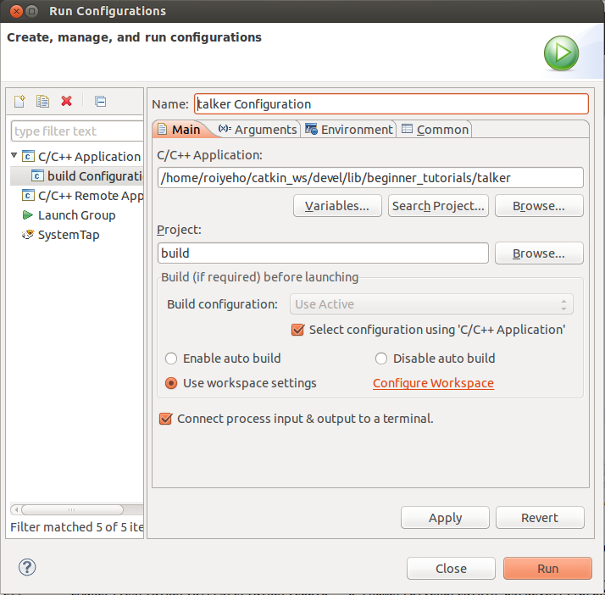
Running the Node Inside Eclipse

Slide 37
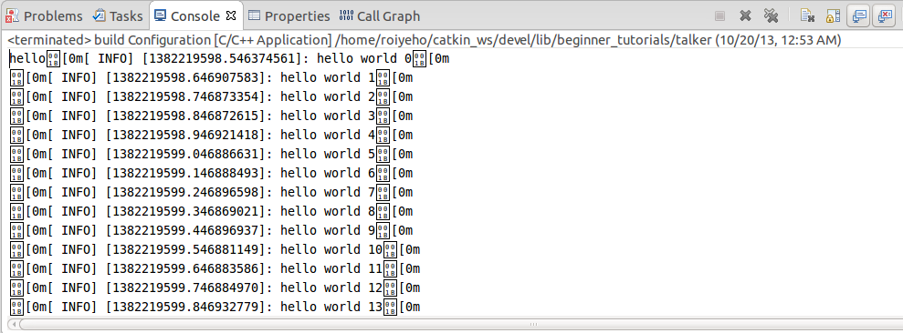
Running the Node Inside Eclipse

Slide 38
Running the Node From Terminal
Make sure you have sourced your workspace's setup.sh file after calling catkin_make:
Can add this line to your .bashrc startup file
Now you can use rosrun to run your node:
$ cd ~/catkin_ws
$ source ./devel/setup.bash
$ rosrun beginner_tutorials talker

Slide 39
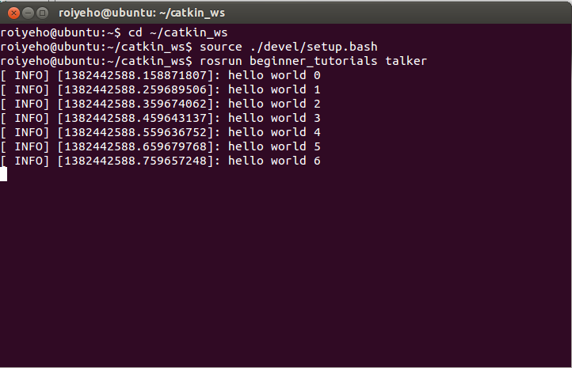
Running the Node From Terminal

Slide 40
Debugging
To enable debugging, you should first execute the following command in the catkin_ws/build folder:
Restart Eclipse
Then you will be able to use the standard debugging tools in Eclipse
$cmake ../src -DCMAKE_BUILD_TYPE=Debug

Slide 41
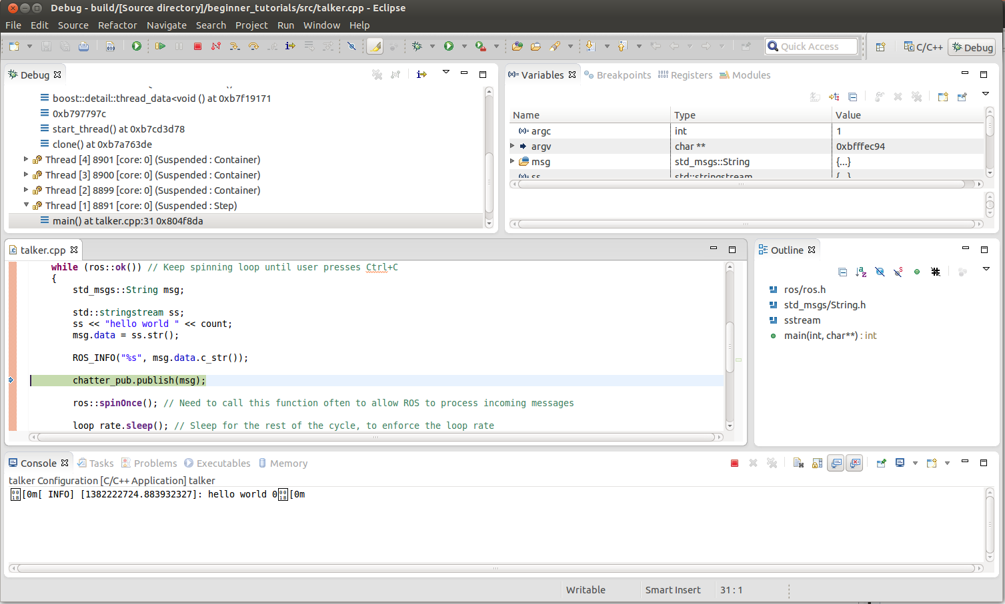
Debugging

Slide 42
Homework (not for submission)
Install Eclipse and integrate it with ROS
Create a new ROS package called “timer_package”
Create a node in this package called “timer_node”
The node will publish to a topic called “timer_topic” the message “current time is: ” with the current time every 1 second

