Slide 1

Diapositiva de recursos humanos 1
Machine Learning Proyect
Carlos María del Pino
Lamlih Houssam

Slide 2
Index
Exploratory Data Analysis
Methodology
KNN
Logistic Regression
Gradient Boosting
LDA (Discriminat Analysis)
Randon Forest
Conlusions

Slide 3
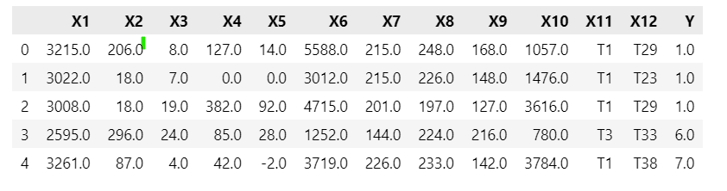
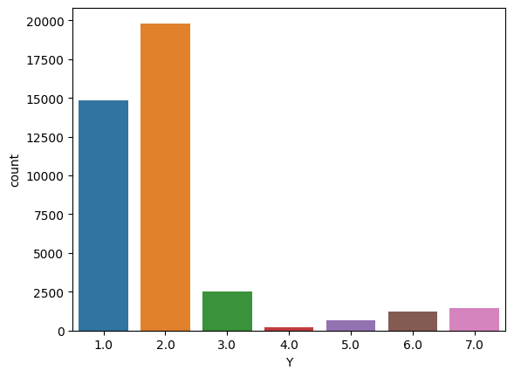
Exploratory Data Analysis

Slide 4
Exploratory Data Analysis
Initial understanding of the dataset
X1, X3, X6 or X10 are going to be suitable for using for predicting the value of Y
X2 or X9 are not adequate to predict the label

Slide 5
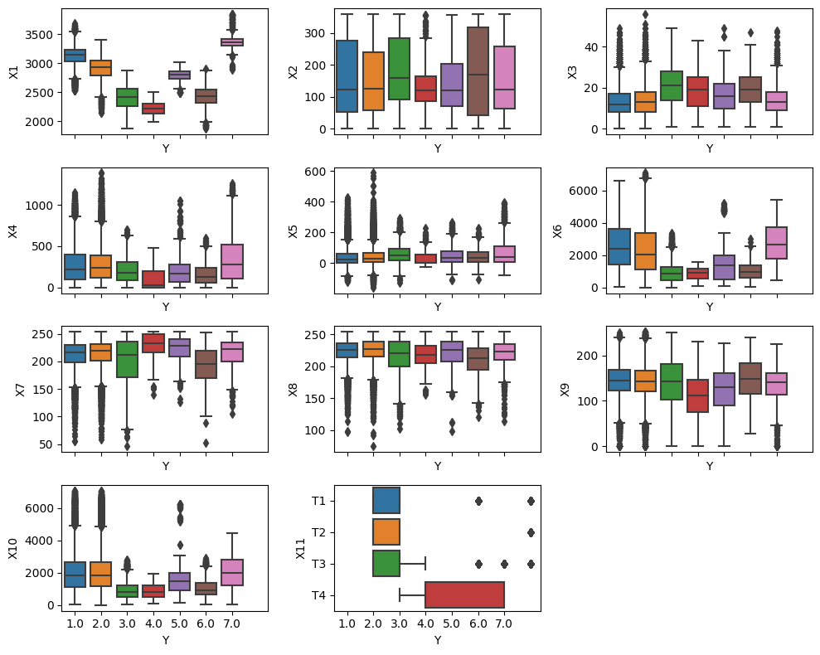
Exploratory Data Analysis

Slide 6
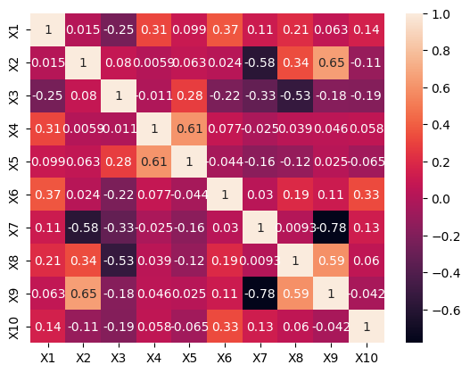
Exploratory Data Analysis

Slide 7
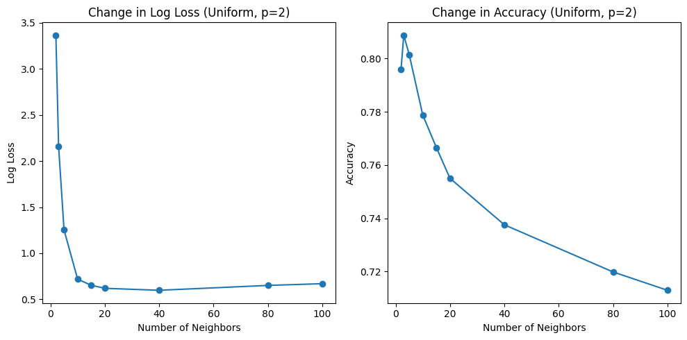
Methodology
KNN

Slide 8
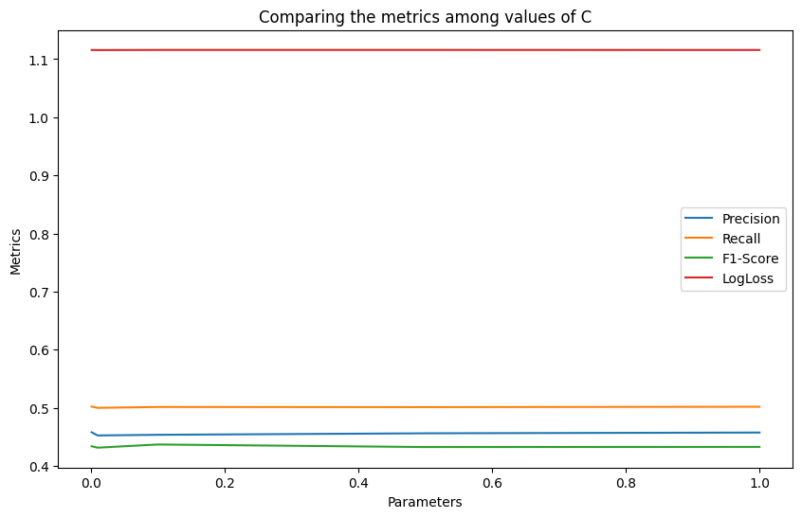
Methodology
Logistic Regression

Slide 9
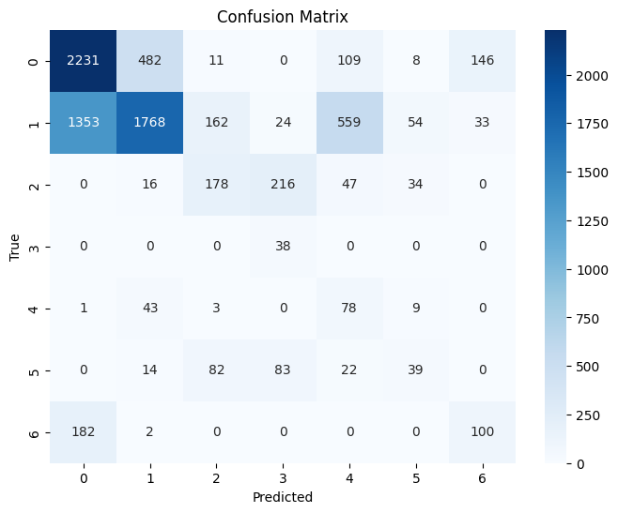
Methodology
Naive Bayes

Slide 10
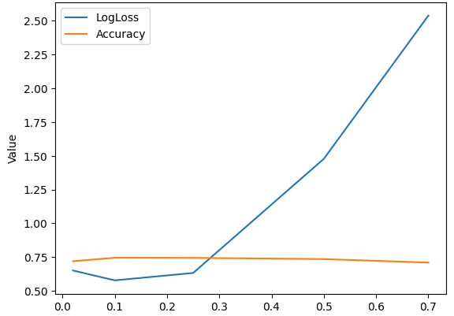
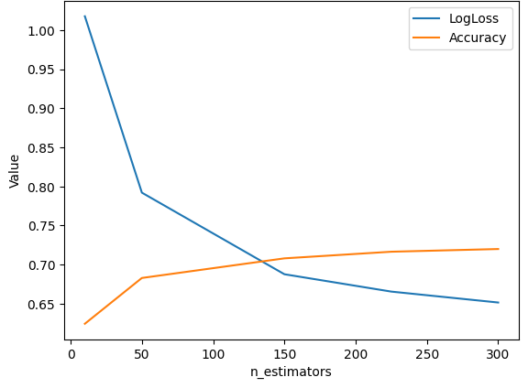
Methodology
Gradient Boosting

Slide 11
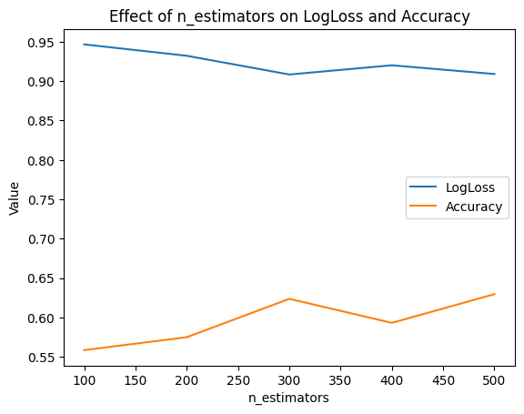
Methodology
Random Forest

Slide 12
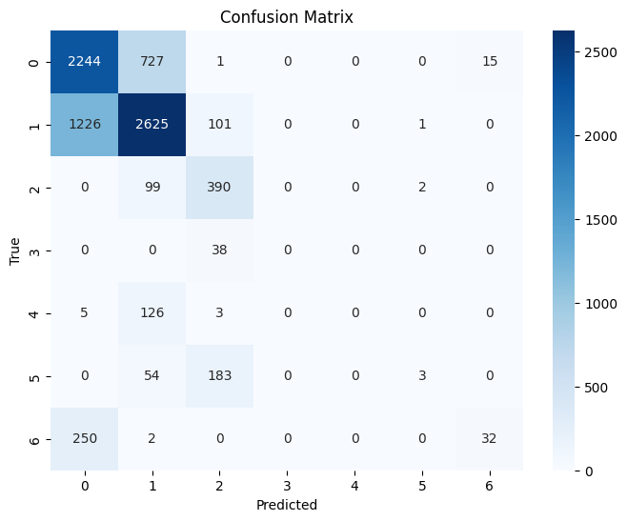
Methodology
Random Forest

Slide 13
Conclusions

