Slide 1







Trending IT Skills for future
Carlos Johel Mejia Arribasplata
October 18, 2024

Slide 2



OUTLINE
Executive Summary
Introduction
Methodology
Results
Visualization – Charts
Dashboard
Discussion
Findings & Implications
Conclusion
Appendix

Slide 3

EXECUTIVE SUMMARY
The IT sector is fast-paced and competitive, demanding that professionals continually upgrade their programming abilities and database knowledge. This project is dedicated to examining new trends in the industry and pinpointing essential areas for skill development, ensuring that professionals remain competitive in a dynamic environment.
Key areas of focus include:
Current Technology Adoption: Gaining insights into the technologies currently prevalent in the industry.
Emerging Technology Trends: Highlighting future technologies expected to shape the IT landscape.
IT Workforce Demographics: Assessing the diversity and demographic changes within the industry.

Slide 4
EXECUTIVE SUMMARY
The main objectives of this project are as follows:
Top Programming Languages: Identifying the most in-demand languages for present and future industry needs.
Key Database Skills: Highlighting the essential skills in database management and development that are highly sought after.
Popular IDEs: Determining the most commonly used Integrated Development Environments (IDEs) among developers.
This analysis will offer a detailed view of the latest IT trends, providing valuable insights for guiding skill enhancement and career progression.

Slide 5

INTRODUCTION
In today’s fast-changing IT landscape, keeping up with emerging trends and skill demands is essential for staying competitive. As technology progresses, professionals need to continually sharpen their expertise in areas like programming, database management, and cloud computing. This presentation will examine the major trends shaping the future of IT, the most in-demand programming languages, crucial database skills, and the top Integrated Development Environments (IDEs).
Drawing on data from job listings, training platforms, and surveys, we’ll offer insights into future skill needs, equipping both organizations and individuals to navigate this evolving industry and prepare for upcoming challenges.

Slide 6

METHODOLOGY
Data Sources and Methodology:
Data was obtained from Stack Overflow, focusing on two key datasets:
Demographics Data
Survey Data on Technologies
Survey Data:
This dataset was analyzed to identify both current and future technology trends, examining variables such as:
Respondents
Technologies used: Programming languages, databases, platforms, web frameworks
Future interest: Desired languages, databases, platforms, and web frameworks for the next year

Slide 7
METHODOLOGY
Demographic Data:
This data provided insights into the diversity within the IT industry, including variables such as:
Gender (focused on men and women)
Age
Education levels
Country distribution
Data Cleaning and Filtering:
Null or missing data was removed.
The gender analysis was limited to men and women.
Tools for Analysis and Visualization:
Python Libraries: Numpy, Pandas, Matplotlib, Seaborn (for data processing and visualization)
IBM Cognos Analytics/Looker Studio: Used for creating interactive dashboards and visualizations
Jupyter Notebook: Utilized for data cleaning and detailed analysis

Slide 8
RESULTS
Analysis Overview: This section compares current technology usage with future trends, emphasizing significant shifts in industry preferences:
Programming Language Trends A side-by-side analysis of the most commonly used programming languages today compared with those projected to be in high demand in the coming years.
Database Trends An in-depth look at current database technologies and the ones expected to grow in popularity, drawing insights from industry data and survey responses.
IDE Trends A comparison between the Integrated Development Environments (IDEs) that are popular among developers now and the IDEs forecasted to take the lead in the future.

Slide 9
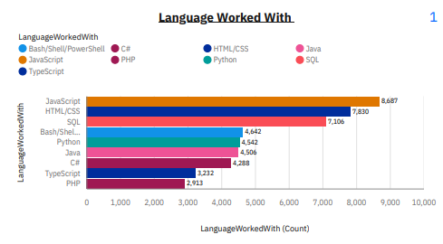
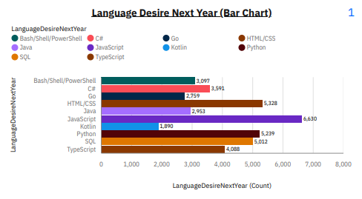
PROGRAMMING LANGUAGE TRENDS
Current Year
Next Year

Slide 10
PROGRAMMING LANGUAGE TRENDS - FINDINGS & IMPLICATIONS
Findings:
JavaScript continues to be the most in-demand programming language, both now and in the foreseeable future.
Python has seen a significant surge in demand, underscoring its growing role in areas like data science, artificial intelligence, and automation.
Shifting Trends: While some traditional languages remain strong, others are seeing a decline, with newer languages gaining traction in the industry.
The Top 5 most in-demand programming languages are:
JavaScript
Python
HTML/CSS
SQL
TypeScript
These trends highlight the evolving landscape of programming languages, with a clear emphasis on versatility and emerging technologies.
Implications:
JavaScript's Dominance: As the most popular and widely used programming language, JavaScript remains essential for web and software development, making it a foundational skill for IT professionals.
Python's Rapid Growth: With its critical role in data science, machine learning, and automation, mastering Python is becoming increasingly vital for IT professionals looking to excel in these high-demand areas.
In-Demand Skills: The top 5 desired languages—JavaScript, Python, HTML/CSS, SQL, and TypeScript—illustrate the industry's growing demand for both frontend and backend development skills.
Adapting to Change: The evolving landscape of programming languages highlights the importance of continuous learning, as IT professionals need to stay current with emerging trends to remain competitive.

Slide 11
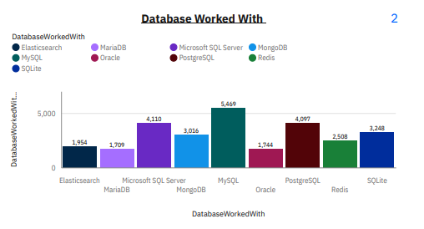
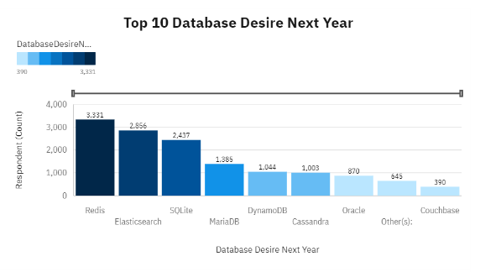
DATABASE TRENDS
Current Year
Next Year

Slide 12
DATABASE TRENDS – FINDINGS & IMPLICATIONS
Findings:
PostgreSQL, MongoDB, and Redis are the most sought-after databases among IT professionals.
Rising Popularity: Interest in MongoDB, Redis, and Elasticsearch has surged, with around 10,000 more respondents favoring these databases as their preferred choices.
Declining Popularity of Oracle: Oracle Database has experienced a decrease in demand, becoming less favored in the industry.
Growing Demand for Database Skills: There is a significant increase in the need for expertise in databases like MongoDB and DynamoDB, reflecting a shift toward more modern, scalable database solutions.
Implications:
Top Databases: PostgreSQL, MongoDB, Redis, MySQL, and Elasticsearch are now the most in-demand databases, aligning with the current needs of the industry and modern development practices.
Rising Preferences: The increasing popularity of MongoDB, Redis, and Elasticsearch can be linked to their advanced functionalities, scalability, and ability to meet the demands of modern applications.
Oracle’s Decline: As Oracle Database becomes less preferred, organizations may start exploring alternative database solutions that are more aligned with evolving technological landscapes.
DynamoDB's Growth: The rising use of DynamoDB signals a shift toward serverless and scalable database architectures, indicating a need for IT professionals to gain deeper expertise in this area for future-proofing their skill set.

Slide 13

DASHBOARD
https://github.com/carlosmejia181414/DashboardProjectCognos

Slide 14
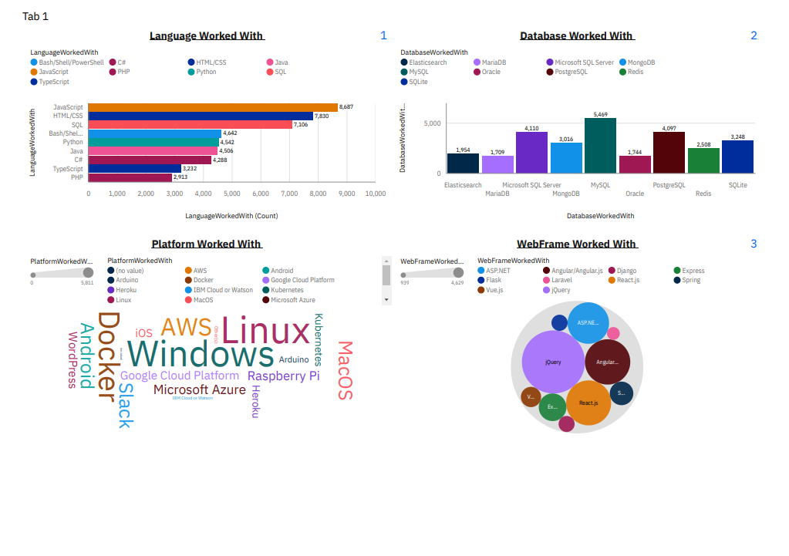
DASHBOARD TAB 1

Slide 15
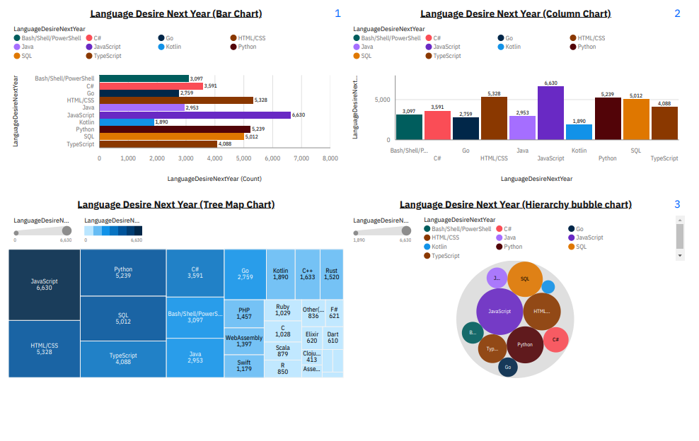
DASHBOARD TAB 2

Slide 16
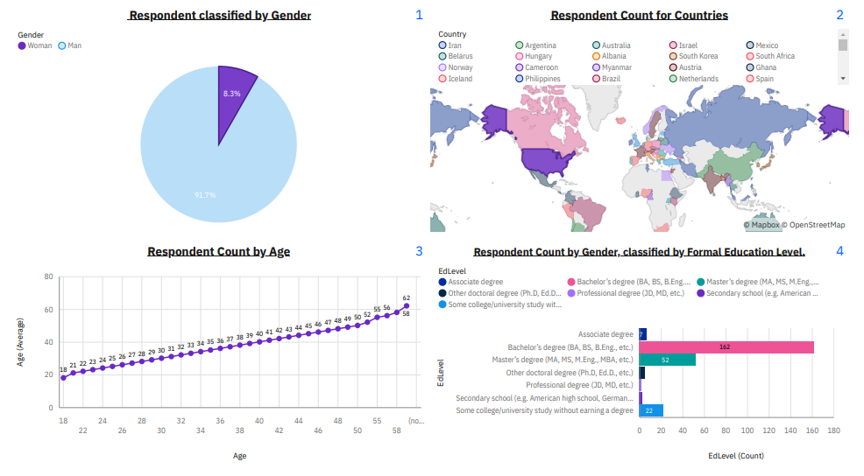
DASHBOARD TAB 3

Slide 17
DISCUSSION
Must-Have Skills for the IT Industry:
To stay competitive in the rapidly changing IT environment, professionals should focus on acquiring the following high-demand skills:
Top Programming Languages:
JavaScript, Python, HTML/CSS, SQL, and TypeScript are the most desired languages for the future.
JavaScript and Python lead in demand due to their versatility, being essential in web development, data science, automation, and more.
Top Database Skills:
PostgreSQL, MongoDB, Redis, MySQL, and Elasticsearch are emerging as the most desirable databases.
This reflects a shift toward modern, scalable, and flexible data storage solutions, as these technologies increasingly replace traditional databases.
Popular Tools & IDEs:
React.js, Angular/Angular.js, Vue.js, jQuery, and ASP.NET are among the most widely used frameworks and tools for web development.
React.js and Vue.js are especially gaining traction for their advanced features and ease of use, making them essential tools for future web projects.
These trends indicate the importance of focusing on modern technologies that support scalability, flexibility, and rapid development, ensuring professionals stay ahead in a dynamic industry.

Slide 18
OVERALL FINDINGS & IMPLICATIONS
Findings:
Top Programming Languages: JavaScript, Python, HTML/CSS, SQL, and TypeScript are now the most sought-after programming languages, reflecting their widespread adoption across multiple IT sectors.
Top Databases: PostgreSQL, MongoDB, Redis, MySQL, and Elasticsearch have become the most desired databases, as businesses increasingly opt for modern, scalable solutions.
Popular Frameworks and Tools: React.js, Angular/Angular.js, Vue.js, jQuery, and ASP.NET continue to be highly favored, with frameworks like React.js and Vue.js gaining particular momentum.
Shifting Skill Demand: There is a noticeable shift in skill demand for the upcoming year, with significant changes in the popularity of programming languages, databases, and frameworks. This trend underscores the importance of IT professionals staying current with emerging technologies to remain competitive.
Implications:
Future Skill Requirements: To remain competitive in the fast-changing IT industry, professionals must prioritize acquiring the following essential skills:
Programming Languages:
JavaScript, Python, HTML/CSS, SQL, and TypeScript will remain critical and highly in-demand skills across various fields.
Databases:
PostgreSQL, MongoDB, Redis, MySQL, and Elasticsearch are becoming the go-to databases. There is also growing demand for newer databases like DynamoDB.
Frameworks & Tools:
React.js, Angular/Angular.js, Vue.js, jQuery, and ASP.NET are the most popular frameworks, with increasing interest in React.js and Vue.js due to their versatility and ease of use in web development.
As the IT industry continues to evolve, the range of skills required to stay competitive is expanding. Professionals must stay updated on these emerging technologies to ensure long-term career success and adaptability in this dynamic landscape.

Slide 19

CONCLUSION
The open-source data from Stack Overflow has been analyzed to provide a thorough understanding of current and future technology trends, aiming to reduce bias in the findings. The analysis indicates a significant shift in technology usage, emphasizing the importance for professionals to update their skills to stay competitive in the evolving IT industry.
Key areas of change include:
Programming Languages: Essential languages for future success include JavaScript, Python, HTML/CSS, SQL, and TypeScript.
Databases: The most sought-after databases are PostgreSQL, MongoDB, Redis, MySQL, and Elasticsearch.
Frameworks & IDEs: Leading frameworks and IDEs include React.js, Angular/Angular.js, Vue.js, jQuery, and ASP.NET.
These findings underscore the need for IT professionals to continuously adapt and expand their skill sets to meet the changing demands of the industry.

Slide 20

APPENDIX
Additional Insights Summary:
Detailed Analysis of Programming Language Shifts:
JavaScript remains a dominant force in the programming world, but the rapid rise of Python is remarkable. Python's versatility, especially in data science and machine learning, has been a major factor driving its increased demand.
TypeScript is also gaining significant traction due to its enhanced features over JavaScript, such as better tooling and error handling, making it a strong choice for future projects that require scalable and maintainable code.
Database Popularity and Functionalities:
PostgreSQL and MongoDB continue to gain popularity due to their flexibility and scalability, making them ideal for handling both structured and unstructured data.
The rise of NoSQL databases like MongoDB and Redis is driven by the demand for high-performance applications and real-time analytics.
The decline in the use of traditional relational databases such as Oracle may reflect a broader industry trend towards open-source and cloud-native solutions, where cost-effectiveness and ease of integration are critical factors.
These insights highlight the ongoing evolution of both programming and database technologies, pointing to a future where adaptability and continuous learning are key to professional success.

Slide 21
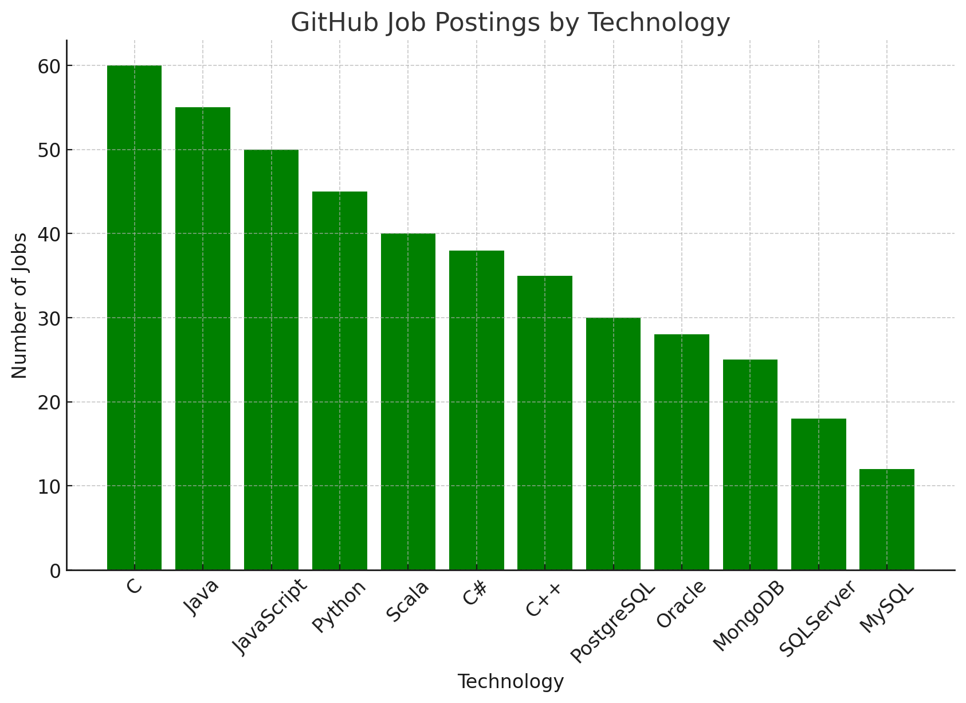
JOB POSTINGS
In Module 1 you have collected the job posting data using Job API in a file named “job-postings.xlsx”. Present that data using a bar chart here. Order the bar chart in the descending order of the number of job postings.

Slide 22
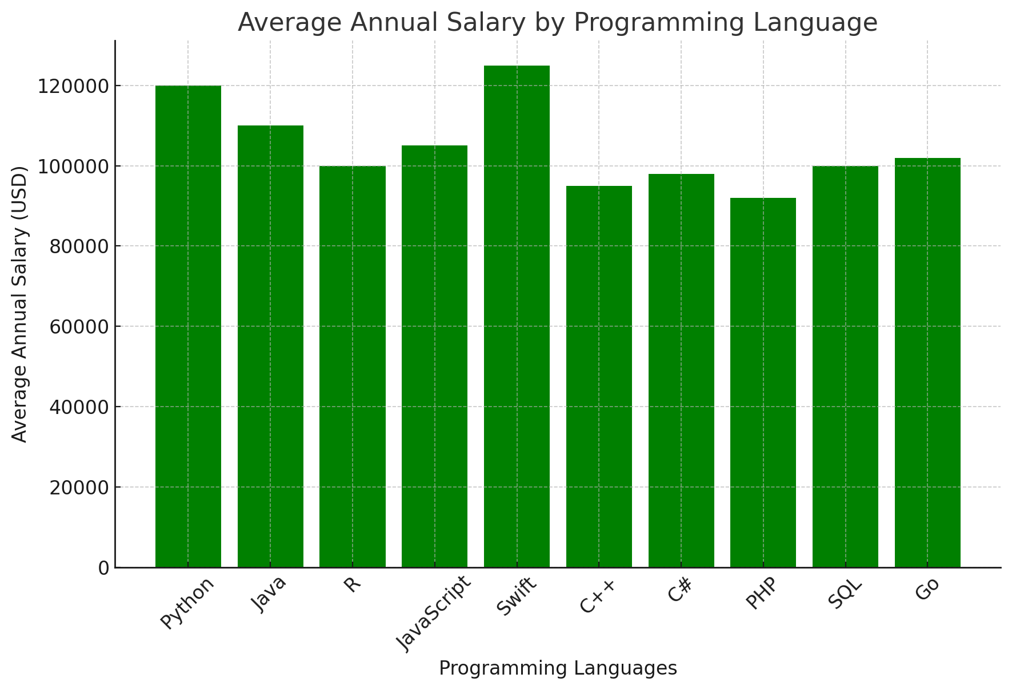
POPULAR LANGUAGES
In Module 1 you have collected the job postings data using web scraping in a file named “popular-languages.csv”. Present that data using a bar chart here. Order the bar chart in the descending order of salary.

